Slide 1
Introduction to shared memory parallel programming with OpenMP
Paschalis Korosoglou (support@grid.auth.gr)
User and Application Support
Scientific Computing Center @ AUTH

Slide 2
Overview
Shared vs Distributed memory models
Why OpenMP
How OpenMP works
Basic examples
How to execute the executable

Slide 3
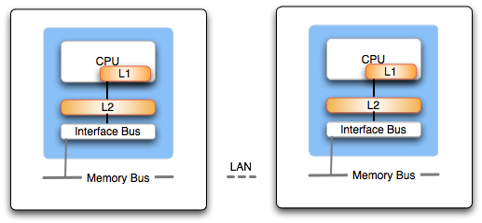
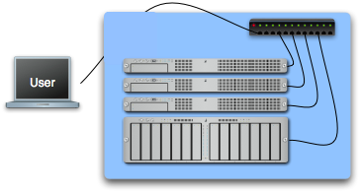
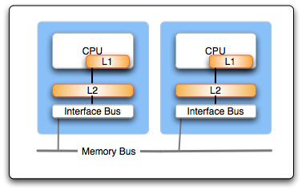
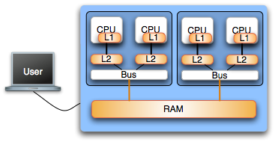
Hardware considerations
Notes:
Shared memory programming is different from message passing because they rely on two very different means of communication. Shared memory relies on implicit communication, which is facilitated by the shared memory space. This makes shared memory programming much more intuitive for many programmers wishing to parallelize their programs. Unfortunately, because it operates under the assumption of shared memory space, it is susceptible to the inherent scaling limitations of the mechanisms that create this shared view of the memory.Message passing assumes that there is no shared memory and that all communications must be enabled through the sending of explicit messages. It is not intuitive because it requires the programmer to manage the sending, receiving, and coordination among the parallel processes.
Shared memory applications are ideal for use on single SMP systems where all processors and memories are tightly integrated on a hardware level. As CPUs increase the number of cores per chip, shared memory programming will get a lot of attention. It is no silver bullet, however because of the inherent limitations present in scaling up the size of the shared memory systems. At some point, multiple SMP machines must be connected in a network, and coordinating some set of these systems requires explicit message passing due to the fact that their is no physically shared memory. Even if shared memory is emulated among individual SMP machines, it still must be implemented at its lowest level using message passing.

Slide 4
Introduction to OpenMP
API extension to C/C++ and Fortran languages
  Most compilers support OpenMP
    GNU, IBM, Intel, PGI, PathScale, Open64 …
Extensively used for writing programs for shared memory architectures over the past decade
Thread (process) communication is implicit and uses variables pointing to shared memory locations; this is in contrast with MPI which uses explicit messages passed among each process

Slide 5
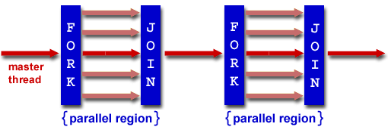
Threaded parallel programming (openMP)
openMP is based on a fork - join model
  Master - worker threads
  Use of directives and pragmas within source code

Slide 6
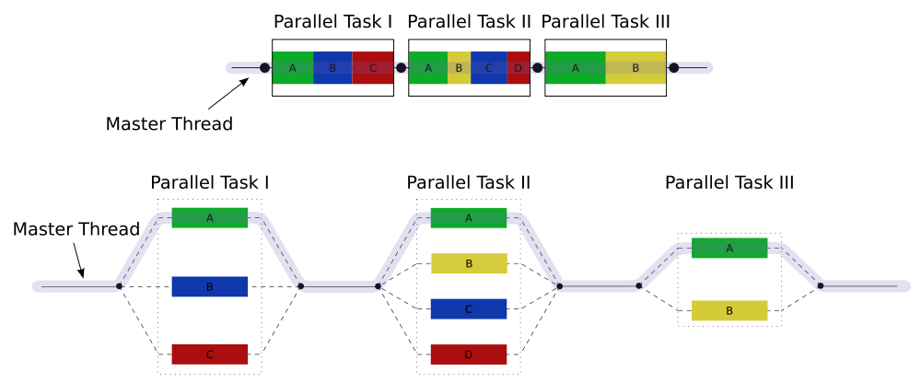
Approach towards parallelism
From serial to parallel with OpenMP

Slide 7
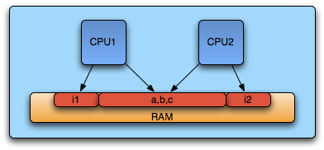
Memory issues
Threads have access to the same address space
  Communication is implicit
Programmer needs to define
  local data
  shared data

Slide 8
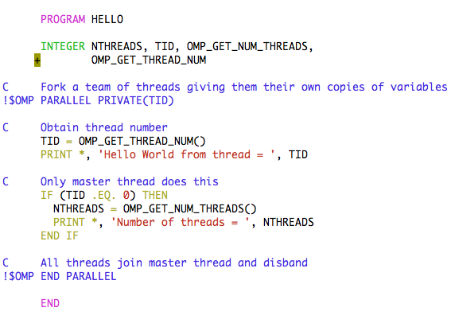
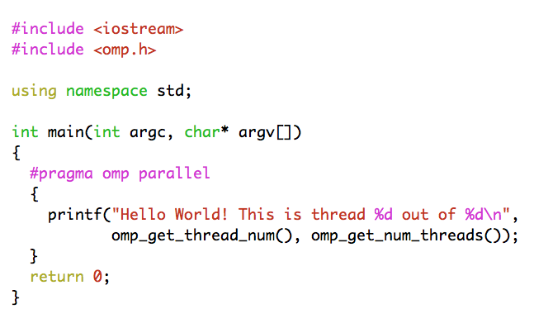

Yet another hello world example
Environment variable
OMP_NUM_THREADS

Slide 9
Common API calls
Call | Description
int omp_get_num_threads() | Returns the number of threads in the concurrent team
int omp_get_thread_num() | Returns the id of the thread inside the team
int omp_get_num_procs() | Returns the number of processors in the machine
int omp_get_max_threads() | Returns maximum number of threads that will be used in the next parallel region
double omp_get_wtime() | Returns the number of seconds since a time in the past
bool omp_in_parallel() | 1 if in parallel region, 0 otherwise

Slide 10
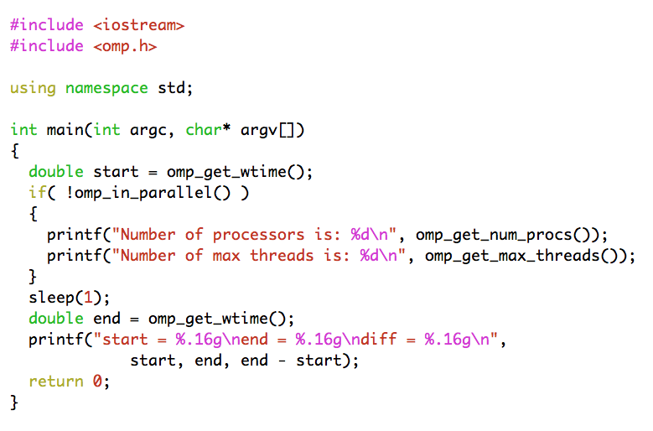
Common API calls example

Slide 11
Data scoping
For each parallel region the data environment is constructed through a number of clauses
  shared (variable is common among threads)
  private (variable inside the construct is a new variable)
  firstprivate (variable is new but initialized to its original value)
  default (used to set overall defaults for construct)
  lastprivate (variable’s last value is copied outside construct)
  reduction (variable’s value is reduced at the end)

Slide 12
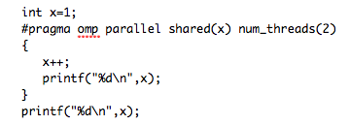
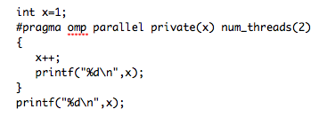
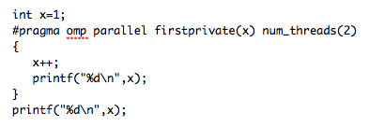
A few examples
x = 3
x = 2
x = 3
x = 2
x = 3
x = 3
or
Will print anything and then x=1
x = 2
x = 2
x = 1
Notes:
Show examples

Slide 13
Synchronization
OpenMP provides several synchronization mechanisms
  barrier (synchronizes all threads inside the team)
  master (only the master thread will execute the block)
  critical (only one thread at a time will execute)
  atomic (same as critical but for one memory location)

Slide 14
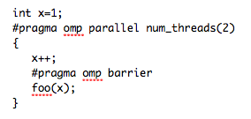
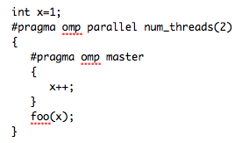
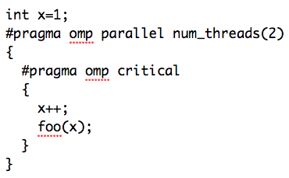
Synchronization examples
foo(3), foo(3)
foo(2), foo(2)
or
foo(1), foo(2)
foo(2), foo(3)
Notes:
Show examples

Slide 15
Data parallelism
Worksharing constructs
  Threads cooperate in doing some work
  Thread identifiers are not used explicitly
  Most common use case is loop worksharing
  Worksharing constructs may not be nested
DO/for directives are used in order to determine a parallel loop region

Slide 16
The for loop directive
#pragma omp for [clauses]
for (iexpr ; test ; incr)
Where clauses may be
  private, firstprivate, lastprivate
  Reduction
  Schedule
  Nowait
Loop iterations must be independent
Can be merged with parallel constructs
Default data sharing attribute is shared

Slide 17
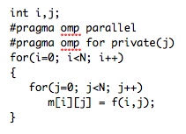
j must be declared private explicitly
i is privatized automatically
Implicit synchronization point at the end of for loop

Slide 18
The schedule clause
Schedule clause may be used to determine the distribution of computational work among threads
  static, chunk; The loop is equally divided among pieces of size chunk which are evenly distributed among threads in a round robin fashion
  dynamic, chunk; The loop is equally divided among pieces of size chunk which are distributed for execution dynamically to threads. If no chunk is specified chunk=1
  guided; similar to dynamic with the variation that chunk size is reduced as threads grab iterations
Configurable globally via OMP_SCHEDULE
  i.e. setenv OMP_SCHEDULE "dynamic,4"

Slide 19
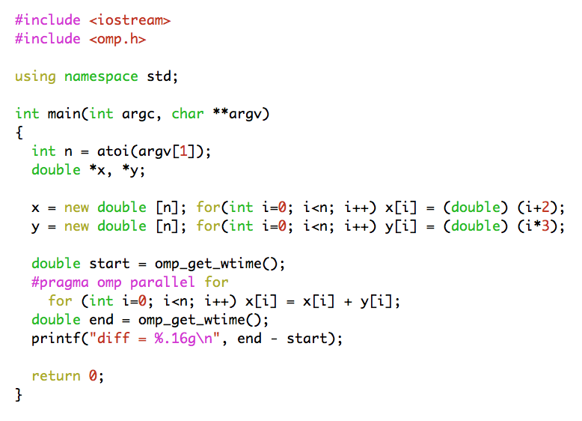
Adding two vectors

Slide 20
Reduction clause
Useful in the case one variable’s value is accumulated within a loop
Using the reduction clause
  A private copy per thread is created and initialized
  At the end of the region the compiler safely updates the shared variable
  Operators may be +, *, -, /, &, ^, |, &&, ||

Slide 21
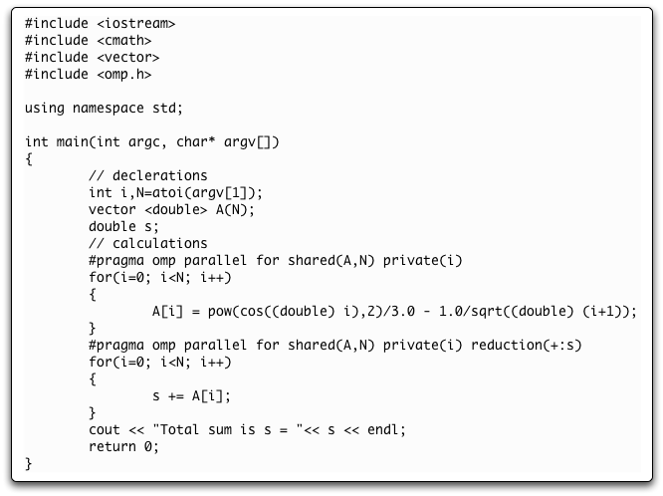
Reduction clause example
Notes:
Good point to switch to openmp exercises

Slide 22
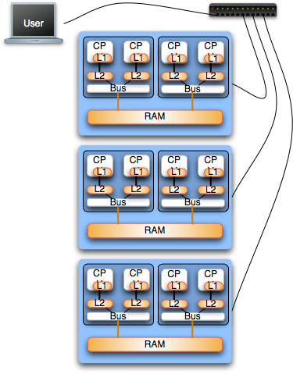
Mixing MPI and OpenMP
Hybrid architectures
  Clusters on SMPs
  HPC Platforms
    IBM BlueGene (i.e. Jugene)
    IBM P6 (i.e. Huygens)
Good starting point
  Mapping of MPI on nodes (interconnection layer)
  Multithreading with OpenMP inside SMPs
Notes:
There do exist situations that are most efficiently solved using a hybrid application of both shared memory and message passing. Often times these situations consist of tightly coupled computations on multiple SMP machines, which communicate (as little as possible) with one another. This is an advanced aspect of parallel programming that will be covered in a more in depth tutorial

