Slide 1


Hands-on session: Overview and usage of PARADOX software stack
Vladimir Slavnic
Institute of Physics Belgrade, Serbia
slavnic@ipb.ac.rs

Slide 2
Overview
- Overview of PARADOX software stack
- Compilers
- Performance tools: debuggers and profilers
- Libraries
- Application software
- Using compilers
- Useful flags
- Using numerical libraries
- Intel MKL libraries (linking guide)
- Debugging simple codes using GDB
- Finding memory leaks with Valgrind
- Performing simple profiling using gprof

Slide 3
Compilers
PARADOX cluster supports development of software in C/C++ and Fortran programming languages through different toolchains:
  GNU Compiler Collection
  Intel Compilers
  Portland Group Compilers
  IBM XL Compilers (available on tPARADOX)

Slide 4

GNU Compilers Collection
GNU Compiler Collection or GCC is standard compiler on most modern Unix-like computer operating systems
Includes front ends for compiling:
  C
  C++
  Objective-C
  Fortran
  Java
  Ada
  Go
Most important for HPC are the C/C++ and Fortran languages as most applications designed for such platforms are written in one or more of these language specifications

Slide 5
GNU Compilers Collection
Ported to a wide variety of processor architectures
Widely deployed as a tool in commercial, proprietary and closed source software development environments
Performs well on a variety of native and cross targets
Available for most embedded platforms
http://gcc.gnu.org/

Slide 6
Intel Compilers
Intel's suite of compilers with front ends for C, C++, and Fortran:
  C, C++ - icc, icpc
  FORTRAN – ifort
Compilers are distributed through different package suites:
  Intel Parallel Studio, Intel Parallel Studio XE, the Intel C++ Composer package, the Intel C++ Composer XE package, the Intel Composer XE package and the Intel Cluster Studio
Compilers available for GNU/Linux, Mac OS and Microsoft Windows systems

Slide 7
Intel Compilers
Intel tunes its compilers to optimize for its hardware platforms therefore producing highly optimized code for Intel processors
Different optimization features and multithreading capabilities
  Automatic vectorizer that can generate SSE, SSE2, SSE3, SSSE3, SSE4 and AVX SIMD instructions,
  Supports both OpenMP 3.1 and automatic parallelization for symmetric multiprocessing
http://software.intel.com/en-us/articles/intel-compilers/

Slide 8
PGI Compilers
The Portland Group, Inc or PGI
Set of commercially available Fortran, C and C++ compilers for high-performance computing system
Incorporate:
  global optimization
  vectorization
  software pipelining
  shared-memory parallelization
  capabilities targeting both Intel and AMD processors

Slide 9
PGI Compilers
PGI supports the following high-level languages:
  Fortran 77, Fortran 95, Fortran 2003
  High Performance Fortran (HPF)
  ANSI C99
  ANSI/ISO C++
Recently PGI has been involved in the expansion of the use of GPGPUs for high-performance computing, developing CUDA Fortran with NVIDIA Corporation and PGI Accelerator Fortran and C compilers which use programming directives
http://www.pgroup.com/

Slide 10
IBM XL Compilers
Proprietary suite of compilers from IBM developed for its platforms:
  POWER
  Cell CPUs
  Blue Gene systems
Well established in HPC
Support for C, C++ and FORTRAN
Producing highly optimizing code for IBM CPUs
Access to highly-tuned libraries, optimization utilities and development utilities
Recommended to use with IBM hardware
  .

Slide 11
Using compilers
GCC compiler toolchain is, by default, available on the users path:
  $ gcc
  $ gfortran
  $ f77
All Intel tools are installed at /opt/intel directory
In order to use them user should source provided scripts, for example:
  $ source /opt/intel/composerxe/bin/compilervars.sh intel64
Intel tools are not present at PARADOX worker nodes (only at ui.ipb.ac.rs) so linking with static Intel libraries (static compilation) is necessary when executables will run on batch system and they are using Intel libraries (for example, libiomp5.so used with OpenMP executables)
-

Slide 12
Important flags (1)
-o exe_file : names the executable exe_file
-c : generates the correspondent object file. Does not create an executable.
-g : compiles in a debugging mode
-Idir_name : specifies the path where include files are located
-Ldir_name : specifies the path where libraries are located
-l<lib_name> : asks to link against the lib<libname>
    -pg: profiling with gprof (needed at the compilation)
    -Wall : show all reasonable warnings
    -static-intel : link Intel provided libraries statically (ICC)

Slide 13
Important flags (2)
Optimizations:
  -O0, -O1, -O2, -O3: optimization levels (intel default : -O2)
  Intel specific:
    -ip, -ipo: inter-procedural optimizations (mono and multi files)
    -fast: default high optimization level (-O3 -ipo -static)
    -opt_report: generates a report which describes the optimization in stderr (-O3 required)
    -x<code> generate specialized code to run exclusively on processors (SSE4.1, SSE4.2, AVX…)
Compile with OpenMP:
  gcc: -fopenmp
  icc: -openmp

Slide 14
Simple optimization example (1)
Copy source code test.c from /tmp/simple_optimization_example/ directory on ui.ipb.ac.rs to /nfs/username directory:
  $ cp /tmp/simple_optimization_example/test.c /nfs/demoXXX
Make a simple submit script for it (or use one from your serial job)

Slide 15
Simple optimization example (2)
Try to compile it with different flags or compilers (gcc and icc with O0, O2, O3) and measure execution times:
$ gcc –o test -Wall -O0 test.c -lm
$ time ./test
real 0m13.388s
user 0m13.370s
sys 0m0.010s
$ gcc –o test -Wall -O1 test.c -lm
$ time ./test
real 0m10.030s
user 0m10.030s
sys 0m0.000s

Slide 16
Performance tools
Debuggers:
  TotalView Debugger
  GDB
  PGI pgdbg
  Intel Debugger
  IBM Parallel Debugger (PDB) on tPARADOX
Profilers:
  gprof
  PGI pgprof
  Intel Vtune
  Valgrind

Slide 17

  TotalView Debugger (1)
TotalView is a GUI-based source code defect analysis tool
It allows you to debug one or many processes and/or threads
Gives control over program execution, from basic debugging operations like stepping through code to sophisticated techniques that are becoming more commonplace in the high performance computing world such as Graphic Processor Support (debug CUDA)
Especially designed for use with complex, multi-process and/or multi-threaded applications

Slide 18
  TotalView Debugger (2)
Support for threads, OpenMP, MPI, or GPUs.
Provides analytical displays of the state of your running program
TotalView works with C, C++ and Fortran applications written for Linux (including the Blue Gene platforms), UNIX and Mac OS X platforms
One of the most popular HPC debuggers

Slide 19
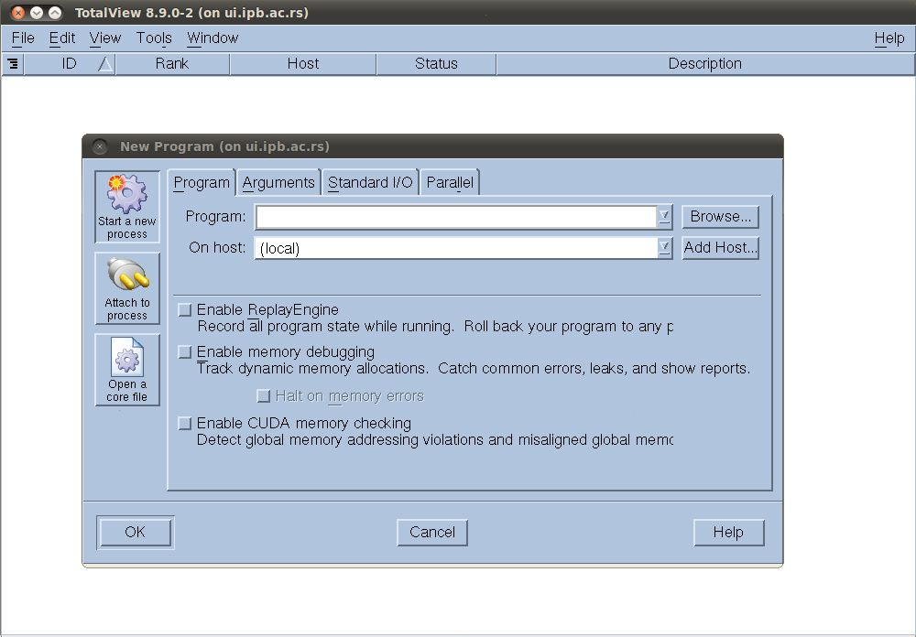
  TotalView Debugger (3)
http://www.roguewave.com/products/totalview-family/totalview.aspx

Slide 20

GDB (1)
GDB, the GNU Project debugger
Allows user to see:
  What is going on `inside' another program while it executes
  What another program was doing at the moment it crashed
GDB can do four main kinds of things (plus other things in support of these) to help user catch bugs :
  Start program, specifying anything that might affect its behavior
  Make program stop on specified conditions
  Examine what has happened, when program has stopped
  Change things in program, so user can experiment with correcting the effects of one bug and go on to learn about another

Slide 21
GDB (2)
The program being debugged can be written in:
  Ada
  C
  C++
  Objective-C
  Pascal
  and many other languages…
Programs might be executing on the same machine as GDB (native) or on another machine (remote)
GDB can run on most popular UNIX and Microsoft Windows variants
http://www.gnu.org/s/gdb/

Slide 22
PBDBG (1)
PGDBG is a symbolic debugger from PGI for Fortran, C, C++ and assembly language programs
It provides debugger features, such as execution control using breakpoints, single-stepping, and examination and modification of application variables, memory locations, and registers
PGDBG supports debugging of certain types of parallel applications:
  Multi-threaded and OpenMP applications
  MPI applications
  Hybrid applications, which use multiple threads or OpenMP as well as multiple MPI processes on Linux clusters

Slide 23
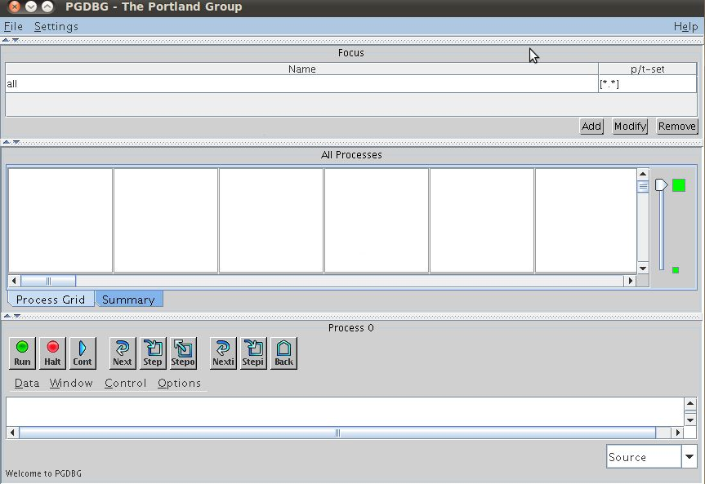
PBDBG (2)
http://www.pgroup.com/products/pgdbg.htm

Slide 24
Intel Debugger (1)
The Intel Debugger (IDB) provides support for debugging programs written in C, C++, and Fortran 77, 90 and 95
It provides a choice of command-line and graphical user interface (GUI) on the Linux Eclipse platform
A part of the Intel® C++ Composer XE 2011 for Linux and Intel® Fortran Composer XE 2011 for Linux
The Intel® Debugger can debug both single and multithreaded applications
Provides OpenMP windows with information about current tasks, teams, task waits, barriers, task spawn trees and locks

Slide 25
Intel Debugger (2)
The Intel Debugger (IDB) features:
  Attaches to (and detaches from) a running process and debugs the matching program
  Loads a program into (and unloads a program from) the debugger, automatically creating and deleting processes as necessary
  Supports multiple-process debugging, associating with one or more programs
  See processes and examine detailed process state
  Set breakpoints for a specific process
  Supports remote debugging of applications on embedded Intel architecture (using a remote agent)
  Debugs programs with shared libraries
  Debugs core files
  …
http://software.intel.com/en-us/articles/idb-linux/

Slide 26
IBM Parallel Debugger
Part of IBM Parallel Environment (PE)
Standard for debugging on POWER systems
The parallel debugger (pdb) presents user with a single command line interface that supports most dbx/gdb execution control commands
http://www-03.ibm.com/systems/software/parallel/

Slide 27
Debugging simple codes using GDB
Alternatives:
  Using printf() (adding trace to program)
  Use debbuger with whom you can:
    attach to running process
    change the value of variables at run-time
    make program stop on specific conditions
    list source code
    print variables type
    inspect a process that has crashed
    ...
Choice is easy

Slide 28
GDB basic usage (1)
Compiling (examples are present at /tmp/gdb):
  Enable debugging with flag -g :
  $ gcc –g –o test gdb1.c
Source code and executable one to one mapping is made
Symbol table is created
Optimization can change things!
Load executable:
  $ gdb ./test
Symbols are loaded and we can run program (VM)
We see a command prompt:
  $(gdb)_

Slide 29
GDB basic usage (2)
Commands:
  run-Start execution
  list [arg] -List source code around argument
  break [arg] -Add a “break point” at arg
  delete n-Delete break point number n
  print [arg] -Print the content of arg
  continue-Continue execution after a break
  next-Execute next line
  step-Step into next line (enters functions)
  backtrace-History of function calls
  help–Shows help
  kill-Kill program witout quitting gdb
  quit-Quit gdb

Slide 30
GDB basic usage (3)
Type run and program will start:
  $(gdb) run <arg1, arg2 ...>
set args – set arguments for next running
list – list lines of source code (10 lines around argument are displayed):
list
list linenum
list function
list driver.c:20

Slide 31
GDB basic usage (4)
Setting breakpoints
  Set a breakpoint at specific line on current source code file:
    (gdb) break 8
  Set a breakpoint at specific function:
    (gdb) break my_function
  Set a breakpoint at specific line on some source file :
    (gdb) break parsing.cc:45

Slide 32
GDB basic usage (5)
Examining the stack:
  backtrace - Print backtrace of all stack frames
  frame - Select and print a stack frame
  up -Select and print stack frame that called this one
  down - Select and print stack frame called by this one
  info locals - Local variables of current stack frame
  info args - Local arguments of current stack frame

Slide 33
GDB basic usage (6)
Watchpoints
  Set on variables (expressions) -variable must be in current scope
  watch –Set a watchpoint for an expression.
  rwatch-Set a read watchpoint for an expression.
  awatch-Set a read/write watchpoint for an expression.
  Disable–turn off watchpoint

Slide 34
GDB basic usage (9)
Catchpoints
  Set on events (C++ exceptions or the loading of a shared library and others)
  catch EVENT–event can be :
    throw -The throwing of a C++exception
    catch -The catching of a C++ exception
    exec -A call to `exec'
    fork -A call to `fork'
    load -A loading of any library
    load LIBNAME -A loading of specific library
    unload -Unloading of library
    thread_start –Starting any threads, just after creation

Slide 35
GDB basic usage (8)
Inspecting variables
  ptype–print the data type of a variable
    (gdb) ptypemyvar
    type = double
  print–view the value of a variable
    (gdb) print i
    $4 = -107
  Inspecting an array:
    (gdb) p myIntArray
    $46 = {0, 1, 2, 3, 4, 5}
    (gdb) p myIntArray[3]@7
    $54 = {3, 4, 5, 10, 1107293224,1079194419, -1947051841}

Slide 36
GDB basic usage (9)
Inspecting a structure:
  (gdb) p myStruct
  $2 = {name = 0x40014978 “Mile mikic“, EyeColour = 1}
  (gdb) print myStruct.name
  $6 = 0x40014978 "Mile Mikic“
set - Changing variable value (must be in current context):
  (gdb) set imidate = 14
All Fortran variables must be in lowercase!!!

Slide 37
GDB basic usage (10)
Debbuging a running process (gdb2.c):
attach pid (from gdb) -attach to the running process with pid
  $ gdb
  (gdb) attach 17399
  Attaching to process 17399….
$ gdb program pid (outside gdb)
Attaching to program: /home/vlada/temp/test2, process 8165
Reading symbols from /lib64/libc.so.6...(no debugging symbols found)...done.
Loaded symbols for /lib64/libc.so.6
Reading symbols from /lib64/ld-linux-x86-64.so.2...(no debugging symbols found)...done.
0x00000030e8c9a510 in __nanosleep_nocancel () from /lib64/libc.so.6
detach – detach from process
Change variables

Slide 38
gprof
Used to determine which parts of a program are taking most of the execution time
gprof is the standard Unix profiler
It produces basic performance reports including
  Call counts
  Timing information
  Descendent information for called functions
http://sourceware.org/binutils/docs/gprof/

Slide 39
  PGI pgprof
PGPROF is a powerful interactive postmortem statistical analyzer by PGI
Supports:
  MPI process-parallel programs
  OpenMP thread-parallel programs
  Programs incorporating PGI Accelerator directives and CUDA Fortran.
PGPROF can be used to visualize and diagnose the performance of the components of your program
PGPROF associates execution time with the source code and instructions of your program, allowing you to see where and how execution time is spent
http://www.pgroup.com/products/pgprof.htm

Slide 40
  Intel Vtune (1)
Intel VTune Amplifier XE
Commercial application for software performance analysis for 32 and 64-bit x86 based machines
  Threading and performance optimization tool for C/C++ and Fortran developers
Both GUI and command line interfaces
Basic features work on both Intel and AMD hardware, advanced hardware-based sampling requires an Intel-manufactured CPU
Offers various kinds of code profiling:
  Stack sampling
  Thread profiling
  Hardware event sampling

Slide 41
  Intel Vtune (2)
The profiler result consists of details such as time spent in each sub routine which can be drilled down to the instruction level
The tool can be also used to analyze thread performance
http://software.intel.com/en-us/articles/intel-vtune-amplifier-xe/

Slide 42
Valgrind
Valgrind is a multipurpose code profiling and memory debugging tool for Linux
It allows user to run program in Valgrind's own environment that monitors memory usage such as calls to malloc and free (or new and delete in C++)
If there is usage uninitialized memory, write off the end of an array, or forget to free a pointer, Valgrind can detect it
http://valgrind.org/

Slide 43
Simple Valgrind examples:
Memory leak (1)
Memory leaks are among the most difficult bugs to detect
They don't cause any outward problems until you've run out of memory and your call to malloc suddenly fails
One mistake can be costly if your program runs for long enough and follows that branch of code
Copy /tmp/valgrind/leak.c to your /nfs/username directory:
  $ cp /tmp/valgrind/leak.c /nfs/demoxxx
Compile source code:
  $ gcc -o test leak.c
Start valgrind:
  $ valgrind --tool=memcheck ./test

Slide 44
Simple Valgrind examples:
Memory leak (2)
Observe output
Enable leak check
  $ valgrind --tool=memcheck --leak-check=yes ./test
Observe output
Compile your program with –g flag:
  $ gcc -g -o test leak.c
Run with valgrind again:
  $ valgrind --tool=memcheck --leak-check=yes ./test
Output now shows exact line in source code where the lost memory was allocated

Slide 45
Simple Valgrind examples:
Invalid pointer
Copy /tmp/valgrind/point.c to your /nfs/username directory:
  $ cp /tmp/valgrind/point.c /nfs/demoxxx
Compile source code:
  $ gcc –g -o test2 point.c
Start valgrind:
  $ valgrind --tool=memcheck --leak-check=yes ./test2
Observe output
We're using a pointer outside the range - an 'Invalid write'

Slide 46
Simple profiling with gprof (1)
Profiling using gprof involves following steps:
Compile your program using the -pg option (you must use the -g option as well if you want line by line profiling):
  Copy /tmp/gprof/prof.cpp to your /nfs/username directory:
  $ cp /tmp/gprof/prof.cpp /nfs/demoxxx
  Compile source code:
  $ g++ –pg -o test prof.c

Slide 47
Simple profiling with gprof
(2)
Run program as normal (through the batch system). This will create a file called gmon.out -- if this file hasn't been created, it's probably because you did not compile with the -pg option.
Run gprof with program name as argument
$ gprof test gmon.out
It is useful to pipe the output to a textfile that can be viewed in a text editor:
$ gprof test gmon.out > profile.txt

Slide 48
Simple profiling with gprof
(3)
Observe the output
Each sample counts as 0.01 seconds.
% cumulative self self total
time seconds seconds calls ms/call ms/call name
60.80 0.78 0.78 1 778.28 778.28 exponential()
40.27 1.29 0.52 1 515.48 515.48 sinFunc()

Slide 49
Libraries
LAPACK
BLAS
FFTW
SPRNG
Intel MKL
NumPy & SciPy
MPI libraries
IBM ESSL, IBM PESSL, IBM MASS (tPARADOX)
...

Slide 50
LAPACK
LAPACK (Linear Algebra PACKage) is a software library for numerical linear algebra
It provides routines for:
  solving systems of linear equations and linear least squares
  eigenvalue problems
  singular value decomposition
  includes routines to implement the associated matrix factorizations such as LU, QR, Cholesky and Schur decomposition.
LAPACK was originally written in FORTRAN 77 and is now written in Fortran 90
The routines handle both real and complex matrices in both single and double precision
http://www.netlib.org/lapack/

Slide 51
BLAS
The BLAS (Basic Linear Algebra Subprograms)
Routines that provide standard building blocks for performing basic vector and matrix operations
The Level 1 BLAS perform scalar, vector and vector-vector operations
The Level 2 BLAS perform matrix-vector operations
The Level 3 BLAS perform matrix-matrix operations
Because the BLAS are efficient, portable, and widely available, they are commonly used in the development of high quality linear algebra software, LAPACK for example. LAPACK
http://netlib.org/blas/

Slide 52
FFTW
FFTW is a C subroutine library for computing the discrete Fourier transform (DFT) in one or more dimensions, of arbitrary input size, and of both real and complex data
FFTW's performance is typically superior to that of other publicly available FFT software,
Competitive with vendor-tuned codes
In contrast to vendor-tuned codes FFTW's performance is portable: the same program will perform well on most architectures without modification
“Fastest Fourier Transform in the West”
http://www.fftw.org/

Slide 53
SPRNG (1)
SPRNG (Scalable Parallel Random Number Generators) is one of the best libraries for generating pseudorandom numbers for parallel applications
It provides user-friendly interfaces for parallel C/C++ and Fortran applications
Enables the user to easily obtain multiple and sufficiently uncorrelated pseudorandom number streams on different processors, with no inter-process communication.

Slide 54
SPRNG (2)
The algorithms implemented in SPRNG are:
  Combined Multiple Recursive Generator
  The 48 bit Linear Congruential Generator
  The 64 bit Linear Congruential Generator
  The modified Lagged Fibonacci Generator
  The multiplicative Lagged Fibbonacci Generator
  The Prime Modulus Linear Congruential Generator
http://sprng.cs.fsu.edu/

Slide 55
Intel MKL (1)
Intel Math Kernel Library (Intel MKL) is a library of optimized, extensively threaded math routines for solving large science, engineering, and financial computational problems
The library supports C/C++ and Fortran language APIs
The most of Intel MKL is threaded which enables more efficient usage of today’s multi-core processors and easier parallelization of developers application or implementation of hybrid programming model

Slide 56
Intel MKL (2)
Threading is performed through OpenMP, and the following mathematical domains are supported:
  Sparse Linear Algebra – Sparse BLAS, Sparse Format Converters, PARDISO Direct Sparse Solver, Iterative Sparse Solvers and Pre-conditioners
  Fast Fourier Transforms
  Optimized LINPACK benchmark
  Vector Math Library
  Statistics Functions – Vector Random Number Generators, Summary Statistics Library
  Cluster Support – ScaLAPACK, Cluster FFT
Support page: http://software.intel.com/en-us/articles/intel-mkl/#support
http://software.intel.com/en-us/articles/intel-mkl/

Slide 57
NumPy & SciPy (1)
NumPy is the fundamental package needed for scientific computing with Python
It contains among other things:
  Powerful N-dimensional array object
  Sophisticated (broadcasting) functions
  Tools for integrating C/C++ and Fortran code
  Useful linear algebra, Fourier transform, and random number capabilities
SciPy (pronounced "Sigh Pie") is open-source software for mathematics, science, and engineering
The SciPy library depends on NumPy, which provides convenient and fast N-dimensional array manipulation

Slide 58
NumPy & SciPy (2)
The SciPy library is built to work with NumPy arrays, and provides many user-friendly and efficient numerical routines such as routines for numerical integration and optimization
Together, they run on all popular operating systems, are quick to install, and are free of charge
NumPy and SciPy are easy to use, but powerful enough to be depended upon by some of the world's leading scientists and engineers
http://www.scipy.org/
http://numpy.scipy.org/

Slide 59
MPI Libraries (1)
Supported implementations:
  MPICH
  MPICH2
  OPENMPI
  MVAPICH & MVAPICH2 (on tPARADOX Cluster)

Slide 60
MPI Libraries (2)
MPICH
  MPICH is an open-source, portable implementation of the full MPI-1 standard specification for a wide variety of parallel computing environments,
  Besides complete implementation of version 1.2 of the MPI Standard, MPICH also implements significant parts of MPI-2, particularly in the area of parallel I/O
  Although discontinued for some time, MPICH implementation (with the last version 1.2.7) is one of the most frequently used MPI library packages. I
  Widely used on all types of computing resources: small clusters, Grid sites and large-scale HPC facilities
  Supports C, C++, F77, and F90
  http://www.mcs.anl.gov/research/projects/mpi/mpich1-old/

Slide 61
MPI Libraries (3)
MPICH-2:
  MPICH-2 is a high-performance, widely portable implementation of the MPI (Message- Passing Interface) standard, designed to implement all of MPI-1 and MPI-2 specifications (including dynamic process management, one-sided operations, parallel I/O, and other extensions)
  MPICH-2 implementation replaces MPICH-1 and it is recommended to be used instead of MPICH-1
  It provides several different process managers (process managers are basically external (typically distributed) agents that spawn and manage parallel jobs) such as Hydra, MPD, SMPD etc.
  http://www.mcs.anl.gov/research/projects/mpich2/

Slide 62
MPI Libraries (4)
OPENMPI:
  The Open MPI Project is an open source MPI-2 implementation that is developed and maintained by a consortium of academic, research, and industry partners
  Features implemented for Open MPI include:
    Full MPI-2 standards conformance
    Thread safety and concurrency
    Dynamic process spawning
    Network and process fault tolerance
    Support network heterogeneity
    Single library supports all networks
  http://www.open-mpi.org/

Slide 63
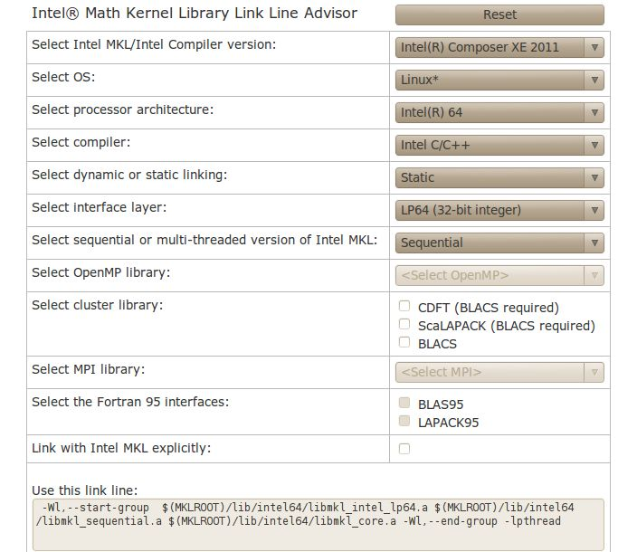
Intel MKL linking guide (1)
You can use Intel MKL link line advisor:
  http://software.intel.com/en-us/articles/intel-mkl-link-line-advisor/
Make choices based on your platform and needs and on-line tool will generate the right link line

Slide 64
Intel MKL linking guide (2)
As for the Intel compiler source the script for the environment initialization (there is a MKL within the compiler suite):
    $ source /opt/intel/composerxe/bin/compilervars.sh intel64
Or use specific MKL environment script:
  $ source /opt/intel/mkl/10.2.3.029/tools/environment/mklvarsem64t.sh

Slide 65
Intel MKL linking example (1)
Copy source code test.c from /tmp/mkl/matrix.c directory on ui.ipb.ac.rs to /nfs/username directory:
  $ cp /tmp/mkl/matrix.c /nfs/demoXXX
Export MKL environment:
      $ source /opt/intel/composerxe/bin/compilervars.sh intel64
Compile code with threaded and sequential version of MKL libraries

Slide 66
Intel MKL linking example (2)
Sequential:
  icc -o matrix_sequential matrix.c -mkl=sequential -static-intel
or
  $ icc -o matrix_sequential matrix.c -Wl,--start-group ${MKLROOT}/lib/intel64/libmkl_intel_lp64.a ${MKLROOT}/mkl/lib/intel64/libmkl_sequential.a ${MKLROOT}/lib/intel64/libmkl_core.a -Wl,--end-group -lpthread -static-intel
Threaded:
  $ icc -o matrix_threaded matrix.c -mkl -static-intel
or
  $ icc -o vlada_thread matrix.c -Wl,--start-group ${MKLROOT}/lib/intel64/libmkl_intel_lp64.a ${MKLROOT}/lib/intel64/libmkl_intel_thread.a ${MKLROOT}/lib/intel64/libmkl_core.a -Wl,--end-group -openmp -lpthread -static-intel

Slide 67
Intel MKL linking example (3)
Use serial and OpenMP job submit scripts to submit serial and threaded version of program using reasonable matrix size (3000-5000)
Use time command with your binary
Compare outputs
$time ./matrix_sequential 5000
Dgemm_multiply(). Elapsed time = 28.56 seconds
real 0m29.535s
user 0m28.794s
Sys 0m0.734s
$ time ./matrix_threaded 5000
Dgemm_multiply(). Elapsed time = 31.3 seconds
real 0m4.974s
user 0m31.483s
Sys 0m1.036s

Slide 68
Applications
AutoDock Vina
CPMD
GAUSSIAN
NAMD
…

Slide 69
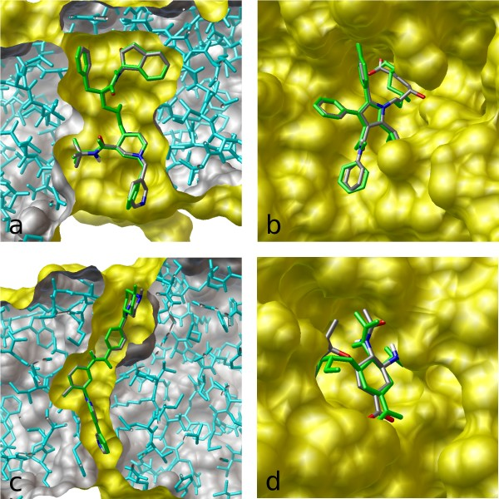
AutoDock Vina
AutoDock Vina is a open-source program for drug discovery, molecular docking and virtual screening
Implements multi-core capability
For its input and output, Vina uses the same PDBQT molecular structure file format used by AutoDock
http://vina.scripps.edu/

Slide 70
CPMD
The CPMD code is a parallelized plane wave/pseudopotential implementation of Density Functional Theory, particularly designed for ab-initio molecular dynamic
CPMD runs on a large variety of different computer architectures
Features:
  Wavefunction optimization: direct minimization and diagonalization
  Geometry optimization: local optimization and simulated annealing
  Molecular dynamics: NVE, NVT, NPT ensembles
  Time-dependent DFT (excitations, molecular dynamics in excited states)
  …
http://www.cpmd.org/

Slide 71
GAUSSIAN
Computational chemistry software used by chemists, chemical engineers, biochemists, physicists and other scientists worldwide.
Starting from the fundamental laws of quantum mechanics, Gaussian predicts the energies, molecular structures, vibrational frequencies and molecular properties of molecules and reactions in a wide variety of chemical environments
Features:
  Molecular mechanics
  Semi-empirical calculations
  SCF methods
  Møller-Plesset perturbation theory
http://www.gaussian.com/
  …

Slide 72
NAMD
Not (just) Another Molecular Dynamics program
Parallel molecular dynamics code designed for high-performance simulation of large biomolecular systems
Based on Charm++ parallel objects
Noted for its parallel efficiency and often used to simulate large systems (millions of atoms)
http://www.ks.uiuc.edu/Research/namd/

Slide 73
Support
PARADOX cluster support:
  hpc-admin@ipb.ac.rs

