Slide 1
Intel MKL Usage
Petar Jovanovic
HPC Administrator
Institute of Physics Belgrade
petarj@ipb.ac.rs

Slide 2
Agenda
Overview of MKL
Things to know before starting
Structure of MKL (Layered Model Concept)
Linking with MKL
  using -mkl compiler option
  using single dynamic library
  selecting libraries to link with
  using the Link-line Advisor
  using the Command-line link tool
Example

Slide 3
Overview of MKL
Computing math library of highly optimized, extensively threaded routines for applications that require maximum performance.
Works best with Intel CPUs where it exploits optimized instruction sets such as SSE2, SSE3, SSSE3 and others
Threading enables it to utilize the growing number of cores per CPU

Slide 4
Overview of MKL
Major areas of computation supported:
  BLAS (level 1, 2 and 3) and LAPACK linear algebra routines;
  PARADISO direct sparse solver, an iterative sparse solver and supportin sparse BLAS (level 1, 2 and 3) routines for solving sparse systems of equations;
  ScaLAPACK distributed processing linear algebra routines, BLACS and PBLAS;
  FFT functions in one, two or three dimentions, and distributed versions;
  Vector Math Library (VML)
  Vector Statistics Library (VSL)
  Data Fitting Library
Notes:
major areas of computation:
BLAS (level 1, 2, and 3) and LAPACK linear algebra routines, offering vector, vector-matrix, and matrix-matrix operations.
The PARDISO* direct sparse solver, an iterative sparse solver, and supporting sparse BLAS (level 1, 2, and 3) routines for solving sparse systems of equations.
ScaLAPACK distributed processing linear algebra routines for Linux* and Windows* operating systems, as well as the Basic Linear Algebra Communications Subprograms (BLACS) and the Parallel Basic Linear Algebra Subprograms (PBLAS).
Fast Fourier transform (FFT) functions in one, two, or three dimensions with support for mixed radices (not limited to sizes that are powers of 2), as well as distributed versions of these functions provided for use on clusters of the Linux* and Windows* operating systems.
Vector Math Library (VML) routines for optimized mathematical operations on vectors.
Vector Statistical Library (VSL) routines, which offer high-performance vectorized random number generators (RNG) for several probability distributions, convolution and correlation routines, and summary statistics functions.
Data Fitting Library, which provides capabilities for spline-based approximation of functions, derivatives and integrals of functions, and search.

Slide 5
Things to know before starting
Target platform
  IA-32 or compatible
  Intel® 64 or compatible
Mathematical problem
BLAS, Sparse BLAS, LAPACK, PBLAS, ScaLAPACK, Sparse Solver routines, VML functions, FFT, Cluster FFT, Trigonometric Transform routines, Poisson, Laplace and Helmholtz Solver routines, Optimization (Trust-Region) Solver routines, Data Fitting Functions, GMP arithmetic functions
Programming Language
  C/C++ or Fortran
Range of integer data
Threading model and number of threads
Linking model
MPI used

Slide 6
Structure of MKL
Layered Model
  Interface Layer
    matches compiled application with the threading and computational parts of the library
  Threading Layer
    links the library with different threading compilers and enables threaded or sequential mode
  Computational Layer
    the core of the library
  Compiler Run-time Libraries
    support for threading with different compilers
Notes:
[INTERFACE LAYER]
This layer matches compiled code of your application with the threading and/or computational parts of the library. This layer provides:
LP64 and ILP64 interfaces.
Compatibility with compilers that return function values differently.
A mapping between single-precision names and double-precision names for applications using Cray*-style naming (SP2DP interface).
SP2DP interface supports Cray-style naming in applications targeted for the Intel 64 architecture and using the ILP64 interface. SP2DP interface provides a mapping between single-precision names (for both real and complex types) in the application and double-precision names in Intel MKL BLAS and LAPACK. Function names are mapped as shown in the following example for BLAS functions ?GEMM:
SGEMM -> DGEMM
DGEMM -> DGEMM
CGEMM -> ZGEMM
ZGEMM -> ZGEMM
Mind that no changes are made to double-precision names.
[THREADING LAYER]
This layer:
Provides a way to link threaded Intel MKL with different threading compilers.
Enables you to link with a threaded or sequential mode of the library.
This layer is compiled for different environments (threaded or sequential) and compilers (from Intel, GNU*, and so on).
[COMPUTATIONAL LAYER]
This layer is the heart of Intel MKL. It has only one library for each combination of architecture and supported OS. The Computational layer accommodates multiple architectures through identification of architecture features and chooses the appropriate binary code at run time.
[COMPILER RUN-TIME LIBRARIES]
To support threading with Intel compilers, Intel MKL uses RTLs of the Intel® C++ Composer XE or Intel® Fortran Composer XE. To thread using third-party threading compilers, use libraries in the Threading layer or an appropriate compatibility library.

Slide 7
Linking with MKL (1)
Ways of linking:
  using the Intel® Composer XE compiler (using -mkl compiler option)
  explicit dynamic linking
  explicitly listing libraries on the link line
  using an interactive interface (Link-line advisor)
  using an internally provided tool (command line link tool)
note:
general compiler flags for linking are -L<dir> and -l<name> where <dir> is the directory where the library can be found and name is the name of the library without lib prefix and extension (i.e. libmkl_core.so goes to -lmkl_core)

Slide 8
Linking with MKL (2)
This is only available on Intel's compiler
-mkl or -mkl=parallel links with standard threaded MKL
-mkl=sequential links with sequential version of MKL
-mkl=cluster links with cluster components (sequential) that use Intel MPI

Slide 9
Linking with MKL (3)
Explicit dynamic linking boils down to using a single dynamic library, abreviated SDL: libmkl_rt.so
SDL allows selection of interface and threading library at runtime.
  env variables:
    $MKL_SET_INTERFACE_LAYER (values: LP64 or ILP64)
    $MKL_SET_THREADING_LAYER (values: INTEL, SEQUENTIAL, GNU, PGI)
By default it provides LP64 interface on Intel 64 bit architecture and Intel threading
Example:
icc application.c -lmkl_rt

Slide 10
Linking with MKL (4)
Explicitly listing libraries to link with
  choose one linbrary from the interface layer and one from threading layer
  add the mkl core library and run-time libraries
Interface layer:
  libmkl_intel.a, libmkl_intel.so, libmkl_intel_lp64.a, libmkl_intel_lp64.so
Threading layer:
  libmkl_intel_thread.a, libmkl_intel_thread.so
Computational layer
  libmkl_core.a, libmkl_core.so
Run-time layer
  libiomp5.a, libiomp5.so

Slide 11
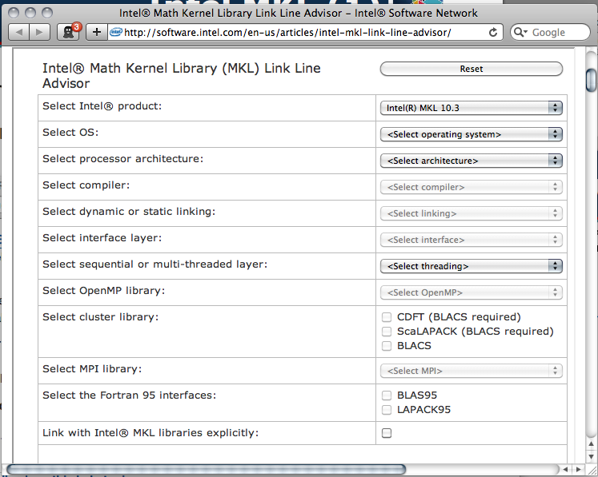
Linking with MKL (5)
Using the Link-line Advisor (Recommended)
available at http://software.intel.com/en-us/articles/intel-mkl-link-line-advisor

Slide 12
Linking with MKL (6)
Using the Command line link Tool
  mkl_link_tool can be found* in <mkl_directory>/tools directory
  similar to Link line Advisor, but works offline.
  modes:
    inquiry mkl_link_tool (–libs|-opts|-env) [Intel MKL Link Tool options]
    compilation mkl_link_tool [options] <compiler> [options2] file1 [file2 ...]
    interactive mkl_link_tool -interactive
* actually not available in the installation on Paradox, and many others noted they couldn't find the tool in various versions of MKL (with and without Composer), more information can be found at:http://software.intel.com/en-us/articles/mkl-command-line-link-tool/
Notes:
for compilation mode:
options represents any number of Link Tool options
compiler represents the compiler name: ifort, icc (icpc, icl), cl, gcc (g++), gfortran, pgcc (pgcp), pgf77 (pgf90, pgf95, pgfortran), mpiic, mpiifort, mpic (mpic++), mpif77 (mpif90, mpif95)
options2 represents any number of compiler options

Slide 13
Example (1)
MKL versions on Paradox:
  standalone at /opt/intel/mkl/10.2.3.029
  with Composer XE at /opt/intel/composerxe/mkl
activating MKL and Intel compiler:
  source /opt/intel/composerxe/bin/compilervars.sh intel64
activating specific MKL environment script (does not load Intel compiler)
  source /opt/intel/mkl/10.2.3.029/tools/environment/mklvarsem64t.sh

Slide 14
Example (2)
Demo code is on ui.ipb.ac.rs at /tmp/mkl/matrix.c
MKL environment setup:
source /opt/intel/composerxe/bin/compilervars.sh intel64
Compile the code, linking with threaded and sequential versions of the library

Slide 15
Example (3)
Sequential:
icc -o matrix_sequential matrix.c -mkl=sequential -static-intel
or
icc -o matrix_sequential matrix.c -Wl,--start-group ${MKLROOT}/lib/intel64/libmkl_intel_lp64.a ${MKLROOT}/lib/intel64/libmkl_sequential.a ${MKLROOT}/lib/intel64/libmkl_core.a -Wl,--endgroup -lpthread -static-intel
Threaded:
icc -o matrix_threaded matrix.c -mkl -static-intelor
icc -o matrix_threaded matrix.c -Wl,--start-group ${MKLROOT}/lib/intel64/libmkl_intel_lp64.a ${MKLROOT}/lib/intel64/libmkl_intel_thread.a ${MKLROOT}/lib/intel64/libmkl_core.a -Wl,--end-group -openmp -lpthread -static-intel

Slide 16
Example (4)
Single Dynamic Library linking:
icc -o matrix_sdl matrix.c -lmkl_rt
Set environment:
export MKL_INTERFACE_LAYER=LP64
export MKL_THREADING_LAYER=SEQUENTIAL
real 0m9.951s
user 0m6.324s
sys 0m0.271s
export MKL_THREADING_LAYER=INTEL
real 0m3.571s
user 0m0.141s
sys 0m0.220s

Slide 17
References
Intel MKL: http://software.intel.com/en-us/articles/intel-mkl/
MKL Documentation and User Guides: http://software.intel.com/en-us/articles/intel-math-kernel-library-documentation/
Link-line Advisor: http://software.intel.com/en-us/articles/intel-mkl-link-line-advisor

