Slide 1
TotalView Debugger
Josip Jakić
Scientific Computing Laboratory
Institute of Physics Belgrade
josipjakic@ipb.ac.rs

Slide 2
Agenda
Introduction
Getting started with TotalView
Primary windows
Basic functions
Further functions
Debugging parallel programs
Topics not covered
References and more information

Slide 3
Introduction
TotalView is a sophisticated software debugger product from Rogue Wave Software, Inc.
Used for debugging and analyzing both serial and parallel programs
Designed for use with complex, multi-process and/or multi-threaded applications
Supported on most HPC platforms
Provides both a GUI and command line interface
Includes memory debugging features
Supports the usual HPC application languages:
  C/C++
  Fortran77/90
  Assembler

Slide 4
Getting started with TotalView (1/2)
-g flag enables generation of symbolic debug information for most compilers
Programs compiled without the -g option are allowed to be debugged, however, only the assembler code can be viewed
Programs should be compiled without optimization flags
Parallel programs may require additional compiler flags
A variety of ways to start the program
  totalview (invokes New Program dialog box)
  totalview filename
  totalview filename corefile
  totalview filename -a args
  totalview filename -remote hostname [:portnumber]

Slide 5
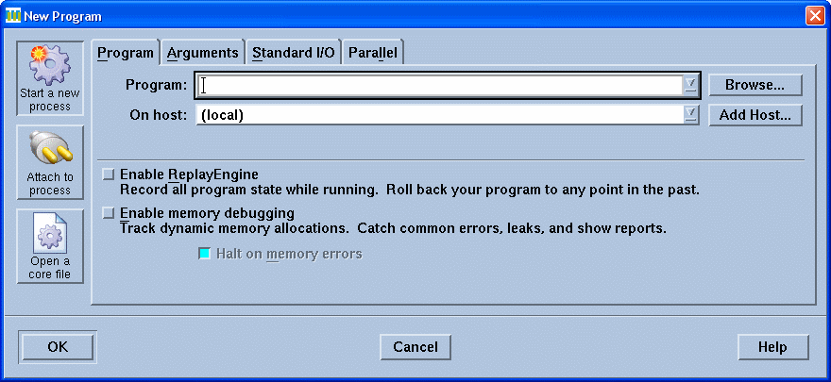
Getting started with TotalView (2/2)
New Program dialog box
Numerous options for various means of selecting a program

Slide 6
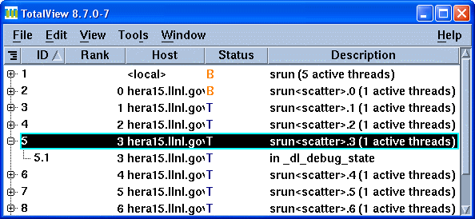
Primary Windows (1/7)
Root Window
Appears when the TotalView GUI is started
Overview of all processes and threads, showing assigned ID, MPI rank, host, status and brief description/name for each

Slide 7
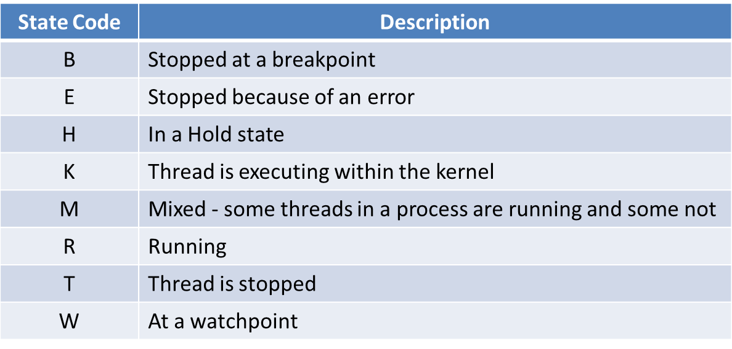
Primary Windows (2/7)
Root Window
  Process and Thread State Codes

Slide 8
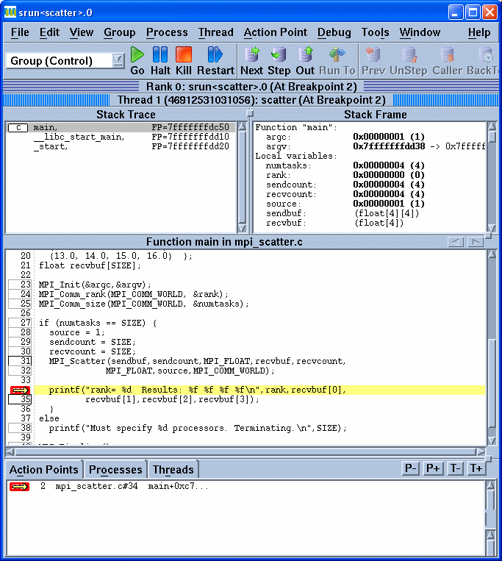
Primary Windows (3/7)
Process Window

Slide 9
Primary Windows (4/7)
Process Window
  For multi-process/multi-threaded programs, every process and every thread may have its own Process Window if desired
  Comprised of:
    Pull-down menus
    Execution control buttons
    Navigation control buttons
    Process and thread status bars
    4 "Panes"

Slide 10
Primary Windows (5/7)
Process Window
  Stack Trace Pane
    Shows the call stack of routines the current executable is running
  Stack Frame Pane
    Displays the local variables, registers and function parameters for the selected executable.
  Source Pane
    Displays source for the currently selected program or function with program counter, line numbers and any associated action points

Slide 11
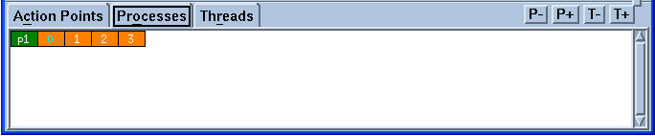
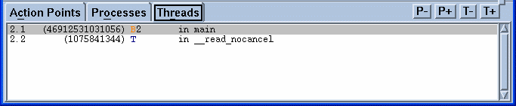
Primary Windows (6/7)
Process Window
  Action Points, Processes, Threads Pane
    A multi-function pane. By default, it shows any action points that have been set
    May also select Processes to show attached processes or Threads to show associated threads

Slide 12
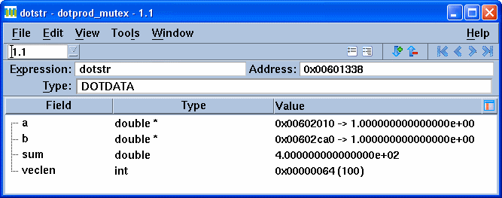
Primary Windows (7/7)
Variable Window
Displays detailed information about selected program variables
Permits editing, diving, filtering and sorting of variable data

Slide 13
Basic Functions (1/4)
Viewing Source Code
  Source, Assembler or Both
  To toggle between the different display modes:
    Process Window > View Menu > Source As
Displaying Function / File Source Code
  Finding and displaying the source code:
    Process Window > View Menu > Lookup Function
Setting a Breakpoint
  Most basic of TotalView’s action points used to control a program’s execution
  Halts execution at a desired line before executing the line
  ˝Boxed˝ lines are eligible for breakpoints

Slide 14
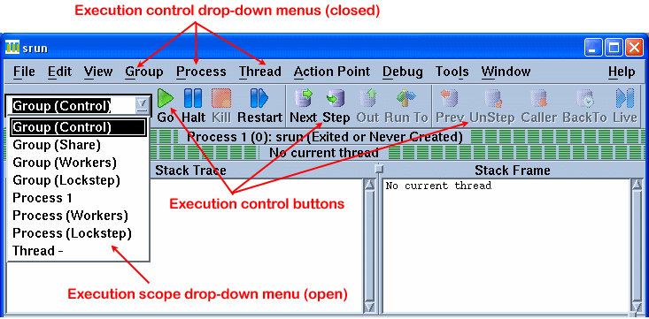
Basic Functions (2/4)
Controlling the execution of a program within TotalView involves two decisions:
  Selecting the appropriate command
  Deciding upon the scope of the chosen command

Slide 15
Basic Functions (3/4)
Group, Process, Thread Command Scopes
  For serial programs, execution scope is not an issue because there is only one execution stream
  For parallel programs, execution scope is critical - you need to know which processes and/or threads your execution command will effect
Viewing and Modifying Data
  TotalView allows you to view variables, registers, areas of memory and machine instructions
  Leaving a Variable Window open allows you to perform runtime monitoring of variables (updated each time program is stopped)
  You can edit variables from within the Variable Window
  The modified variable has effect when the program resumes execution

Slide 16
Basic Functions (4/4)
Arrays
  For array data, TotalView provides several additional features:
    Displaying array slices
    Data filtering
    Data Sorting
    Array statistics
  Array Viewer
    To view a multi-dimensional array in "spreadsheet" format:
      Variable Window > Tools Menu > Array Viewer

Slide 17
Further Functions(1/5)
Viewing a Core File
  TotalView can be used to examine the core file from a crashed job and examining the state (variables, stack, etc.) of the program when it crashed
    Check your shell's limit settings, use either the limit (csh/tcsh) or ulimit -a (sh/ksh/bash) command and override if neccessary
Code fragments
  Code fragments can include a mixture of:C, Fortran or Assembler language
  TotalView built-in variables ($tid, $pid, $systid ... )
  TotalView built-in statements ($stop, $hold, $stopall ...)
  Code fragments can be entered by two methods:
    Evaluate Window
    Evaluation Point

Slide 18
Further Functions(2/5)
TotalView supports four different types of action points:
  Breakpoint
  Process Barrier Point
  Evaluation Point
    causes a code fragment to execute when reached
  Watchpoint
    Monitors when the value stored in memory is modified and either stop execution or evaluates
Managing action points
  Deleting Action Points
    Delete All
  Disabling / Enabling Action Points
    Suppress All
  Saving / Loading Action Points

Slide 19
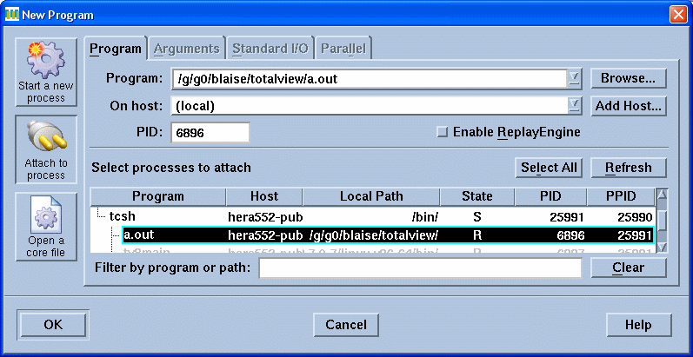
Further Functions(3/5)
Attaching / Detaching Processes
  In the New Program Dialog Box, select the Attach to process button

Slide 20
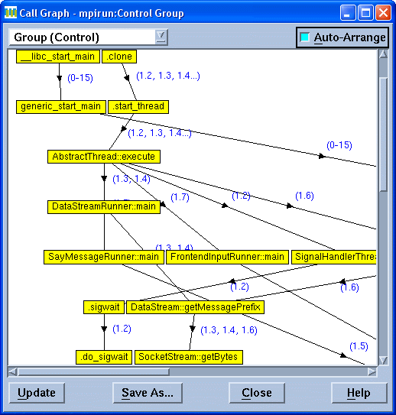
Further Functions(4/5)
Displaying Program's Call Graph
  Process Window > Tools Menu > Call Graph

Slide 21
Further Functions(5/5)
Some other functions and settings
  Setting Executable Command Arguments
  Setting Source Code Search Paths
  Setting stdin, stdout, and stderr
  Setting Preferences
  Signal Handling
  Debugging Memory Problems
  Visualizing Array Data
  Command Line Interpreter (CLI)

Slide 22
Examples
Demonstration on topics covered so far using simple serial code
  Starting TotalView
  Primary windows
  Basic Functions
  Setting Evaluation Points
  Attach to a hung process
  Debugg the hung process

Slide 23
Debugging Parallel Programs (1/8)
Process/Thread Groups
  Types of P/T Groups:
    Control Group:
      Contains all processes and threads created by the program across all processors
    Share Group:
      Contains all of the processes and their threads, that are running the same executable
    Workers Group:
      Contains all threads that are executing user code
    Lockstep Group:
      Includes all threads in a Share Group that are at the same PC (program counter) address

Slide 24
Debugging Parallel Programs (2/8)
Debugging Threaded Codes
  Finding Thread Information
    Root Window
    Process Window
  Selecting a Thread
    Thread Navigation Buttons
  Execution Control for Threaded Programs
    Three Scopes of Influence
    Synchronous vs. Asynchronous
    Thread-specific Breakpoints

Slide 25
Debugging Parallel Programs (3/8)
Viewing and Modifying Thread Data
  Laminated Variables
    In a parallel program, the same variable will usualy have multiple instances across threads and/or processes
    Laminating a variable means to display all occurrences simultaneously in a Variable Window
    Laminated variables can include scalars, arrays, structures and pointers
    Variable Window > View Menu > Show Across > Thread

Slide 26
Debugging Parallel Programs (4/8)
Debugging OpenMP Codes
  Thread-based
  Setting the number of threads
    Default: usually equal to the number of cpus on the machine
    OMP_NUM_THREADS environment variable at run time
    OMP_SET_NUM_THREADS routine within the source code
  Code transformation
  Master thread vs. Worker threads
  Execution Control
    You can not step into or out of a PARALLEL region
    Set a breakpoint within the parallel region and allow the process to run to it
  Manager Threads

Slide 27
Debugging Parallel Programs (5/8)
Debugging MPI Codes
  Multi-Process
  MPI manager process
    Typically, MPI programs run under a "manager" process, such as poe, srun, prun, mpirun, dmpirun, etc.
  Automatic process acquisition
MPI features similar to OpenMP
  Selecting an MPI Process
    Process Navigation Buttons
  Controlling MPI Process Execution
    MPI task execution can be controlled at the individual process level, or collectively as a "group"
Starting and Stopping Processes
Holding and Releasing Processes

Slide 28
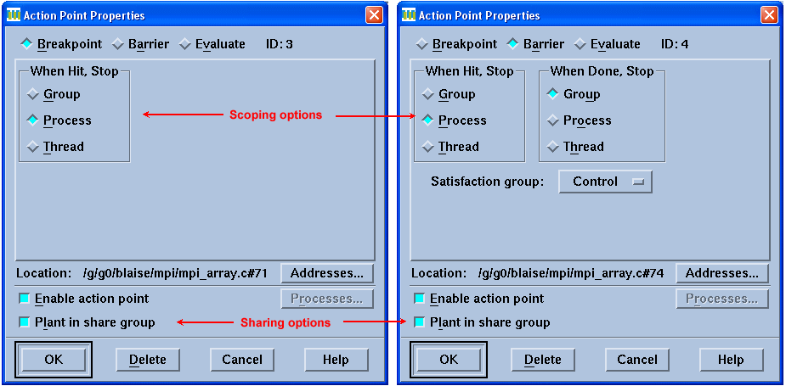
Debugging Parallel Programs (6/8)
Breakpoints and Barrier Points
  Individual breakpoint and barrier point behavior can be customized via the Action Point Properties Dialog Box

Slide 29
Debugging Parallel Programs (7/8)
Displaying Message Queue State
  Process Window > Tools Menu > Message Queue
  The Message Queue Window
  Types of Messages Displayed:
    Pending receives - non-blocking and blocking.
    Pending sends - non-blocking and blocking.
    Unexpected messages - messages sent to this process which do not yet have a matching receive operation.
Message Queue Graph
  Process Window > Tools Menu > Message Queue Graph

Slide 30
Debugging Parallel Programs (8/8)
Debugging Hybrid Codes
  Hybrid codes are programs that use more than one type of parallelism
  Combines technics used in threaded, OpenMP and MPI debugging
Attaching to a Running Batch Job
  If you have a batch job that is already running, you can start TotalView on one of the cluster's login nodes and then attach to it

Slide 31
Examples
OpenMP example
  Specify number of threads
  Set breakpoint inside parallel region
  Display a variable's value across all threads
MPI example
  Start TotalView using mpirun and executable
  Set a barrier point
  Display variables across processes

Slide 32
Topics not covered
CLI
Setting up remote debugging sessions
Memory debugging
Replay engine
and more...

Slide 33
References and More Information
The most useful documentation and reference material is from TotalView's vendor site: http://www.roguewave.com/
Online tutorial: /https://computing.llnl.gov/tutorials/totalview/
TotalView on PARADOX
Login to ui.ipb.ac.rs via ssh using –X flag
  $ ssh <username>@ui.ipb.ac.rs –X
TotalView is located at the following path:
  /opt/toolworks/totalview.8.9.0-2/bin/totalview

