Slide 1
TAU Performance System
Petar Jovanovic
HPC Administrator
Institute of Physics Belgrade
petarj@ipb.ac.rs

Slide 2
Outline
Overview of TAU
Instrumentation and Measurement Options
Analysis tools
Notes on installation and building
Example

Slide 3
Overview of TAU (1)
TAU is a performance evaluation tool
Supports parallel profiling and tracing
Uses PDT for automatic source level instrumentation
Profiling and tracing can measure time as well as hardware performance counters from CPU
Highly portable and is free (BSD style license)
Comes bundled with analysis tools

Slide 4
Overview of TAU (2)
Multi-level performance instrumentation
  Multi-language automatic source instrumentation
Flexible and configurable performance measurement
Widely ported parallel performance profiling system
  Computer system architectures and operating systems
  Different programming languages and compilers
Support for multiple parallel programming paradigms
  Multi-threading, message passing, hybrid, gpgpu
Integration in complex software, systems and applications

Slide 5
Instrumentation Approach (1)
Based on direct performance observation
  Direct instrumentation of program code (probes)
  Instrumentation invokes performance measurement
  Event measurement: performance data, meta-data, context
Instrumentation levels
  source code, object code, runtime system, library code, executable code, operating system
Different levels provide different information
Different tools needed for each level
Static instrumentation
  program instrumented prior to execution
Dynamic instrumentation
  program instrumented at runtime

Slide 6
Instrumentation Approach (2)
TAU suports several measurement options (profiling, tracing, profiling with hw counters, etc.)
Each measurement configuration corresponds to a unique stub makefile and library that is generated when configure script is run during installation.
  Implies the need for administrator to install all possible configurations users might want.
Configuration is performed through a number of environment variables.
Target applications are run using TAU's compile or runtime wrappers
Analysis of gathered performance data is done using tools such as paraprof, jumpshot, etc.

Slide 7
Analysis Tools
Paraprof
  graphical representation of profiling data
  profiles of various metrics, on functions or threads
  callpath profile and call graph
  MPI communication matrix
Jumpshot
  used for trace visualization.
  provides timeline and histogram views
  scalable level of detail support
PerfExplorer and PerfDMF
  performance data mining
  used for management of large databases of performance data

Slide 8
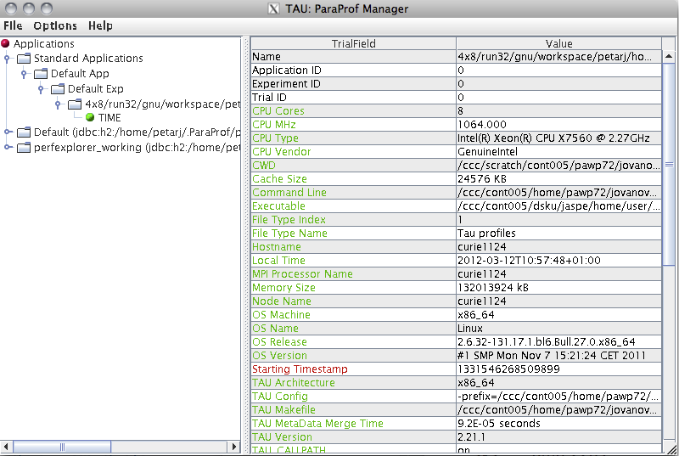
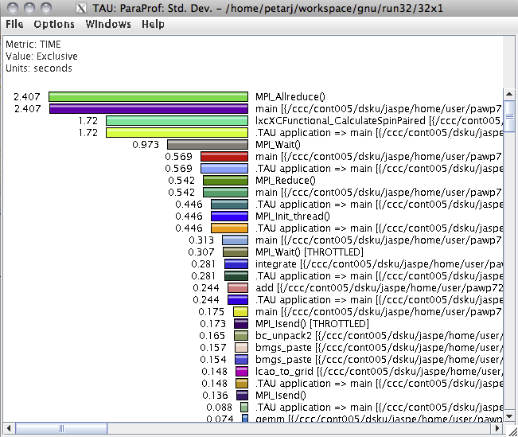
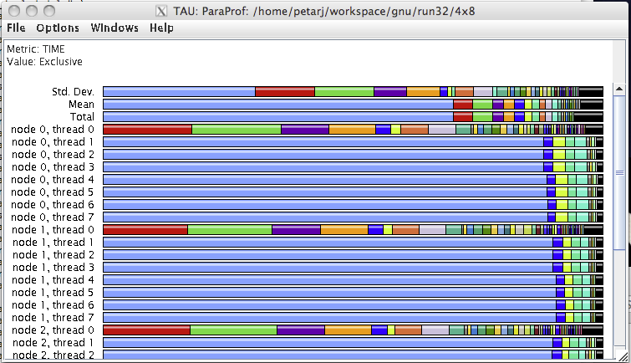
Analysis Tools
Paraprof

Slide 9
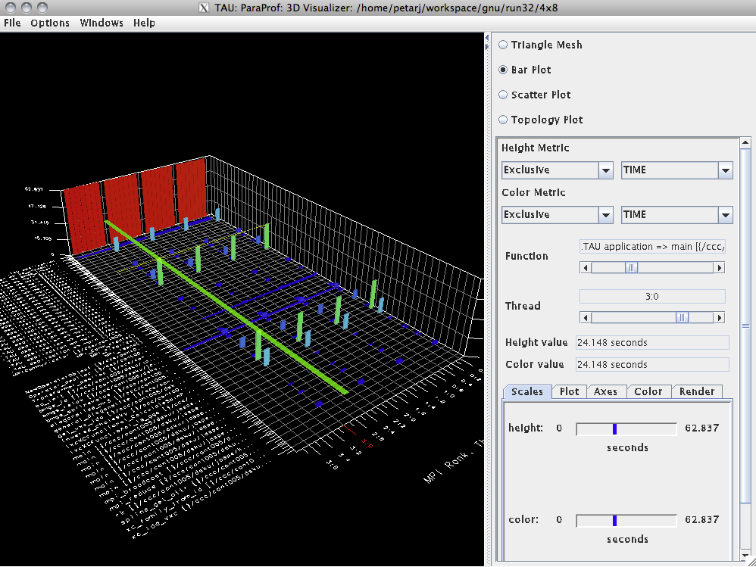
Analysis Tools
Paraprof

Slide 10
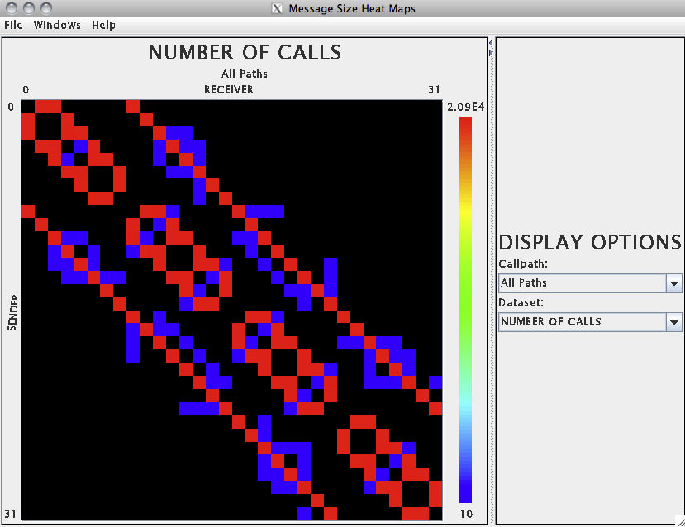
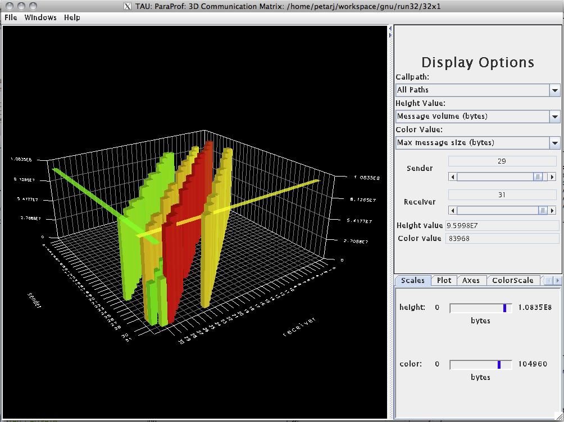
Analysis Tools
Paraprof

Slide 11
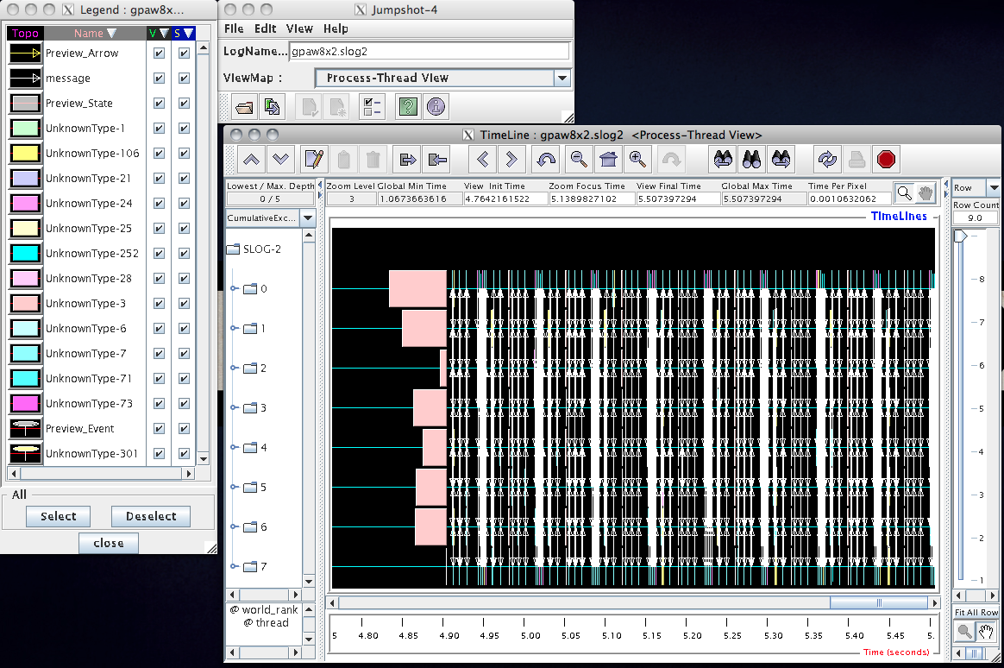
Analysis Tools
Jumpshot

Slide 12
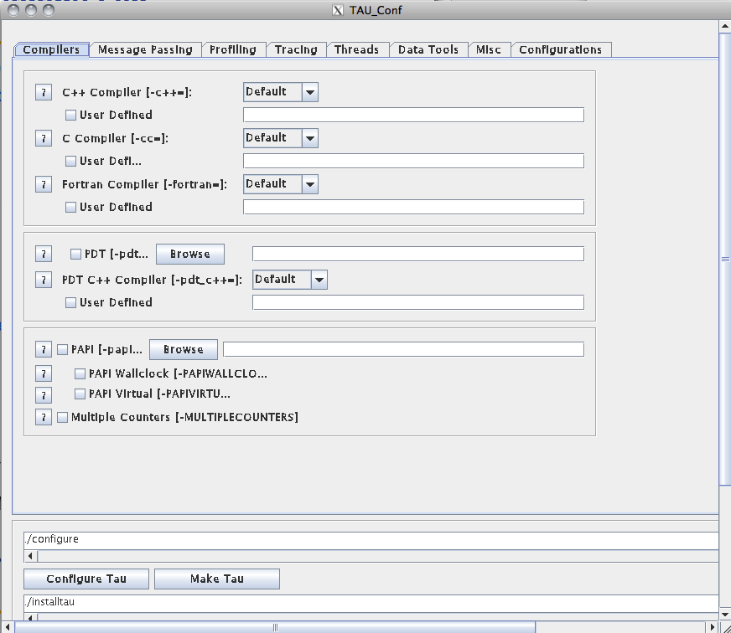
Notes on installation and building
Usually responsibility of system administrator
Since much of what can be done depends on how TAU was built, odds are user will have to build her own custom installation
Java GUI is provided for configuration and building:
$ ./tau_setup
$ ./installtau

Slide 13
Example
Demonstrates TAU instrumentation of a threaded C application (using pthreads)
Covers basic use of bundled profile and trace analysis tools
The code is part of standard examples from TAU package which can be found in $TAUROOT/examples/cthreads

Slide 14
References
TAU site: http://www.cs.uoregon.edu/Research/tau/home.php
TAU documentation: http://www.cs.uoregon.edu/Research/tau/docs.php
VI-HPS: http://www.vi-hps.org/training/material

