Slide 1
Debugging with GDB
Vladimir Slavnic
Research Assistant
SCL, Institute of Physics Belgrade
slavnic@ipb.ac.rs

Slide 2
Debug or not?
What is debugging?
“The best debugging is to avoid bugs”
  good program design
  follow good programming practices
  always consider maintainability and readability of code over getting results fast
  maximize modularity and code re-use
Debugging is a last resort

Slide 3
printf() or debugger?
Using printf() (adding trace to program)
With debugger you can:
  attach to running process
  change the value of variables at run-time
  make program stop on specific conditions
  list source code
  print variables datatype
  inspect a process that has crashed
  ...
Answer is obvious!

Slide 4

What is GDB?
GDB, the GNU Project debugger
Allows user to see:
  What is going on`inside’ a program while it executes
  What program was doing at the moment it crashed
GDB can do four main kinds of things to help users catch bugs :
  Start program, specifying anything that might affect its behavior
  Make program stop on specified conditions
  Examine what has happened, when program has stopped
  Change things in program, so user can experiment with correcting the effects of one bug and go on to learn about another

Slide 5
GDB features
The program being debugged can be written in:
  Ada
  C
  C++
  Objective-C
  Pascal
  and many other languages…
Programs might be executing on the same machine as GDB (native) or on another machine (remote)
GDB can run on most popular UNIX and Microsoft Windows variants
Debugging standard

Slide 6
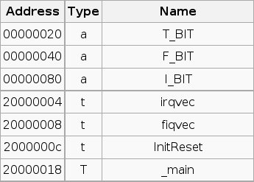
Basic usage: compiling
Enable debugging with flags -g or –ggdb:
gcc –g –o test test.c
Source code and executable one to one mapping is made
Symbol table:
Optimization can change things

Slide 7
Basic usage: loading
Load executable:
gdb ./test
Symbols are loaded and we can run program
We see a command prompt:
(gdb)_

Slide 8
Basic usage: run and list
Type run and program will start (and finish, maybe)
  (gdb) run arg1 "arg2" ...
set args – set arguments for next running
list - list lines of source code (10 lines around argument are displayed):
  list
  list linenum
  list function
  list driver.c:20
.gdbinit

Slide 9
Basic usage: commands
run - Start execution
list [arg] - List source code around argument
break [arg] - Add a “break point” at arg
delete n - Delete break point number n
print [arg] - Print the content of arg
continue - Continue execution after a break
next - Execute next line
step - Step into next line (enters functions)
backtrace - History of function calls
help – Shows help
kill - Kill program without quitting gdb
quit - Quit gdb

Slide 10
Breakpoints, Watchpoints and Catchpoints
breakpoint - stops your program whenever a particular point in the program is reached
watchpoint - stops your program whenever the value of a variable or expression changes
catchpoint - stops your program whenever a particular event occurs

Slide 11
Watchpoints
Set on variables (expressions) - variable must be in current scope
watch – Set a watchpoint for an expression
rwatch - Set a read watchpoint for an expression
awatch - Set a read/write watchpoint for an expression
disable – turn off watchpoint (same as breakpoints)

Slide 12
Catchpoints
Set on events (C++ exceptions or the loading of a shared library and others)
catch EVENT – event can be :
  throw - The throwing of a C++ exception.
  catch - The catching of a C++ exception.
  exec - A call to `exec'.
  fork - A call to `fork'.
  load - A loading of any library.
  load LIBNAME - A loading of specific library.
  unload - Unloading of library.
  thread_start – Starting any threads, just after creation

Slide 13
Setting breakpoints
Set a breakpoint at specific line on current source code file:
(gdb) break 40
Set a breakpoint at specific function:
(gdb) break my_function
Set a breakpoint at specific line on some source file :
(gdb) break parsing.cc:45
Set a breakpoint at address:
(gdb) break 0x43443432

Slide 14
Removing breakpoints
info breakpoints - get a list of breakpoints
delete – delete all break points
delete n – delete breakpoint n
clear function – delete breakpoint set on function
clear linenumber – delete breakpoint at linenumber
disable n – disable breakpoint n
ignore - skip a breakpoint a certain number of times

Slide 15
Navigating through the program
next - Execute a single line in the program. Skip over function calls
step - Execute a single line in the program. Step into functions
continue - continue program being debugged
advance - continue the program up to the given location

Slide 16
Examining the stack (1)
backtrace - Print backtrace of all stack frames
frame - Select and print a stack frame
up - Select and print stack frame that called this one
down - Select and print stack frame called by this one
info locals - Local variables of current stack frame
info args - Local arguments of current stack frame

Slide 17

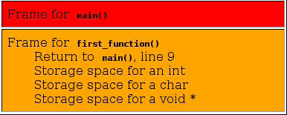
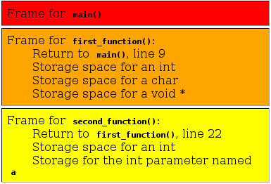
Examining the stack (2)
1 #include <stdio.h>
2 void first_function(void);
3 void second_function(int);
4
5 int main(void)
6 {
7 printf("hello world\n");
8 first_function();
9 printf("goodbye goodbye\n");
10
11 return 0;
12 }
13
14 void first_function(void)
15 {
16 int imidate = 3;
17 char broiled = 'c';
18 void *where_prohibited = NULL;
19
20 second_function(imidate);
21 imidate = 10;
22 }
23 void second_function(int a)
24 {
25 int b = a;
25 }

Slide 18
Inspecting variables (1)
ptype – print the data type of a variable
(gdb) ptype myvar
type = double
print – view the value of a variable
(gdb) print i
$4 = -107
Inspecting an array:
(gdb) p myIntArray
$46 = {0, 1, 2, 3, 4, 5}
(gdb) p myIntArray[3]@7
$54 = {3, 4, 5, 10, 1107293224, 1079199, -7051841}

Slide 19
Inspecting variables (2)
Inspecting a structure:
(gdb) p myStruct
$2 = {name = 0x40014978 “Petar Petrovic", EyeColour = 1}
(gdb) print myStruct.name
$6 = 0x40014978 “Petar Petrovic“
set - Changing variable value (must be in current context):
(gdb) set myvariable = 10.0
All Fortran variables must be in lowercase

Slide 20
Debugging a Running Process
attach pid (from gdb)- attach to the running process with pid:
$ gdb
(gdb) attach 17399
Attaching to process 17399….
$ gdb program pid (outside gdb) –
Attaching to program: code/running_process/someprocess, process 17399
0x410c64fb in nanosleep () from /lib/tls/libc.so.6
(gdb)
detach – detach from process
Change variables

Slide 21
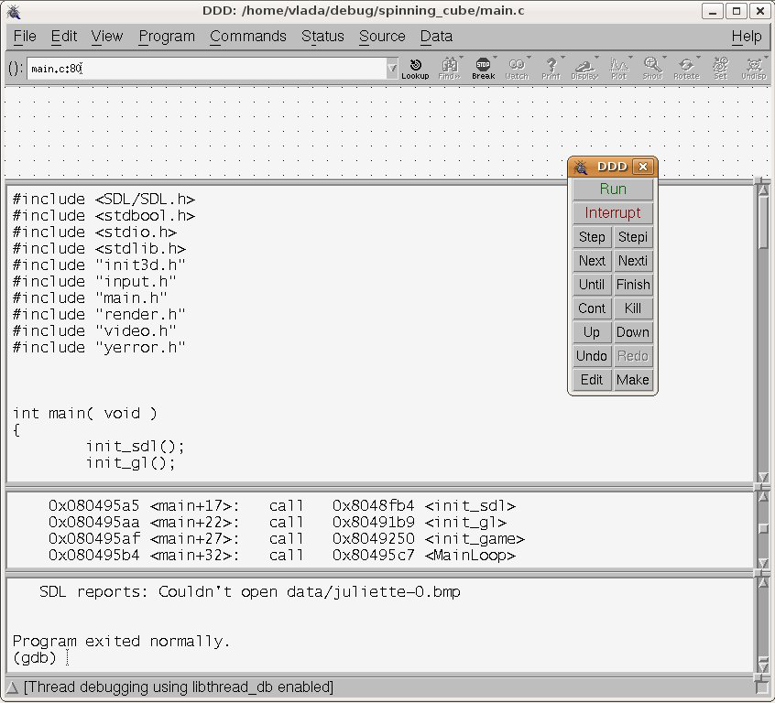
ddd - gdb graphical frontend

Slide 22
References
http://www.gnu.org/software/gdb/
http://www.dirac.org/linux/gdb/
http://www.delorie.com/gnu/docs/gdb/gdb_toc.html

