Slide 1
USING THE e-INFRASTRUCTURES IN COMPUTATIONAL CHEMISTRY
Ljupčo Pejov
ljupcop@pmf.ukim.mk
Institute of Chemistry, Faculty of Natural Sciences and Mathematics
Ss. Cyril and Methodius University
Skopje, Macedonia

Slide 2


FP7-INFRASTRUCTURES-2010-2
HP-SEE
High-Performance Computing Infrastructure for South East Europe’s Research Communities

Slide 3
THE UNDERLYING PHYSICAL LAWS NECESSARY FOR THE
MATHEMATICAL THEORY OF A LARGE PART OF PHYSICS AND THE
WHOLE OF CHEMISTRY ARE THUS COMPLETELY KNOWN, AND THE
DIFFICULTY IS ONLY THAT THE EXACT APPLICATION OF THESE
LAWS LEADS TO EQUATIONS MUCH TOO COMPLICATED
TO BE SOLUBLE.
THE METHODS OF THEORETICAL PHYSICS SHOULD BE APPLICABLE TO ALL THOSE BRANCHES OF THOUGHT IN WHICH THE ESSENTIAL FEATURES ARE EXPRESSIBLE WITH NUMBERS.
AS LONG AS QUANTUM MECHANICS IS CORRECT, ALL ISSUES IN PHYSICS AND CHEMISTRY ARE ACTUALLY PROBLEMS IN APPLIED MATHEMATICS.
THE LEVEL OF EXACTNESS OF A GIVEN SCIENCE IS DIRECTLY PROPORTIONAL TO THE LEVEL AT WHICH THE PROBLEMS IN THAT SCIENCE CAN BE SUBJECTED TO COMPUTATION.
GOD USED BEAUTIFUL MATHEMATICS IN CREATING THE WORLD.
-- P. A. M. DIRAC

Slide 4
Why do we need computational resources in chemistry (and chemical engineering).
Which e-infrastructures are more suitable for a particular problem: grid vs. high-performance clusters.
Choosing and defining the problem.
Developing a computational algorithm and strategy.
Writing the codes.
Implementing the computational approach on a given platform (linking, compiling, using parallel computing environment…).
Automating the procedure (???).

Slide 5
HC-MD-QM-CS - Hybrid Classical or Quantum Molecular Dynamics – Quantum Mechanical Computer Simulation of Condensed Phases.
Application description and objectives
  To study the properties of condensed phases, liquids (such as e.g. solutions of ions and various molecular systems in molecular liquids), solids (including small molecular systems adsorbed on surfaces), computer simulations, which will use parallel numerical algorithms will be carried out.
  The overall objective of the work is to develop a novel general method for computation of complex in-liquid properties of the system, with potential applicability in the field of biomedical sciences, catalysis, etc.
  Scientific impact:
    These studies are of high fundamental significance, concerning the properties of condensed phases and influence thereof on various molecular species

Slide 6
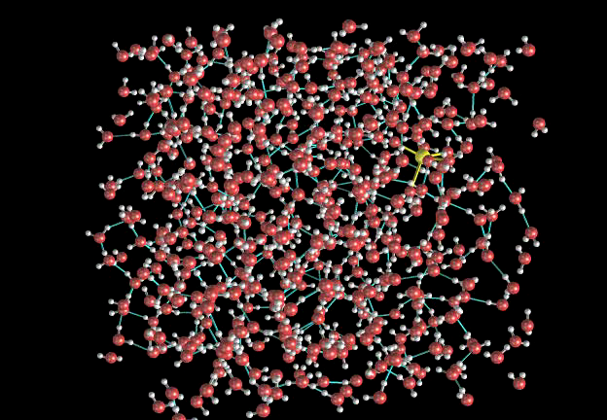

Slide 7
HPC implementation:
    All parts of this application require vast computational efforts, in particular the quantum molecular dynamics simulations. Though computations required for certain sequences of the complex hybrid algorithms can be carried out on standard PC clusters, the more complex and demanding ones require low-latency parallel environment.
Achievements:
  Efficient implementation of a genetic algorithm to optimize the interaction potential energy parameters of liquid CCl₄
  Efficient implementation of a complex hybrid quantum mechanical (ab initio) molecular dynamics – quantum mechanical methodology used for simulation of complex condensed phase systems. The methodology is inherently a multistep one, and certain steps are excellently scalable on parallel high-performance clusters.
  Implementation of hybrid QMD-TDDFT methodology to explain the origin of the solid-state thermochromism and thermal fatigue of polycyclic overcrowded enes.
  Implementation of a hybrid CPMD-QM_{el}-QM_{nuc} methodology to compute the vibrational spectrum of aqueous hydroxide anion.
  Application of molecular dynamics simulations to confirm the experimental evidence for the existence of dangling OH bonds in hydrophobic hydration shells.
  Application of sequential MD-QM_{el}-QM_{nuc} methodology to compute the vibrational spectra of the first-shell water molecules in ionic water solutions.

Slide 8
Vibrations of aqueous hydroxide anion
Summary of experimental (Raman) and theoretical (power spectrum or
DOS) OH and H2O frequencies from the literature and from our work. H2O-sol means water peak in the solution.

Slide 9
Method
ν(OH⁻) - the anharmonic OH stretching vibrational frequency, i.e. the 0 → 1 vibrational transition
Δν (OH⁻) - the gas-to-solution frequency shifts, i.e.
Δν (OH⁻) = ν (OH⁻ in solution) - ν (isolated OH⁻ ion)
computed from the positions of the peak maxima.
We use a sequential Car-Parrinello Molecular Dynamics (CPMD) +Quantum chemical (QC_{elec}) +Quantum mechanical (QM_{nucl}) computational approach.
The MD box used in the current study consists of 44 H₂O + 2 Na⁺ + 2 OH⁻ (corresponding to a 2.5 molal concentration). Our calculated spectrum will be compared to the experimental Raman study of a 2.0 molal NaOH(aq) solution, which has a reported peak maximum at 3625 cm⁻¹ in the region of interest.
We will use the label O* for the hydroxide ion's oxygen atom, and H* for its hydrogen atom, contrary to Ref.

Slide 10
Step 1, aqueous solution simulations.
Car-Parinello Molecular Dynamics (CPMD) simulations of aqueous NaOH solutions.

Slide 12
Leap-frog algorithm
t

Slide 13
Verlet algorithm

Slide 14
Density functional theory

Slide 19
Each CPMD simulation consists of two phases:
wavefunction optimization and
molecular dynamics simulation.
As the optimization runs involve an iterative procedure that needs to converge, the number of iterations required to achieve final convergence being strongly dependent on the particular architecture, compilers and compilation parameters etc., this phase is strongly platform – dependent and not so suitable for benchmarking.
The molecular dynamics phase. To demonstrate the scalability of the approach, in Fig. 1 variation of the wall-clock computational time required to carry out an MD simulation of a modest-size water cluster (consisting of 32 water molecules) is plotted against the number of computing processes (processors/cores). Fig. 2 shows the same data, where both axes are logarithmic (log-log plot). The parallelization has been achieved by the MPI paradigm.

Slide 20
Fig. 1.

Slide 21
Fig. 2.

Slide 22
We selected 76 snapshots from the CPMD simulation, taken at regular intervals from the 10 ps long production run, i.e. 152 OH⁻ candidates for a vibrational analysis.
We then excluded from the analysis all configurations where proton transfers (or good transfer attempts) were found to occur. We classified a snapshot as a proton transfer case along the O_{w} - - -O* coordinate, if for , at least one of the following three criteria is fulfilled: (i) r₁ > 1.2 Å, (ii) r₂ < 1.4 Å, (iii) |δ| = |r₁ − r₂ | < 0.1 Å.
The remaining number of cases to be analysed was 130, which we thus believe to represent geometries sufficiently far from a proton transfer.

Slide 23
Step 2, construction of system to be used in the Quantum Chemical (QC) calculations. From each of the collected snapshots, clusters were extracted, for which we performed QC calculations in Step 3. A dividing plane between the O* and H* sides of the ion is defined in Fig. 3. Each "QM cluster" was composed of a central OH⁻ ion, all water molecules residing within an R(O_{w} • • • O*) distance of less than 3.5 Å on the O* side, and all water molecules residing within an R(O_{w} • • • H*) distance of less than 4.5 Å on the H* side. These cut-offs were based on the information from the radial pair distribution functions (rdfs).

Slide 24
Definition of regions I, II and III constructed with the help of a dividing plane through the center of the O*–H* bond of the hydroxide ion. Region I contains all water molecules within a R(O*–O_{w}) distance of 3.5 A. Regions II and III contain all water molecules within a R(H*–O_{w}) distance of 4.5 A.

Slide 25
Step 3, QC calculations of the potential energy surface (PES). One-dimensional potential energy curves ΔE(r(OH⁻)) (or U (r(OH⁻)) were calculated in the interval 0.7 Å < r(OH⁻) < 1.5 Å with an increment of 0.015 Å. The B3LYP/6-31G++(d,p) method with basis-set superposition error (BSSE) correction according to the Counterpoise method.

Slide 27
Step 4, vibrational Quantum Mechanical (QM) calculations. The vibrational energy levels were calculated quantum-mechanically from the one-dimensional potential energy curves using the discrete variable representation (DVR)

Slide 29
Step 5, analysis of frequency vs. field correlations. We will discuss the frequency shifts in relation to the electric field that the full hydration shell, or selected parts of it, generate over the molecule. Here we will probe the electric field at the equilibrium H* position for each snapshot (the equilibrium position is known from Step 3) and, moreover, only probe the component along the O*-H* bond. We denote this F// @ H*. The // subscript means "along the vibrational coordinate", i.e. here along the OH bond. We define the electric field as positive along the molecular axis if it is oriented as if there were positive charges on the oxygen side of the molecule and negative charges on the H side
+ –
+ [ O-H]– –
+ –
positive field direction

Slide 30
Graphical representation of the positions and orientations of the water molecules relative to the ion in the CPMD simulation. Lower panel: each dot represents the position of the center-of-mass of a molecule. Upper panels: Radial distribution functions for the three regions I, II, and III. The curves have been scaled according to the respective volumes of regions I, II and III to reflect the number of water molecules in each region, i.e. they take the solid angle of the region into account.

Slide 31
Sample potential energy curve for E(r_{OH}) vs. r_{OH} for one of the OH ions in one of the snapshots from the CPMD simulation and potential energy curve for the isolated OH ion. The curves have been made to coincide at their respective minima. The difference between the two curves is the curve marked ΔE_{ext}, where ext stands for external, i.e. the ion’s interaction with its surroundings. BSSEcorrectedB3LYP/6-31G++(d,p) calculations.

Slide 32
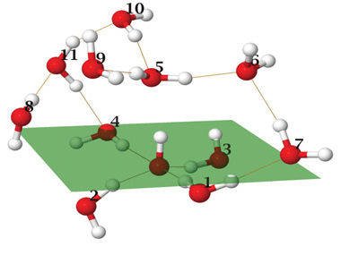

Slide 33
Anharmonic OH frequency histograms. (a) finite QC cluster, (b) periodic QC calculations.

Slide 38
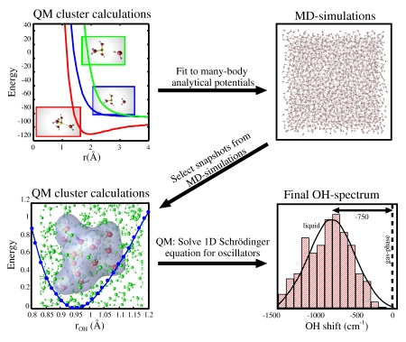

Slide 39
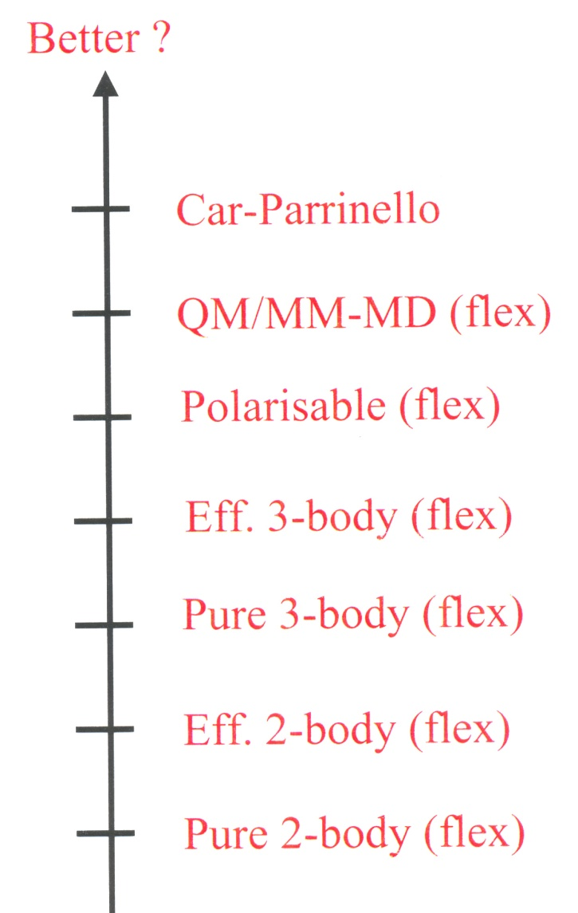
Conclusions
Which is the best way to model molecules in liquids ?
”Better - in principle”
?
Quantum-dynamical Car-Parrinello
MD + QM
Many-body potentials from ab initio
QC for some fixed geometry?

Slide 40
ISIS and KALKYL HPC clusters at UPPMAX – Uppsala, Sweden
SEE-grid cluster
The new HPC cluster at FINKI, Skopje, Macedonia
The new HPC cluster at Institute of Chemistry, Skopje, Macedonia (The FEYNMAN cluster)
THANK YOU FOR YOUR ATTENTION

