Slide 1


DESIGN OF NOVEL NANO-PHOTONIC COMPOUNDS
Aggelos Avramopoulos Manthos G. Papadopoulos
Institute of Biology, Medicinal Chemistry and Biotechnolodgy Computational Chemistry Group
National Hellenic Research Foundation
Athens, Greece

Slide 2
OUTLINE
Brief theoretical overview
Basic theoretical concepts: Theoretical framework of the (hyper)polarizabilities
Results
Rare gas Derivatives.
Ni-dithiolenes.
Fullerenes
Conclusions
HP-SEE User Forum 2012,October 17-19, 2012, Belgrade, Serbia

Slide 3
Definition of the electric properties
When a molecular system is placed in a homogeneous static electric field F, its energy may be expanded in a Taylor expansion series as follows:
E = E⁽⁰⁾ -μ_{α}F_{α} - (1/2)α_{αβ}F_{α}F_{β} - (1/6)β_{αβγ}F_{α}F_{β}F_{γ} - (1/24)γ_{αβγδ}F_{α}F_{β}F_{γ}F_{δ} - ...
μ_{α} : Dipole moment
α_{αβ}: Polarizability
β_{αβγ}: First hyperpolarizability
γ_{αβγδ}: Second hyperpolarizability
HP-SEE User Forum 2012,October 17-19, 2012, Belgrade, Serbia

Slide 4
Where n corresponds to the order of the property.
n=1, p=μ
n=2, p=α
n=3, p=β
n=4, p=γ
Average values

Slide 5
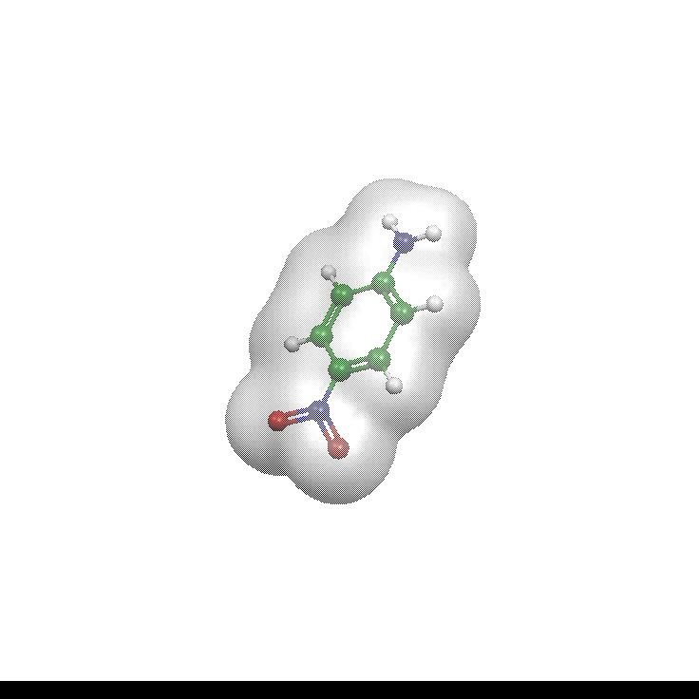
Why the study of these properties is important:
Theory
Allow the advance understanding of the electronic and vibrational structure of the molecules.
Applications
Design and study of NLO materials (optical processing of information, optical computing)
THE GOAL
DESIGNING MOLECULES FOR NON-LINEAR OPTICAL APPLICATIONS
2ω
ω
ω

Slide 6
Factors that affect the study of the (hyper)polarizabilities:
Electron correlation
High level quantum chemistry ab-initio
methods need to be used
MP2
CCSD
CCSD(T)
CASSCF
CASPT2
Basis set effects
Pol and Hypol (Developed by Sadlej et. al.)
aug-cc-pvNZ, N=2-5( Developed by Dunning et. al.)

Slide 7
Factors that affect the study of the (hyper)polarizabilities:
Vibration of the molecules
Methods used for the computation of the vibrational contribution:
Bishop – Kirtman Perturbation theory
Field Induced Coordinates
Environmental Effects
Method used for the computation of the Local field effect:
Discrete Local Field Theory
Relativistic Effects
Quite important when the molecule is composed from heavy atom(s)
Methods: Douglas –Kroll approximation
Pseudopotentials

Slide 8
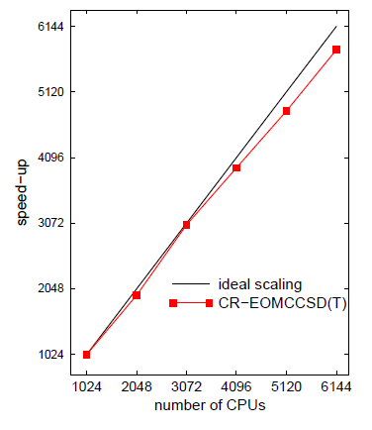
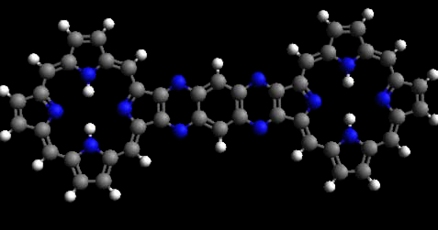
√ The efficient computation of the L&NLO properties of big systems (graphenes, Fullerenes, Ni based molecular conductors) NEEDS a large massively parallel computational chemistry software designed to take advantage of large computing resources.
√ Necessity for HPC resources.

Slide 9
Rare gas derivatives
We consider insertion of one or two noble gas atoms, Ng, in the chemical bond A-B, leading to A-Ng-B or A-Ng-Ng-B.
► Ar in HF leading to HArF
► Xe in HC_{n}H leading to HXeC_{n}H
► Two Ng in HF leading to H-Ng-Ng-F
Ng: Ar, Kr, Xe
HArF: L. Khriachtchev et al., Nature, 406, 874 (2000)

Slide 10
Correlation effect on first hyperpolarizability
HF molecule
β(HArF)=76 β(HF) !

Slide 11
p^{el}
p^{pv}
p^{zpva}
μ_{z}
2.778
-0.05
(0.034)
α_{zz}(0;0)
α_{zz}(-ω;ω)
59.24
65.57
41.87
(34.31)
-0.18
(-0.03)
4.96
(1.43)
5.49
(1.68)
β_{zzz}(0;0,0)
β_{zzz}(-ω;ω,0)
β_{zzz}(-2ω;ω,ω)
-1443.4
-1859.8
-3723.9
-710.5
(285.9)
-333.6
(-68.5)
21.3
(1.5)
-146
(-68.4)
-188.2
(-88.0)
! Vibrational contribution is significant
Notes:
In parenthesis the HF value is quoted

Slide 12
HXeC₂H
Synthesized by
L. Khriachtchev, H. Tanskanen, J. Lundell, M. Pettersson, H. Kiljunen and M. Räsänen,
J. Am. Chem. Soc., 125, 4696 (2003).

Slide 13
α_{zz}(HXeC₂H)~4 α_{zz}(HC₂H) (MP2/aug-cc-pVDZ)

Slide 15
γ_{zzzz}(HXeC₂H)~12.6 γ_{zzzz}(HC₂H) (MP2/aug-cc-pVDZ)

Slide 16
Method: MP2/aug-cc-pVDZ
The effect of
1 and 2
Xe atoms

Slide 17
H-Xe-C≡C-C≡C-H γ_{zzzz} =111190 a.u
H-C≡C-Xe-C≡C-H γ_{zzzz} =28 488 a.u.
H-C≡C-C≡C-H γ_{zzzz} = 31224 a.u.
The position of Xe has a significant effect on γ_{zzzz}
Method: MP2/aug-cc-pVDZ

Slide 18
Method: CASSCF (10 electrons in 14 orbitals)
ΔΕ: CASPT2, Transition Dipole Moments:CASSCF
Xe insertion makes the spectrum lower in energy, more dense, many non-zero contributions in the transition dipole moment matrix.
A SOS model for gamma gives:
γ_{zzzz} (HXeC₂H) = 2.6 γ_{zzzz} (HC₂H)

Slide 19
HAXeH,A=O,S
Synthesized by
M. Pettersson L. Khriachtchev, J. Lundell, M. Räsänen, J. Am. Chem. Soc, 120, 7979, (1998)
M. Pettersson, J. Lundell L. Khriachtchev, E. Isoniemi, M. Räsänen, J. Am. Chem. Soc, 121, 11904, (1999).

Slide 21
HF MP2 CCSD CCSD(T)
β_{zii}
-112.9
-25.6
-111.6
-11.1
-118.3
-2.3
-112.9
6.1
8.1
106.8
14.5
101.3
13.4
111.3
13.6
114.3
-715.7
-2288.6
-657.7
-988.2
-695.8
-976.2
-644.1
-475.7
β
-492.3
(-10.90)
-1324.4
(-13.15)
-452.9
(-14.84)
-538.8
(-21.09)
-480.4
(-14.47)
-520.3
(-18.7)
-446.0
(-15.8)
-213.1
(-20.6)
ii: xx,yy,zz.
In plane components are most affected from electron correlation effects
More enhanced on HXeSH
β(HXeOH) = 28.2 β(H₂O) β(HXeSH) = 10.3 β(H₂S)
Method: CCSD(T)/aug-cc-pVDZ
Notes:
First Column HXeOH, Second HXeSH In parenthesis the values of the non-Xe derivatives

Slide 22
Interpretation of the results
A simple Sum Over State model for beta (and for alpha and gamma ) can qualitatively explains the influence of the noble gas insertion on the Studied NLO properties.
Two state model:
μ_{gg}: ground state dipole moment
μ_{ee}: excited state dipole moment
μ_{ge}: transition dipole moment
Ε_{ge}: transition energy
CIS approach for the calculation of the excited states and the corresponding dipole moment vectors

Slide 23
HArF case
HArF β_{zzz}=-561.5 a.u. HF/Pol
-340.7 a.u. TSM
HF β_{zzz}=-7.4 a.u. HF/Pol
-5.7 a.u. TSM
μ_{gg}(3.473; 0.745), μ_{ee}(-0.814;-0.907), μ_{ge}(+1.419;-0.611) and E_{ge}(0.276; 0.570)
HOXeH case
Excited state dipole moments are equal to 0.378 a.u. and 0.312 a.u., the related transition dipoles are 1.645 a.u. and 0.640 a.u, and the excitation energies 0.243 a.u. and 0.403 a.u., respectively for HOXeH and H₂O.
β_{zzz}(HXeOH)/β_{zzz}(H₂O) = 23.2 (aug-cc-pVDZ method)
Notes:
In parenthesis the tot HF value.

Slide 24
1. The SOS analysis shows that the large increase of β (associated with the inserted Xe or Ar) is due to an increase of μ_{ee}- μ_{gg} (in absolute value) and μ_{ge} (stronger oscillator strengths for many transitions) and a decrease of E_{ge} (lowering excited states).
2. The electronic spectrum is more dense
! The NLO properties are:
proportional to products of TDM matrix elements
inversely proportional to products of energy differences
Therefore an enhancement to NLO properties is expected

Slide 25
The case of HXeXeF molecule*
Method
Prop.(a.u.)
HF
CCSD(T)
HF
HXeF
HXe₂F
HF
HXeF
HXe₂F
μ_{z}
0.759
2.283
6.454
0.703
1.975
3.788
α_{zz}
5.59
51.25
206.96
6.19
59.59
420.43
β_{zzz}
-9.8
-436.7
-9633
-11.5
-582.1
-11040
(γ_{zzzz} x 10⁻³)
0.219
16.9
720
0.284
22.7
-4000
Basis Set:aug-cc-pVDZ
*

Slide 26
Electronic ground state description
HXeXeF
58% (σ)² + 35% (σσ*)
HXeF
88%(σ)²
HF
99%(σ)²

Slide 27
Interpretation of the results
Method
Prop. (a.u.)
CCSD
MSCASPT2ª
HF
HXeF
HXe₂F
HF
HXeF
HXe₂F
ΔΕ
0.681
0.259
0.117
0.521
0.256
0.107
|μ_{ge}|
0.463
1.647
3.948
0.502
1.761
4.199
μ_{e}
-0.513
-1.376
2.325
μ_{g}
0.709
2.051
4.990
0.650
1.956
4.719
Δμ_{eg}
-1.163
-3.332
-2.394
β_{zzz}
-3.2
-473
-11070
ª Active Space/active electrons: 4550/16

Slide 28
Description of the ground state
Eª
HXeXeF 58.0% σ² + 35% σσ* 3.09 eV
HXeΟXeF 87.0% σ² + 9% σσ* 3.81 eV
FXeΟXeF 76.5% σ² + 10% σσ* 5.20 eV
ª. First excitation energy
! O insertion between Xe-Xe increases the stability of the system
HXeXeF 13.1 kcal/mol
HXeOXeF 14.9 kcal/mol
FXeOXeF 40.5 kcal/mol

Slide 29
 | HXeXeFª | HXeOXeF | HXeOXeH | FXeOXeF
μ_{z} | 3.788 | 2.747 | 0.987 | 0.623
α_{zz} | 420.4 | 92.8 | 107.3 | 90.5
β_{zzz} | -11040 | -1720 | -49 | -89.0
Insertion of O reduces the L&NLO properties
Method: CCSD(T)/aug-cc-pVTZ
^{a.} aug-cc-pVDZ

Slide 30
The L&NLO properties of Ni-Dithiolenes
Points of interest:
The diradical character and its variation with the structure
The impressive NLO properties and their interpretation
“The term diradical has generally been used loosely to describe systems which can be formally written with two unpaired electrons”

Slide 31
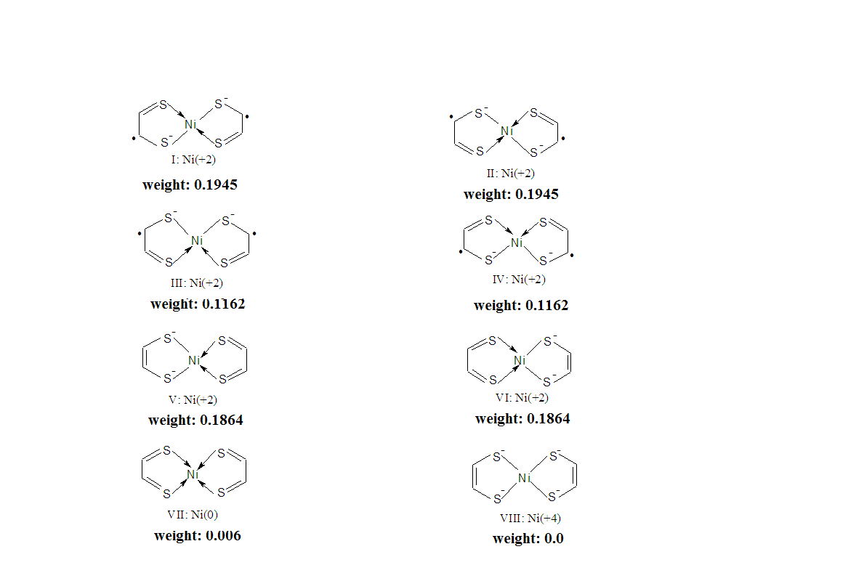
The resonance structures of Ni(S₂C₂H₂)₂

Slide 32
Excited states structure of Ni(S₂C₂H₂)₂
State
ΔE/eV
Main configuration
1¹A_{g} ( diradicaloid)ª
−0.004^{b}
… (π₂)²(π₃)⁰ - (π₂)⁰(π₃)²
1¹B_{1u} (ππ*)^{c}
0.000^{b}
… (π₂)¹ (π₃)¹
.
. 14 states
.
3¹B_{3u} (σ_{SNi} π π ∗ π *)
3.064
… (σ_{SNi})¹ (π ₁)¹ (π ₂)² (π ₃)²
1³B_{1u} (diradical)^{d}
0.612
… (π ₂)¹ (π ₃)¹
ª 1¹A_{g} [71% (π₂)²(π₃)⁰−21% (π₂)⁰(π₃)²].
^{b} The energy difference is within the method accuracy. For simplicity
the 1¹A_{g} state will be considered the ground state at this level.
^{c} 1¹B_{1u} state 65% [(π ₂)¹(π ₃)¹].
^{d} 1³B_{1u} state 92% [(π ₂)¹(π ₃)¹].
Basis set: ANO-RCC
Method: CASSCF/CASPT2

Slide 33
The main findings of the CASSCF/CASPT2 computations are:
The quasidegenaracy of 1¹A_{g} and 1¹B_{1u} and the large number of low lying excited states.
These features are very likely to lead to large NLO properties
Property
Method
α_{zz}
γ_{zzzz}x10⁻⁴
UBHandHLYP
245.3
67.7
UCCSD
300.5
72.4
UCCSD(T)
364.3
119.0
CASSCF/CASPT2
m/a₁b₁b₂a₂^{b}
Basis set: ZPolX
12/4242 (4σ2π,4σ*2π*)
67.9/282.2
1647.5/216.0
16/4444 (4σ4π,4σ*4π*)
243.2/340.7
1102.7/184.7
20/4646 (4σ6π,4σ*6π*)
309.3/363.8
869.5/153.1

Slide 34
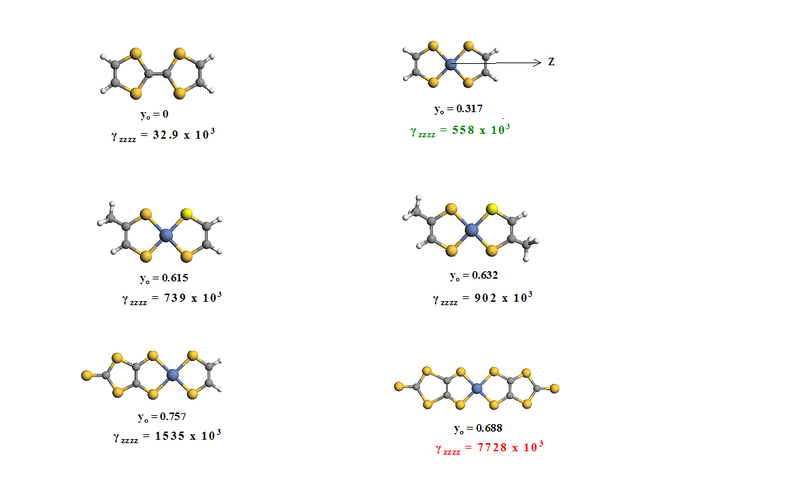

Slide 35
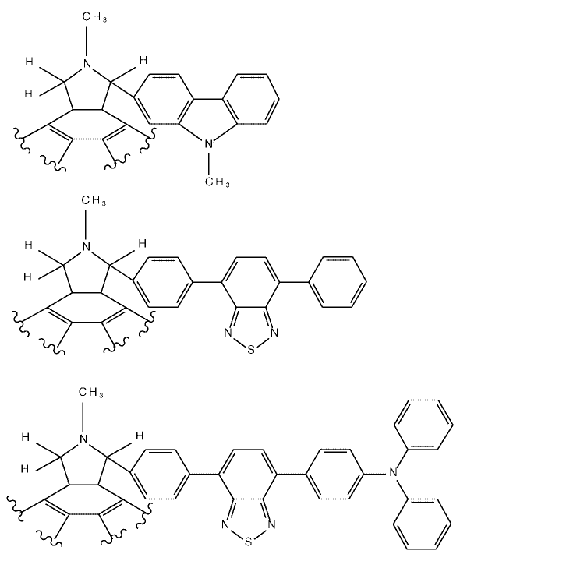
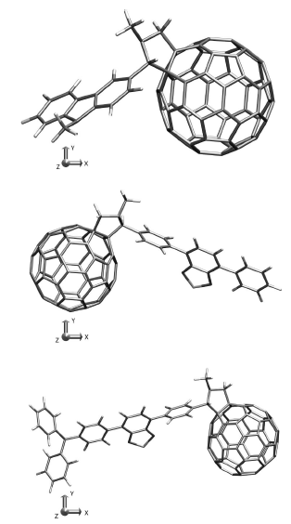
The L&NLO properties of [60]fullerene derivatives

Slide 36
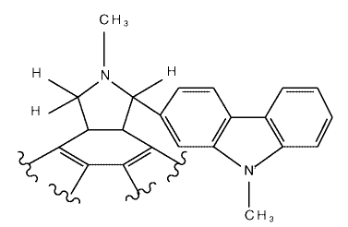
Selection of the appropriate method (e.g. functional)
The computations were done by using HPC facilities.

Slide 37
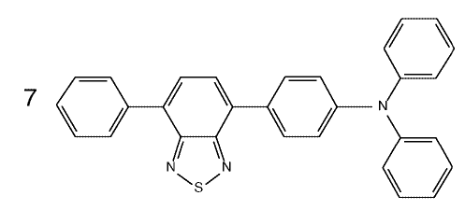
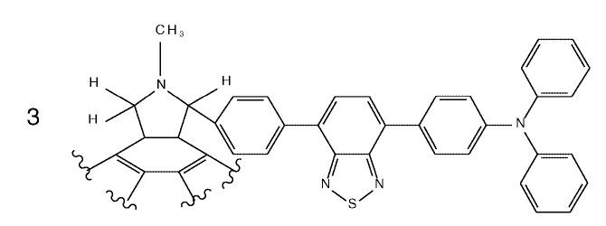
Computation of the electronic and vibrational contributions
 | 3 | 7
 | 119.0 | 86.6
 | 836.3 | 339.0
 | 1530.1 | 2443.0
 | 835.8 | 268.0
 | 293915 | 133909
 | 361605 | 17552
Method:
HF/6-31G

Slide 38


Selection of functional groups

Slide 39
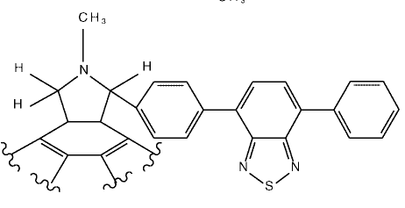
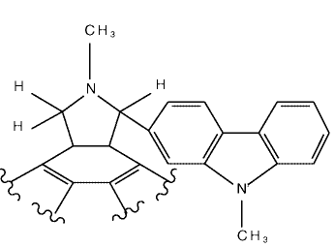
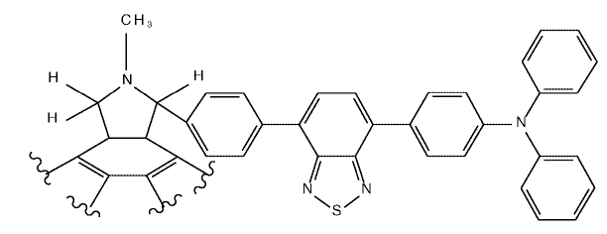
 | 1 | 2 | 3
 | 591.89 | 679.70 | 817.90
 | 546.6 | 521.5 | 1756.2
 | 135377 | 307890 | 730346
2
Method: PM3
1
3

Slide 40
CONCLUSIONS
☑ Ng insertion significantly modifies the NLO response.
Ng insertion modifies remarkably the electronic spectrum
(larger transition dipole moments, low lying states).
The diradical character enhances the NLO properties.
The tuning of NLO response in Fullerenes derivatives depends on the functional groups.
! Tuning the NLO properties
TDM matrix elements inverse proportional
to products of energy differences
Notes:
Force field to describe Coulomb interaction (LR)
During MD step

Slide 41
A.Avramopoulos, H. Reis, J. Li and M. G. Papadopoulos, J. Am. Chem. Soc., 126, 6179 (2004);
F. Holka, A. Avramopoulos, O. Loboda, V. Kellöand M. G. Papadopoulos, Chem Phys. Letters, 472, 185 (2009);
A. Avramopoulos, L. Serrano-Andrés, J. Li, M. G. Papadopoulos, J. Chem. Theor. Comp., 6, 3365 (2010);
A. Avramopoulos, Luis-Serrano-Andrés, H. Reis, M. G. Papadopoulos, J. Chem. Phys., 127, 214102 (2007)
A. Avramopoulos, J. Li, N. Holzmann, G. Frenking, M. G. Papadopoulos, J. Phys. Chem. A, 115, 10226 (2011).
L. Serrano-Andrés, A. Avramopoulos, J. Li, P. Labéquerie, D. Bégué, V. Kellö, and M. G. Papadopoulos, J. Chem. Phys,. 131, 134312 (2009).
O. Loboda, R. Zalesny, A. Avramopoulos, J. M. Luis, B. Kirtman, N. Tagmatarchis, H. Reis, M. G. Papadopoulos, J. Phys. Chem. A, 113, 1159 (2009).

Slide 42
Dr Manthos G. Papadopoulos , Research Director NHRF
Dr. Heribert Reis, NHRF, Greece
Dr. Jiabo Li SciNet Technologies, San Diego,California
Dr. Luis Serrano-Andres,University of Valencia,Spain
Dr. Josep Maria Luis, University of Girona, Spain
Prof. Bernard Kirtman, University of California, Santa Barbara, USA
Prof. Vladimir Kellö, Comenius University, Slovakia

Slide 43


Computational Chemistry Group
http://www.eie.gr/nhrf/institutes/iopc/researchgroups/ccg-group/ccg-en.html

