Slide 1


WORKFLOW PETRI NETS USED IN MODELING OF PARALLEL ARCHITECTURES
Inga Țițchiev
Institute of Mathematics and Computer Science

Slide 2
Essence of the problem
Cloud
competitive advantage
operational necessity
bioinformatics,
physics,
mathematical modeling,
web servers and database,
optimization of business decisions,
medicine
Notes:
Adoption of cloud environment is quickly transformed from a competitive advantage to an operational necessity, facilitating innovation and thus allowing definition of new computational models and occurrence of new working opportunities. Also not less significant costs reduction by using techniques of parallel processing and storing data in the cloud, which being combined with increasing performance requirements of applications led to their successful use in various fields (bioinformatics, physics, mathematical modeling, web servers and database, the optimization of business decisions, medicine).

Slide 3
Relationship between elements
More complex structure
analyze
Computer
description
Management of interactions
Notes:
The development of computer is characterized not only by increasing the number of elements involved in data processing but by presenting the relationship between them and the management of interactions with a more complex structure.
The quality of such new interactions contributed to the occurrence of new problems related to the analysis, modeling and representation of causal relations by such objects of complex systems that can act in parallel.

Slide 4
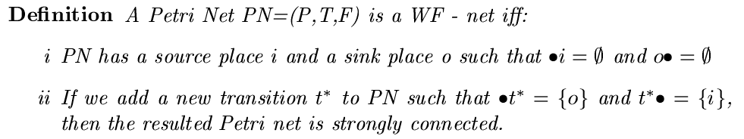
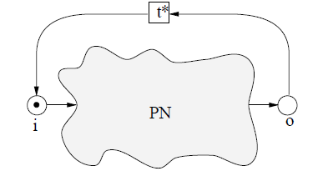
Workflow Petri nets
Notes:
Debugging of the parallel interactions is a difficult and complicated process.
For a better understanding of these processes workflow Petri nets formalism is used, which is an environment of interaction of the processes (including the parallel one) and in which they can control the execution of successions and allow one or another operation to be held.

Slide 5
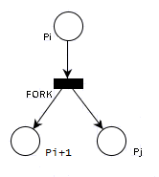
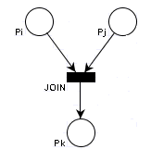
Fork and Join operations
Notes:
We consider how parallelism can be introduced in a normal process into computer system. It is considered branching operations (FORK) and union (JOIN) initially proposed by Dennis and Van Horn [1966]. A branching operation performed with the precondition pi determines current continuation of postcondition pi + 1 and starts a new process execution at location pj. A union operation will recombine two processes in one (or, equivalently, destroy one of the two processes and will allow the other to be performed). These operations can be modeled by a workflow Petri net

Slide 6
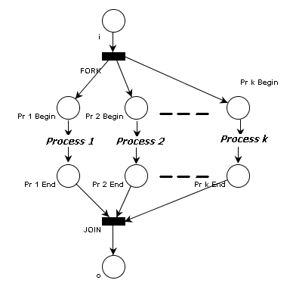
Parallel execution of k processes
Notes:
If we consider parallel execution
of k processes, then we obtain the combination of the two operations defined above -- branching and union
Parallelism is useful in solving a problem if concurrent processes can cooperate in solving the problem. Such cooperation involves common processes information and resources. Shared access to information and resources must be controlled in order to ensure correct functioning of the system.

Slide 7
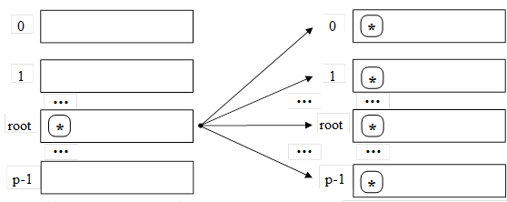
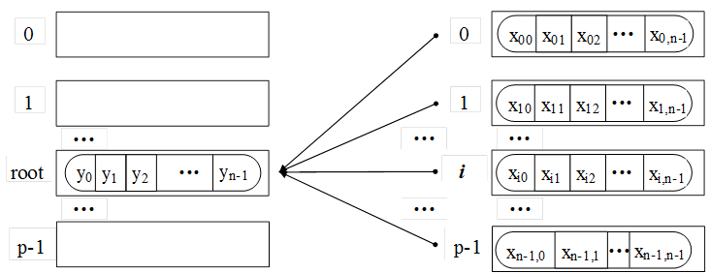
OpenMPI operations
point to point operations
collective operation
One to many
Many to one
Notes:
One of the standards that ensure a maximum portability of applications is OpenMPI.
To represent existing operations in OpenMPI, will be used the formalism of workflow Petri nets[2]. They allow to model this things in a very intuitive graphical manner.
In MPI two types of operations exist: point to point operations and collective operation}.

Slide 8
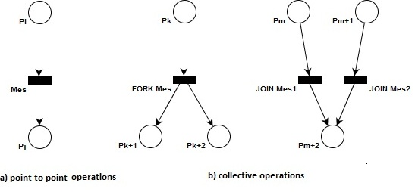
OpenMPI operations by means of workflow Petri Nets

Slide 9
TECHNICAL EQUIPMENT
To run applications with parallel technologies at the Institute of Mathematics and Computer Science the 48 core IMI-RENAM cluster is used. At this cluster on virtualization platforms next Home Training Infrastructures were deployed:
- MS Windows Compute Cluster 2003, 4 Nodes, 12 Cores (CPUs: QuadCore Intel Xeon E5335 2,0 GHz, QuadCore Intel Xeon E5310 1,6 GHz) to run different tasks serial, parallel, parametric sweep and task flow;
- Grid-Site: MD-02-IMI, 4 Worker Nodes, total 16 VCPU, 1 GB RAM per 1 VCPU – to test applications and prepare them for porting from local clusters to EGI GRID and to HP-SEE regional resources.;
- on Virtual Machine: 64 bit Scientific Linux 6.3; Intel(R) Parallel Studio XE 2011 (4 cores, 4 Gb RAM) – for compiling and debugging of applications.

Slide 10
Conclusion
it was shown that workflow Petri nets is a convenient formal method for modeling information flow. Thus, it was shown how workflow Petri nets have been used for representation of parallel processes in order to better understand these processes. On the local cluster the applications can be tested and prepared for execution on more productive resources.

