Slide 1
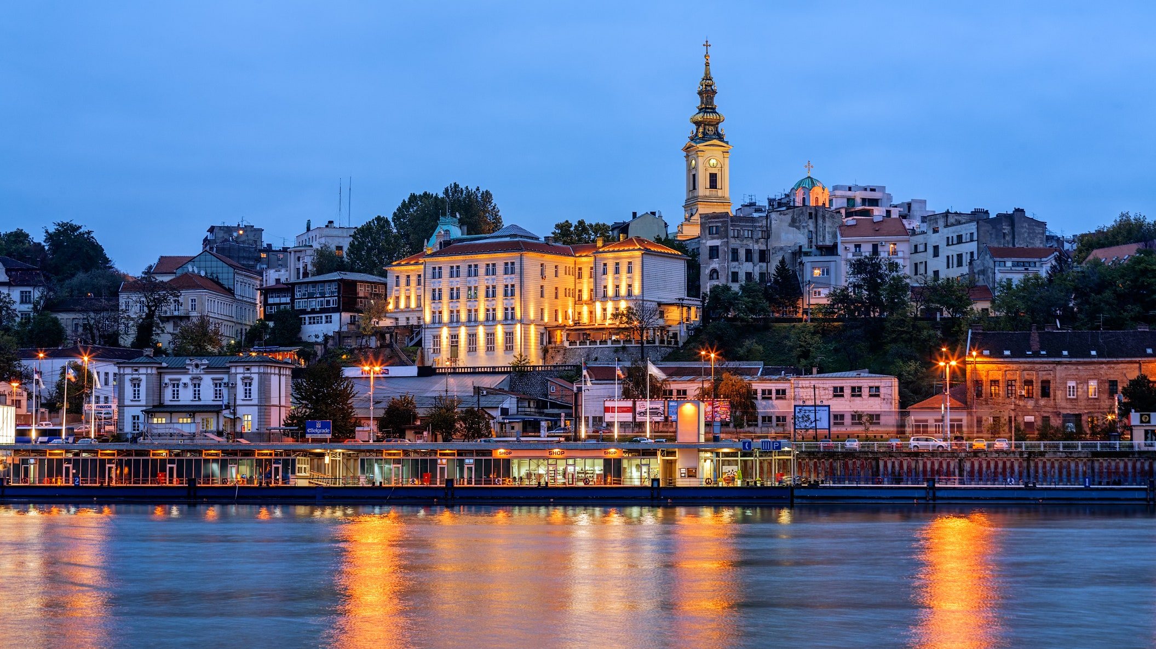




Hadronization in Vacuum and in Medium
Rainer J Fries
Texas A&M University
FIAS
Exploring Quark-Gluon Plasma through soft and hard probes

Slide 2
The Hadronization Problem
arXiv:2203.11601
No solutions based on first principles.
For Monte Carlo calculations: need models based on reasonable assumptions that describe data comprehensively
Some features in heavy ion collisions not addressed in standard models like Lund string fragmentation.
Renewed interest in Hadronization
Even in p+p some new data is challenging models.

Slide 3

Hybrid Hadronization

Slide 4
Hybrid Hadronization
A hybrid of string fragmentation and recombination.
Interpolates smoothly in between, two limits:
  Dilute systems → Dominance of string fragmentation
  Dense systems → Dominance of quark recombination
Use a physics criterion to separate the domains: recombination probabilities vanish for large phase space distances
Monte Carlo implementation available, e.g implemented in JETSCAPE since v2.0.
String regime
K. C. Han, R. J. Fries, C. M. Ko, Jet Fragmentation via Recombination of Parton Showers, Phys.Rev.C 93, 045207 (2016)
Recombination regime

Slide 5
Hybrid Hadronization Work Flow
Input:
Provide partons with virtualities below some cutoff, with space-time information and color tags
.
Recombination Step:
Go through the system sampling the recombination probabilities for all possible q-qbar and q-q-q bound states.
Intermediate Step:
Recombined hadrons and remnant partons in a string system (only color singlets were removed).
Fragmentation Step:
Remnant partons tend to be farther apart in phase space. Fragement using PYTHIA 8.

Slide 6
Hybrid Hadronization Work Flow
Input:
Provide partons with virtualities below some cutoff, with space-time information and color tags
.
Bath of thermal partons
Recombination Step:
Go through the system sampling the recombination probabilities for all possible q-qbar and q-q-q bound states.
Recombination with thermal partons
Intermediate Step:
Recombined hadrons and remnant partons in a string system (only color singlets were removed).
Remnant strings with thermal partons
Fragmentation Step:
Remnant partons tend to be farther apart in phase space. Fragement using PYTHIA 8.

Slide 7



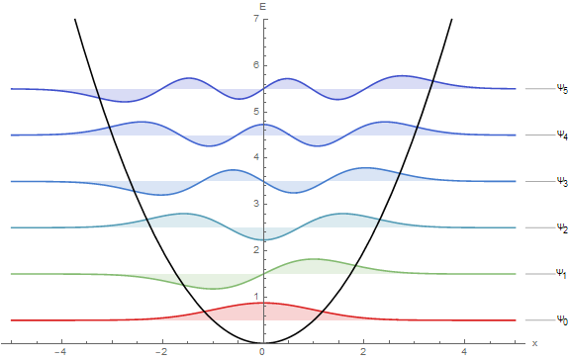

Setting up the Recombination problem
Quarks/antiquarks = wave packets in phase space
For simplicity: Gaussian wave packets around centroid phase space coordinates $\left({\vec{r}}_{i},{\vec{p}}_{i}\right)$, of given width $δ$. Color and spin information might be available (otherwise treated statistically).
Short range interaction modeled by isotropic harmonic oscillator potential of width $1/ν$.
Use the Wigner formalism in phase space. We need angular momentum eigenstates.
Attractive force

Slide 8

Angular Momentum Eigenstates in Phase space
Wigner distribution in phase space for given wave functions $ψ_{1}, ψ_{2}$:
(Diagonal) results known for angular momentum eigenstates: S. Shlomo, M. Prakash, Phase space distribution of an N –dimensional harmonic oscillator, Nucl. Phys. A 357,157 (1981).
Recalculate Wigner distributions using an expansion of angular momentum eigenstates in products of 1D-states.
Here summed over magnetic quantum number $m$ (no polarization).
M. Kordell, R. J. Fries, C. M. Ko, Annals Phys. 443, 168960 (2022)

Slide 9

Wigner Distributions
Recall that Wigner distributions can be negative.
When summed over $m$, they only depend on magnitudes of position and momentum, and the relative angle $θ$ between.
Examples of a few lowest states

Slide 10

Coalescence
Probability for coalescence of Gaussian wave packets using the Wigner distributions.
Again sum over $m$, since we are not interested in polarization here (see remark later).
Results discussed here for $1/ν=2δ$ (relation between quark wave packet width $δ$ and harmonic oscillator length scale $1/ν)$.
Bound state Wigner distribution;
only depends on relative phase
space corrdinates
Wigner distributions of two Gaussian wave packets.
Wigner for center of mass motion.

Slide 11

Coalescence Probabilities
Probabilities depend on the relative coordinates of the wave packet centroids, called $r$ and $q$ here.
$θ$ = angle between $r$ and $q$.

Slide 12

Coalescence Probabilities
Probabilities can be written in terms of just two variables: total phase space distance squared $v$ and total angular momentum squared $t$.
If summed over states with the same energy, the probabilities are simply Poissonian given by phase space distance
Energy degeneracy broken by orbital angular momentum of the quarks. $t$ makes an intuitive connection between the relative angular momentum of the incoming quarks and the quantum number $l$ of their bound state.
Both are states with N=3

Slide 13
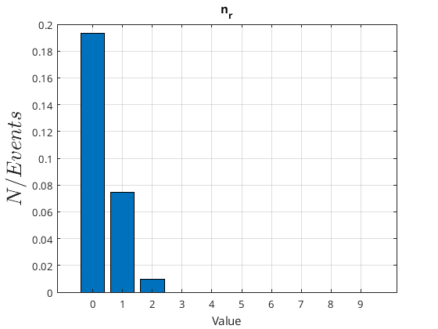
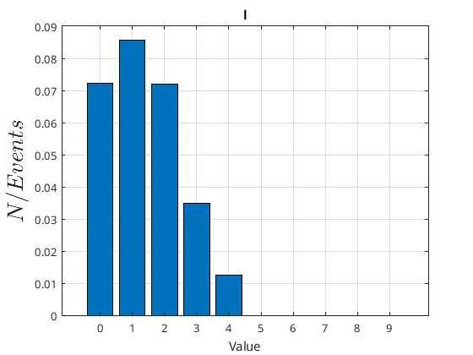
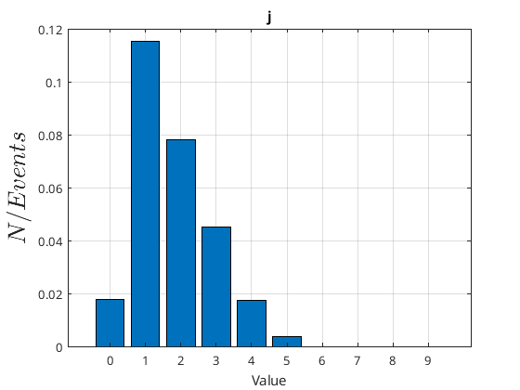

abundances of Resonances in REcombination
Use parton states from running PYTHIA 8 e+e- at 91 GeV
Hybrid Hadronization with $N=4$, no decays;
Spin treated statistically, color flow from PYTHIA.
Hadrons from recombination only
Radial
Orbital angular mom.
Total angular mom.

Slide 14
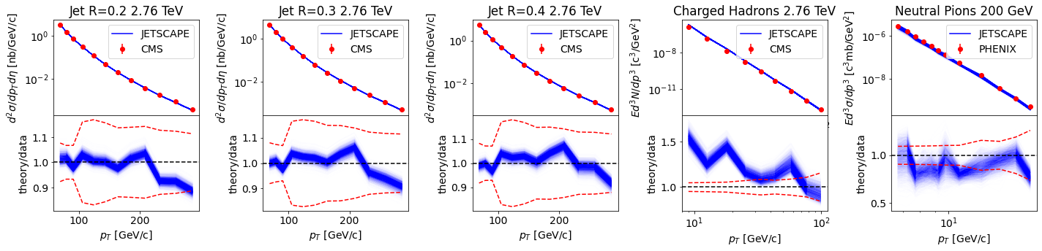
Vacuum Systems: p+p
Some Jet and High-PT observables
Preliminary
CMS: https://doi.org/10.17182/hepdata.77601
PHENIX: https://doi.org/10.48550/arXiv.0704.3599

Slide 15
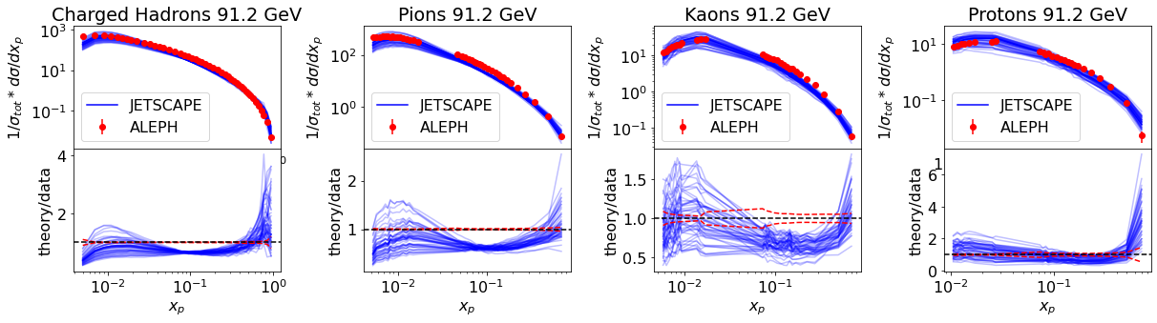
Vacuum Systems: e⁺e⁻
Bring in identified hadron data.
Global event variables like thrust are challenging.
Preliminary
ALEPH: https://doi.org/10.17182/hepdata.47582

Slide 16
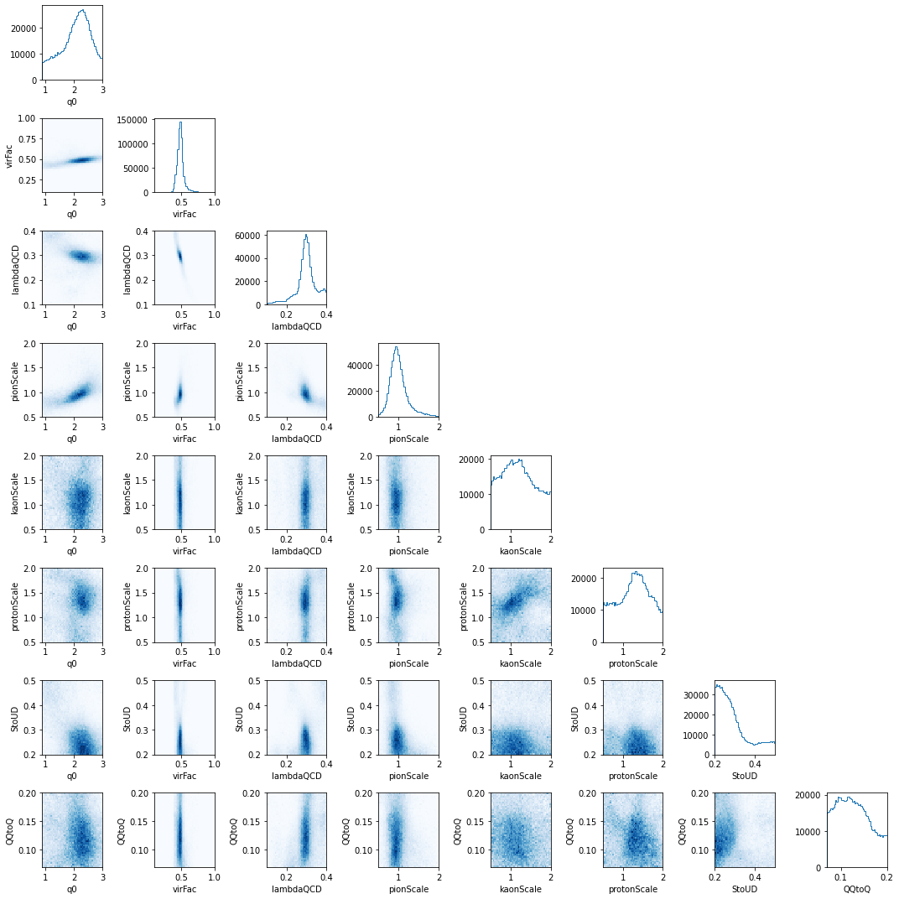


Bayes Calibration
$$Q_{0}$$
Calibrated Parameter Distributions
Hadronization always has to be tuned with a parton event generator.
Here: MATTER as the parton shower generator
Bayes calibration ongoing, using a blend of PYTHIA, HH and MATTER parameters.
Virtuality factor
$$λ_{QCD}$$
Pion scale
Preliminary
Kaon scale
Proton scale
S/UD
QQ/Q

Slide 17
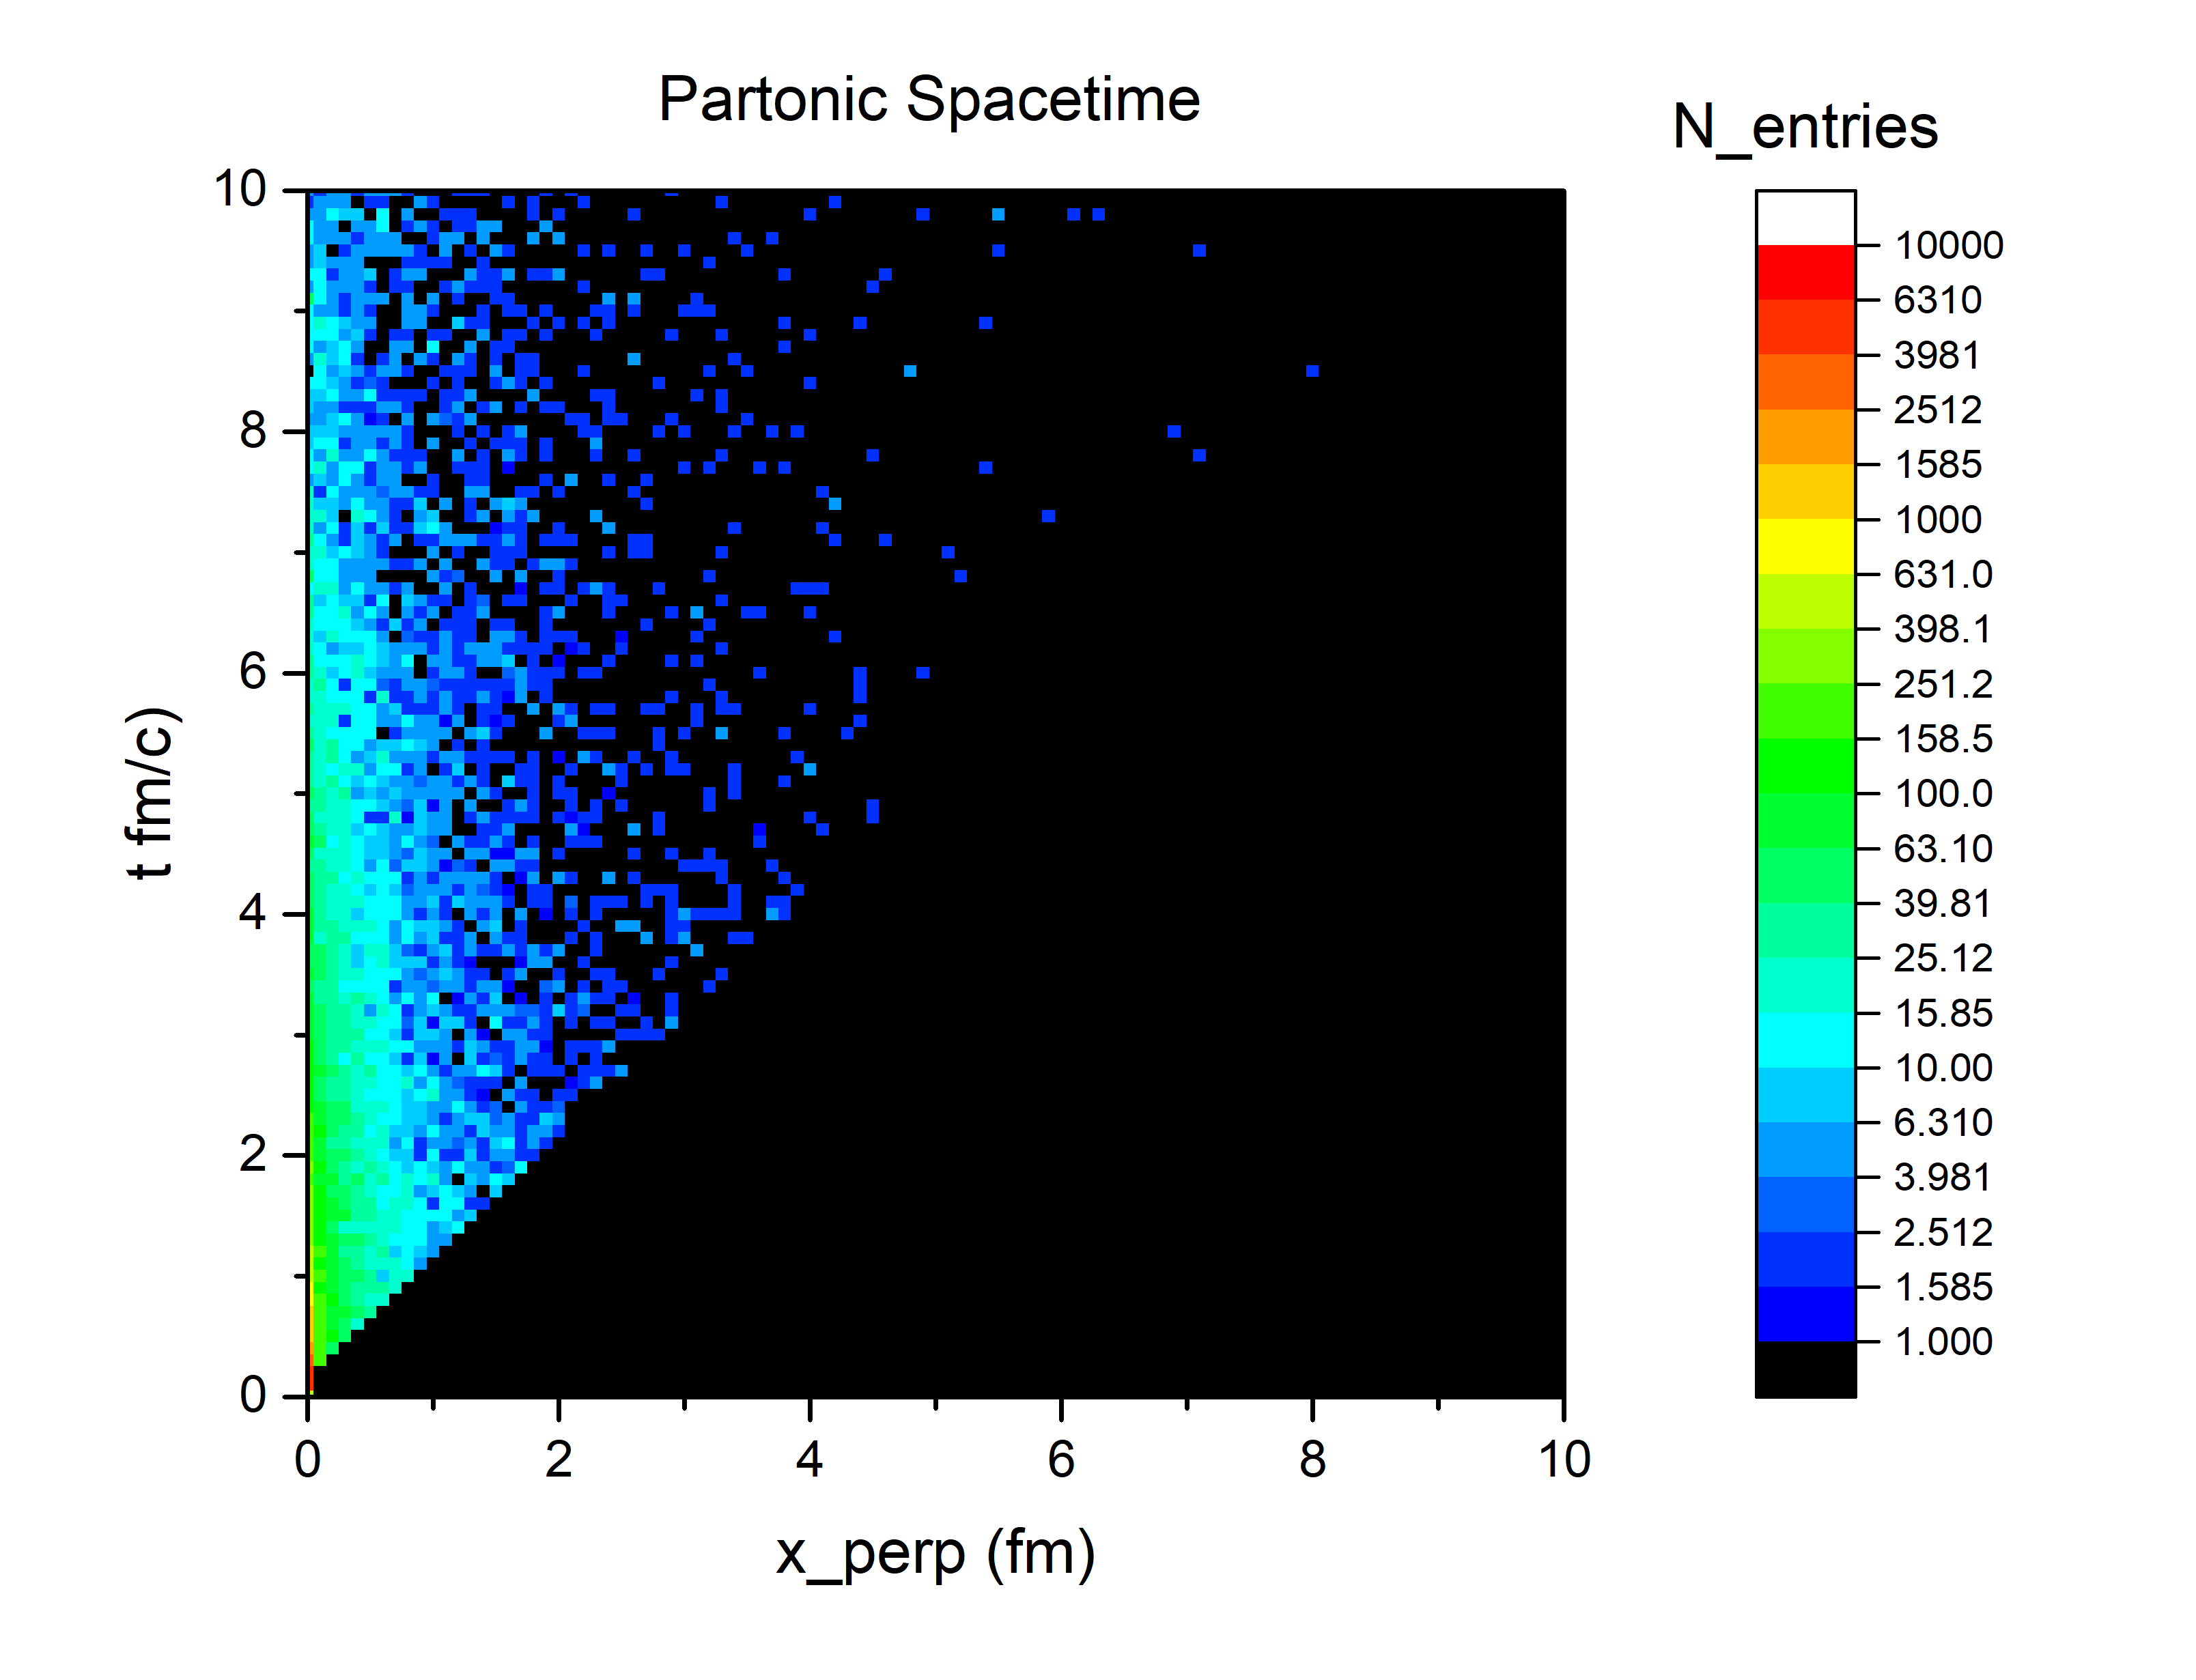
In-Medium Jets: SYSTEMATICS
Analysis of jets in in nuclear media of varying size and flow
Example: JETSCAPE:MATTER+LBT
Sampled spatial positions of shower partons after shower evolution for 100 GeV jets (arb. normalization)
100 GeV vacuum jet
Time since jet was created
Direction transverse to the jet

Slide 18
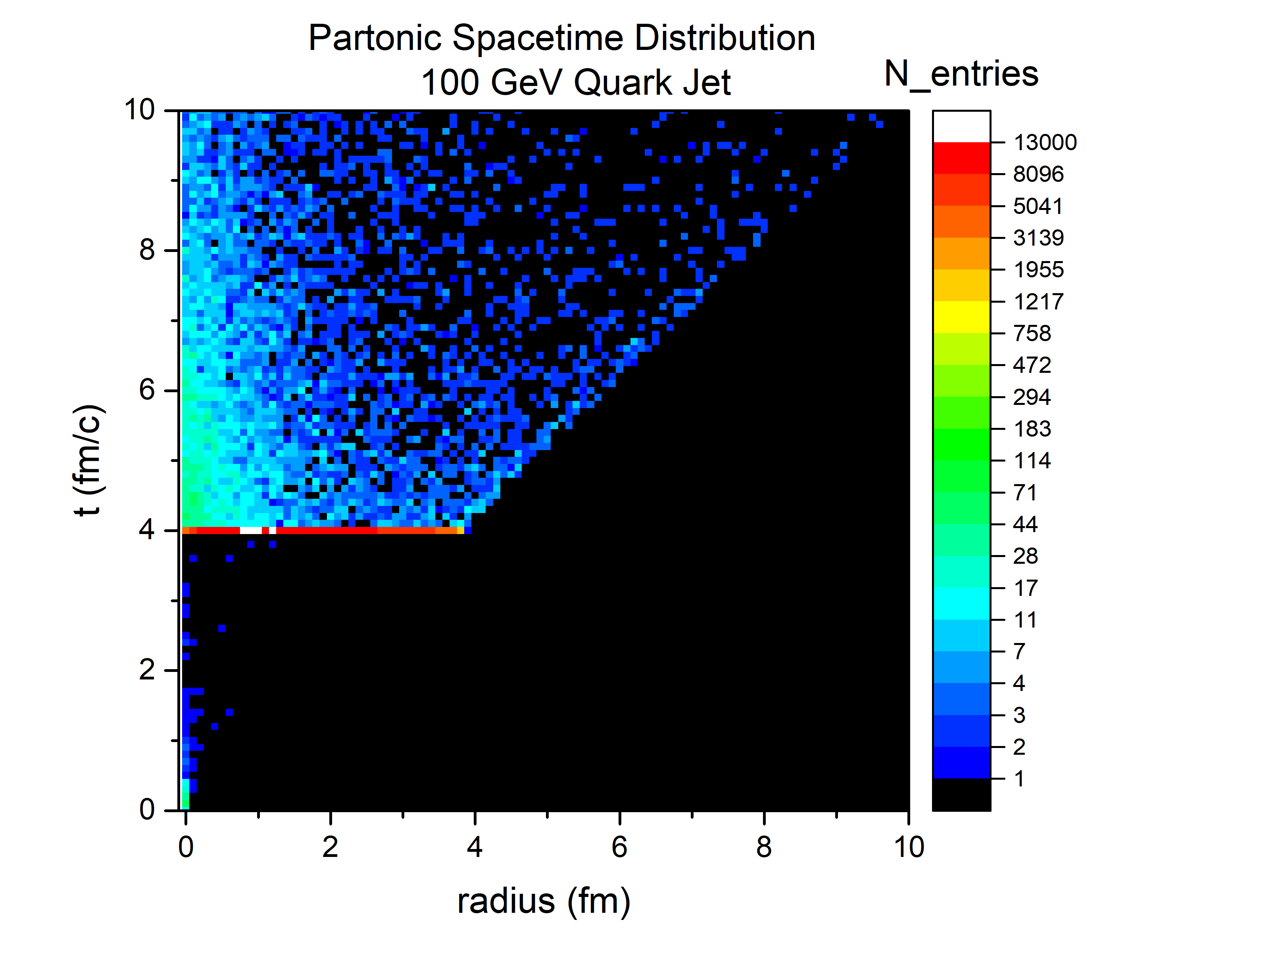

In-Medium Jets: SYSTEMATICS
Analysis of jets in in nuclear media of varying size and flow
Example: JETSCAPE:MATTER+LBT
Sampled spatial positions of shower partons after shower evolution for 100 GeV jets (arb. normalization)
The cores of 100 GeV jets punch through 4 fm of QGP
Time since jet was created
Shower partons inside QGP are absorbed by the medium or accumulate on the hypersurface;
color is randomized
QGP Medium
The jet starts in QGP; the temperature is set to drop below $T_{c}$ after 4 fm/c
Direction transverse to the jet

Slide 19
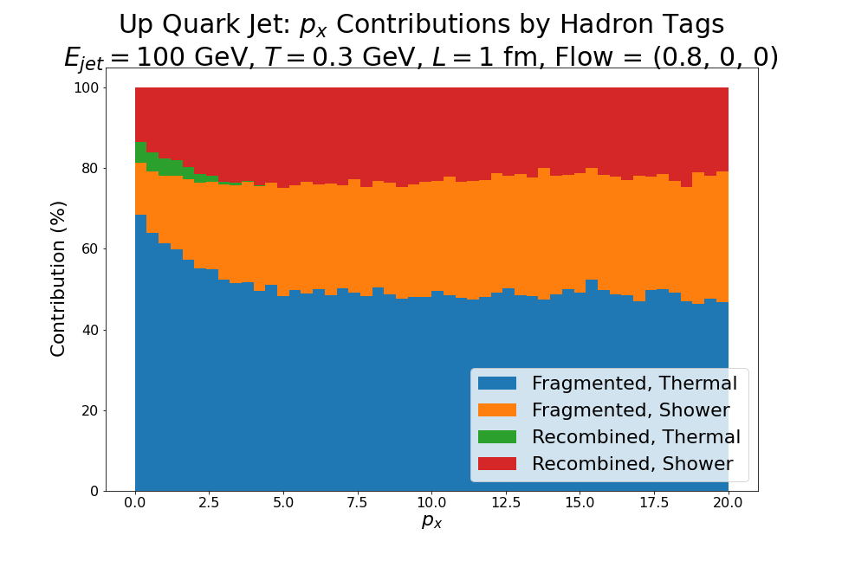
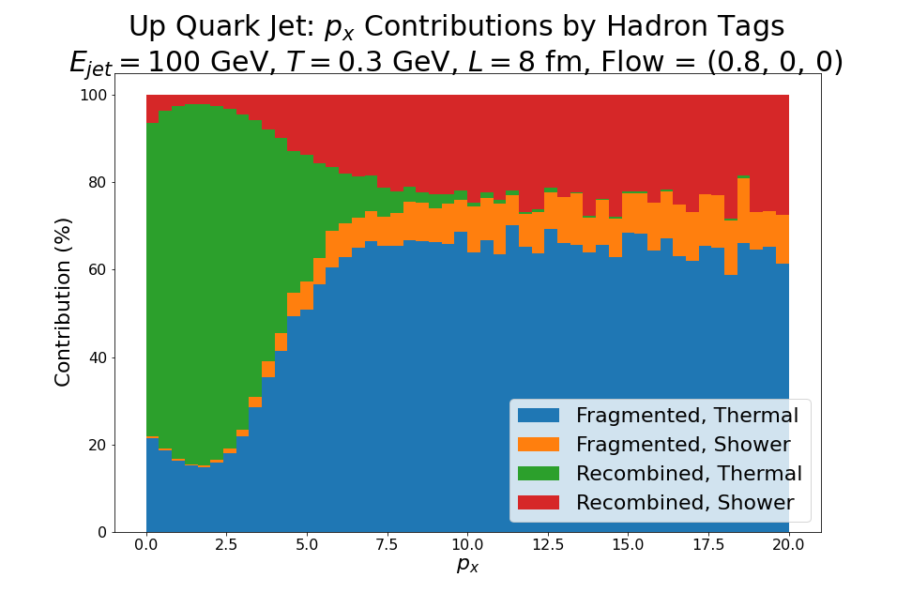
In-Medium Jets: Role of Thermal Partons
Thermal parton contribution grows with medium size.

Slide 20
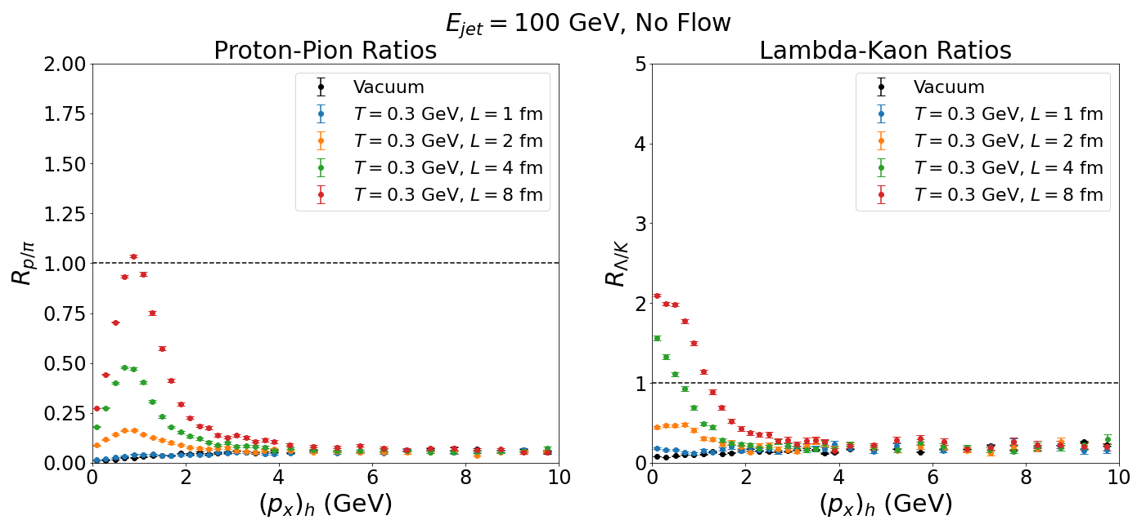
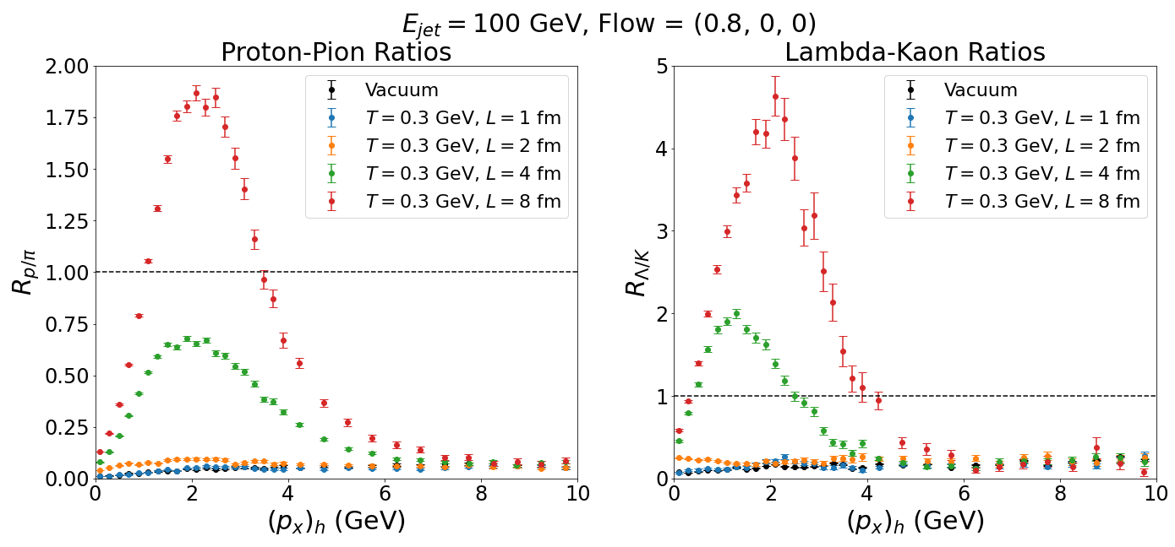
In-Medium Jets: Baryon enhancement
We recover a key signature of quark recombination: baryon/meson enhancement in a medium
Hadronization is sensitive to medium flow.

Slide 21
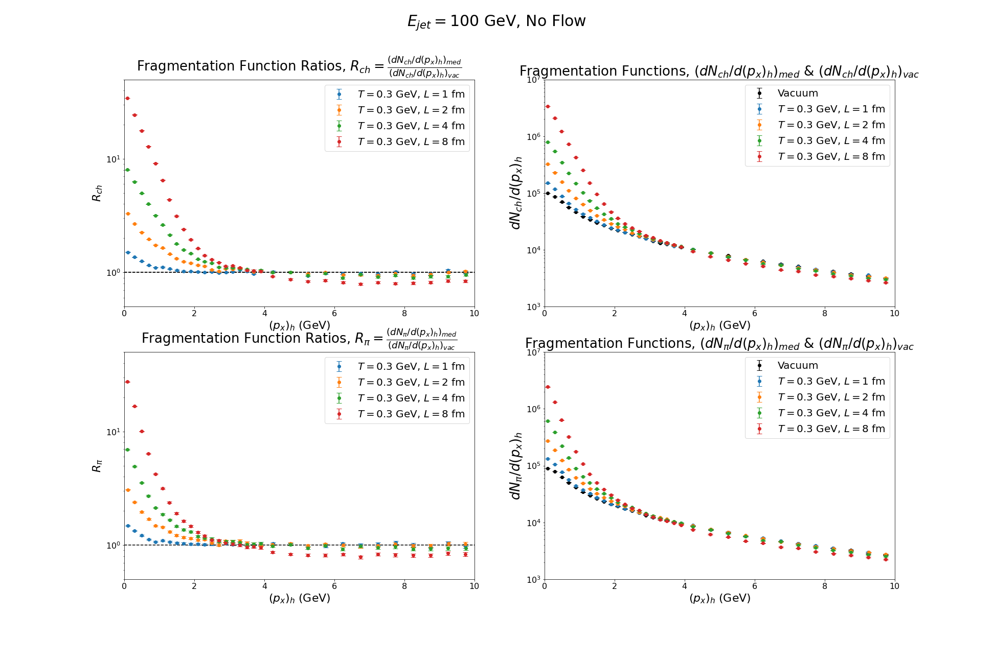
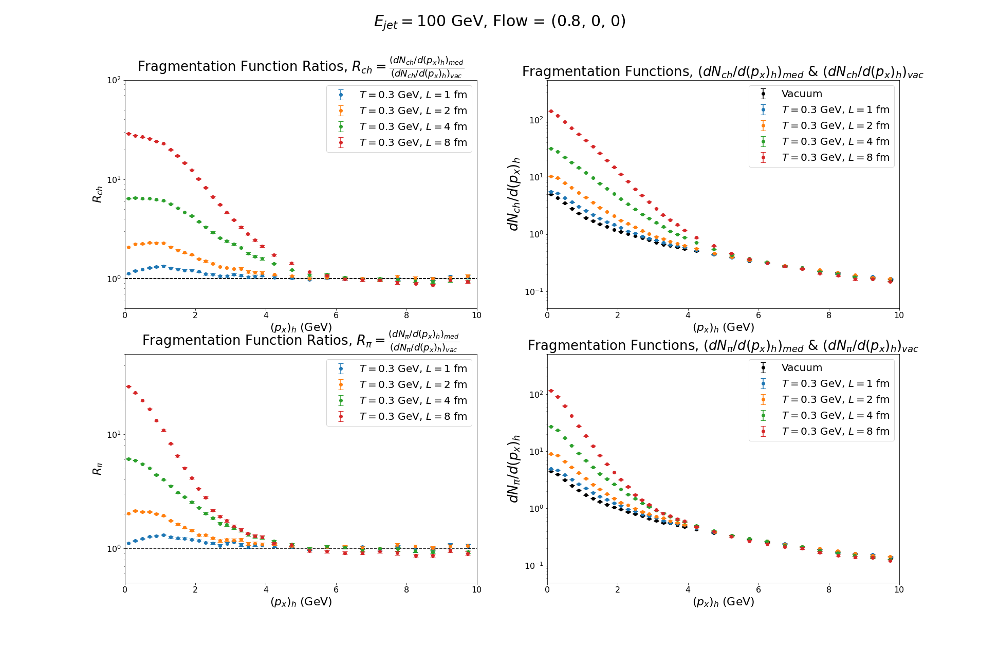
In-Medium Jets: Flow Signals
Correlation of soft partons with the jet increases with medium size.
Hadronization is sensitive to medium flow.

Slide 22
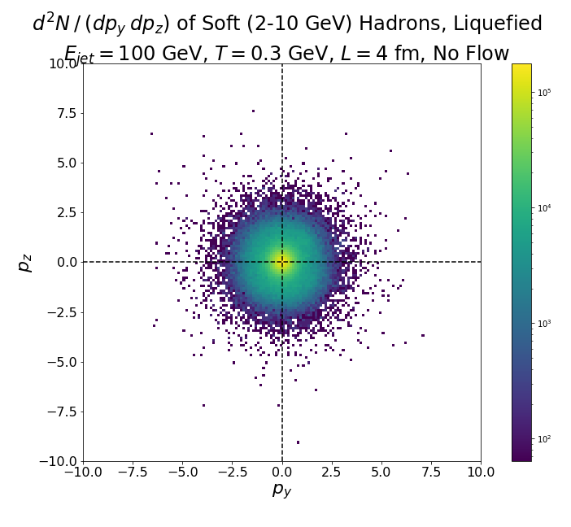
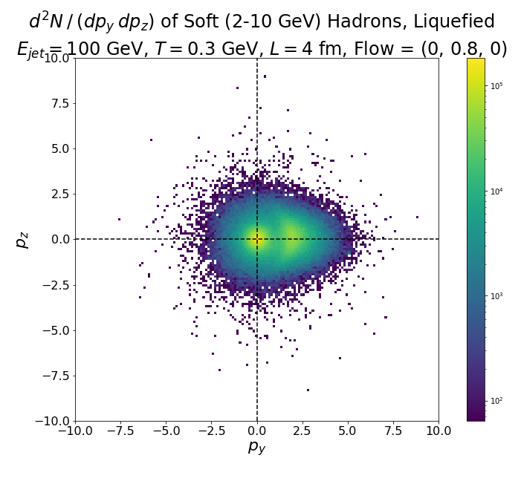
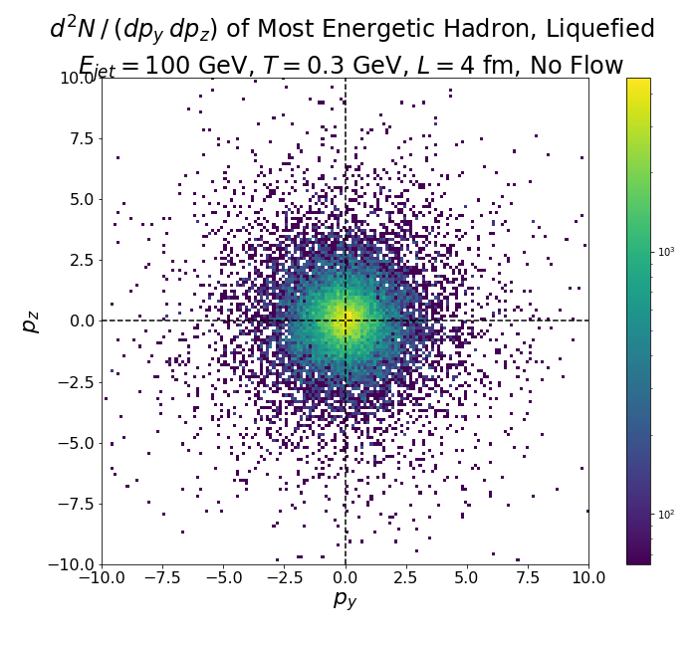
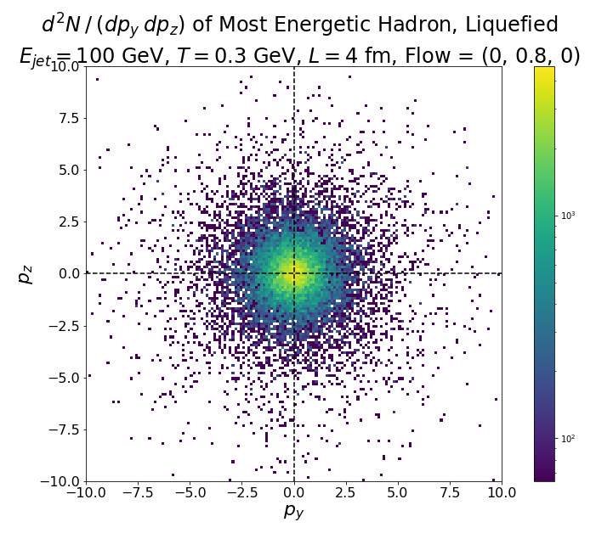


In-Medium Jets: Flow Transverse to the jet
Medium flow transverse to the jets can be picked up by hadrons associated with the jet.
Only releveant for low and intermediate momenta.
$$v_{med}=0.8c\hat{y}$$
$$v_{med}=0.8c\hat{y}$$

Slide 23
Preview: hadronic Phase for Hard Probes
JETSCAPE will add the capability to send hard and soft hadrons both to the hadronic afterburner.
Follow up to pion gas study by Dorau et al. Phys.Rev.C 101, 035208 (2020)
Teaser: e+e- baseline results with and without rescattering. We don’t expect a large effect or no effect at all. p+p and A+A forthcoming.
Preliminary

Slide 24

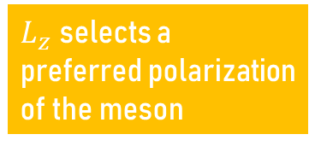


Preview: Polarization
$P_{011}=e^{−v}\left(\frac{1}{2}v_{T}+\frac{L_{z}}{2ℏ}\right)$
$P_{011}=e^{−v}v_{L}$
$P_{01 −1}=e^{−v}\left(\frac{1}{2}v_{T}−\frac{L_{z}}{2ℏ}\right)$
What if we don’t sum over magnetic quantum numbers and ask for the polarization of the meson?
Probabilities are sensitive to the angular momentum component $L_{z}$.
Conclusion: if the collective motion of the quarks at carries net orbital angular momentum, hadronization can give you correspondingly polarized $p$- and $d$-wave mesons.
$L_{z}$ selects a preferred polarization of the meson
$v_{T}$, $v_{L}$: squared phase space distance perpendicular and parallel to the quantization axis.

Slide 25
summary
Hybrid Hadronization is an attempt to model hadronization consistently from very small to very large systems
Recombination in Wigner formalism + string fragmentation
Vacuum systems (e+e-, pp) computed with HH in JETSCAPE look reasonable; tuning ongoing
Clear medium effects: baryon enhancement and manifestation of flow
Hadronic rescattering study for hard probes
Novel polarization effects from orbital angular motion of quarks?

Slide 26
Backup

Slide 27
JETS in Hybrid Hadronization
Decay gluons provisionally into qqbar pairs (gluons whose quarks don’t recombine are later reformed)
Go through all possible quark pairs/triplets, compute the recombination probability and sample it. Recombine the pair/triplet if successful.
Rejected partons again form acceptable string systems (only color singlets removed!)
Remnant strings are fragmented by PYTHIA 8.
Remnant strings from color flow
String Fragmentation

Slide 28
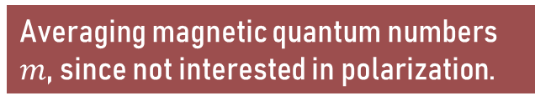
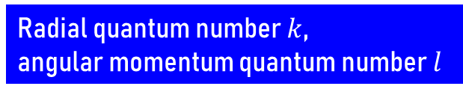
3d-Harmonic Oscillator in Phase space
Use the well-studied 1D-phase space distributions to build the 3D ones
The off-diagonal 1-D Wigner distributions are known [T. Curtright, T. Uematsu, C. K. Zachos, J. Math. Phys. 42 (2001)]
Three off-diagonal 1-D Wigner distributions
Radial quantum number $k$,
angular momentum quantum number $l$
Expansion coefficients for angular momentum eigenstates in terms of products of 1-D states
Averaging magnetic quantum numbers $m$, since not interested in polarization.

Slide 29

Excited Mesons and their decays
We include excited mesons up to $N=k+2l=4$.
Hybrid Hadronization uses PYTHIA 8 for decays: available excited states are limited, but the user can easily add more.
Many more resonances in the PDG -> add
Add as of yet unconfirmed bound states: extrapolate unknown properties.
PDG states
Unconfirmed states

