Slide 1
Exploring the sQGP with sPHENIX
presented at the
The International Workshop
"Exploring Quark-Gluon Plasma Through Soft and Hard Probes" Serbian Academy of Science and Arts, Belgrade, Serbia
May 31st, 2023
W.A. Zajc
Columbia University
with special thanks to Sebastian Tapia Araya, Anders Knospe, Weihu Ma, J. Nagle and all my sPHENIX colleagues
This work was supported by the United States Department of Energy Grant DOE-FG02-86ER-40281

Slide 2
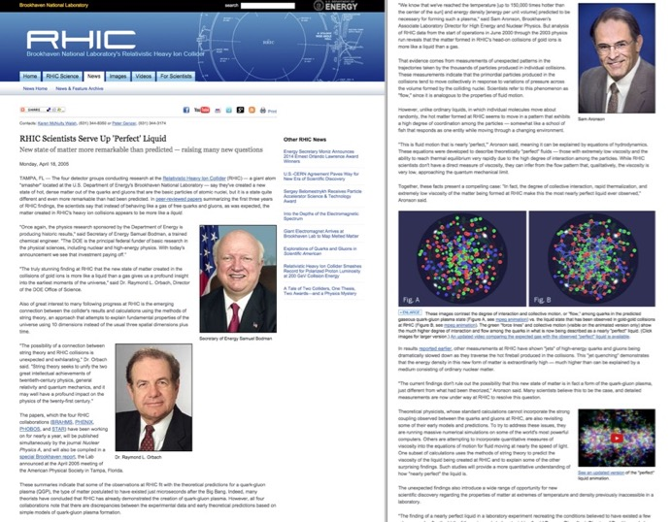
April 18, 2005

Slide 3

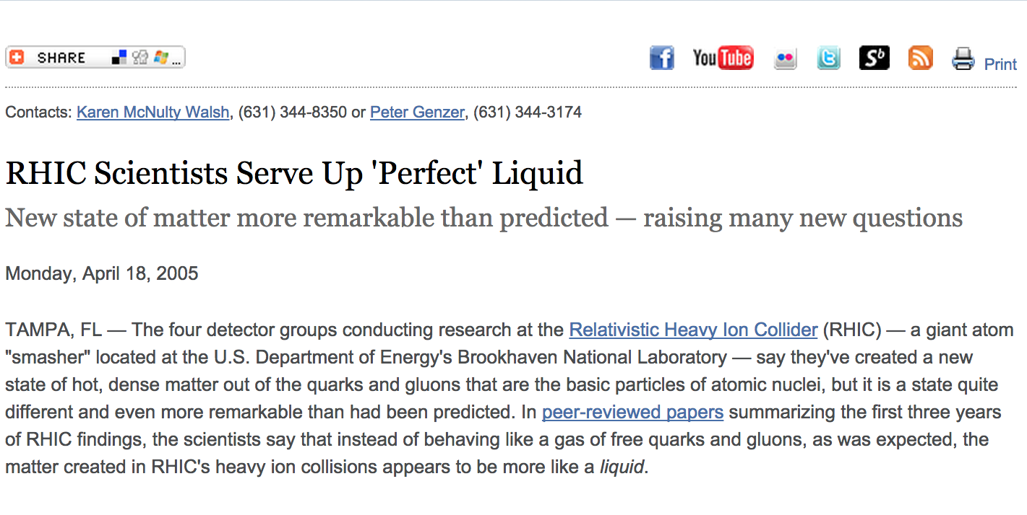
RHIC Scientists Serve Up ‘Perfect’ Liquid
… the scientists say that instead of behaving like a gas of free quarks and gluons, as was expected, the matter created in RHIC’s heavy ion collisions appears to be more like a liquid.

Slide 4
The Papers
Quark gluon plasma and color glass condensate at RHIC?
The Perspective from the BRAHMS experiment,
Nucl.Phys. A757 (2005) 1-27, nucl-ex/0410020
Formation of dense partonic matter in relativistic nucleus-nucleus collisions at RHIC: Experimental evaluation by the PHENIX collaboration,
Nucl.Phys. A757 (2005) 184-283, nucl-ex/0410003
The PHOBOS perspective on discoveries at RHIC,
Nucl.Phys. A757 (2005) 28-101, nucl-ex/0410022
Experimental and theoretical challenges in the search for the
quark gluon plasma: The STAR Collaboration's critical assessment
of the evidence from RHIC collisions,
Nucl.Phys. A757 (2005) 102-183, nucl-ex/0501009

Slide 5
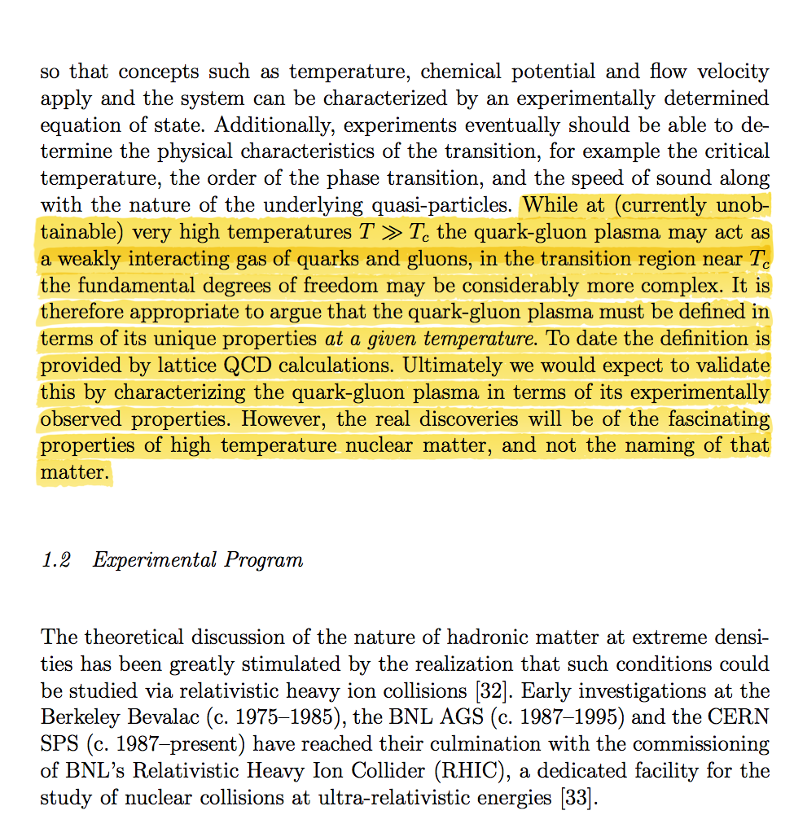
Addressing the nature of QGP discovery
From the PHENIX “White Paper”
nucl-ex/0410003
(4600+ citations)
Q: What is the most
relevant
“experimentally
observed property”?
A. Viscosity
(suitably normalized)

Slide 6
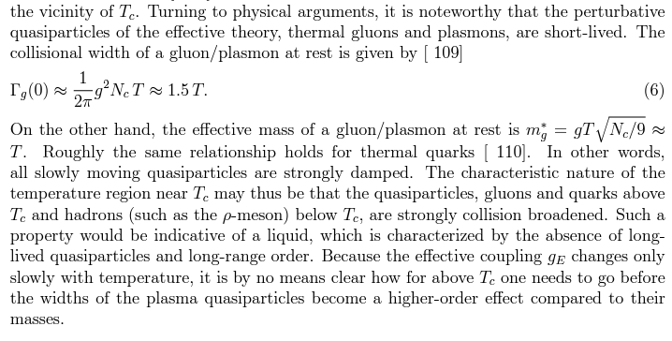
Also in 2005
6
Berndt Müller’s Quark Matter 2005 Theoretical Summary:
arXiv:nucl-th/0508062

Slide 7
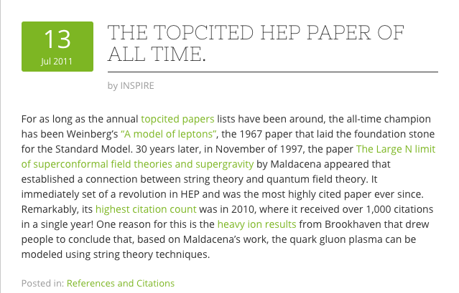
2011 - A Nice Surprise
7

Slide 8
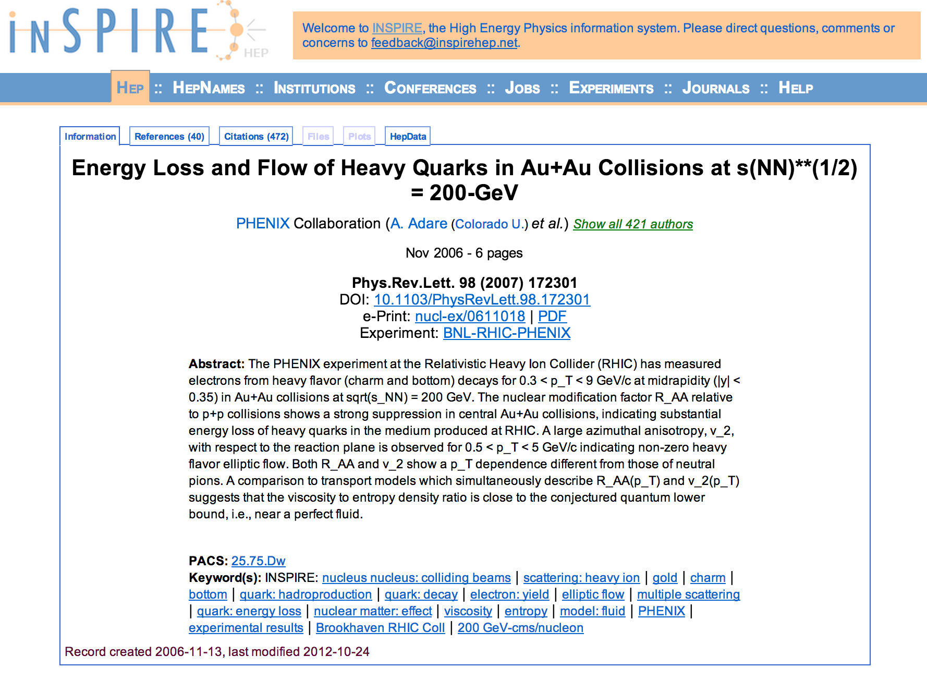
First RHIC Experimental Paper Quantifying η/s

Slide 9
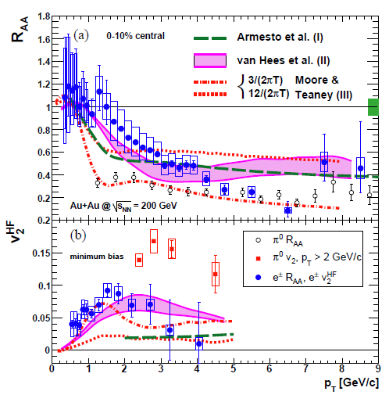
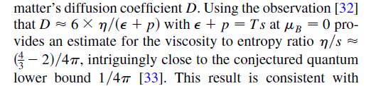
2006 - The Real Surprise
Heavy quark
  Energy loss
  Flow
along with

Slide 10
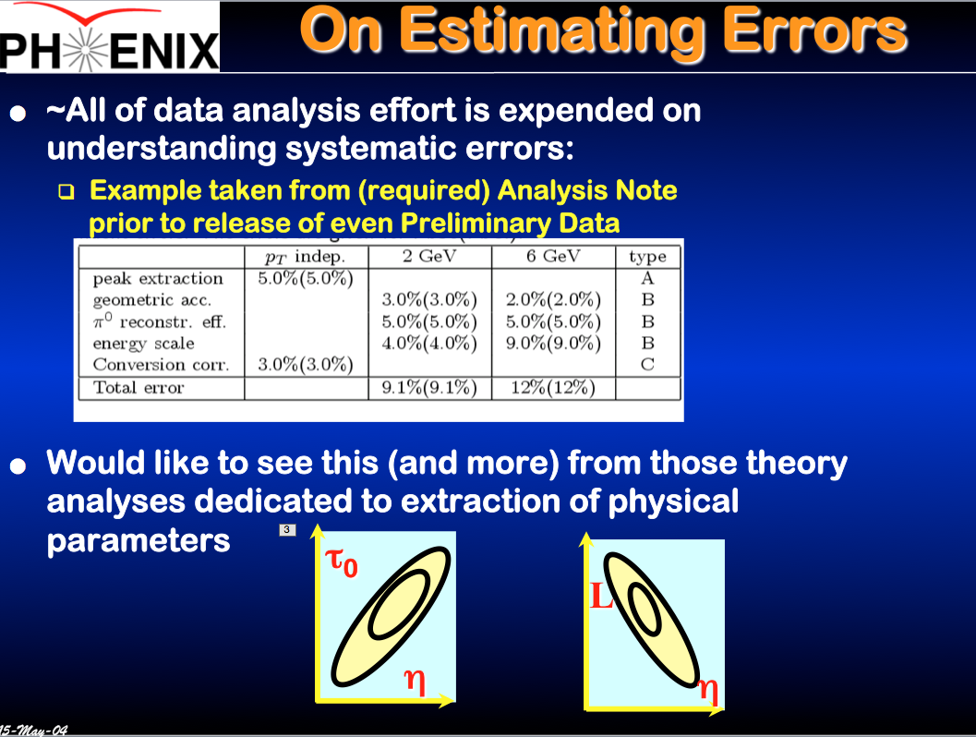
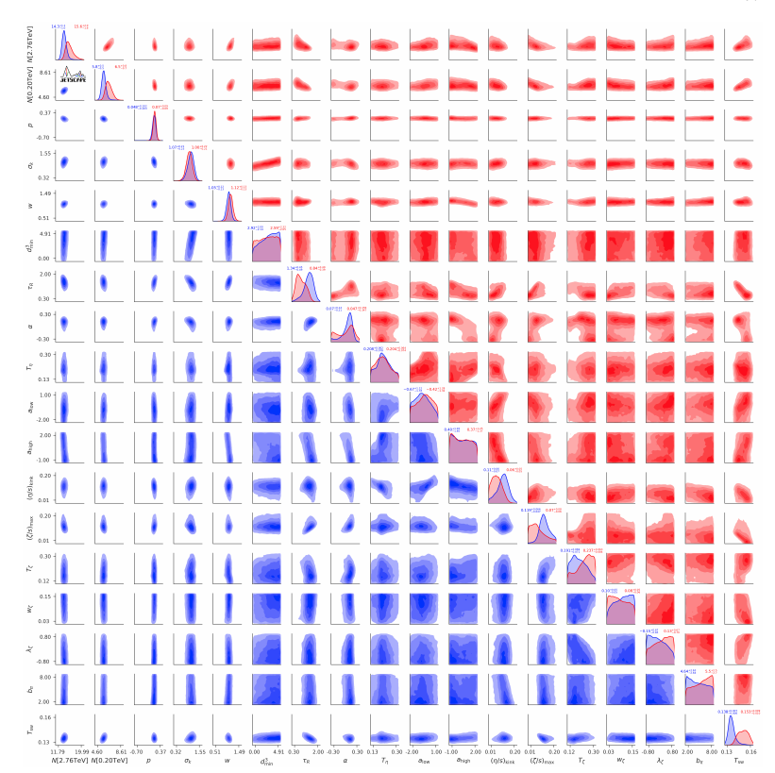
2004 → 2020
Extraordinary progress !
Essential feature: open source code
JETSCAPE, Multi-system Bayesian constraints on the transport coefficients of QCD matter, 2011.01430
Leadership by
Scott Pratt
Steffen Bass
Abhijit Majumder
→

Slide 11
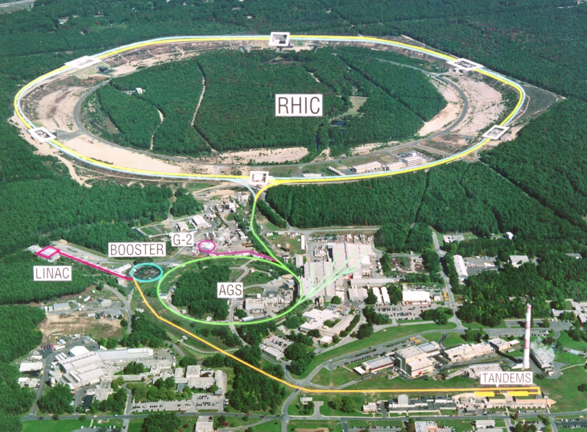
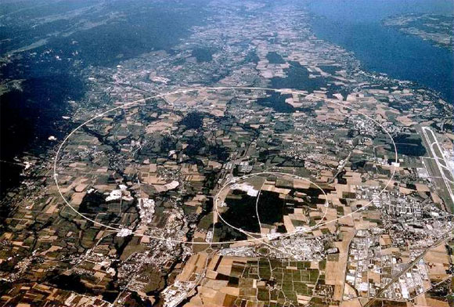
Two Facilities
RHIC
LHC
First collisions 2000
p+p, d+Au, ³He+Au, Zr+Zr, Ru+Ru, Cu+Cu, Cu+Au, Au+Au, U+U
√s_{NN} ~ 7–200 GeV
Polarized protons
First collisions 2010
p+p, Pb+Pb, p+Pb
√s_{NN} =2.76 TeV, 5.5 TeV

Slide 12
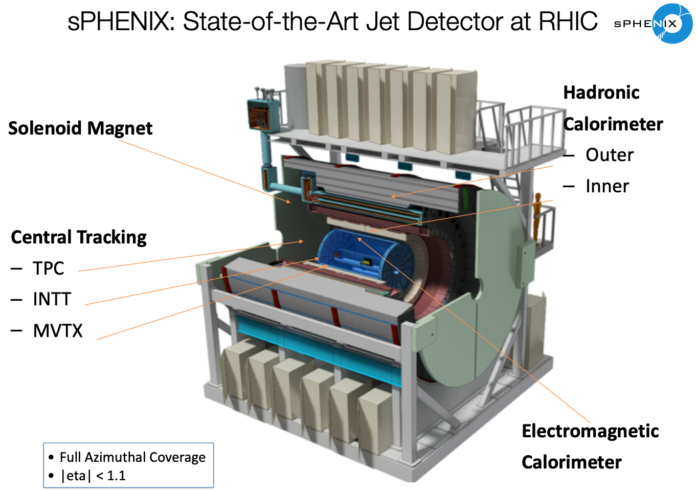
sPHENIX – The Next Step
Open question:
How do
asymptotically free
quarks and gluons
conspire to form
the world’s most
perfect fluid?
To answer:
Probe it on the smallest
possible length scales
with jets and heavy flavor.

Slide 13
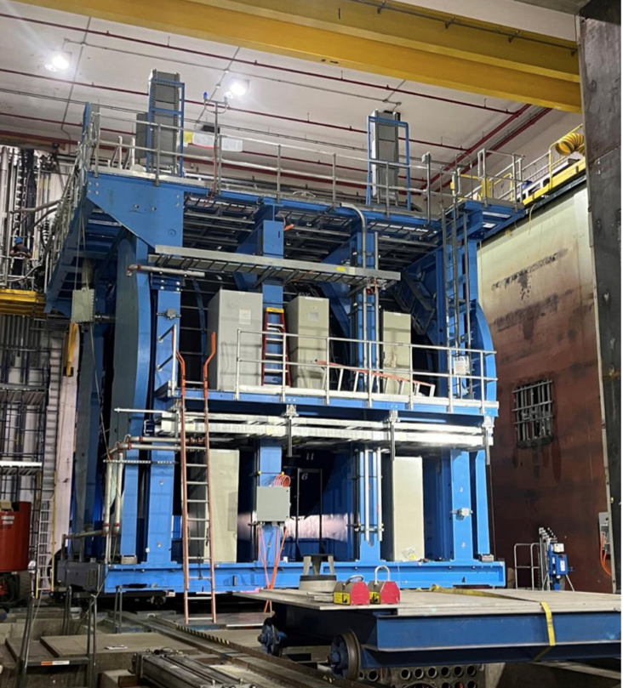
sPHENIX – The Next Step
Open question:
How do
asymptotically free
quarks and gluons
conspire to form
the world’s most
perfect fluid?
To answer:
Probe it on the smallest
possible length scales
with jets and heavy flavor.

Slide 14

sPHENIX – The Next Step
Open question:
How do
asymptotically free
quarks and gluons
conspire to form
the world’s most
perfect fluid?
To answer:
Probe it on the smallest
possible length scales
with jets and heavy flavor.

Slide 15

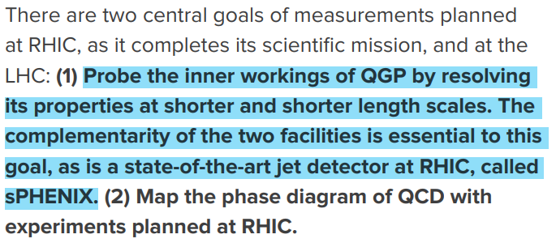
sPHENIX Science Mission
sPHENIX will be the first new collider detector in over twenty years (!)
performing very high precision studies of jet production, jet substructure and open and hidden heavy flavor over an unprecedented kinematic range at RHIC ;
distinguished by high rate capability and large acceptance, combined with high precision tracking and electromagnetic and hadronic calorimetry.

Slide 16
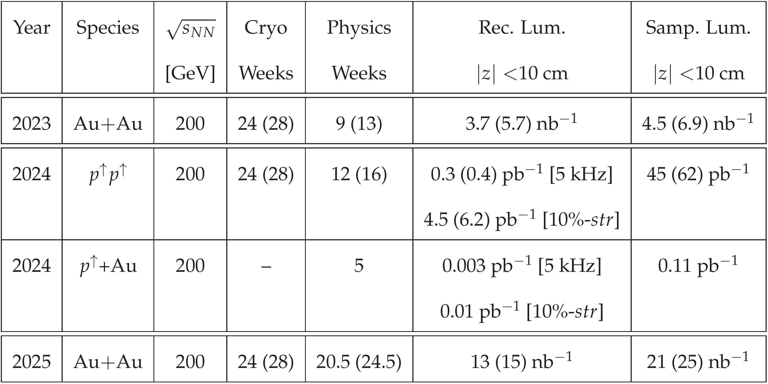
Run Schedule
sPHENIX scientific program consists of 3 years of running:
2023: Au+Au
Commissioning & Calibration, standard candle measurements,
first sPHENIX physics
2024: p+p & p+Au
Reference measurements for heavy ions, cold QCD
2025: Au+Au
(high statistics)

Slide 17
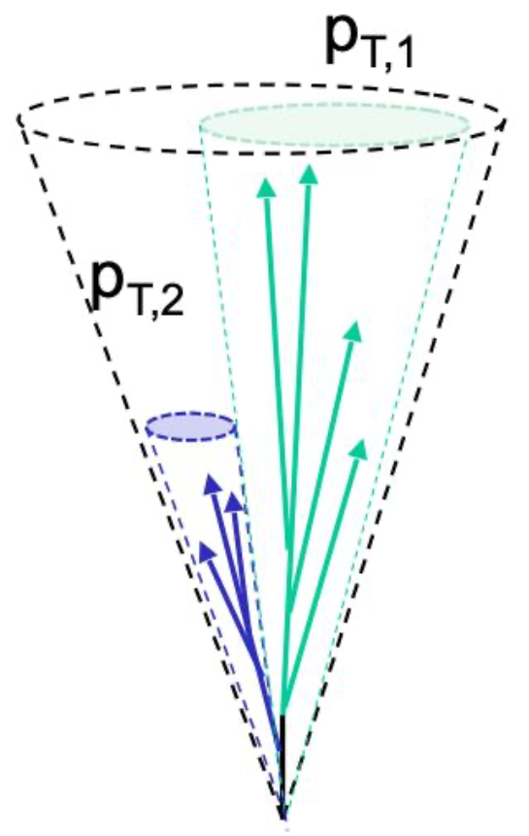
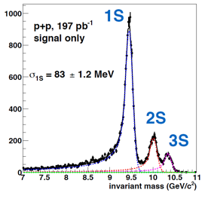
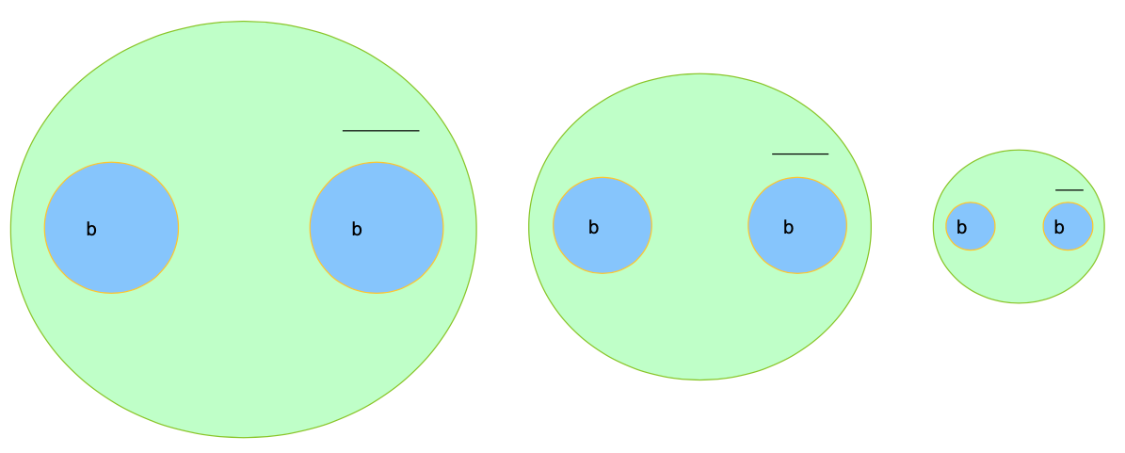
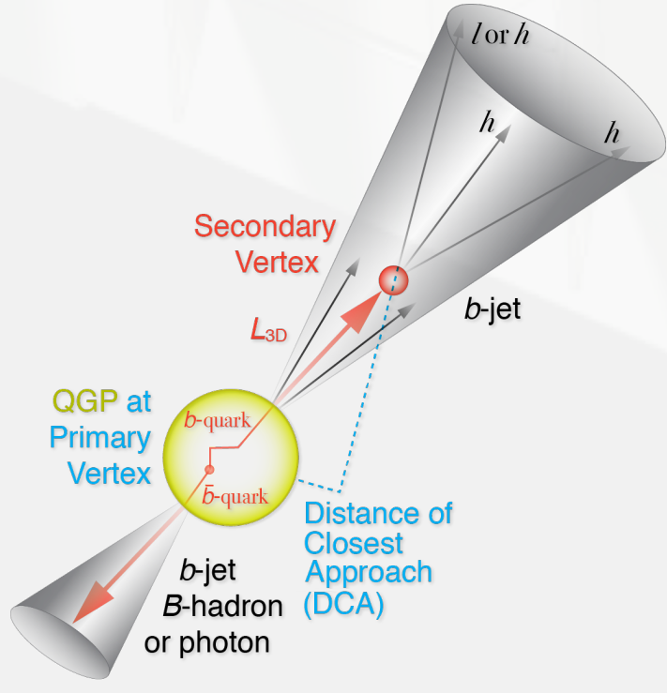


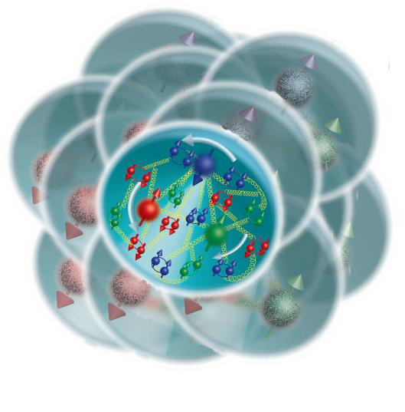
The Core sPHENIX Physics Program
Υ(1s) 0.28fm
Y(3s) 0.78fm
Υ(2s) 0.56fm
vary momentum & angular scale of probe
vary size of probe
Jet physics
Quarkonium spectroscopy
u,d,s
Cold QCD
Parton energy loss
c
vary temperature of QCD matter
vary mass & momentum of probe
study proton spin,
transverse-momentum,
and cold nuclear effects
photon
gluon
b
17

Slide 18
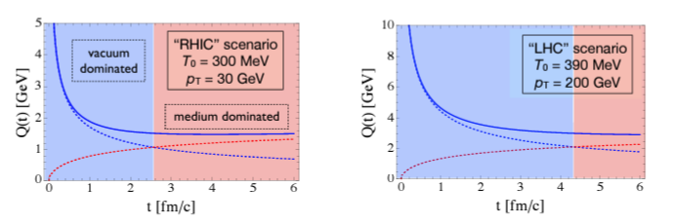
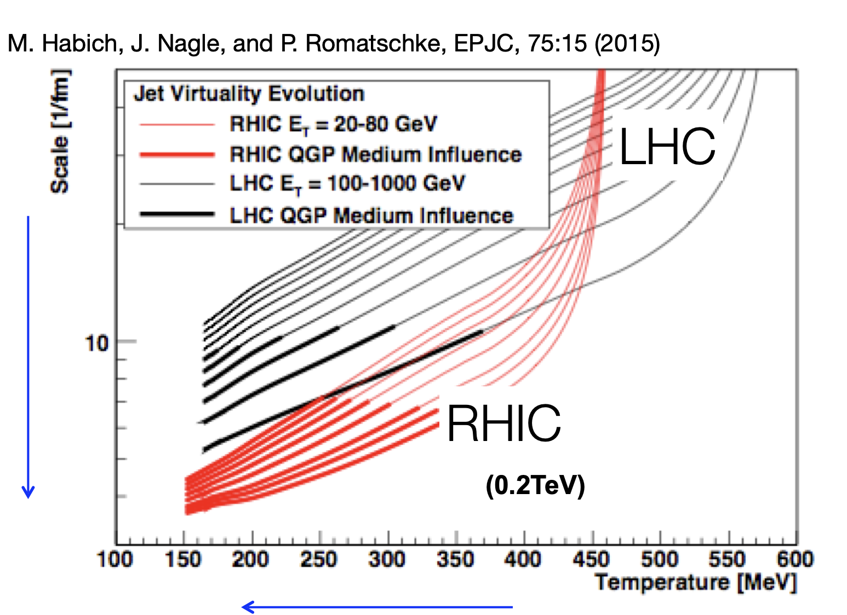
The sPHENIX raison d’être
From the sPHENIX proposal arXiv:1501.06197:
Spanning the largest possible range of virtuality (initial hard process Q²) is very important, but complementary measurements at both RHIC and LHC of produced jets at the same virtuality (around 50 GeV) will test the interplay between the vacuum shower and medium scattering contributions . . .
It is notable that highest energy partons at the LHC, of order 1 TeV, are always dominated by the initial vacuum virtuality evolution (for more than 10 fm/c). In contrast, the lower energy jets and the RHIC medium evolution have the largest influence and map out a unique part of the microscope resolving power and temperature of the quark-gluon plasma.

Slide 19
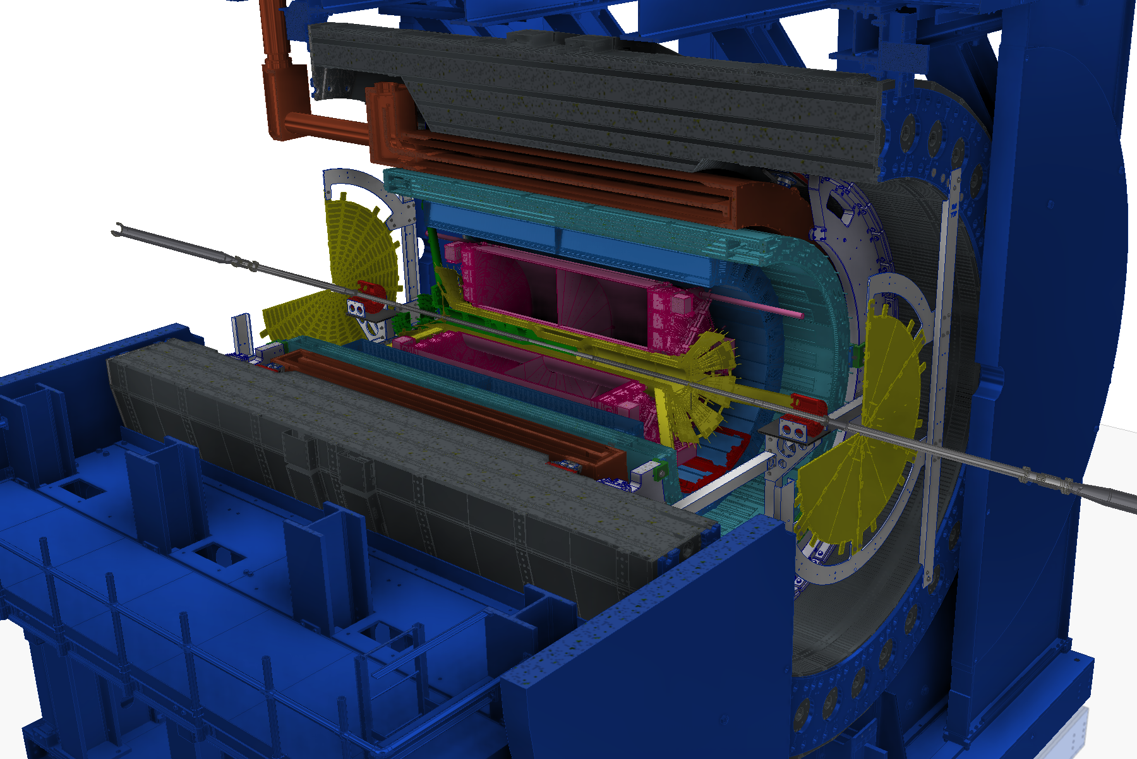
sPHENIX Detector

Slide 20
sPHENIX Detector
MAGNET
Barrel Detectors: |η | < 1.1

Slide 21
sPHENIX Detector
MVTX
MAGNET
INTT
Barrel Detectors: |η | < 1.1
Precision Tracking
TPC
TPOT

Slide 22
sPHENIX Detector
oHCAL
MVTX
MAGNET
INTT
iHCAL
EMCAL
Barrel Detectors: |η | < 1.1
Precision Tracking
Full Hadronic Calorimetry
TPC
TPOT

Slide 23
sPHENIX Detector
oHCAL
MVTX
MAGNET
INTT
iHCAL
EMCAL
sEPD
Barrel Detectors: |η | < 1.1
Precision Tracking
Full Hadronic Calorimetry
MinBIAS
TPC
TPOT

Slide 24
sPHENIX Detector
oHCAL
MVTX
MAGNET
INTT
iHCAL
EMCAL
sEPD
Barrel Detectors: |η | < 1.1
Precision Tracking
Full Hadronic Calorimetry
High Rate DAQ: 15 KHz
MinBIAS
TPC
TPOT

Slide 25
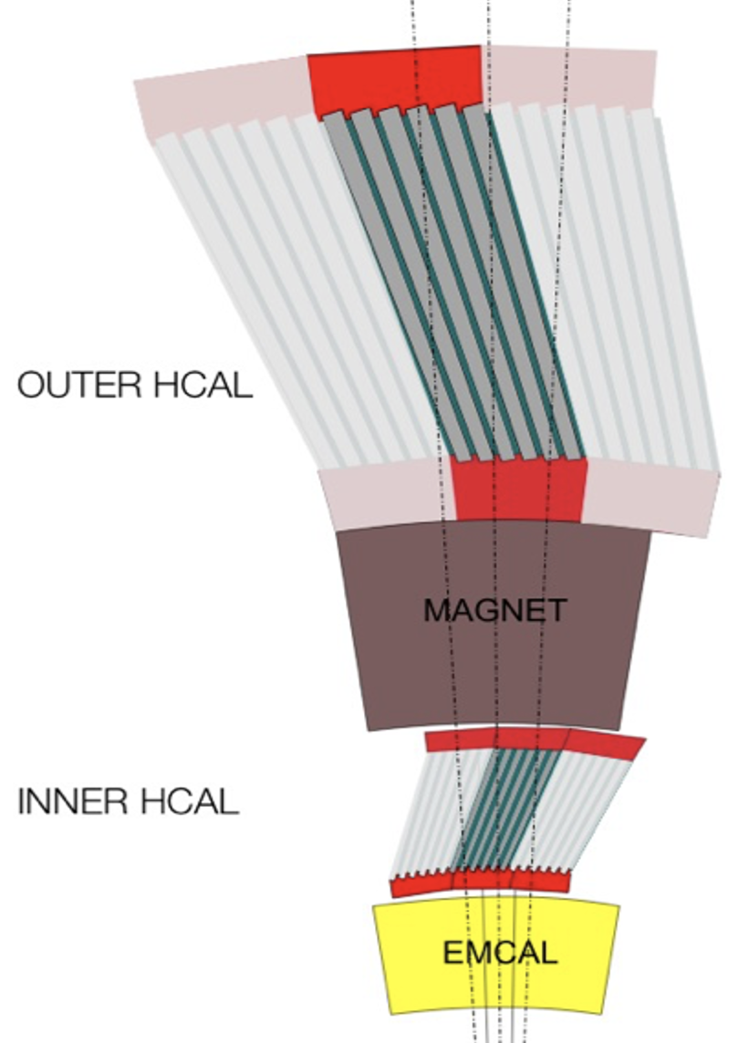

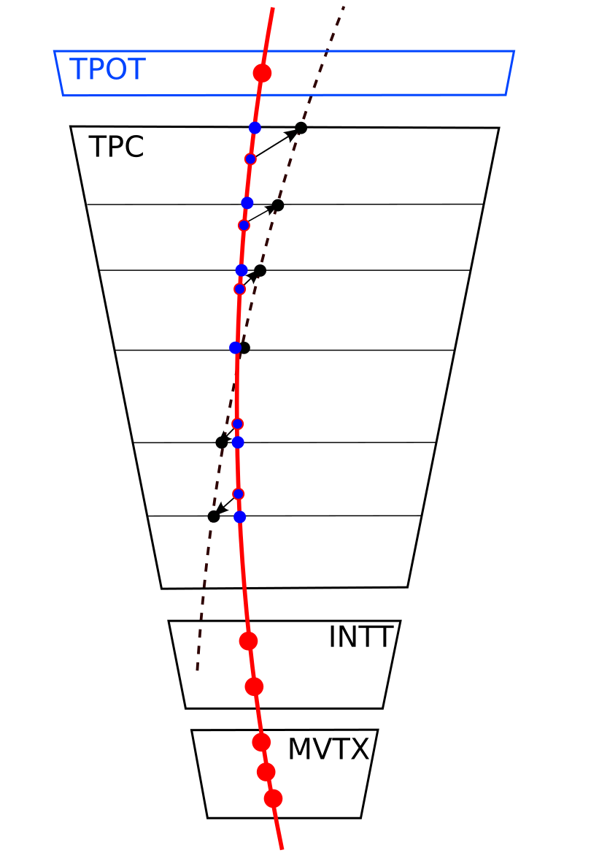
sPHENIX Detector
Calorimeter system
oHCAL
MVTX
MAGNET
INTT
oHCal
iHCAL
EMCAL
sEPD
iHCal
Barrel Detectors: |η | < 1.1
Precision Tracking
Full Hadronic Calorimetry
High Rate DAQ: 15 KHz
MinBIAS
TPC
TPOT
Tracking system

Slide 26
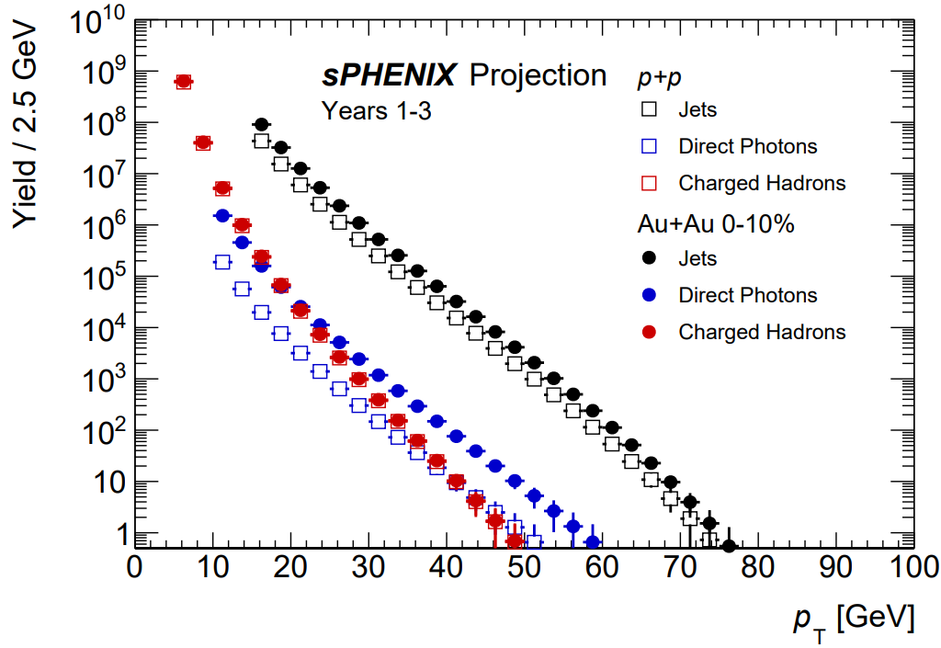
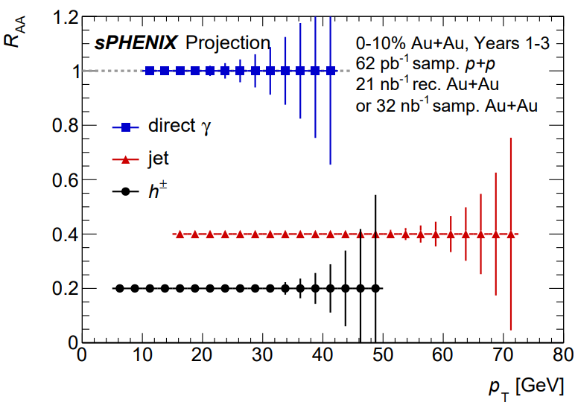
High-p_{T} Probes
Probing the QGP with precise jet, direct photon, and hadron measurements
High data rates & 2π EMCal+HCal offer wide p_{T} range for jet reconstruction.
sPHENIX can precisely measure the low p_{T} region, which is challenging at the LHC.
sPHENIX will have kinematic reach out to ∼70 GeV for jets, kinematic overlap with the LHC.
Notes:
Jet reconstruction was performed using a seeded iterative cone jet algorithm (extended version of ATLAS algorithm)

Slide 27
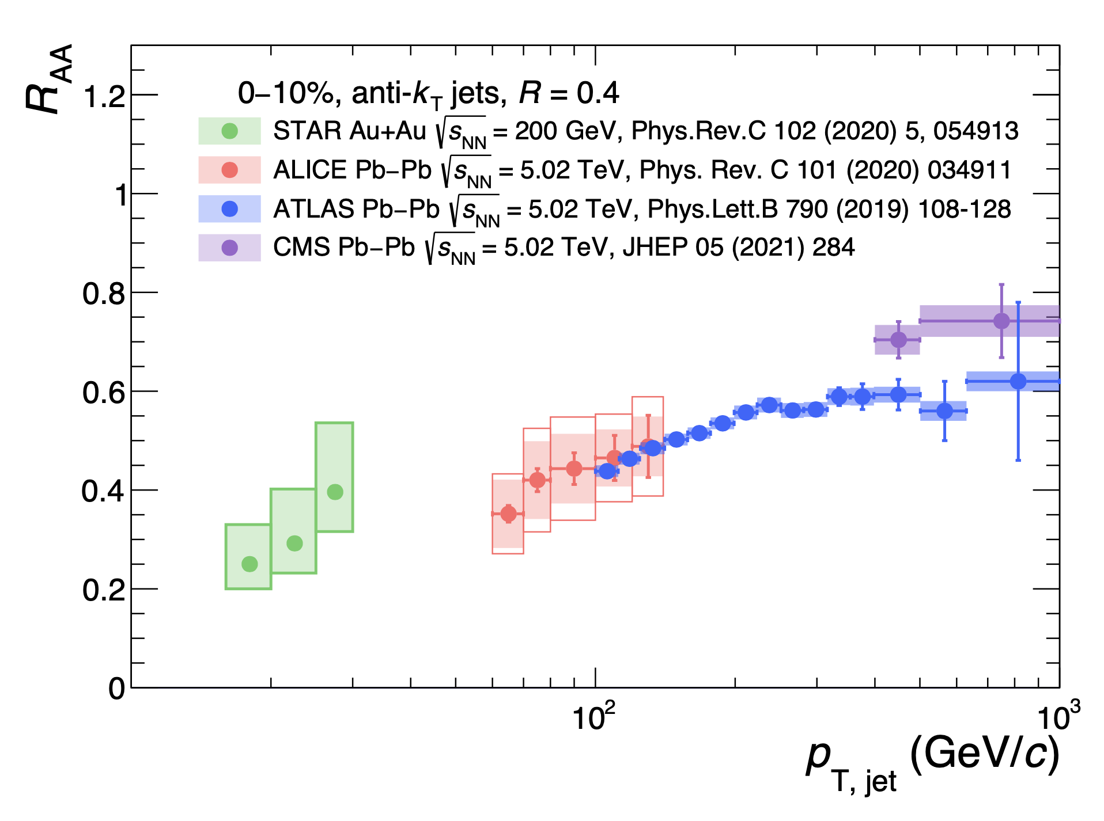
High-p_{T} Probes
Probing the QGP with precise jet, direct photon, and hadron measurements
H. Bossi; John Harris’s talk
High data rates & 2π EMCal+HCal offer wide p_{T} range for jet reconstruction.
sPHENIX can precisely measure the low p_{T} region, which is challenging at the LHC.
sPHENIX will have kinematic reach out to ∼70 GeV for jets, kinematic overlap with the LHC.
Notes:
Jet reconstruction was performed using a seeded iterative cone jet algorithm (extended version of ATLAS algorithm)

Slide 28
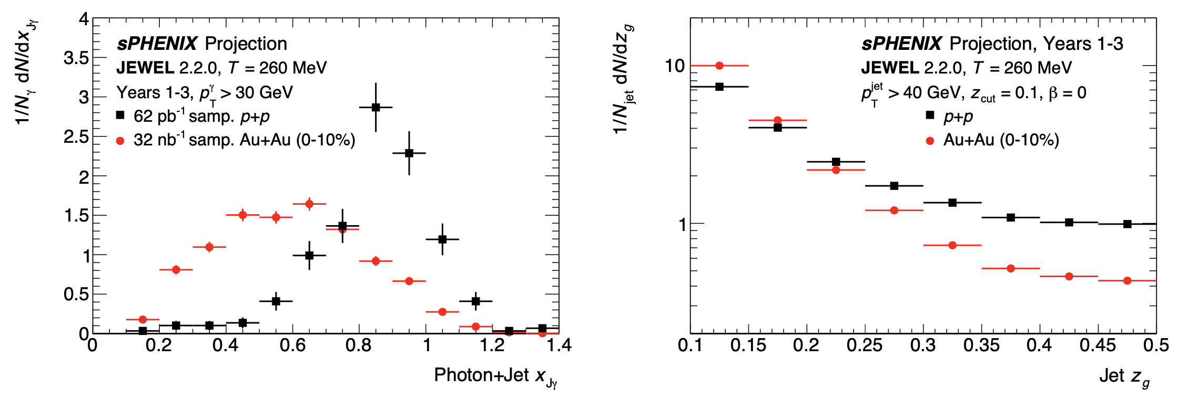
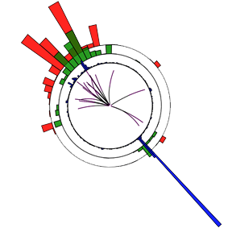
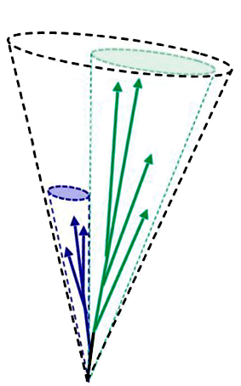


Jet Physics
Jet
p_{T,1}
p_{T,2}
Jet-to-photon momentum balance
Groomed momentum fraction
Photon
sPHENIX G4 simulation
Pythia8, 35 GeV γ+jet event
Jet substructure measurements enabled by fine segmentation of calorimeter + good tracking resolution.
Providing a glimpse into fundamental splittings at parton level.
A “flagship” measurement.
Photon+jet measurements with high statistics.
A direct measure of the jet energy loss.

Slide 29
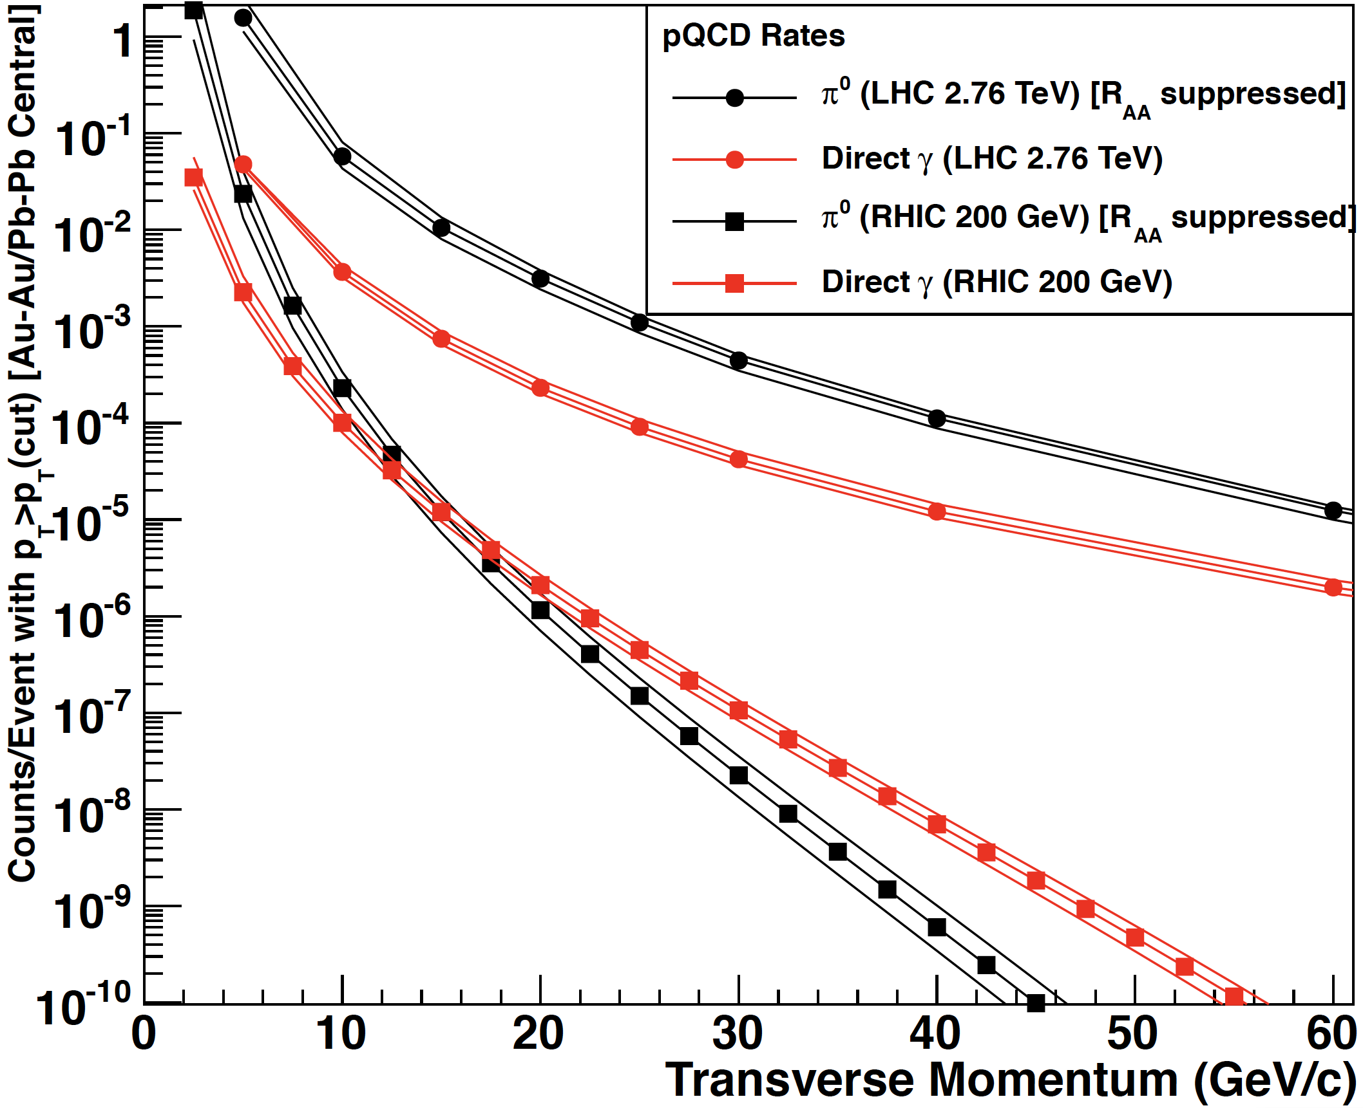
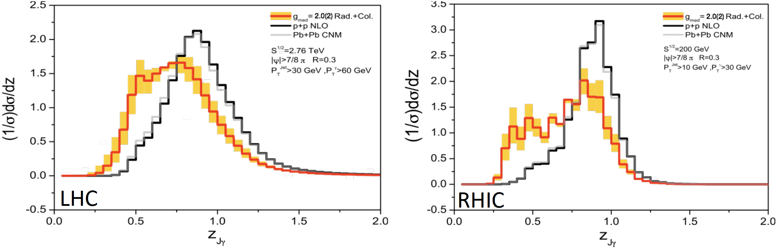
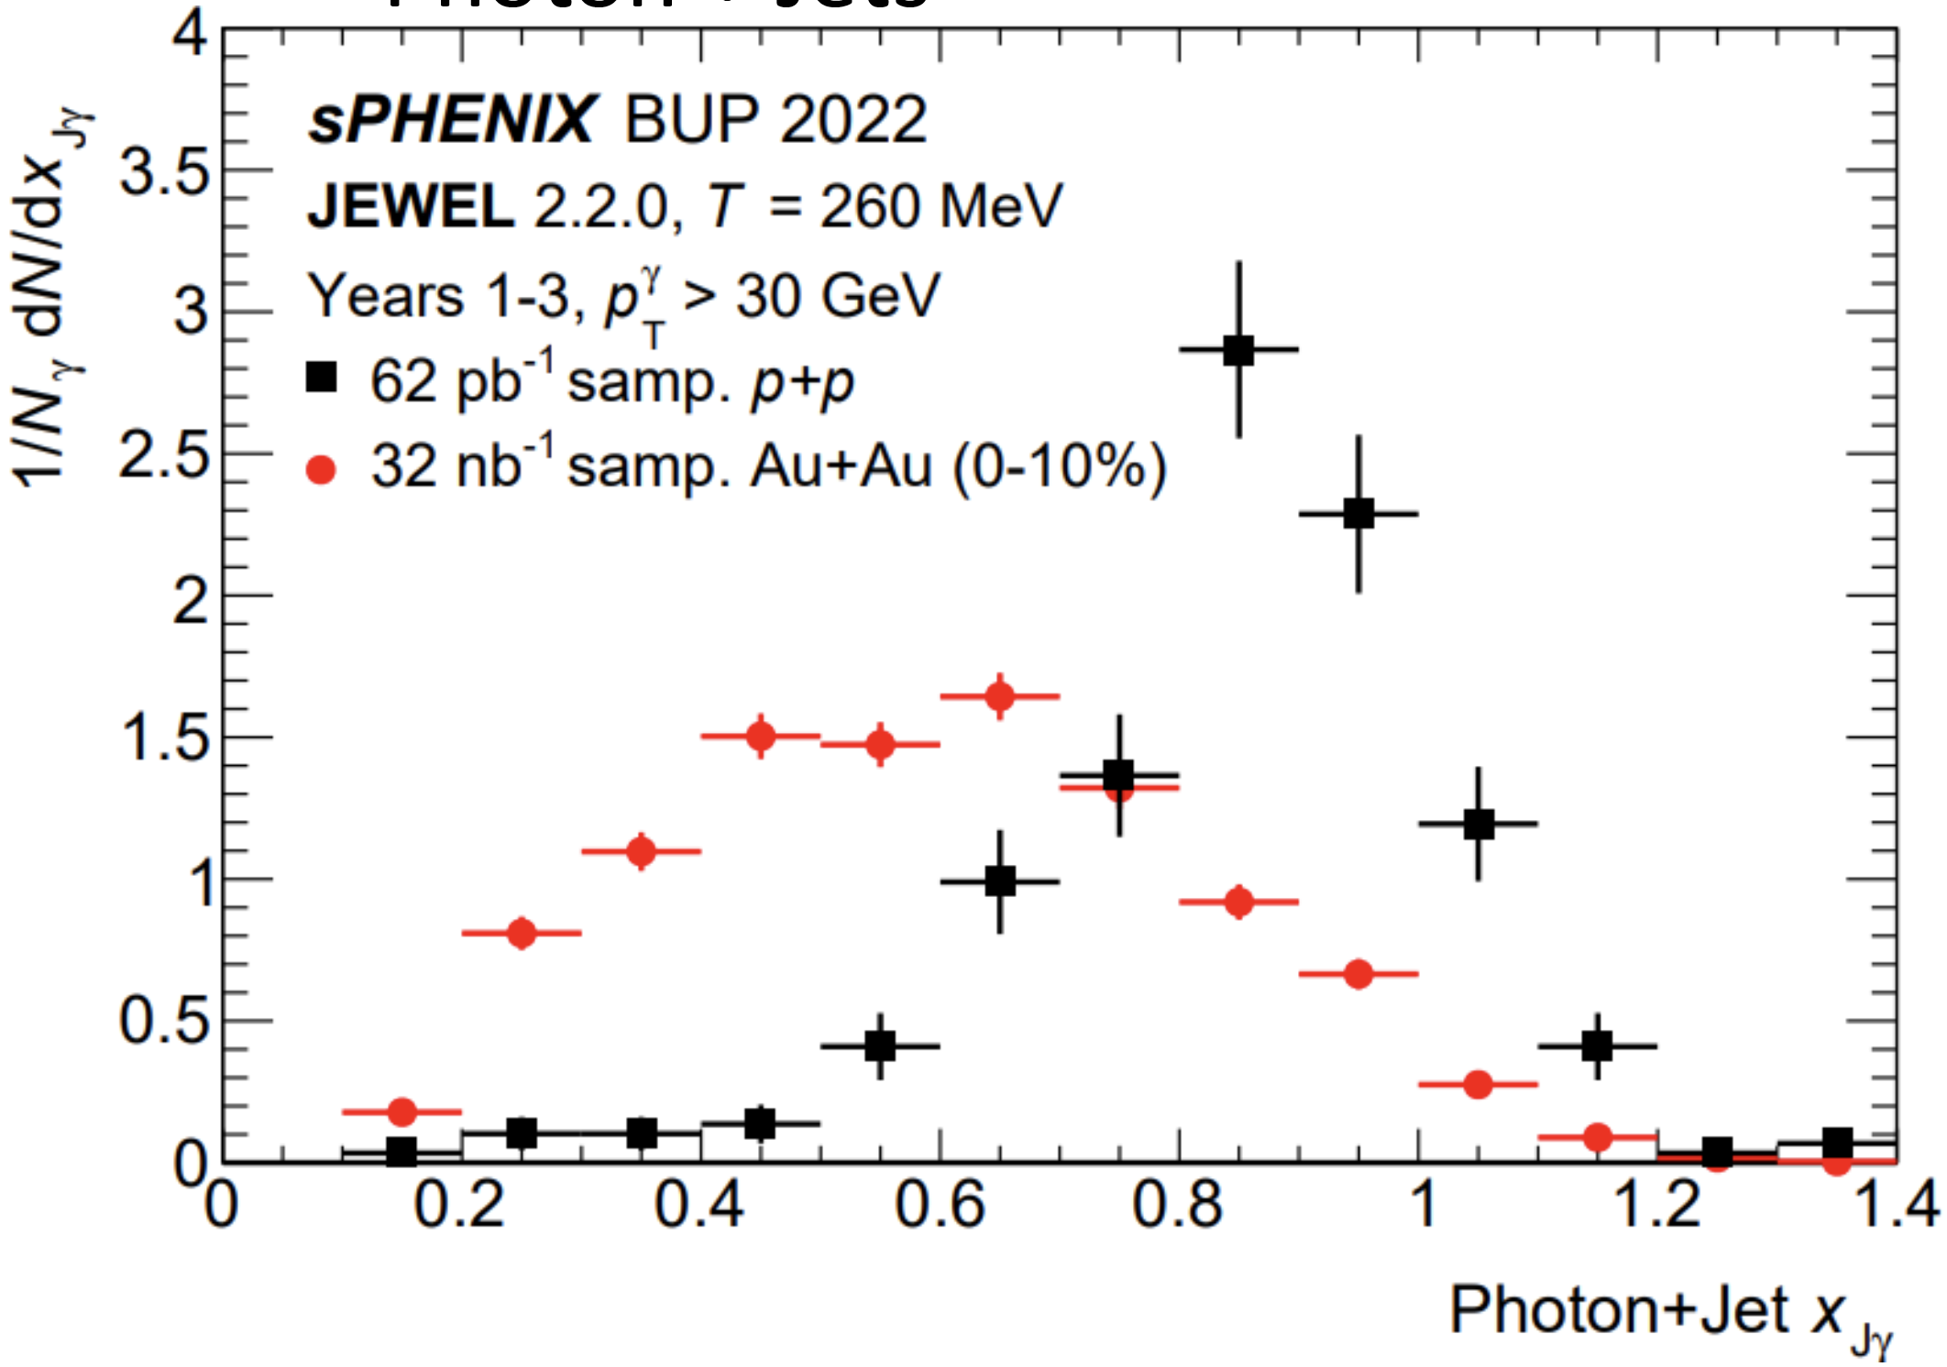
Photon-Tagged Jets
Key measurement in sPHENIX physics program.
RHIC is ideal for measuring direct photons.
Measurements of z_{Jγ} may be more sensitive at RHIC.
LHC

Slide 30
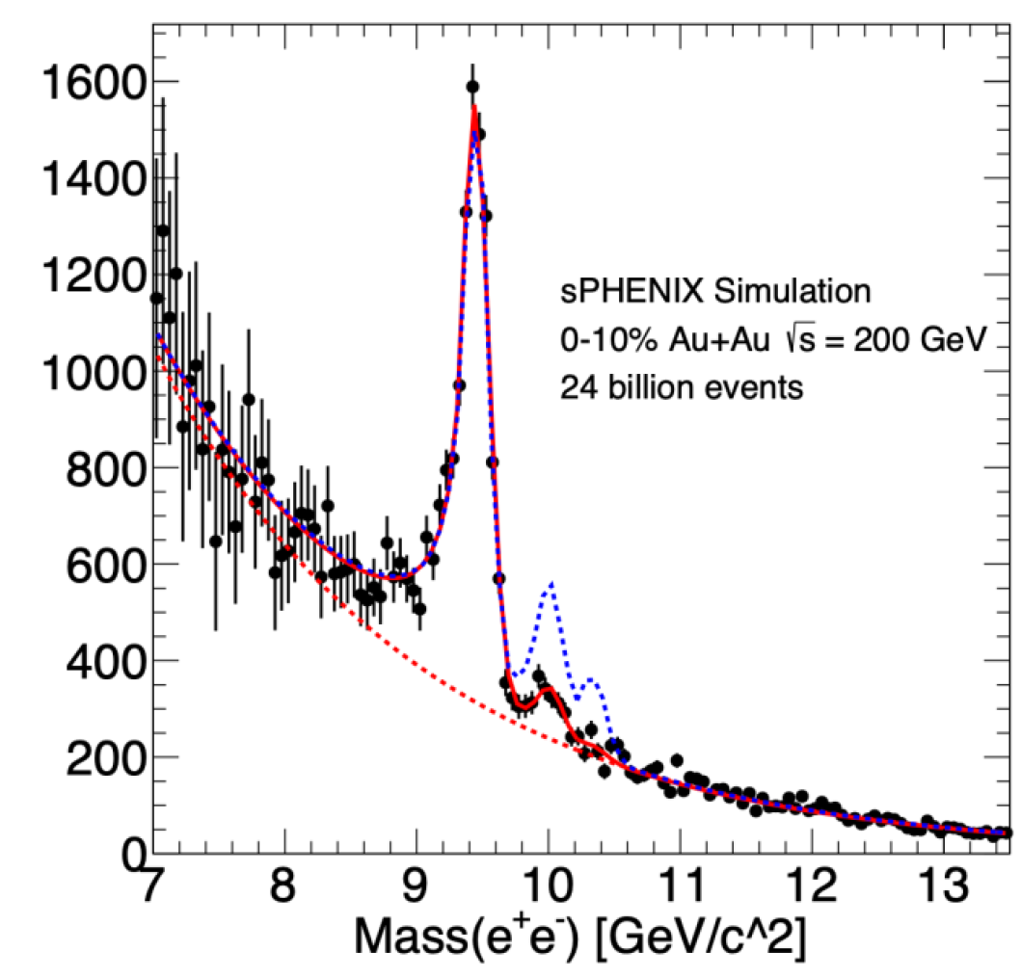
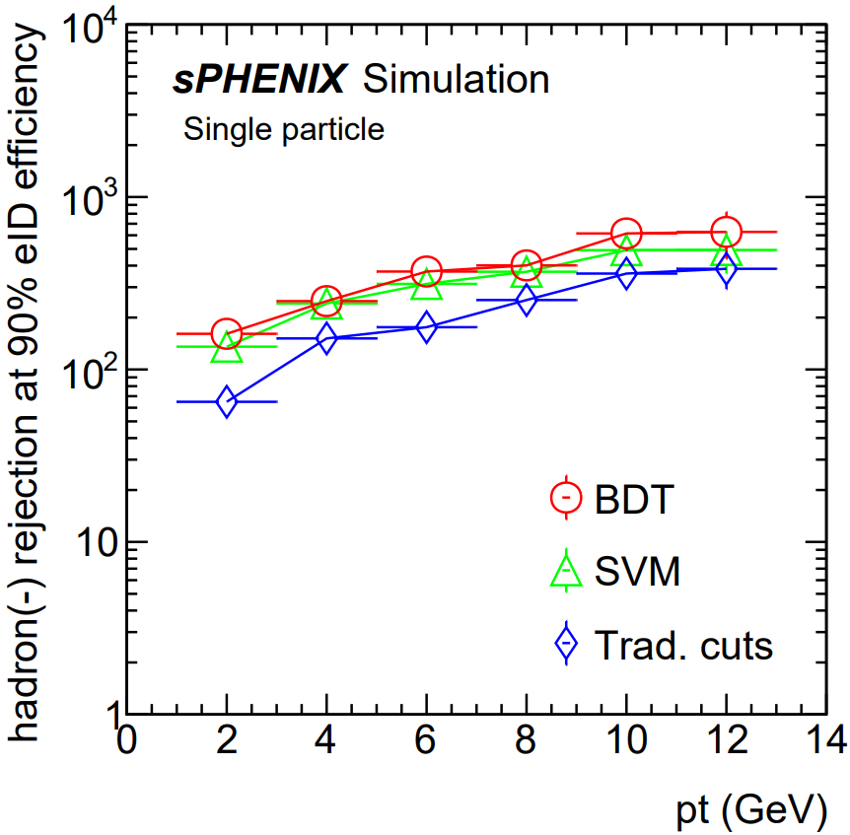
Upsilon R_{AA}
Mass reconstruction
Suppression with clear distinction of three Upsilon states.
Color dipoles probing the QGP at three different length scales.
The centrality dependence and particularly the p_{T} dependence are critical measurements for comparison between
RHIC and the LHC.
Signal enhancement with ML tools (BDT) is expected.

Slide 31
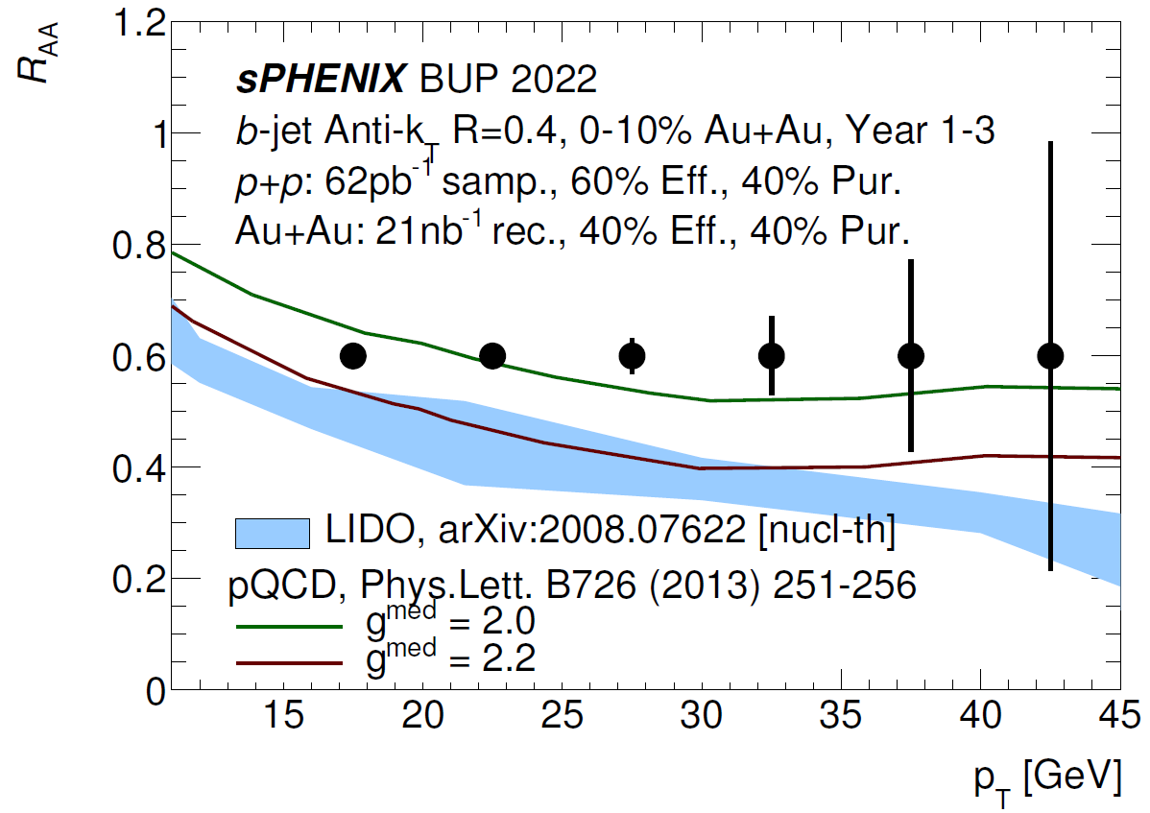
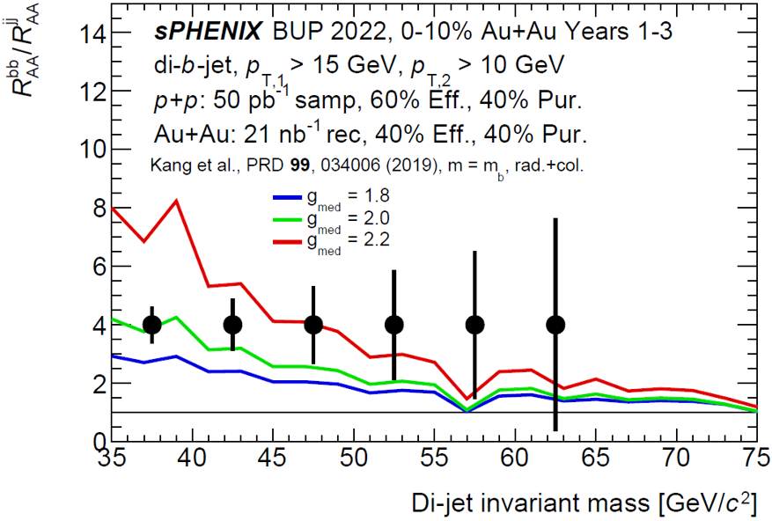
b-Jet Physics
First b-jet tagging at RHIC using precision-DCA (Distance of Closest Approach) track and secondary vertices tagger.
sPHENIX data will place stringent constraints on the b-quark coupling to the QGP.
Back-to-back heavy-flavor jet pairs studying the propagation of quarks in the QGP.

Slide 32
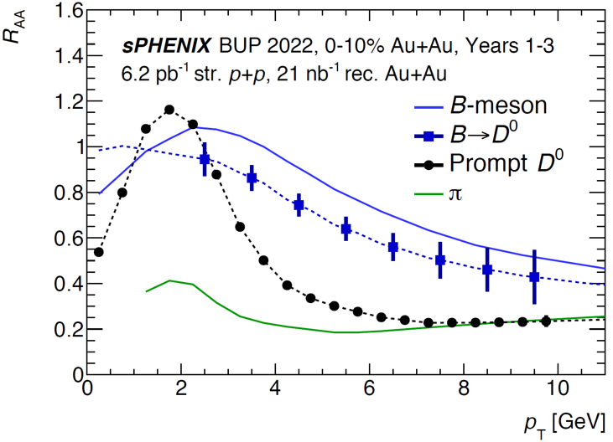
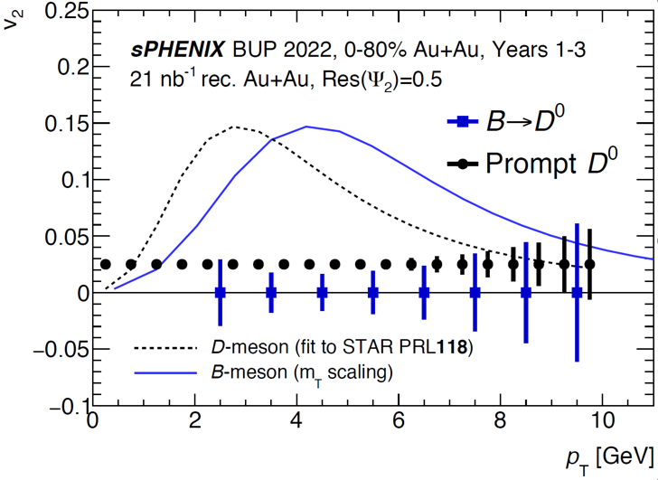
Open Heavy Flavor
R_{AA}
v₂
Cleanly separate open bottom via DCA.
Study mass dependence of energy loss and collectivity.
Bottom quarks and light quarks are expected to be different for RAA and v2 for pT ≲ 15 GeV
Will access b-quark R_{AA} & v₂ via non-prompt 𝐷⁰, full b-hadron reconstruction

Slide 33
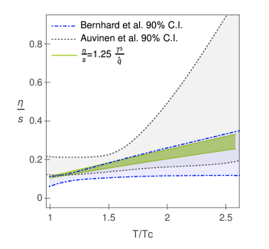
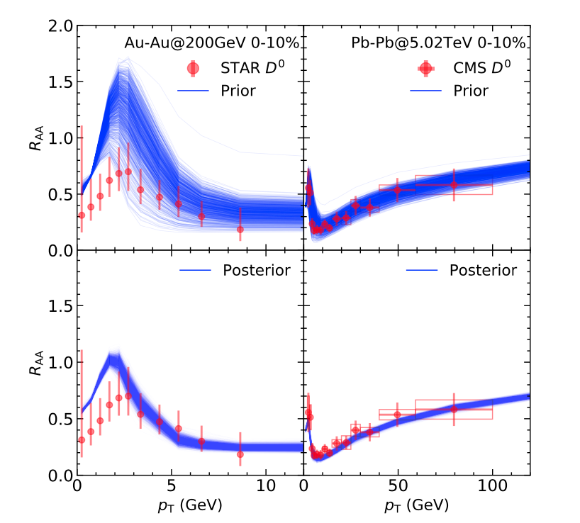
Two Examples (out of many) from This Workshop
Bithika Karmakar:
Constraining η/s Through High-p_{T} Tomography
https://arxiv.org/abs/2305.11318
Shanshan Cao:
Constraining the QGP Properties Using Heavy Quarks
https://arxiv.org/abs/2305.11318

Slide 34
Two Examples (out of many) from This Workshop
Bithika Karmakar:
Constraining η/s Through High-p_{T} Tomography
https://arxiv.org/abs/2305.11318
Shanshan Cao:
Constraining the QGP Properties Using Heavy Quarks
https://arxiv.org/abs/2305.11318
R_{AA}

Slide 35
Current sPHENIX Status
Commissioning!
  200 GeV Au+Au

Slide 36
Current sPHENIX Status
Commissioning!
  200 GeV Au+Au
Events!

Slide 37
Current sPHENIX Status
Commissioning!
  200 GeV Au+Au
Events!
So much more to come!

Slide 38
Preliminary Performance Plots

Slide 39
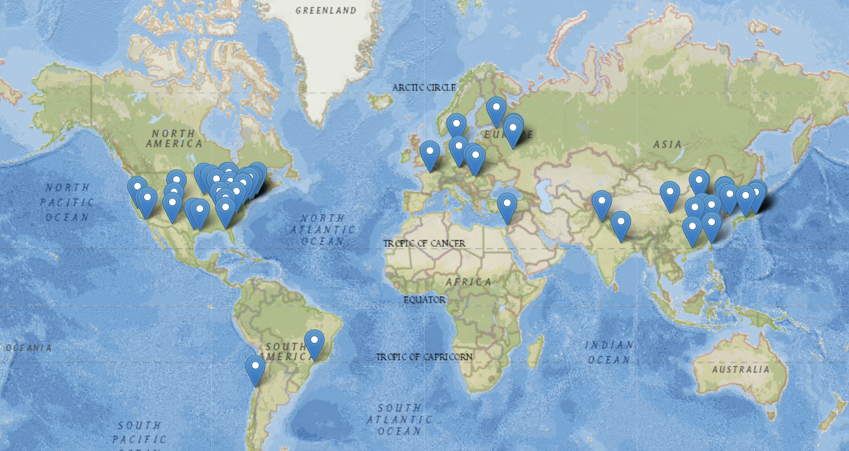
sPHENIX Collaboration
358 Members
83 Institutions
14 Countries
4 Continents
Encouraging diversity is a priority for our collaboration.
  Diversity, Equity, & Inclusion training is a requirement for being an sPHENIX author.

Slide 40
Thank You!
This work was supported by the United States Department of Energy Grant DOE-FG02-86ER-40281

Slide 41
Back-up Material
This work was supported by the United States Department of Energy Grant DOE-FG02-86ER-40281

Slide 42
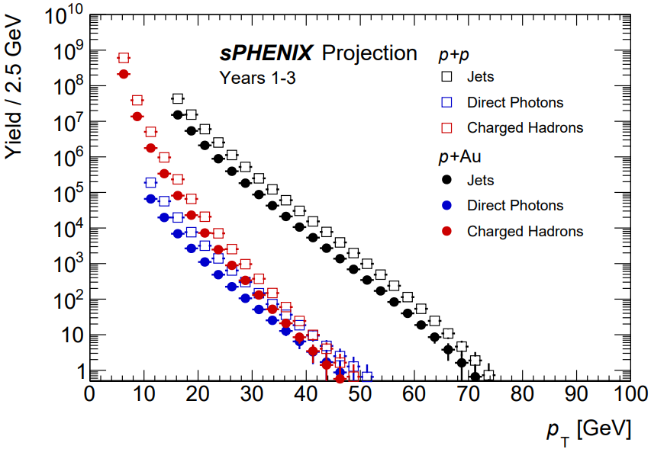
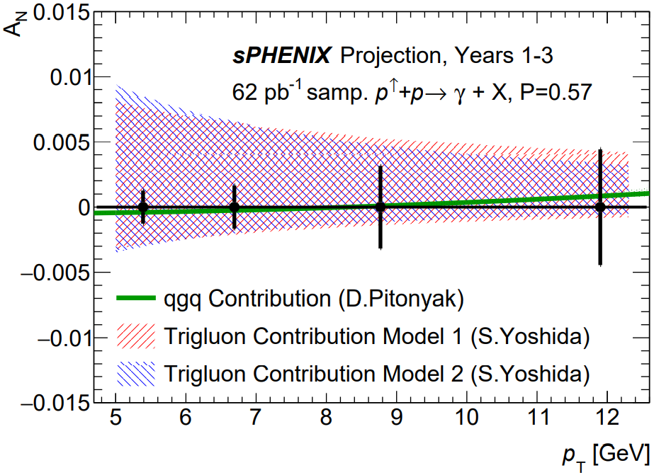
Cold QCD
Hard probes in p+Au
TSSA for direct photon
Study of nuclear modifications using unpolarized p+Au measurements.
Provide information on the nuclear modification of hadronization processes.
Sensitive to the CNM effects.
Spin measurements such as transverse single spin asymmetry (TSSA) will be done using polarized beams.
Study the nucleon spin structure and parton dynamics.

Slide 43
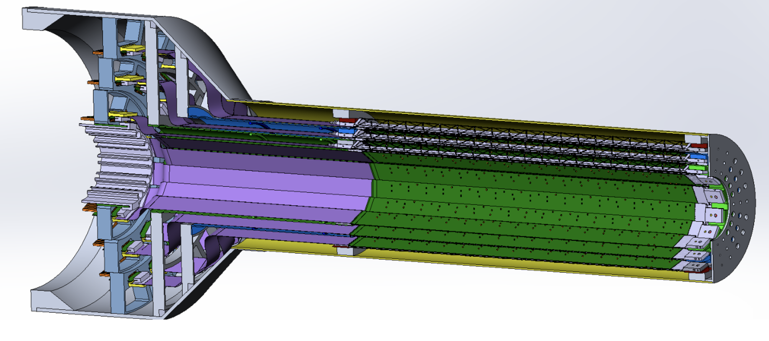
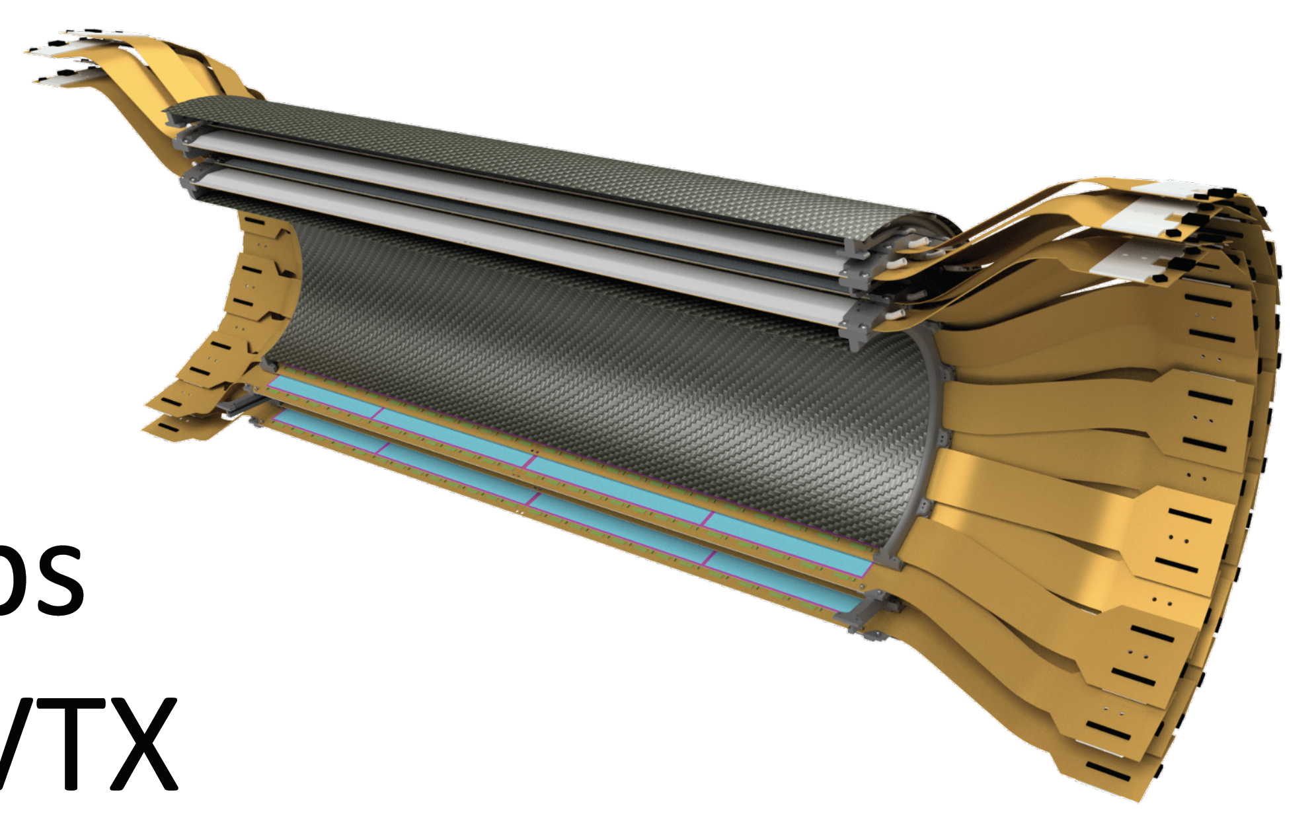
Inner Tracking
MVTX
  Precision vertexing
  Position: 2.3 < r < 3.9 cm
  3 layers of Monolithic Active Pixel Sensors
  Based on new ALICE ITS
  Pixel size: 29✕27 μm
  Position resolution: 5 μm (tracks w/ p_{T} > 1 GeV/c)
INTT
  Position: 7 < r < 12 cm
  2 layers of Si strips
  Pitch: 86 μm
  Single-beam-crossing timing resolution

Slide 44
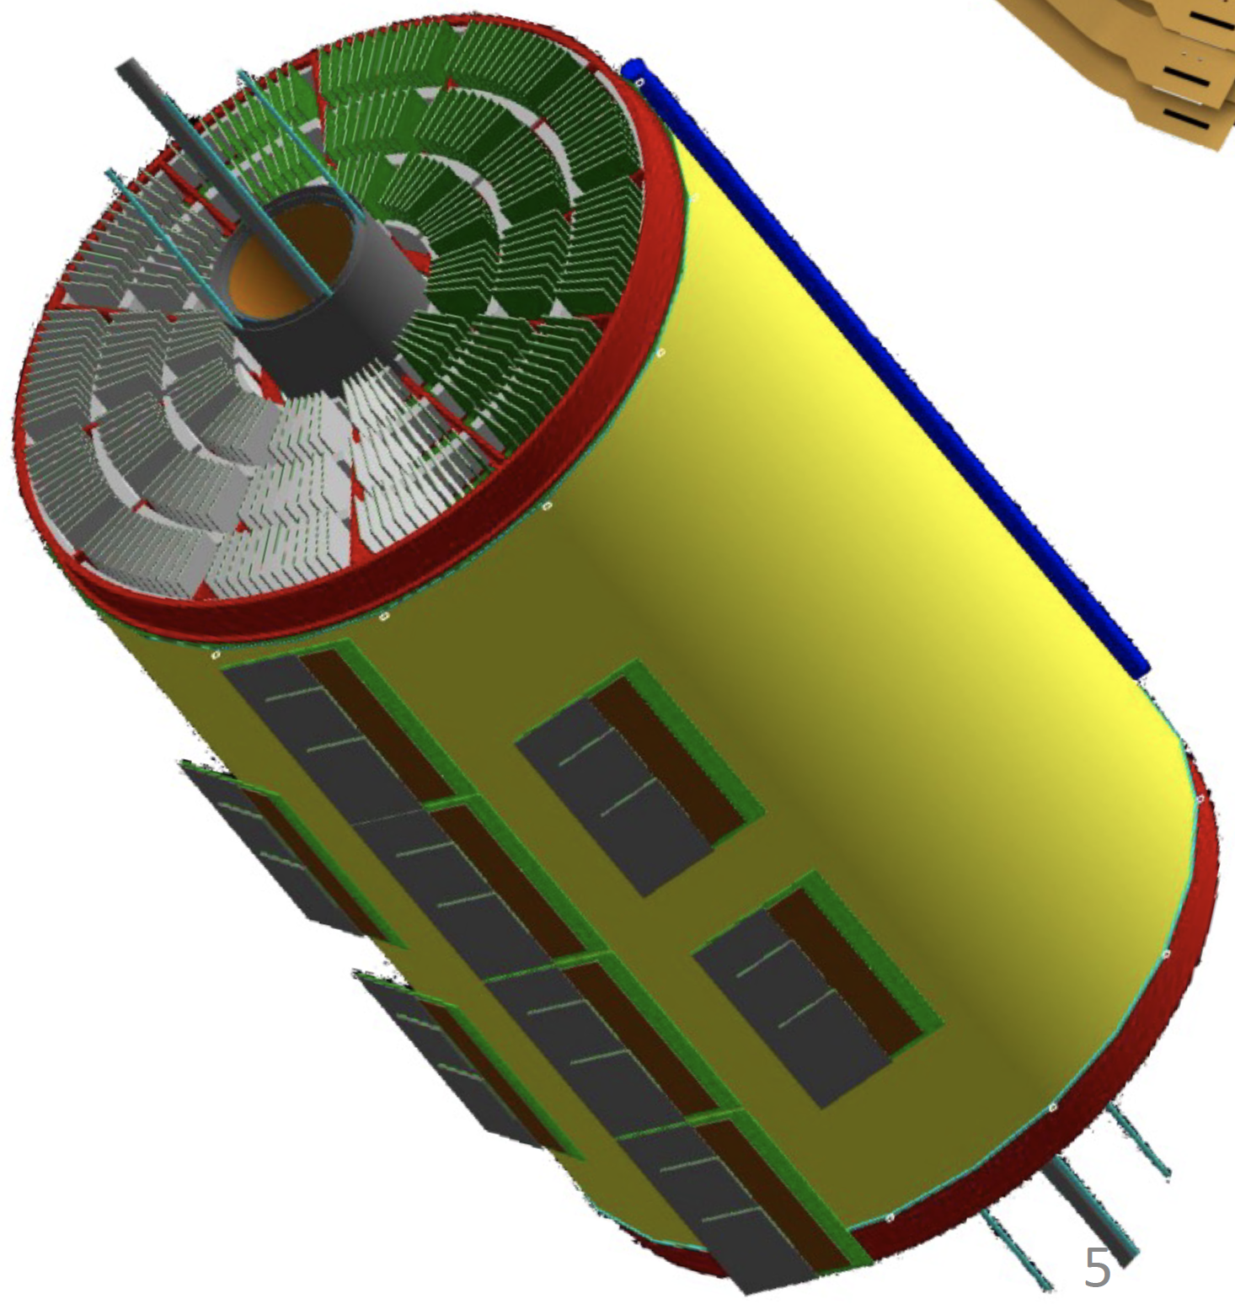
TPC & TPOT
TPC
  Tracking
  Position: 20 < r < 78 cm
  Compact, GEM-based
  Effective hit resolution: ~250 μm
  Continuous (non-gated) readout
TPOT
  Additional information for calibration of beam-induced space charge distortions
  Position: outside TPC
  8 modules of Micromegas

Slide 45
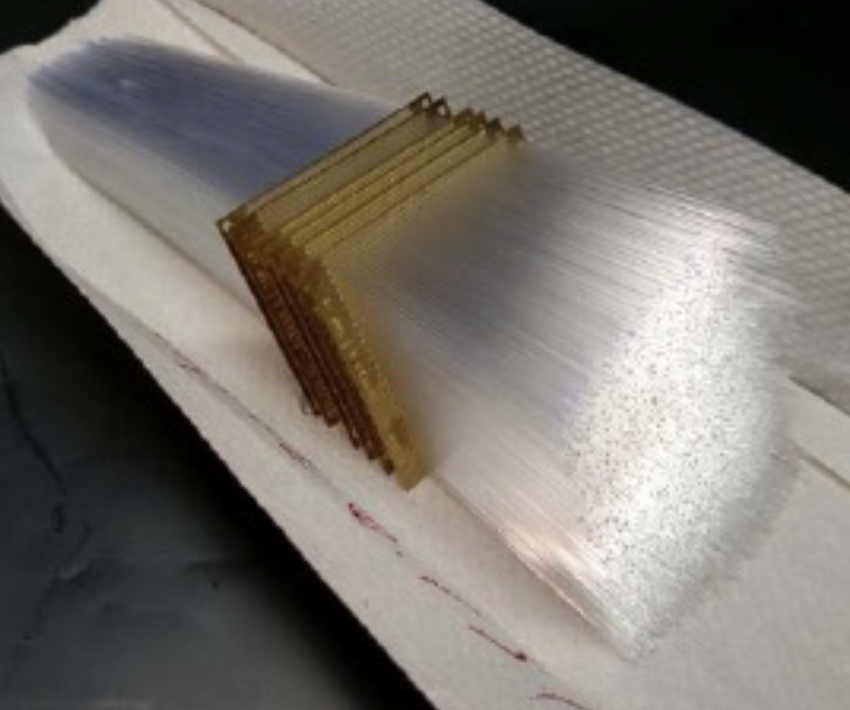



Calorimeters
EMCal
  Tungsten-Scintillating Fiber sampling calorimeter
  Material: 20.1 X₀, 0.83 λ_{int}
  Resolution: 16%/$\sqrt{E} ⨁$ 5%
HCal
  Inner & Outer HCals w/ magnet in between
  Al (inner) & steel (outer) absorber plates
  Scintillating tiles w/ embedded WLS fibers
  Resolution: 88%/$\sqrt{E} ⨁$ 12% (single particle)
Total 5 λ_{int} for both calorimeters combined
Δη ✕ Δφ =
0.025 ✕ 0.025
EMCal
EMCal
Outer HCal

Slide 46


Event Characterization
Min. Bias Detector (MBD)
  Covers 3.51 < |η | < 4.61
  Reuse PHENIX Beam-Beam Counter
  128 channels of 3 cm thick quartz radiator on mesh dynode PMT
  Timing resolution: 120 ps
sPHENIX Event Plane Detector (sEPD)
  2 wheels; 2.0 < |η | < 4.9
  Scintillator plastic (1.2 cm thick), embedded WLS fibers
  Significant improvement of event plane resolution
  Closely based on STAR EPD

Slide 47


Beampipe
sPHENIX beampipe shipped to California for work
Lost in warehouse fire in 2022!
STAR had a spare beampipe that is in good condition and is compatible with sPHENIX design.

Slide 48

Cosmic Rays
The TPC sees cosmic rays.

Slide 49

Data Acquisition
Hybrid DAQ
Triggered readout for calorimeters
Streaming (triggerless) readout for tracking detectors
  Records ~10% of all collisions
  Key to get full p+p statistics in 2024
  Crucial for HF & Cold QCD physics
2023: will record all collisions (Au+Au) w/ minimum-bias trigger

Slide 50

(MC) Event Display

Slide 51

RHIC = Relativistic Heavy Ion Collider
RHIC
First collisions 2000
p+p, d+Au, ³He+Au, Zr+Zr,
Ru+Ru, Cu+Cu, Cu+Au,
Au+Au, U+U
√s_{NN} ~ 7–200 GeV
Polarized protons
First collisions 2010
p+p, Pb+Pb, p+Pb
√s_{NN} =2.76 TeV, 5.5 TeV

