Slide 1
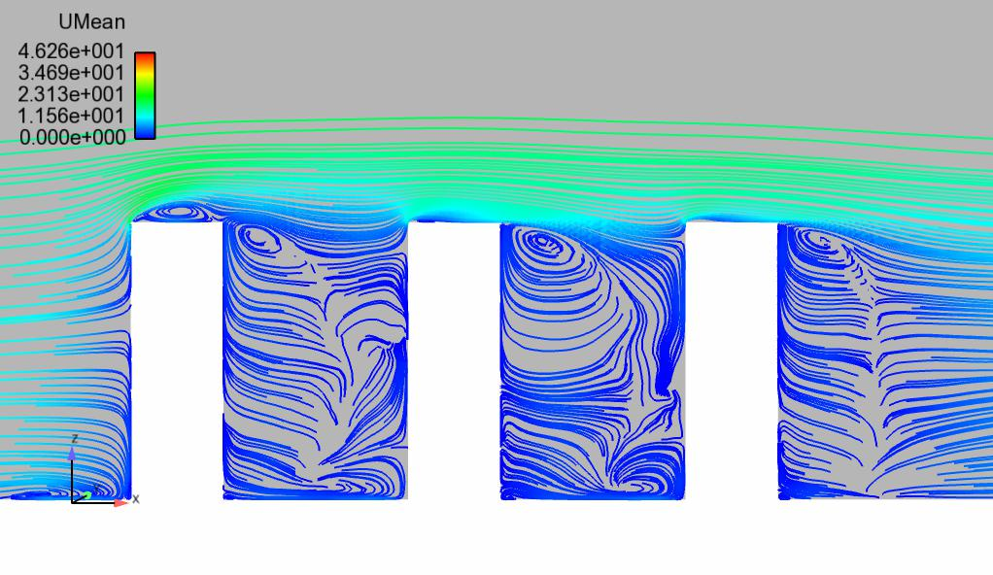



Applied CFD: Simulating the built environment and beyond
Anina Šarkić Glumac
Wind Engineering Group
Instutute of Numerical Analisys and Design of Structures
Faculty of Civil Engineering, University of Belgrade
EuroCC4SEE
Belgrade
20-22 May 2025
EUROCC4SEE | 20.-22. 05. 25. | Belgrade, Serbia

Slide 2
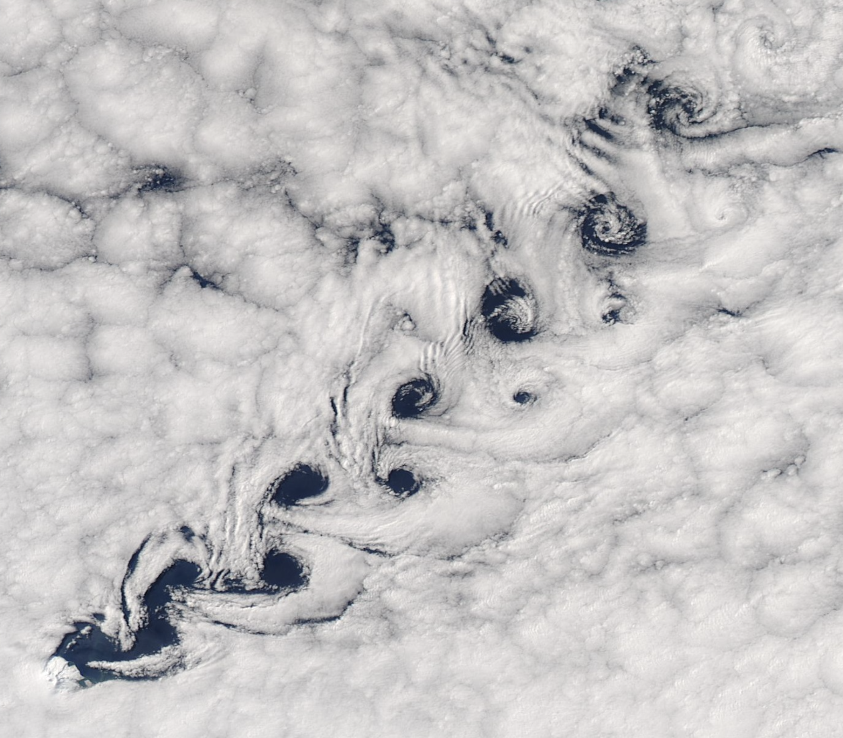



Let Me Introduce Myself
Assistant Professor
Faculty of Civil Engineering
University of Belgrade
Research Scientist
University of Luxembourg
European Evaluator
H2020-MSCA-ITN & HORIZON-MSCA-DN
Doctoral Studies
Building Aerodynamics Laboratory
Ruhr-University Bochum
Magister & Dipl. Ing. Studies
Faculty of Civil Engineering
University of Belgrade
I'm a civil engineer with a background in wind-tunnel testing and CFD, applying these tools to real-world civil and environmental challenges — and recently expanding into data assimilation and machine learning to enhance simulation.
Karman vortex street, Heard Island, Wikipedia

Slide 3
Let Me Introduce Myself
Current Research projects
SeaDream – HORIZON-MSCA-SE-2023 (Partner)
Sustainable Marine Energy and Ecosystem Resilience Advancement through Digital Technologies and Real- Time Crisis Management
ERIES – HORIZON-INFRA-2021 (PI of sub-project)
ERIES – FLOATINGSOLAR: Wind and wave effects on FLOATING SOLAR panels
Previous Research projects
DATA4WIND – H2020-MSCA-IF-2019 (PI)
DATA4WIND – FNR, 2020 (PI)
SEEFORM – DAAD (Partner), etc.
Industrial projects
Bridge on the river Sava, Serbia, consultant for Niemann&Partner
High bay structure of Jysk-Nordic, Denmark, consultant for Niemann&Partner, etc.

Slide 4
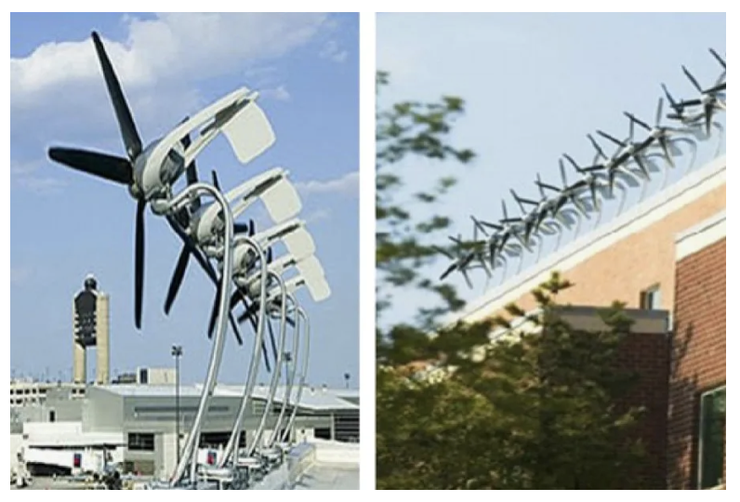
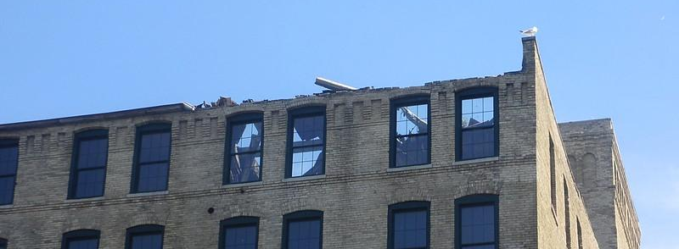
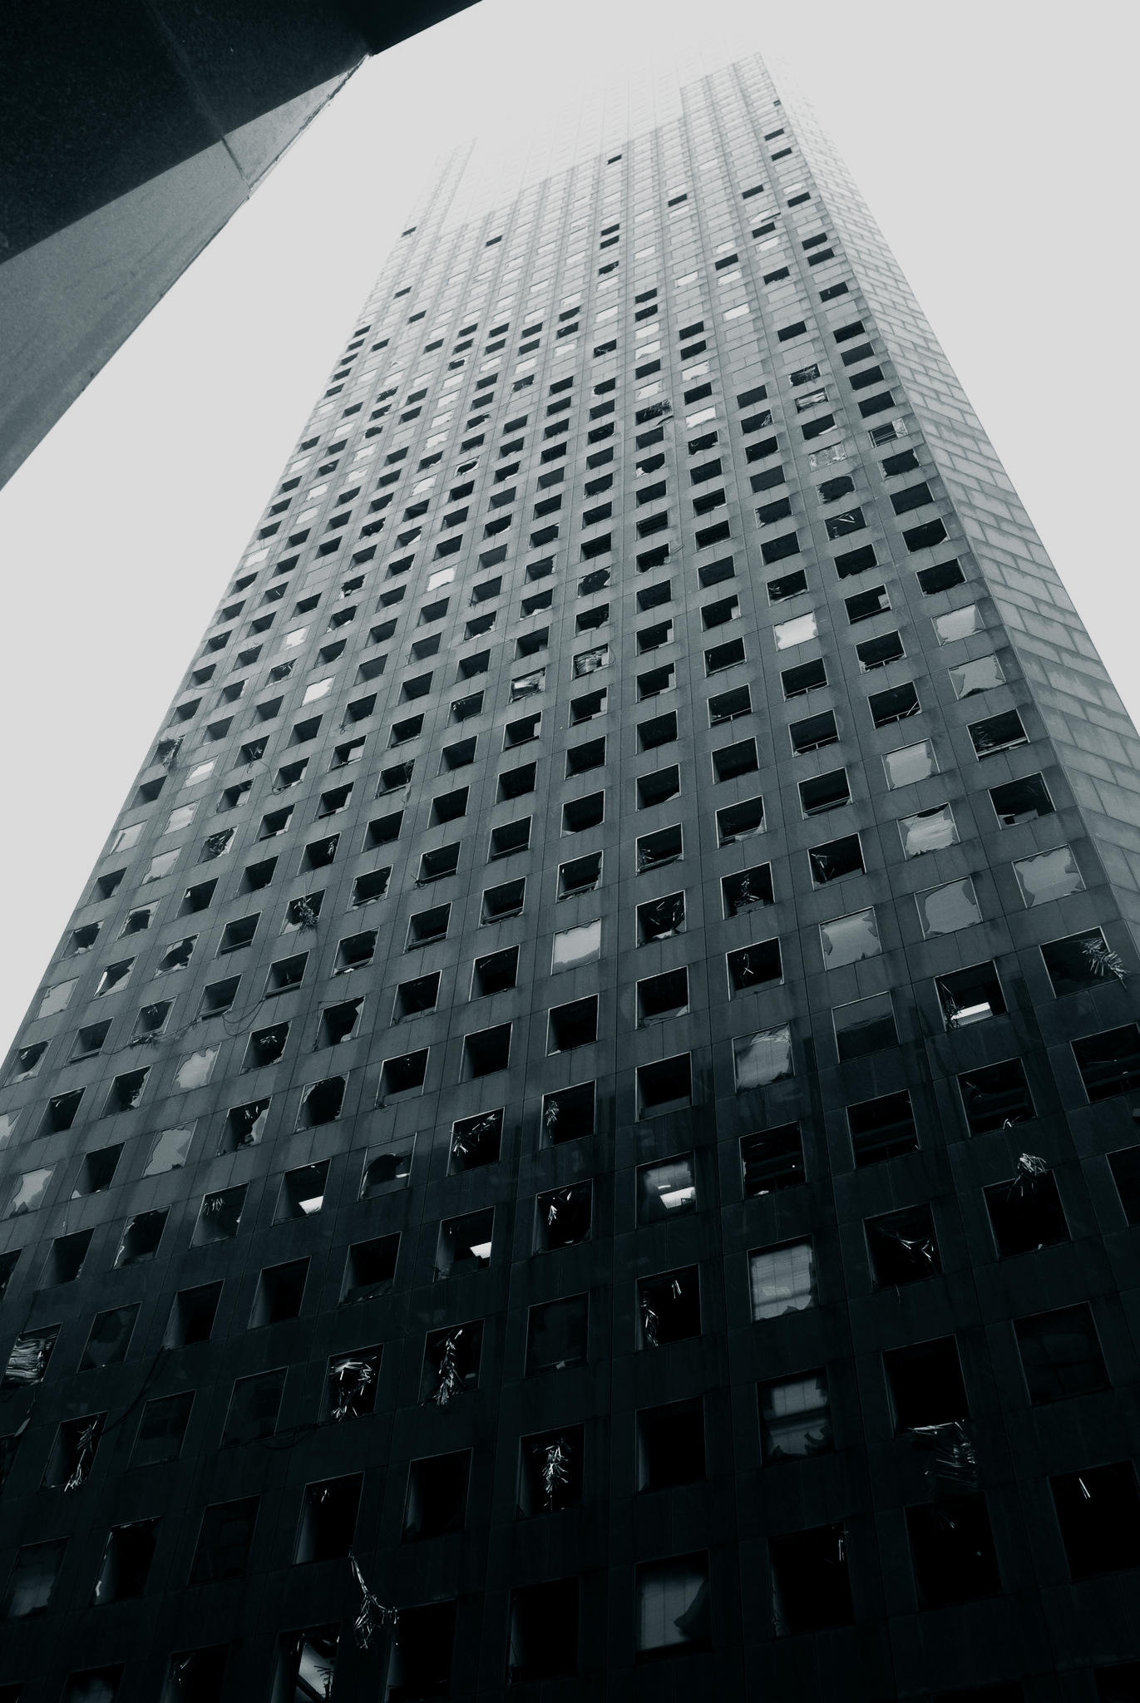
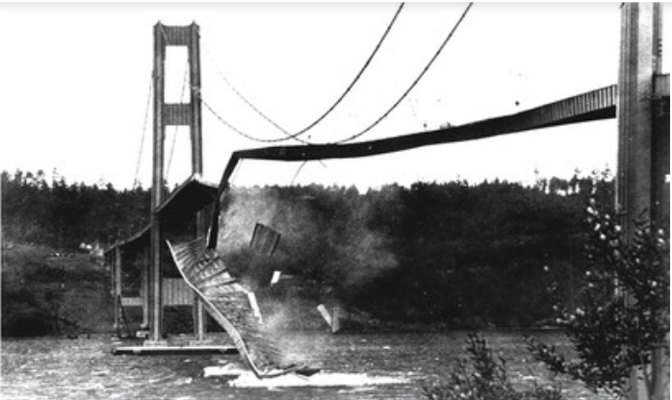
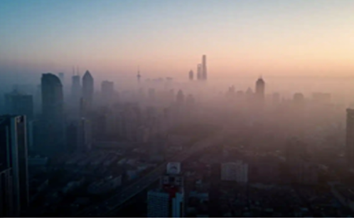
Applied CFD in Built Environment
Civil Engineering
Applications
Environmental Eng.
Applications
WIND
HARVESTING
WIND LOADS
Source: www.flickr.com - ”Roof Damage" by Beige Alert
Boston Logan Airport,
Source: www.propmodo.com/can-tech-help-commercial-d/yatt hotel, Katrina 2005
POLLUTION
BRIDGE AERODYNAMICS
China,
Source: https://www.istockphoto.com/photo/china-shenzhen-skyscraper-gm969333552-264204925?searchscope=image%2Cfilm
Source: www.flickr.com - "JP Morgan Chase Damage" by AlphaTangoBravo / Adam Baker

Slide 5
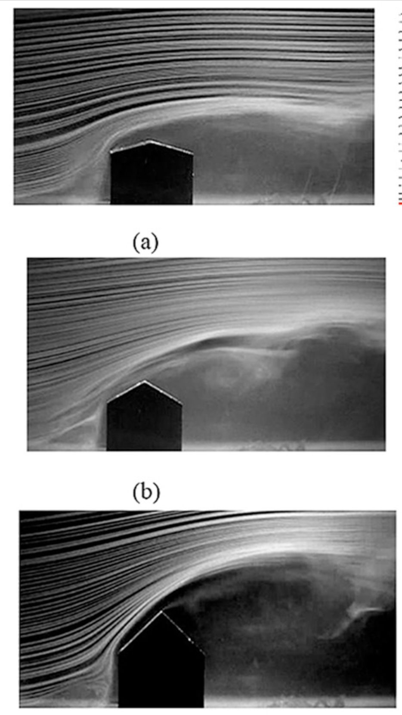
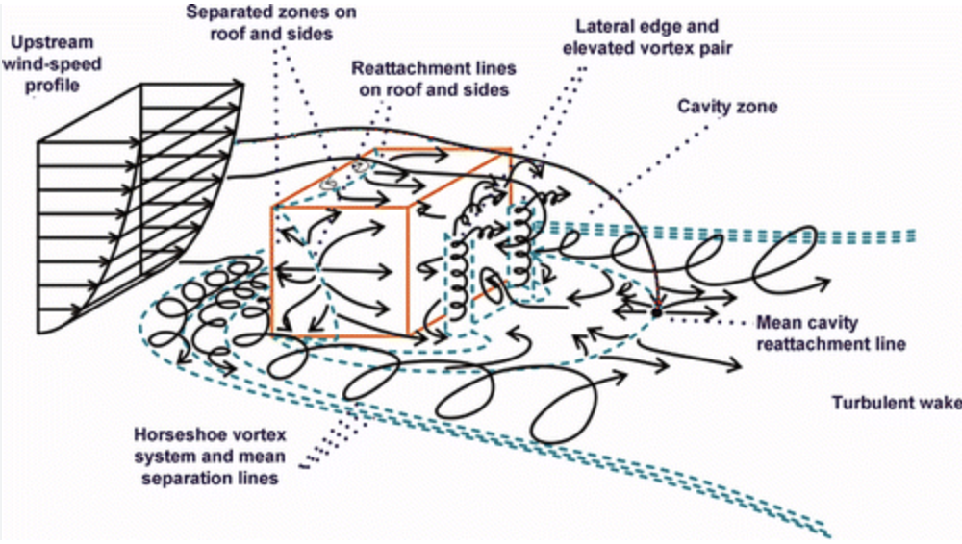
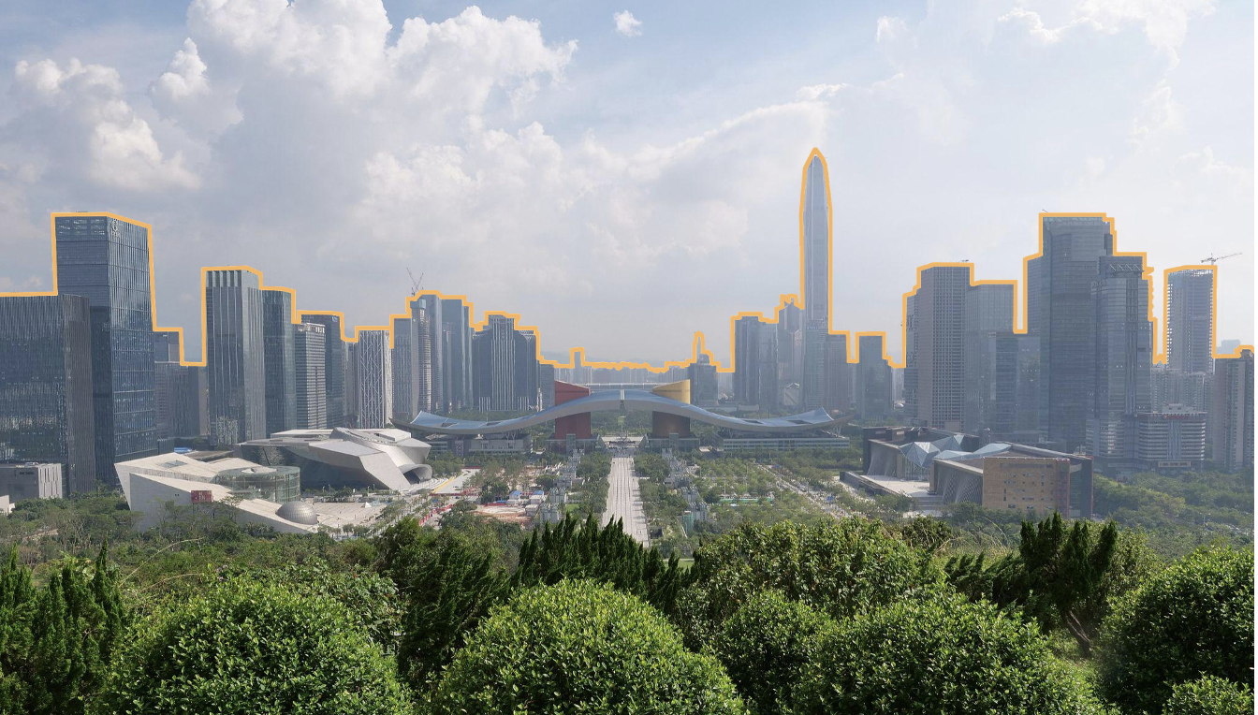
Core Challenges
Turbulent Flow & Geometric Complexity & Variability of Structures
Ozmen et al., Buld. & Envio., 2016
Source: https://en.wikipedia.org/wiki/File:Civic_Center
Blocken et al., J. Buil. Perf. Sim., 2010

Slide 6
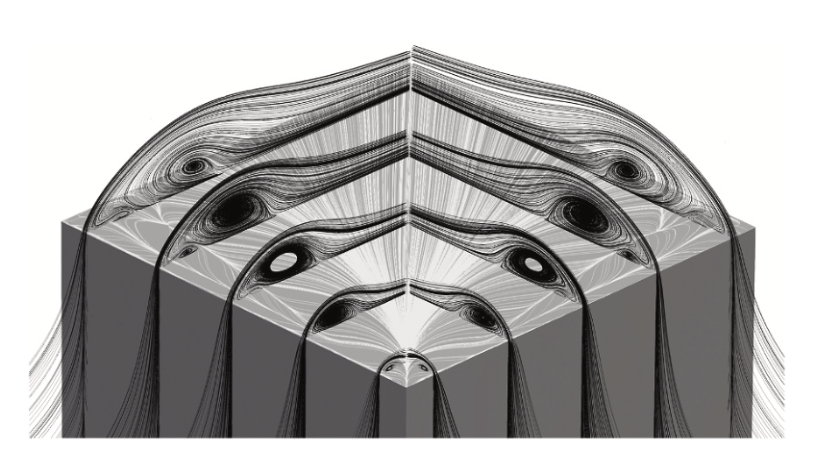
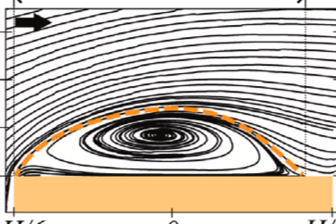
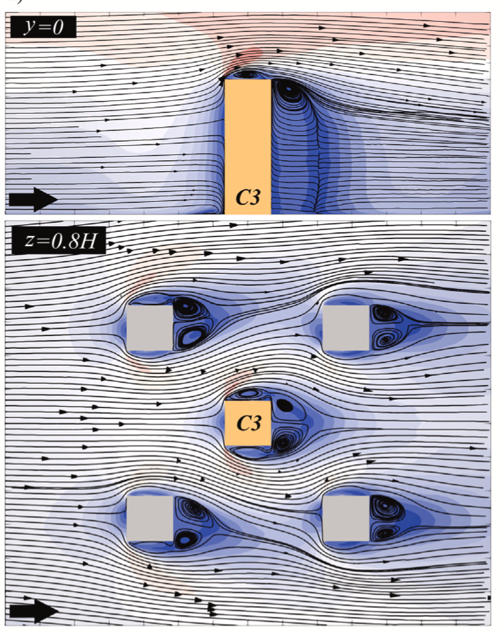
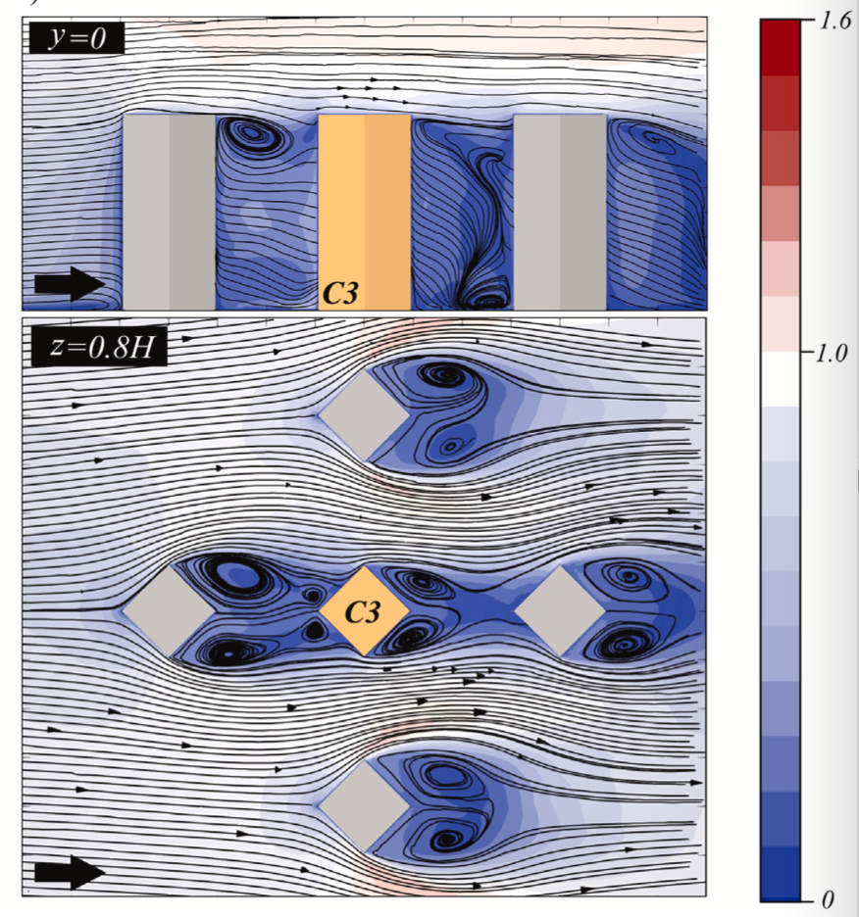
Core Challenges
Variability of Wind Direction

Slide 7
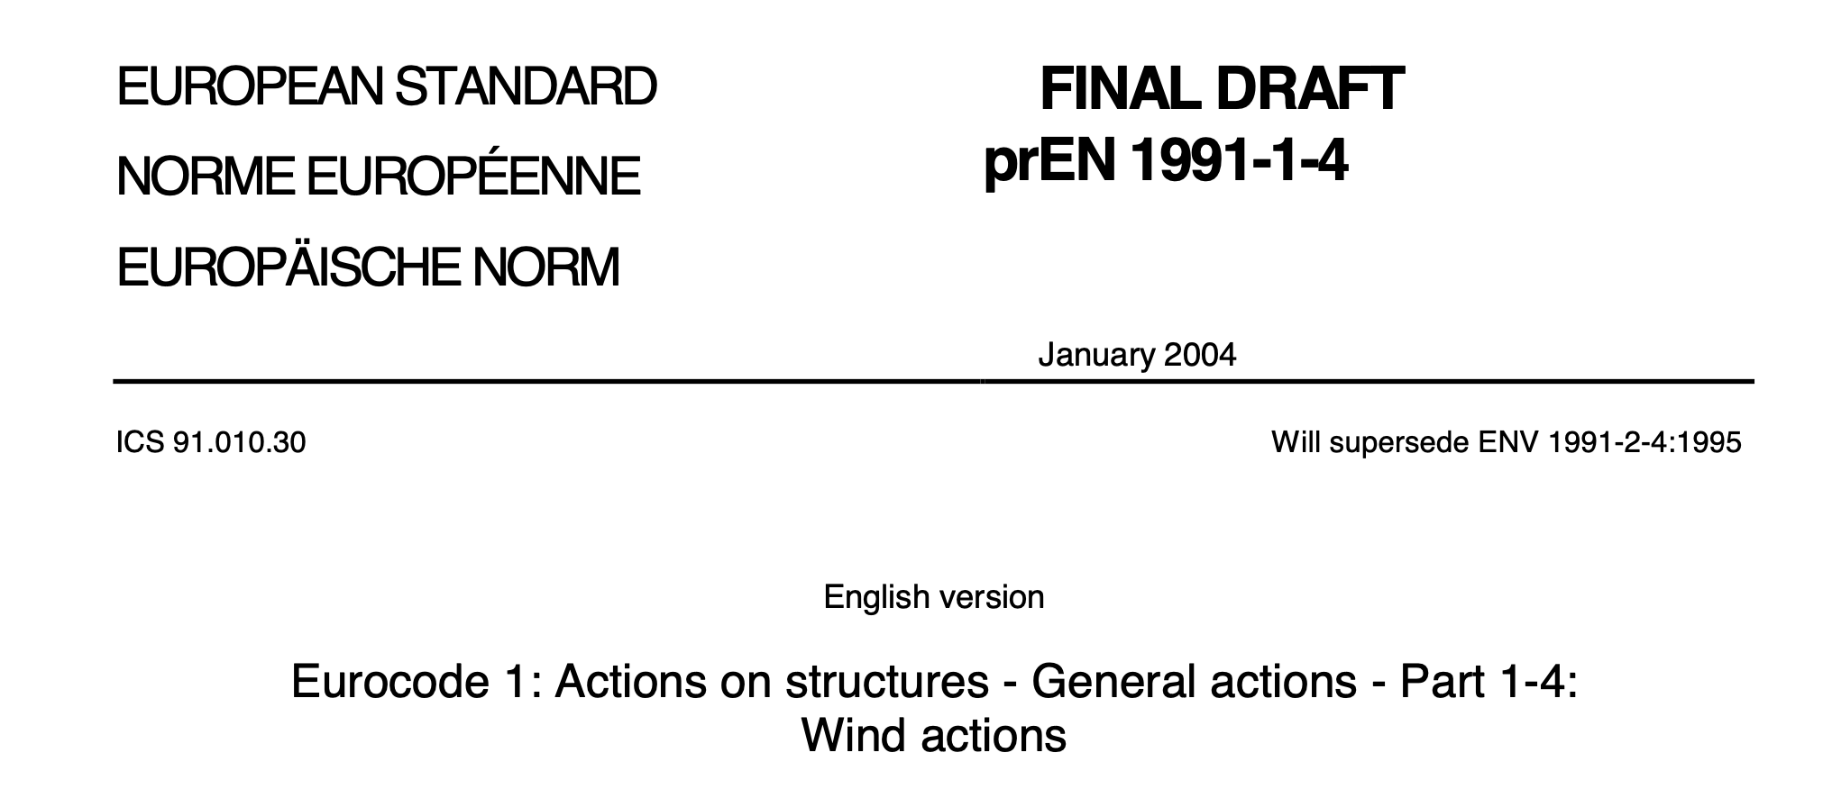
Main Design Methods
STANDARDS & CODES
Pros
Clarity and Consistency:
Structured procedure that engineers can follow, reducing ambiguity in the design process.
Safety and Reliability:
Ensures that structures meet minimum safety and performance requirements.
Standardization Across Projects
Legal and Professional Accountability

Slide 8
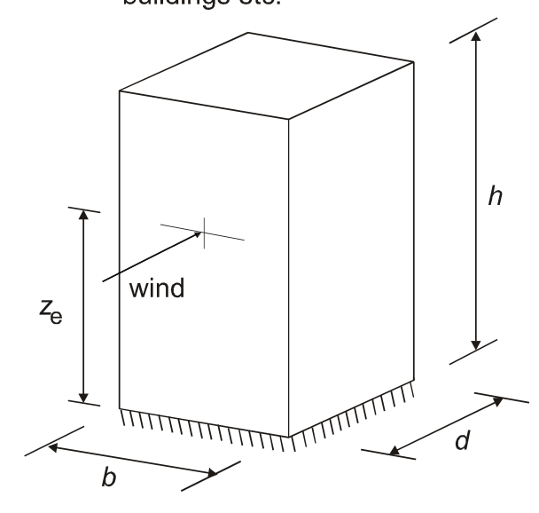
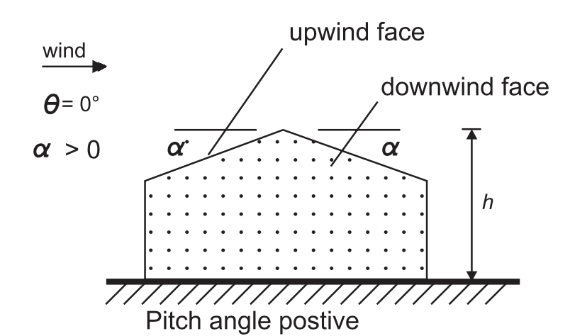
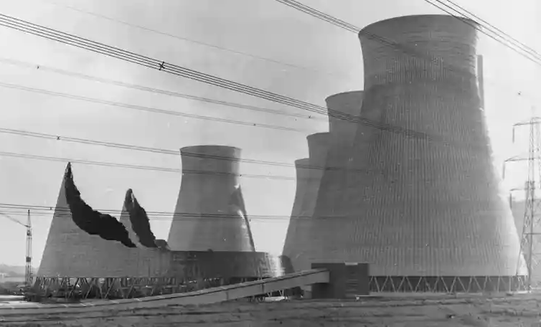

Main Design Methods
Cons
Simplified Geometries Only
The Eurocode primarily addresses basic, regular-shaped structures. It does not adequately cover complex geometries, such as curved façades, high-rise buildings with irregular shapes, etc.
Standard Terrain Categories
The terrain exposure categories are overly simplistic and may not accurately represent urban environments with varying building densities, topography, or vegetation.
Limited Guidance on Local Effects
Effects like channeling, vortex shedding, flutter and wake interactions are not well addressed.
STANDARDS & CODES
Eurocode 1-4
https://greatnorthroad.co.uk/ferrybridge-power-station

Slide 9
Main Design Methods
EXPERIMENTAL
FIELD MEASUREMENTS
NUMERICAL
CFD
Real-world, high-fidelity data
Long-term monitoring
No scaling issues
Low spatial resolution of the measuring points
Difficult to control
Flexible & scalable
Captures detailed flow around complex geometries
Ideal for parametric studies
Sensitive to input (e.g. inflow) conditions
Needs validation!
WIND TUNNEL
Stand alone tool!
Well-established, controlled and repeatable
Low spatial resolution of the measuring points
Scaling issues

Slide 10
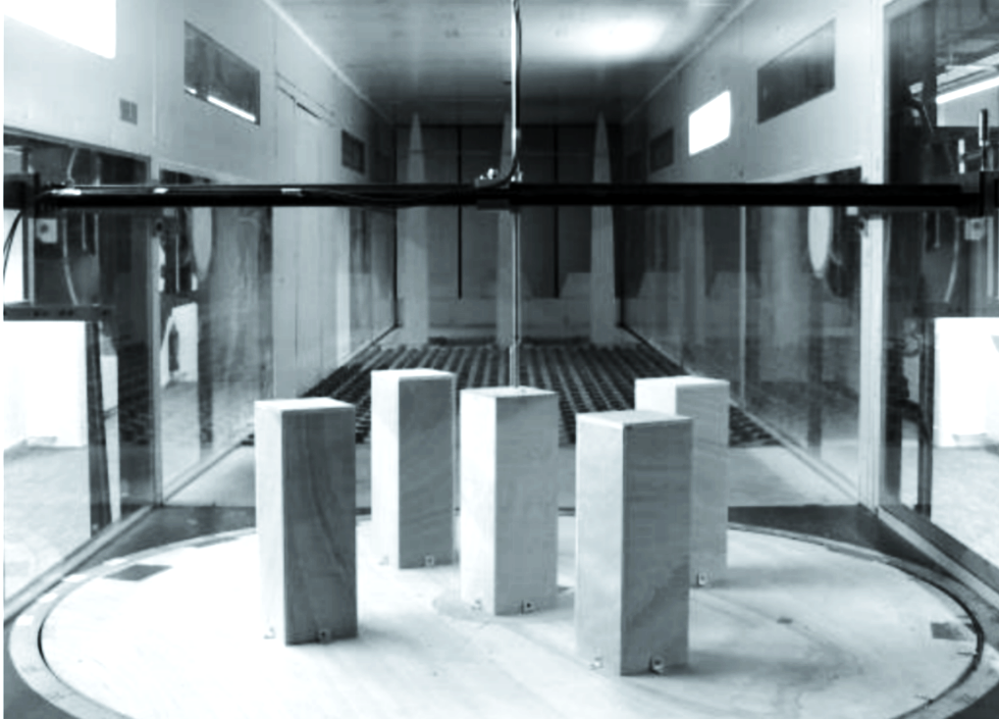
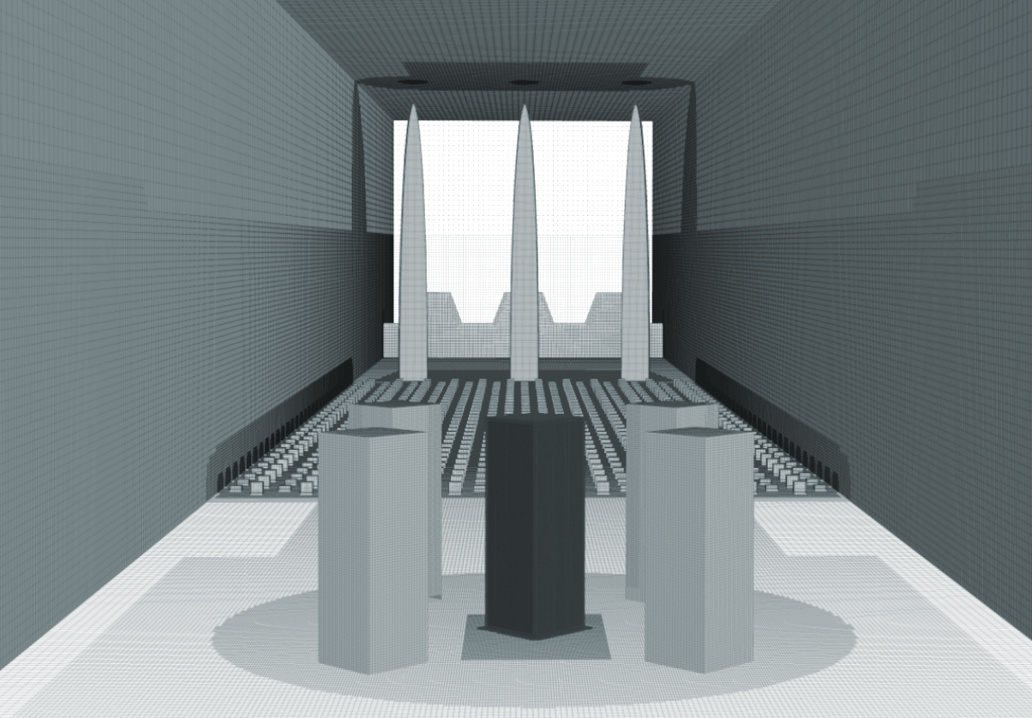
Main Design Methods
Where are we now?
WIND TUNNEL
CFD
VALIDATION
Well-established, controlled and repeatable
Low spatial resolution of the measuring points
Scaling issues
Flexible & scalable
Captures detailed flow around complex geometries
Ideal for parametric studies
Sensitive to input (e.g. inflow) conditions
Needs validation!

Slide 11
Main Design Methods
WIND LOADS
WIND TUNNEL
CFD
VALIDATION
Each method plays a distinct role. WT & CFD used together, form a powerful tool for understanding and designing with wind.

Slide 12
Main Design Methods
ENVIRONMENTAL STUDIES
CFD
WIND TUNNEL
VALIDATION

Slide 13
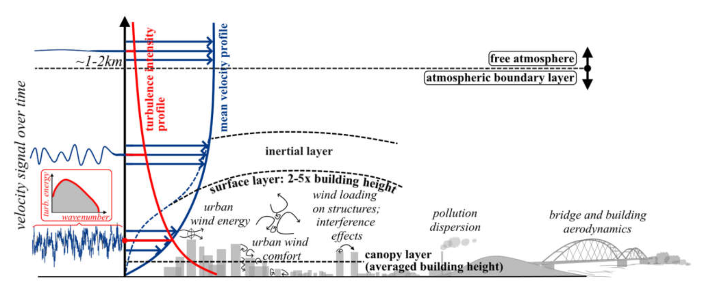
How we handle turbulence numerically?
Approaching Flow - Atmospheric Boundary Layer (ABL)
Kostadinovic Vranesevic, University of Belgrade, 2025

Slide 14
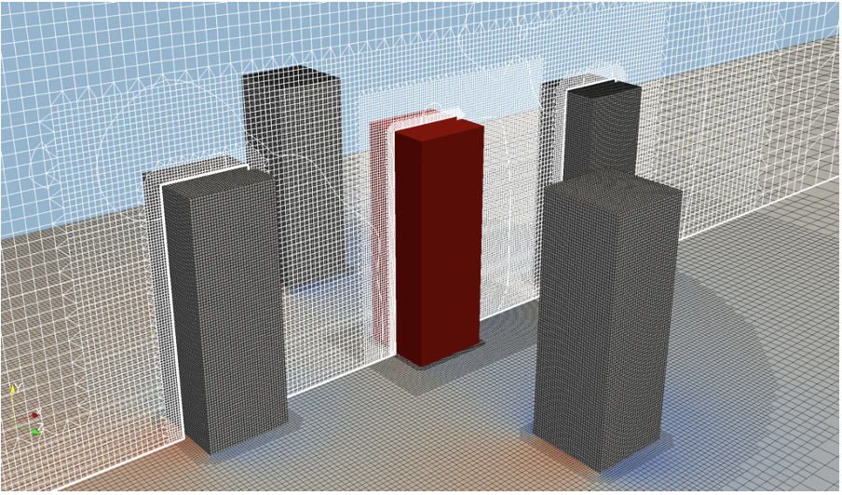
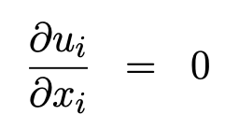
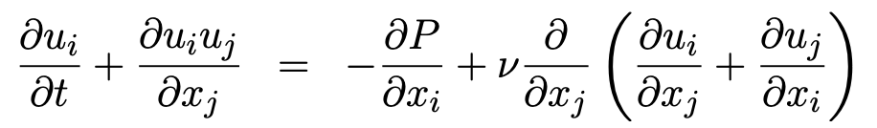
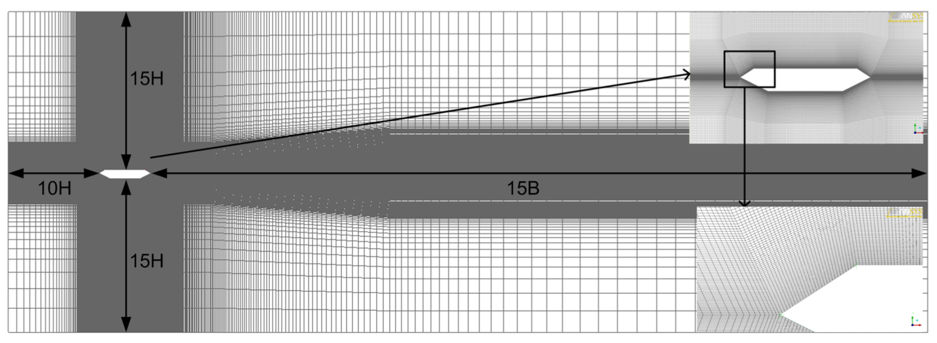
How we handle turbulence numerically?
Discretization of Navier-Stokes Equations
Number of cells: 10x10⁶
Number of cells: 1,2x10⁶

Slide 15
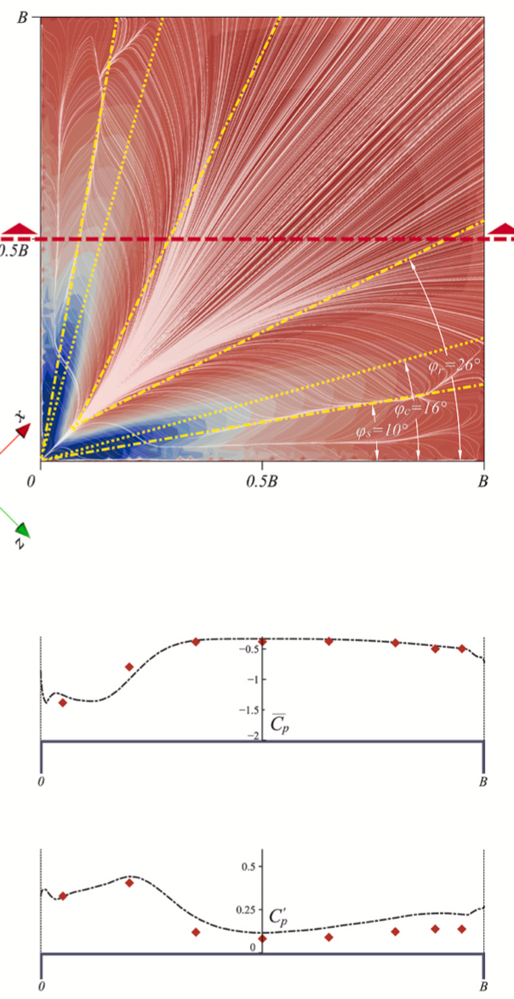
Why such level of resolution?
Complex flow
Flow
Pressures/Forces

Slide 16
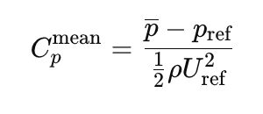
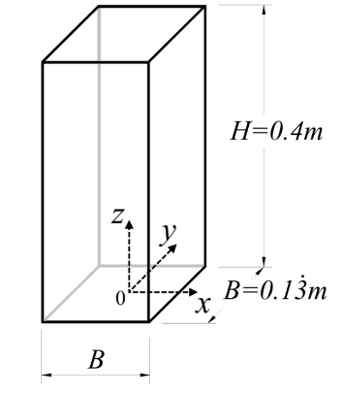
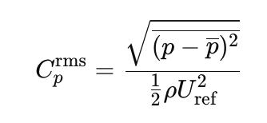
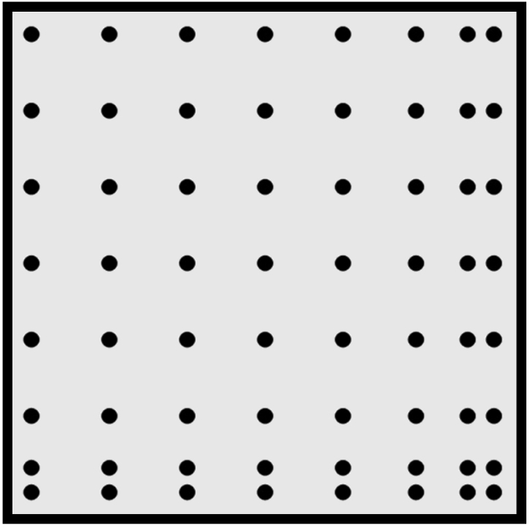
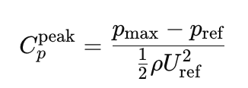
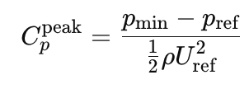
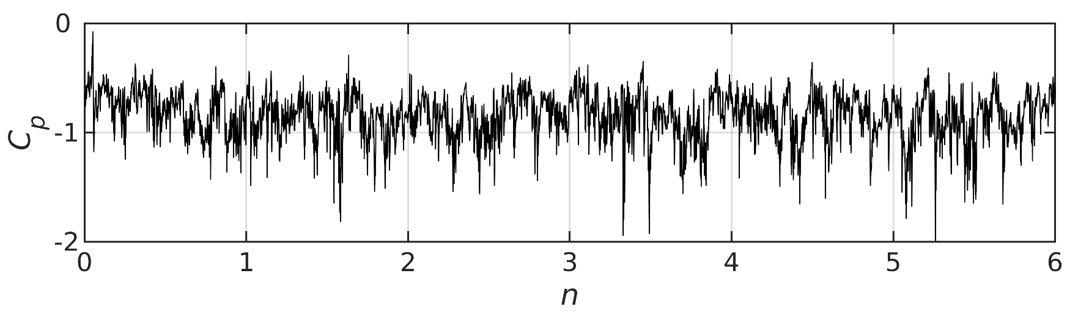
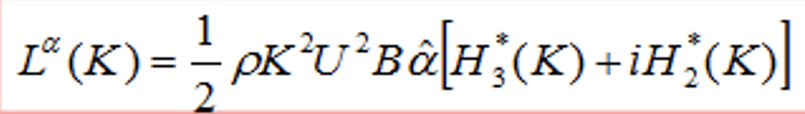
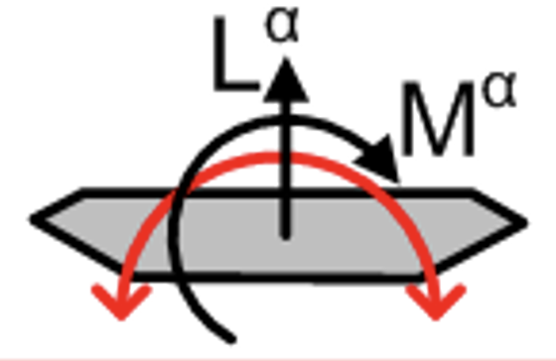
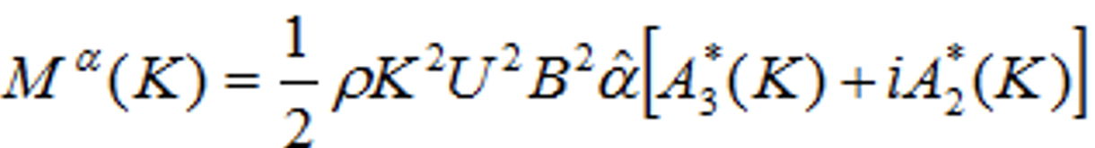
Main QoI for Assessing the Wind Loads?
Pressure Coefficients & Forces
Loads on Structures
roof top
… Aeroelastic Forces
Flutter in Bridges

Slide 17
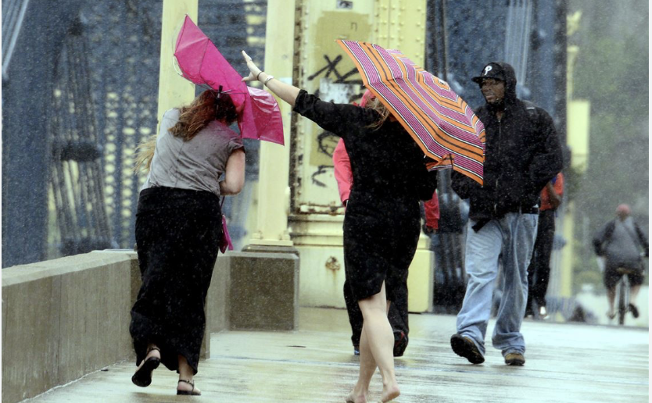
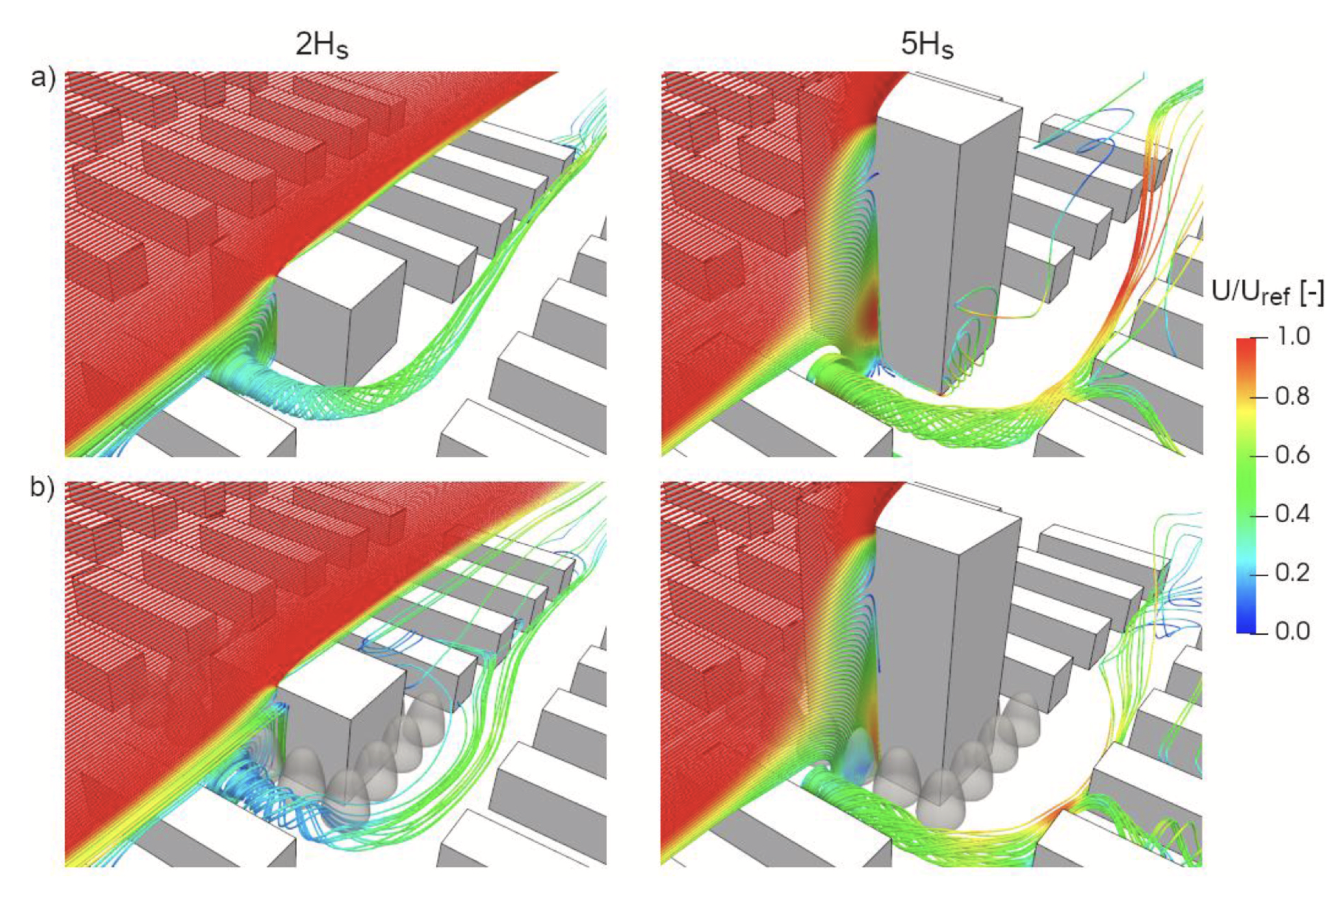
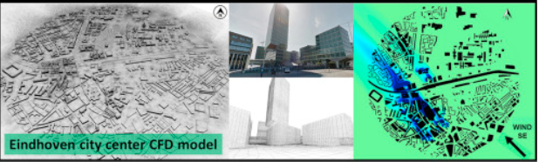
Main QoI for Assessing the Environmental Engineering Studies?
Application Based
- Velocities & Turbulence Intensities
- Pollutant concentrations, etc.
Wind Microclimate Assessment
and/or Optimisation
Pittsburgh,
Source: www.post-gazette.com/news/weather-news/2023/202303250072
Kublaj et al., JWEIA, 2024
China,
Source: https://www.istockphoto.com/photo/china-shenzhen-skyscraper-gm969333552-264204925?searchscope=image%2Cfilm
Blocken et al., JWEIA, 2016
Pollution & Mitigation Studies

Slide 18
How we handle turbulence numerically?
Reynolds-Averaged Navier–Stokes
RANS
Large Eddy Simulation
LES
Efficient estimates
Steady state or Ensemble Averaged
Lack of accuracy
Low fidelity simulation
High comp. costs
Transient response
Satisfactory accuracy
High fidelity simulation
How do we choose a CFD Approach?
Engineering Judgment & Experience
Wind Load Studies – prefer LES if feasible
Environmental Eng. Studies - RANS often sufficient

Slide 19
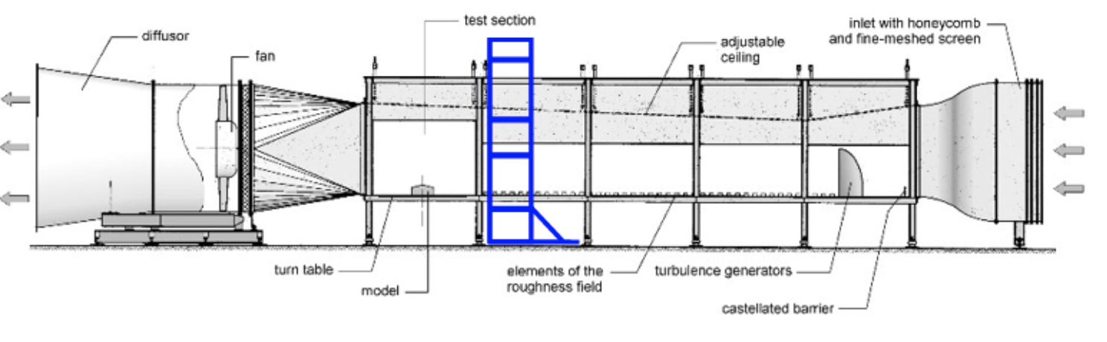
Our Approach
Wind Tunnel

Slide 20
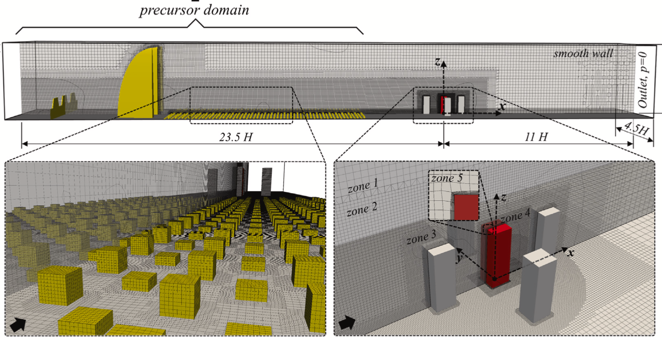
Our Approach
Virtual Wind Tunnel
In case of LES:

Slide 21
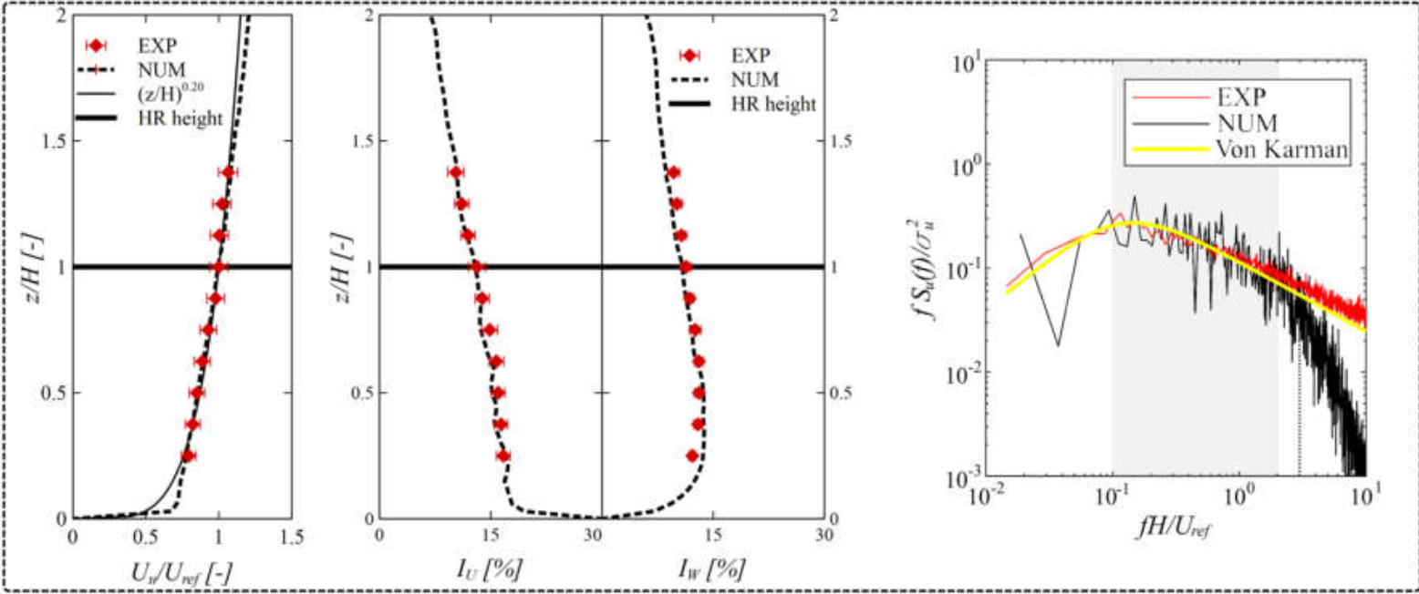
Our Approach
Virtual Wind Tunnel
ABL in case of LES:

Slide 22
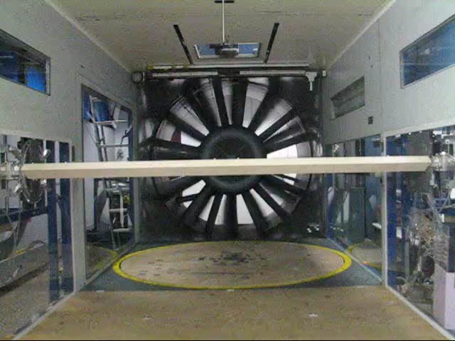
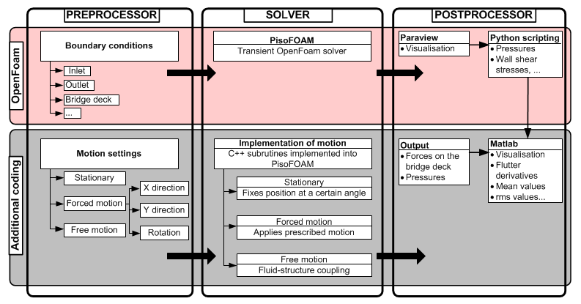

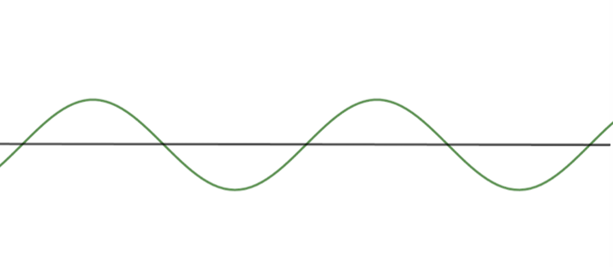
Our Approach
Virtual Wind Tunnel
Bridge Aerodynamics Specialized Experiments
Vortex Shedding
Torsional Divergency
Flutter, etc.

Slide 23
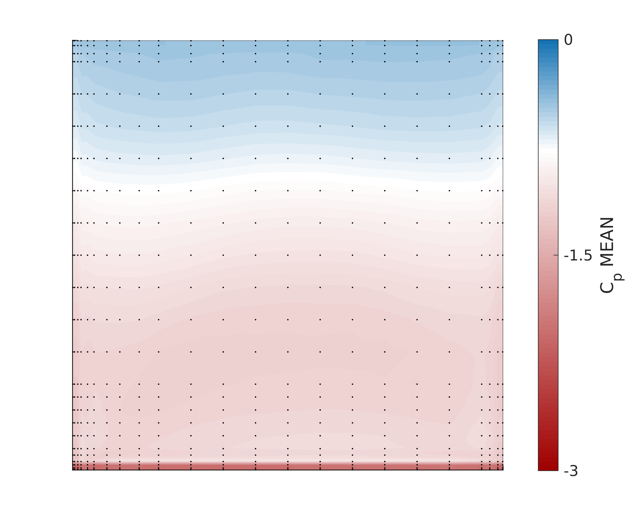
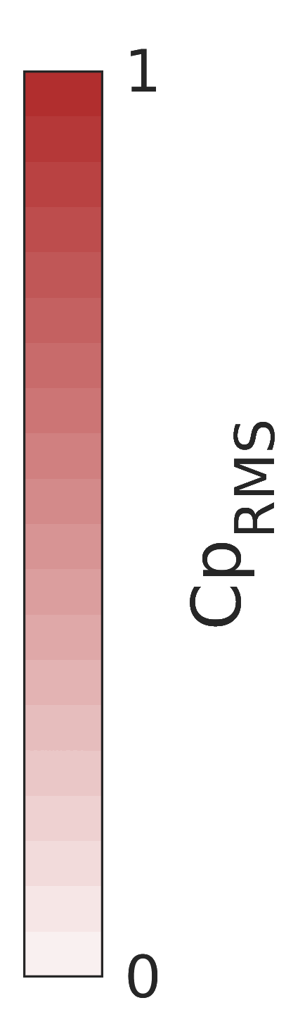
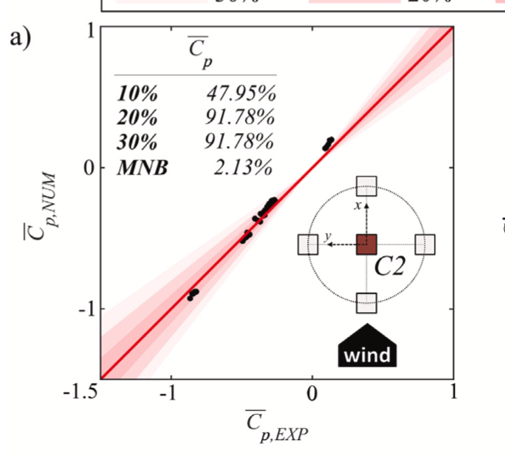
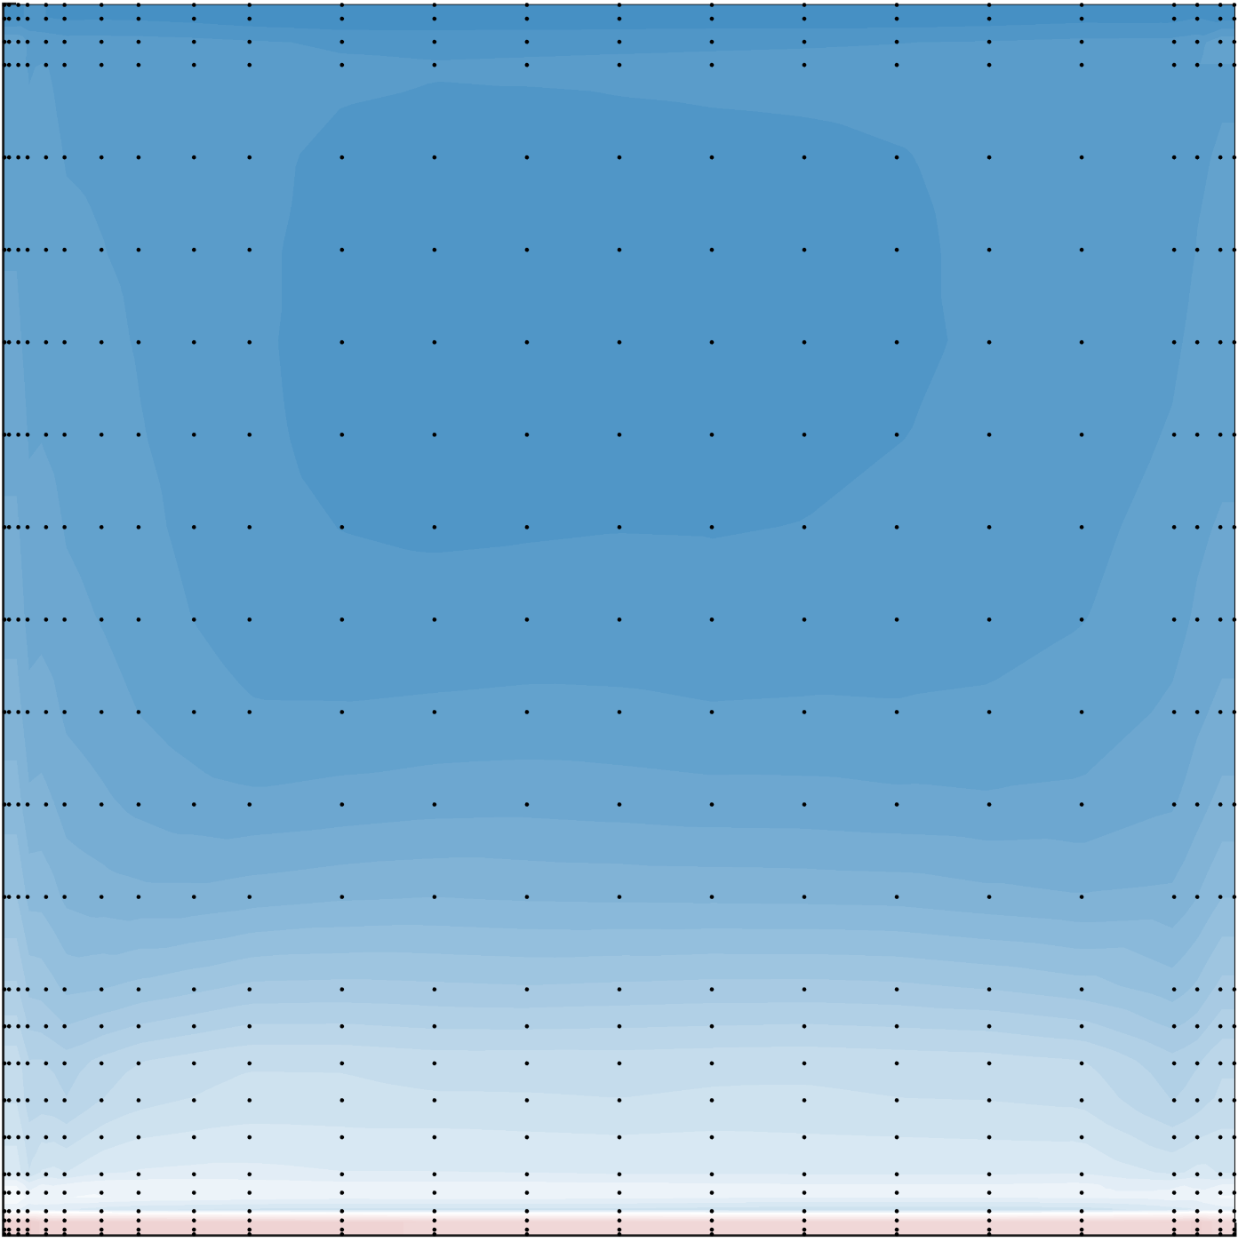
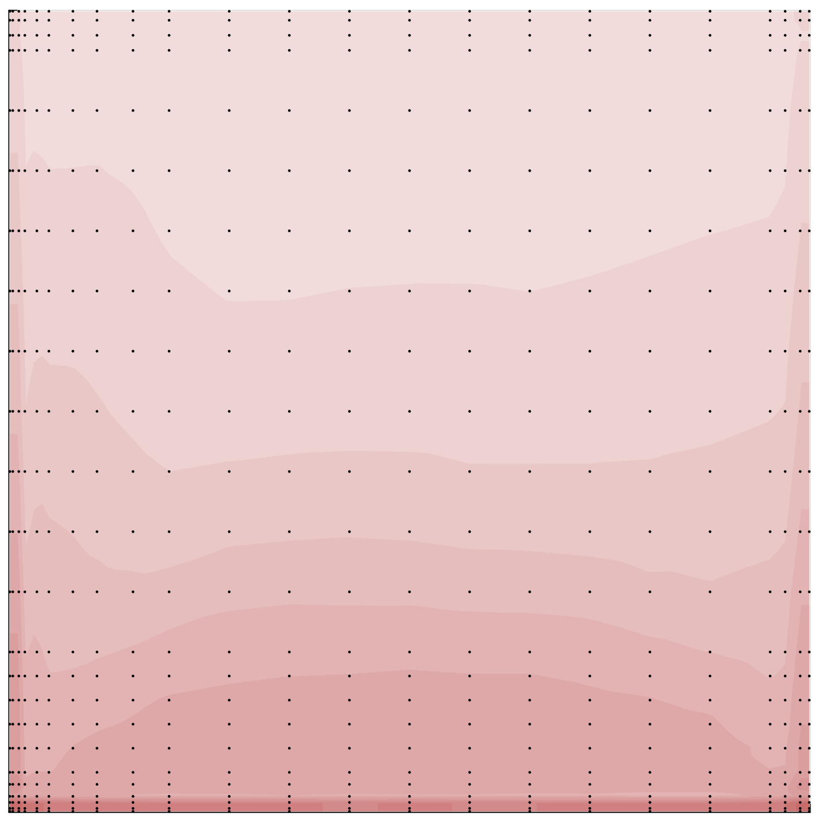







High Rise building
Loads on the Roof Top
(scale 1:300)
LES Pressures -Roof Top
LES vs Exp
roof top
C_{p} MEAN
C_{p} MEAN
C_{p} RMS
-3
0
0
1
C_{p} PEAK
10%. 52.88%
20% 83.72%
30% 96.93%
-8
0
C_{p} PEAK

Slide 24







High Rise building
External Pressure Coefficients – Designed Values
-8
3
Whole Wind Rose!
→ for each direction
– one simulation!

Slide 25



Bridge Aerodynamics - Flutter
Tacoma Narrows collapse 1940
Virtual WT vs Experiments
*) ploted values related to URANS results

Slide 26

Bridge Aerodynamics - Flutter
Aeroelastic Lift Force
One Simulation!

Slide 27
HPC Usage – Absolute Necessity!
High – Rise Building Case
Pre-calculation - Course Mesh:
4,8x10⁶ cells, 5575 CPUh
Main Calculation - Fine Mesh:
10x10⁶ cells, 50000 CPUh
→ for only one wind direction!
Bridge Case
Pre-calculation - Course Mesh:
0,5x10⁶ cells, 1300 CPUh
Main Calculation - Fine Mesh:
1,2x10⁶ cells, 13440 CPUh
→ for only one moving mesh case!

Slide 28



Next Steps… – Machine Learning, Data Assimilation…
How to predict the urban wind flow patterns accurately but with a reasonable computational cost?
How can we use previous knowledge in diverse urban landscape (application in optimisation studies)?
3 LES high-fidelity sim.
for 7 wind directions!
Transfer Learning
How can we use knowledge from experiments (or high-fidelity sim.) to speed-up and enhance the simulations?
Data Assimilation

Slide 29



Wind Engineering Group
Kristina
Kostadinović Vranešević
Miloš Jočković
Anina
Šarkić Glumac
Faculty of Civil Engineering
University of Belgrade

Slide 30
Thank you!
EuroCC4SEE
Belgrade
20-22 May 2025
EUROCC4SEE | 20.-22. 05. 25. | Belgrade, Serbia

