Slide 1
From Theory to Practice:
AI Applications in Multiple Sectors by the Institute Mihajlo Pupin
EuroCC4SEE Workshop in Belgrade, May 21st, 2025
Katarina Stanković, MSc EE & CS
Research and Development Associate
katarina.stankovic@pupin.rs

Slide 2
Outline
The Institute Mihajlo Pupin: Research and Development Powerhouse
  Our Solutions
  Joining Forces with EU-Based R&D Partners
Application of Artificial Intelligence in EU projects
  Reinforcement Learning-Based Optimization of an HVAC System
  Non-Intrusive Load Monitoring and Energy Disaggregation
  Surrogate Data-Driven Optimization of a Manufacturing Process
  Other Applications

Slide 3
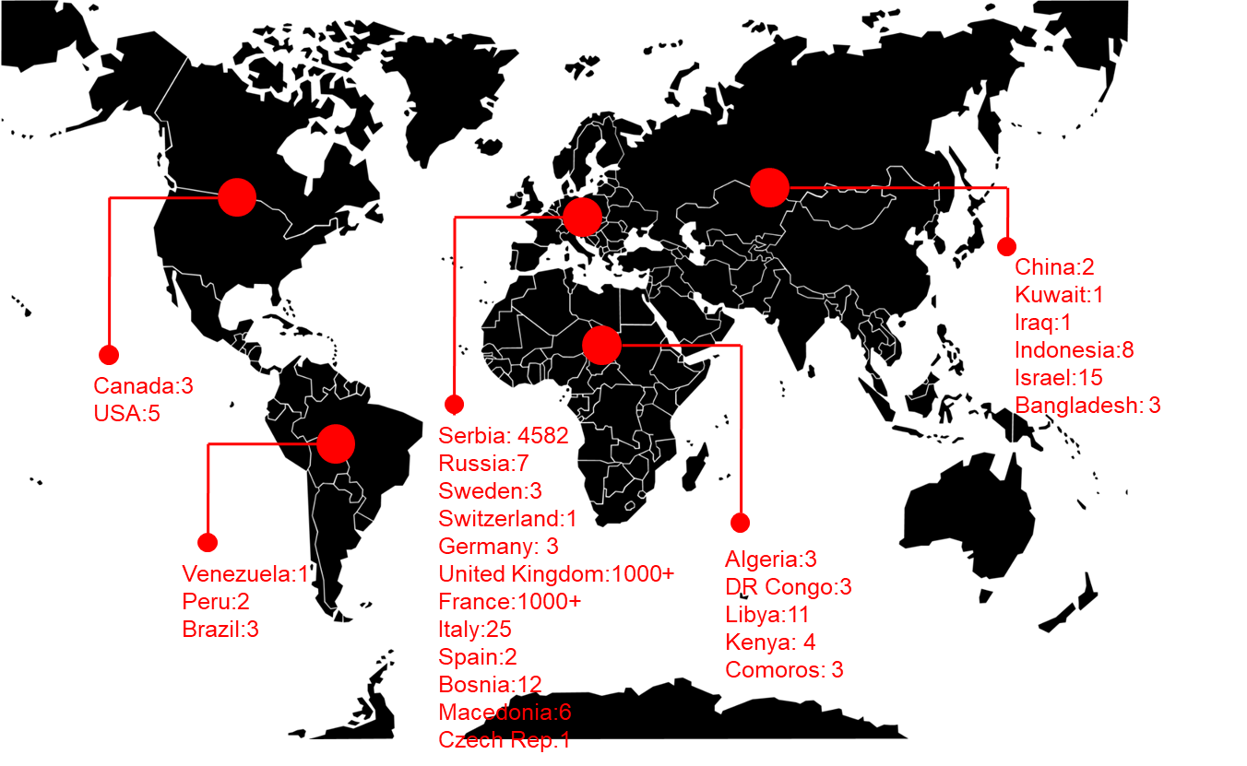
INSTITUTE
MIHAJLO PUPIN
Research and Development Powerhouse
One of the leading Serbian R&D institutions in Applied information and communication technologies (ICT)
One of the biggest and oldest (1946) R&D institutes in the ICT area in the whole of Southeastern Europe
500+ employees, 350+ researchers & engineers
Turnover 60M€.a, 80%+ via Technology Transfer
Affiliated to the University of Belgrade
EU Commissionaire statement:
“Pupin as the best practice example for
bridging academia and industry”

Slide 4

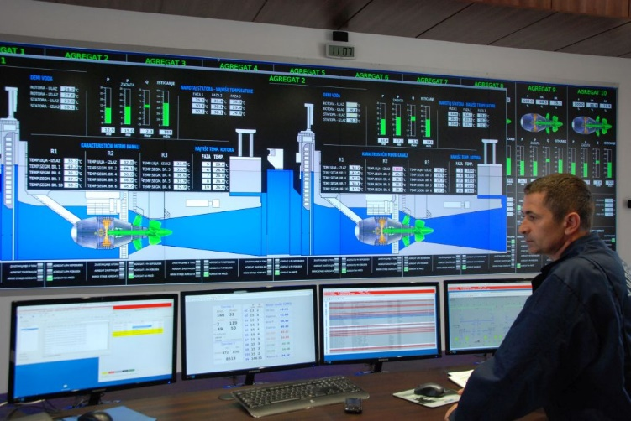
Our Solutions
MAIN PROGRAMS
Information Systems: E-government solutions, Document Management Systems, Decision Support Systems, AI based systems
  Local and central tax administration,
  Serbian Business Registry and e-portal for reports ordering, payment and delivery (one stop shop)
  ISs for Anti-Money Laundry Agency, Ministry of Agriculture, Ministry of Justice and Ministry of Interior
Process Control Systems: Power Production, Transmission and Dispatching Control and Supervision Systems, Water Supply and Management Systems
  40 years in Process Control Systems
  Supervisory Control and Data
  Acquisition Systems (SCADA) and Digital Control Systems (DCS)
  Proprietary SCADA SW (VIEW®) and HW solutions (ATLAS®)

Slide 5
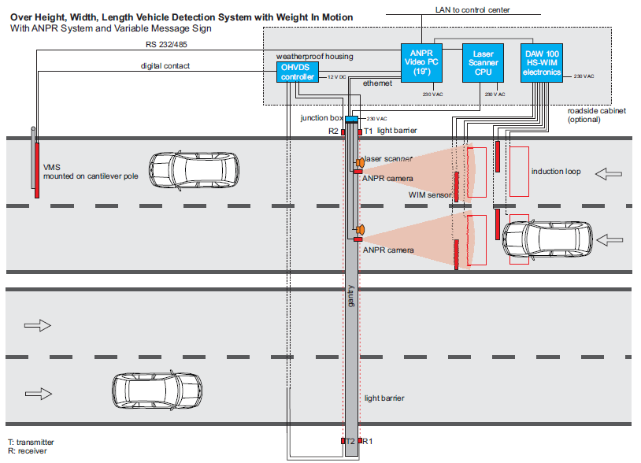
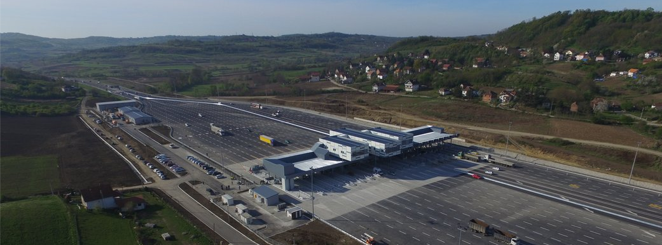
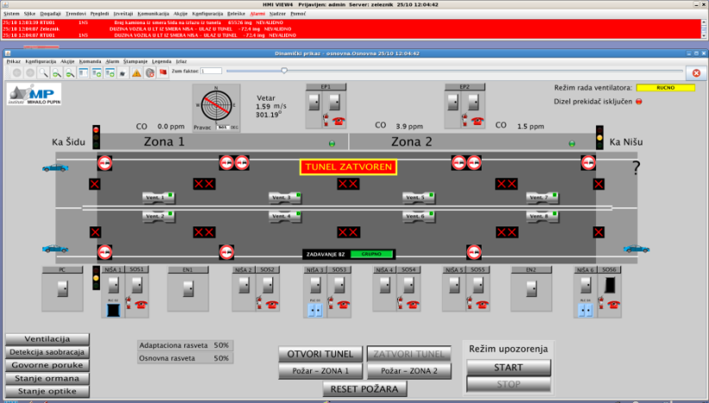
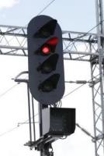
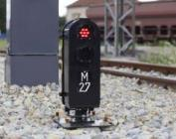

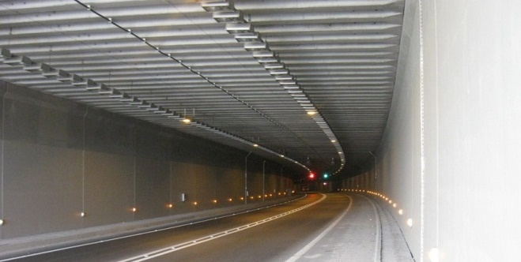
Our Solutions
MAIN PROGRAMS
Traffic Management Systems: Urban Traffic Control, Tunnel Management, Highway Pay-Toll Systems, Parking and Access control system, Weight-in-motion detection
  All pay-toll systems on Serbian motorways are
  products of R&D at IMP
  Toll Collection systems in Serbia, Montenegro, Bosnia and Herzegovina and DR Kongo
Railway Program: Axle Counter, LED signals, HMI solutions
  Universal Train-wheel Detector (UTD)
  Train Axle Counter (BROS)
  Universal LED module (LL-000)
  Main, Shunting, Limit Track LED signals
  Railway LED indicator signals
  Railway safety HMI (MMI10)
Toll Plaza Belgrade (RS)

Slide 6
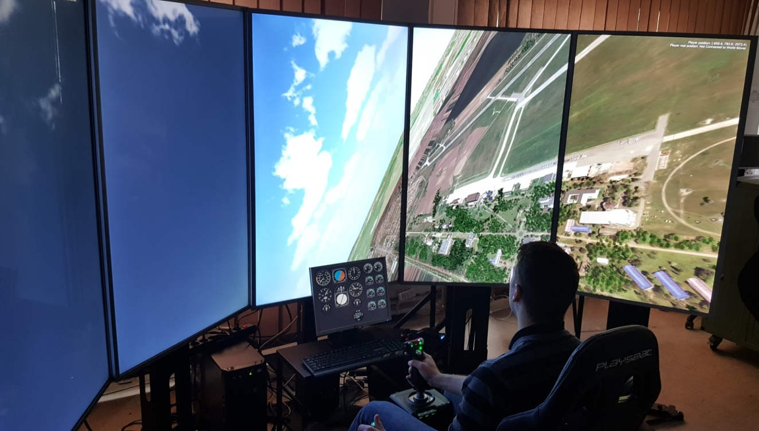

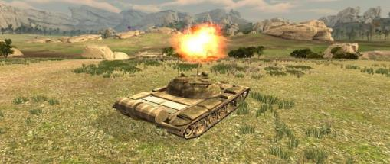
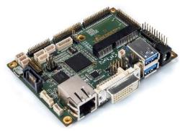
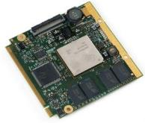
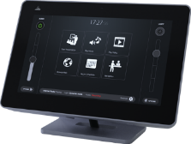
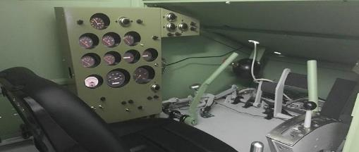
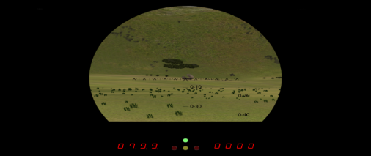

Our Solutions
MAIN PROGRAMS
Defense Program: Simulation and Training Systems, Air War Gaming Systems, Radar signal processing systems, Electronic Surveillance Systems, Ballistic Analyzer
Other Programs and Activities: Robotics, Security, Embedded Systems, Surveillance, Alert & Warning Systems, etc.
  Pico-ITX SBC based on TI’s OMAP5430 SoC
  TI DaVinci DM8168 Qseven Module
  STOS DVA
  LIVIAU S
Virtual T-55 gunner’s optic
Virtual tank on the battlefield
Inside M-84 tank driver compartment
Virtual M-84 gunner’s optic
Virtual reality subsystem for flight simulators SL-G4 and SL-J22

Slide 7






Joining Forces with EU-Based R&D Partners
118 International Research Projects, over 500 partners
13 Horizon Europe (FULL-MAP, STUNNED, EUSOME, LEGOFIT, InterPED, HYCOOL-IT, STREAM IT, ECHO, FEDECOM, R2D2, IntelliLung, OMEGA-X, POLICY ANSWERS)
21 H2020 (NEON, AI-PROFICIENT, HESTIA, SINERGY, TRAPEZE, BorderUAS, PLATOON, TRINITY, IDEAS, REACT, LAMBDA, FeeelAgain, RESPOND, InBETWEEN, SlideWIKI, FLIRT, EEN INNO, FS4SMIH, EENSerbia, EENClientInnoJourney, EENInnoSJourney)
22 FP7 projects (REFLECT, AgroSENSE, META-NET, WBC-INCO-NET, HydroWEEE, ICT-WEB-PROMS, HELENA, EMILI, ENERGY WARDEN, PROCEED, LOD2, CASCADE, H-WEEE-DEMO, EPIC-HUB, SPARTACUS, GenderTIME, ResearchersNight, GeoKNOW, Danube INCO.NET, NoSQL-NET, Trafoon)
7 CIP/EIP (CESAR, EIIRC, GREEN, WEEEN, ICIP, IMAGEEN, Share PSI 2.0)
2 IPA Adrion (GoToTwin, CAROUSEL)
IPA Adriatic (PACCINO)
2 ERASMUS+ (BEST, RE-FEM)
4 SEE (Intervalue, FORSEE, WBINNO, TV-Web)
3 TEMPUS (CARE, HUTON, INCOMING)
8 COST Actions (IC1004, IC1304, CA16116, CA15104, NexusLinguarum, Distributed Knowledge Graphs, VOICES, INTERACT)
1 RSEDP2 (EMC)
2 UNDP (Smart Land, StreetAirPurifier)
3 FP6 projects (SARIB, PROMETEA, Web4WeB)
3 Interreg DANUBE (MOVECO, NewGenerationSkills, EDU-LAB)
2 EC Interreg/CADSES projects (I2E, STRIM)
6 IPA (EPS, Tax, Justice, Agro, POM, APML)
18 Bilateral projects (2 Switzerland, 3 France, 5 Germany, 1 Cyprus, 1 Greece, 1 Norway, 1 Portugal, 1 Slovenia, 3 China)

Slide 8
REINFORCEMENT LEARNING-BASED OPTIMIZATION OF AN HVAC SYSTEM

Slide 9


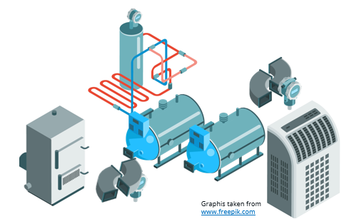
Reinforcement Learning-Based Optimization of an HVAC System
Work conducted within Horizon ECHO project: Efficient Compact Modular THermal Energy StOrage System (2023-2026)
Project aimed at developing novel modular, compact, high performances and Plug&Play thermal energy storage (TES) solutions for heating, cooling and domestic hot water (DHW) production
TES systems enable electricity load shifting, supporting flexible energy systems
ECHO TES based on thermo-chemical and phase changing materials
Overall Heating Ventilation Air-Conditioning (HVAC) system consists of TES, heat pump, various tanks, pumps, valves and fan coils
Its operation is quite complex - a suitable control algorithm required

Slide 10
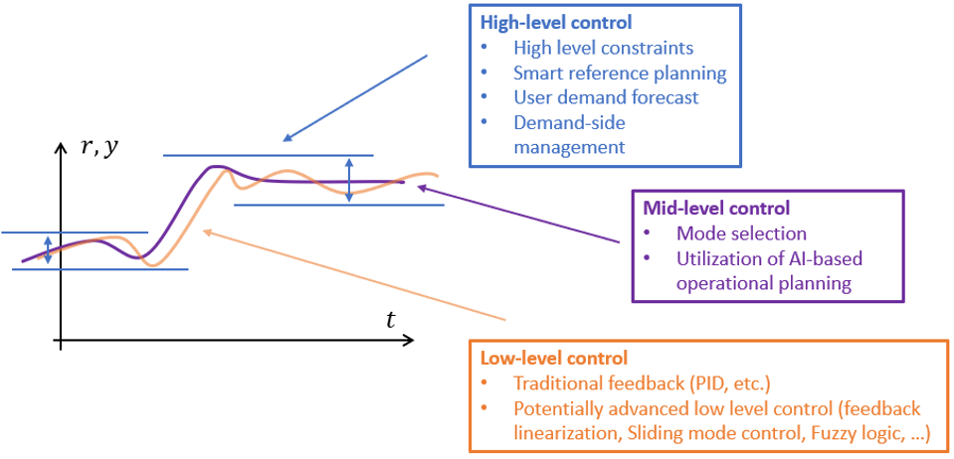


Reinforcement Learning-Based Optimization of an HVAC System
Reinforcement learning (RL) a backbone of local optimization, aka mid-level/prosumer level control
electrical community optimization
Graphis taken from www.freepik.com
Client
Client
Client
Local optimization
Local optimization
Local optimization
. . .
Asset control
Asset control
Asset control

Slide 11
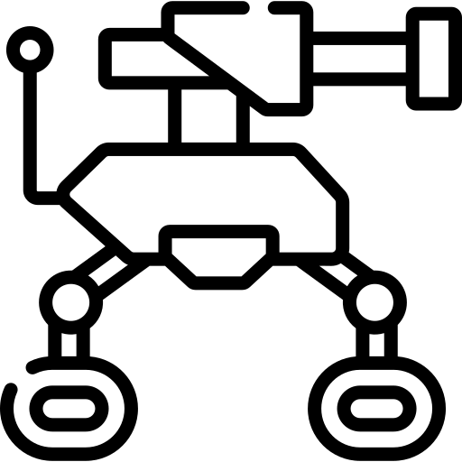

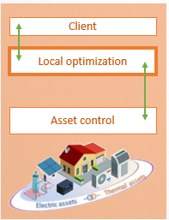

Reinforcement Learning-Based Optimization of an HVAC System
action
Mid-level control objective - to find the optimal asset schedule or optimal system state (e.g. TES charge/discharge/idle) to achieve some predefined goal (e.g. reduce costs):
  agent is a mid-level control algorithm
  environment is the ECHO TES system
Minimization of the total cost of energy for 24-hour period with 15-minute time resolution
Model of environment (ECHO TES system) necessary to train the RL – white-box modelling approach
Various system measurements and forecasts were used:
  Estimated thermal and electrical demand
  Forecasted available RES (e.g. PV)
  Current SoC of ECHO TES
  Pricing scheme
agent
environment
state, reward
prosumer-level control
action
ECHO TES
system
ECHO TES state estimation
total cost

Slide 12
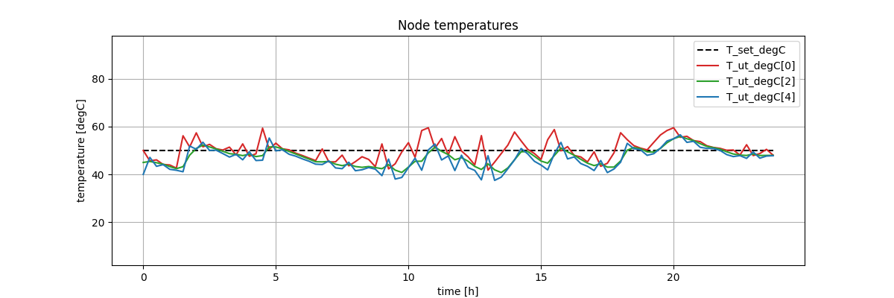
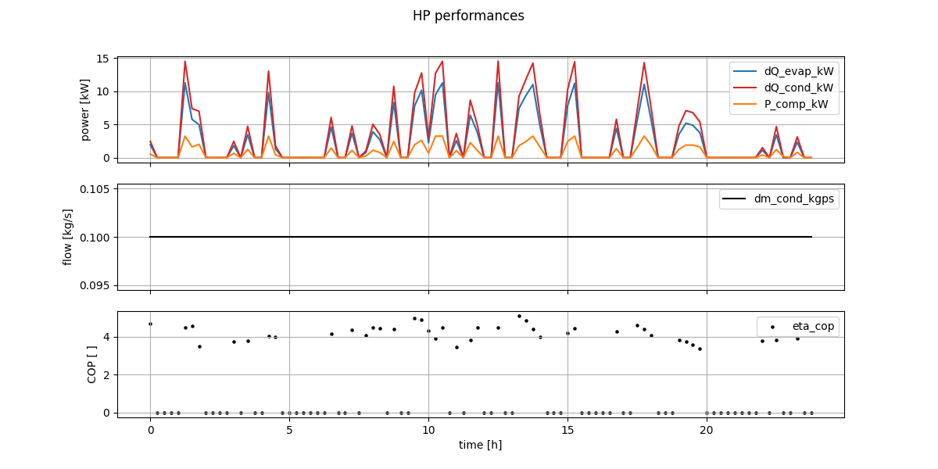
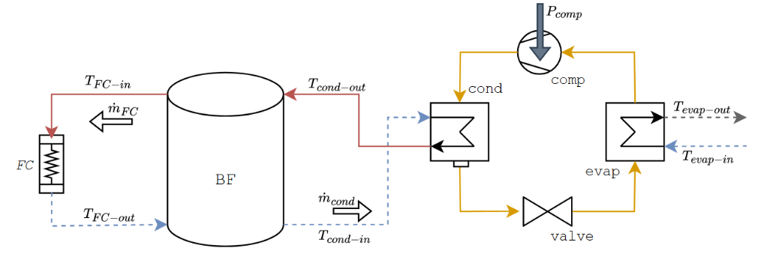
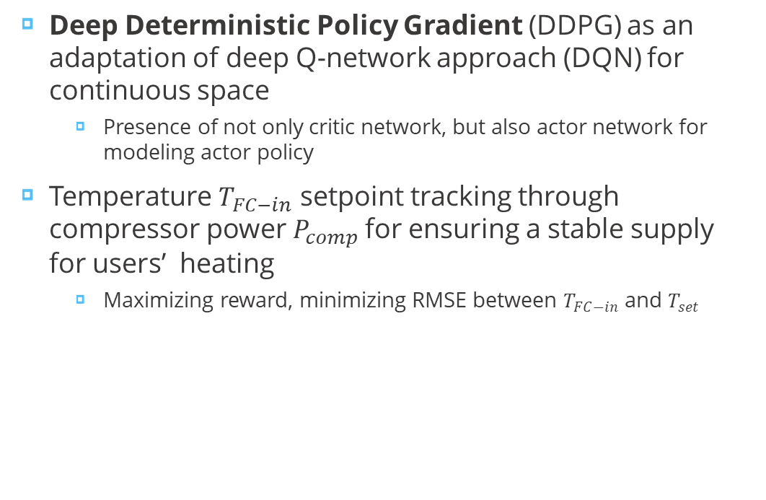
Reinforcement Learning-Based Optimization of an HVAC System
Deep Deterministic Policy Gradient (DDPG) as an adaptation of deep Q-network approach (DQN) for continuous space
  Presence of not only critic network, but also actor network for modeling actor policy
Temperature $T_{FC−in}$ setpoint tracking through compressor power $P_{comp}$ for ensuring a stable supply for users’ heating
  Maximizing reward, minimizing RMSE between $T_{FC−in}$ and $T_{set}$
RMSE = 4.7 °C
Jelić, D., Jelić, M., Stanković, K., Batić, M. Reinforcement Learning-Based Smart Temperature Control for Buffer Tanks in HVAC Systems. Presented on ICIST 2025; to be published in the corresponding Springer proceedings soon.

Slide 13
NON-INTRUSIVE LOAD MONITORING AND DISAGGREATION

Slide 14


Non-Intrusive Load Monitoring and Disaggregation
Work conducted within H2020 HESTIA: Holistic dEmand response Services for European residenTIAl communities (2020-2024)
Project aimed at developing a cost-effective solution for the next-generation demand-side response services.
Power consumption disaggregation on the appliance level
The goal was to develop automated model that can learn which appliances are ON over a period of time
Non-Intrusive Load Monitoring (NILM)
Generalization issue in model training required special attention

Slide 15
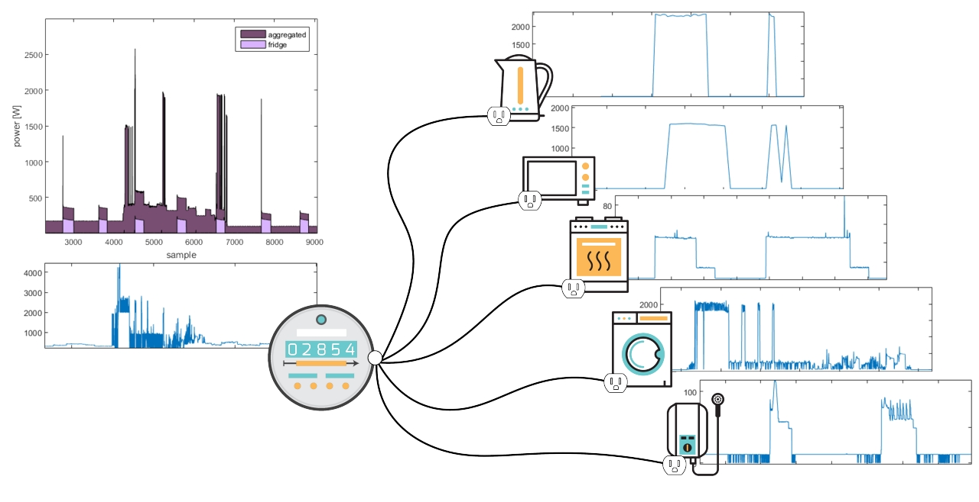
Non-Intrusive Load Monitoring and Disaggregation
Pujić D, Tomašević N, Batić M. A Semi-Supervised Approach for Improving Generalization in Non-Intrusive Load Monitoring. Sensors. 2023; 23(3):1444. https://doi.org/10.3390/s23031444

Slide 16
Non-Intrusive Load Monitoring and Disaggregation
  Pilot houses usually unequipped with appliance individual consumption measuring sensors
    Labels (individual consumption) are available only in public data sets
  Training on one data set and testing on the other can significantly decrease the performance of the model
  Domain adversarial neural network (DANN) approach
    designed to train the model so that it extracts the features that are relevant for the problem, not for the domain
    specific architecture and training process:
      feature extractor (FE) for obtaining relevant features from aggregated consumption
      classifier (C) for classification whether appliance is on or off depending on the extracted features
      discriminator (D) to classify the domain of the input data (training or testing)
input
FE
D
C
domain label
activation label

Slide 17
Non-Intrusive Load Monitoring and Disaggregation
NILM intended for high consuming appliances
Methodology applied on four different appliances from REDD and UK-DALE data set
 | REDD | REDD + UK-DALE
 | Seq2point | Seq2point | DANN
Refrigerator | 85% | 59% | 62%
Tumble dryer | 85% | 80% | 82%
Dishwasher | 88% | 78% | 79%
Microwave | 82% | 89% | 84%
input
input
input
FE
D
C
FE
D
C
FE
D
C
domain label
activation label
domain label
activation label
domain label
activation label
Parameters not taken into account in any point of the considered training phase
Trainable parameters
Non-trainable parameters

Slide 18
SURROGATE DATA-DRIVEN OPTIMIZATION OF A MANUFACTURING PROCESS

Slide 19
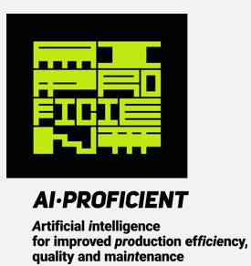
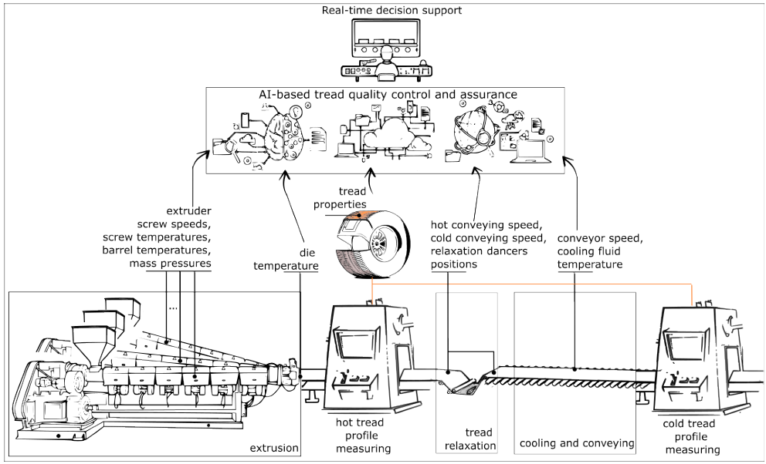
Surrogate Data-Driven Optimization of a Manufacturing Process
Work conducted within H2020 AI-PROFICIENT: Artificial Intelligence for improved PROduction efFICIEncy, quality and maiNTenance (2020-2023)
Project aimed at developing proactive control strategies to improve manufacturing processes efficiency, quality and maintenance.
Tire tread production plant – one of the pilot sites
Key product characteristics like thickness, width, and weight are continuously monitored
Their control within tight quality limits required
Hundred of different treads yearly produced
A wide range of process conditions and product specifications
AI-based Quality analysis and assurance tool

Slide 20
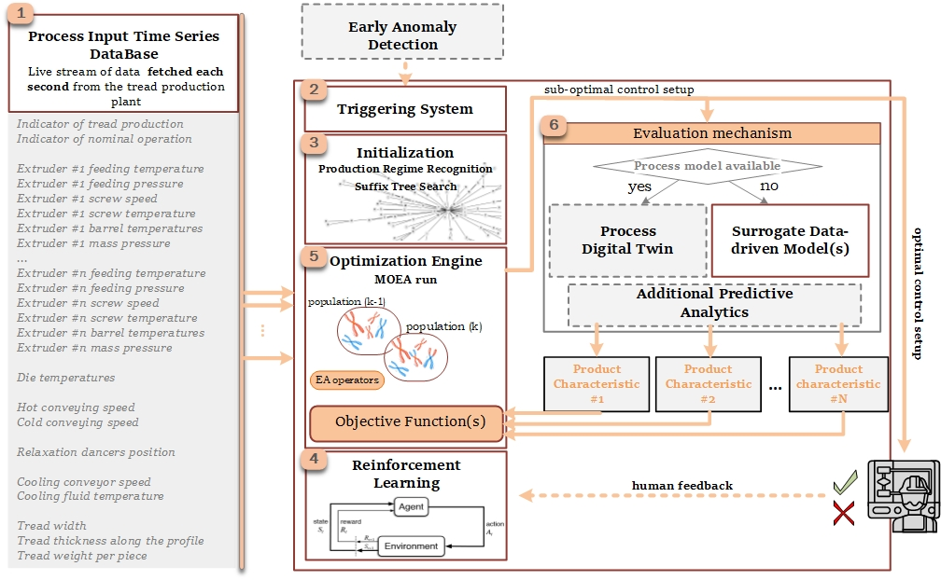
Surrogate Data-Driven Optimization of a Manufacturing Process

Slide 21
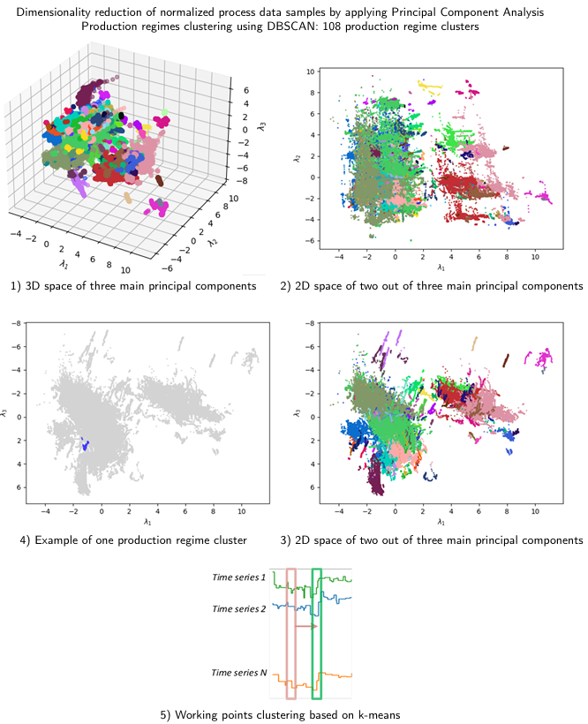
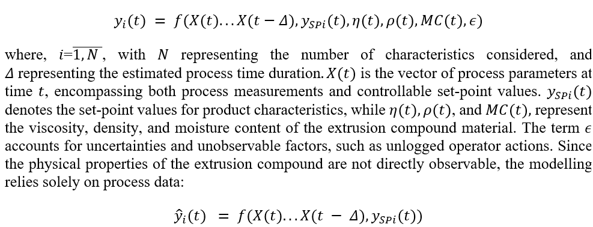
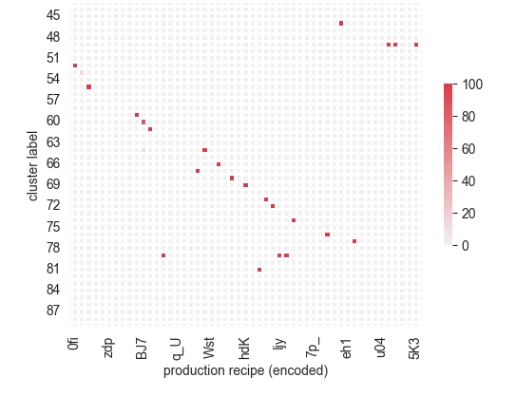
Surrogate Data-Driven Optimization of a Manufacturing Process
Multi-objective evolutionary optimization based on decomposition (MOEA/D)
Surrogate data-driven models (machine learining)
  simulate how various process parameter combinations impact product quality.
Production regime recognition prevents excessively long execution
  optimization constrained to the local environment of a current working point
  Density-Based Spatial Clustering of Applications with Noise (DBSCAN)
  Process modelling with suffix trees
  Recipe-agnostic clustering (modified purity metric achieved 93.42%)
Optimization initialization based on Suffix tree search
  Execution time reduction of up to 76.9%

Slide 22
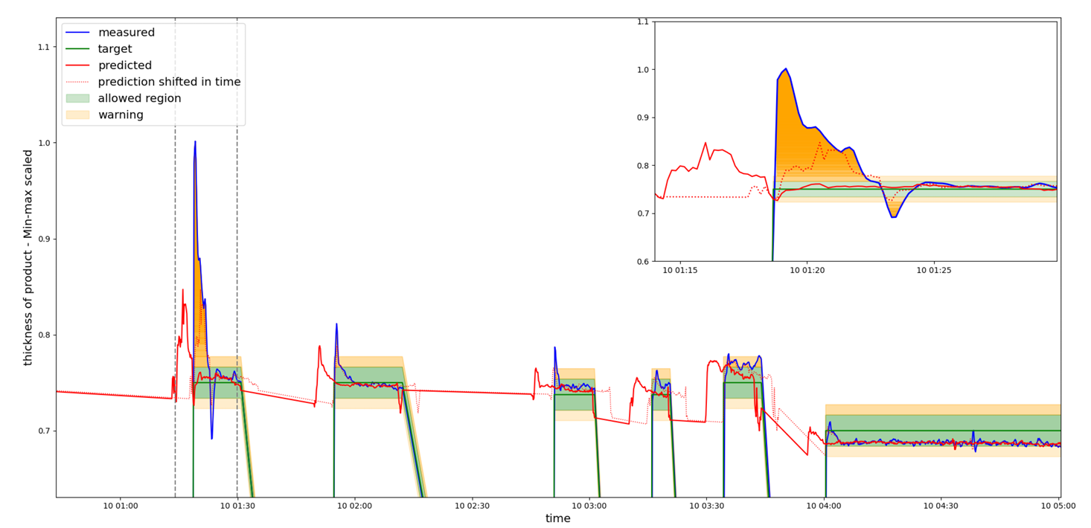
Surrogate Data-Driven Optimization of a Manufacturing Process
K. Stanković, D. Jelić, N. Tomašević, and A. Krstić, ‘Manufacturing process optimization for real-time quality control in multi-regime conditions: Tire tread production use case’, Journal of Manufacturing Systems, vol. 76, pp. 293–313, 2024, doi: https://doi.org/10.1016/j.jmsy.2024.07.015.

Slide 23
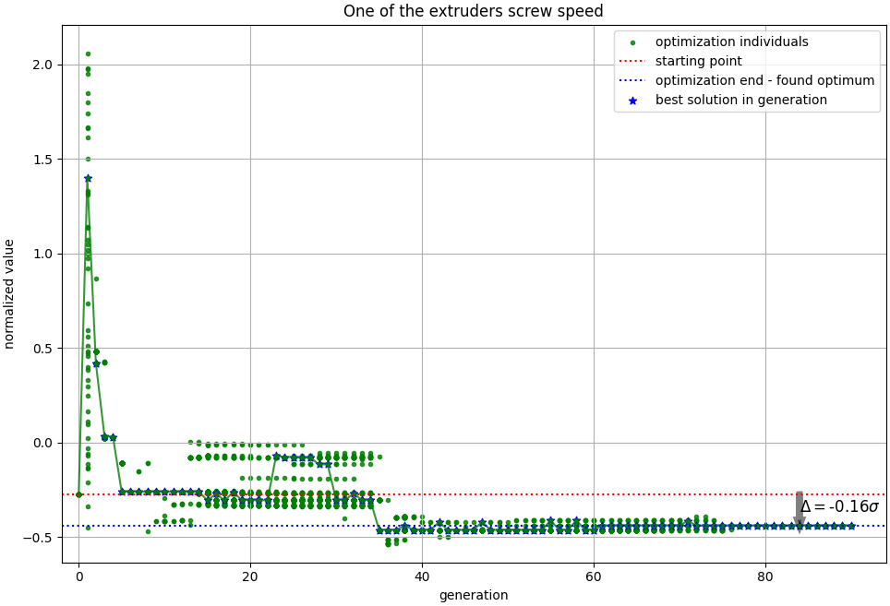
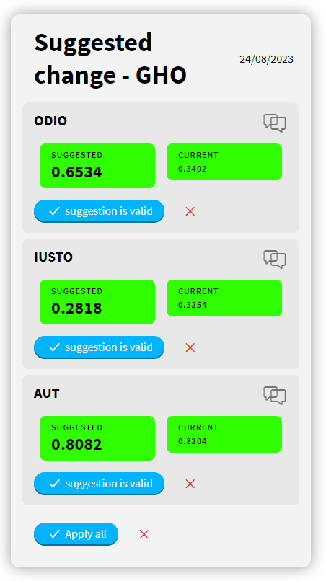
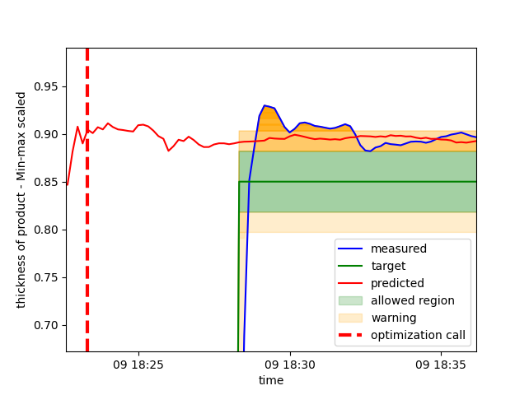
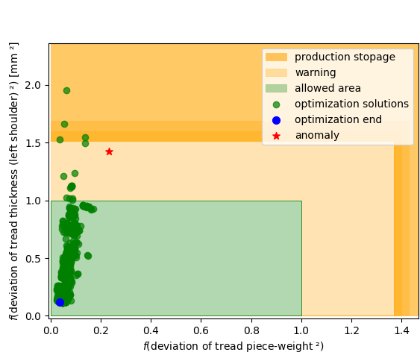
Surrogate Data-Driven Optimization of a Manufacturing Process
K. Stanković, D. Jelić, N. Tomašević, and A. Krstić, ‘Manufacturing process optimization for real-time quality control in multi-regime conditions: Tire tread production use case’, Journal of Manufacturing Systems, vol. 76, pp. 293–313, 2024, doi: https://doi.org/10.1016/j.jmsy.2024.07.015.
waste reduction of 59.7%

Slide 24
OTHER APPLICATIONS

Slide 25

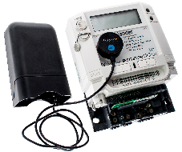

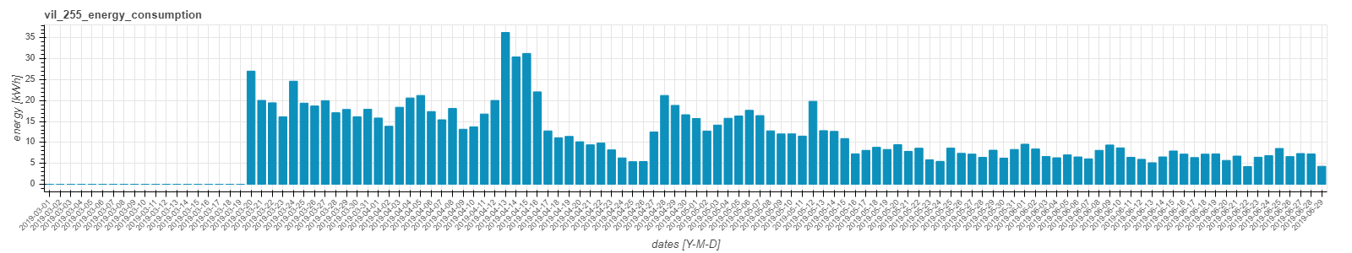

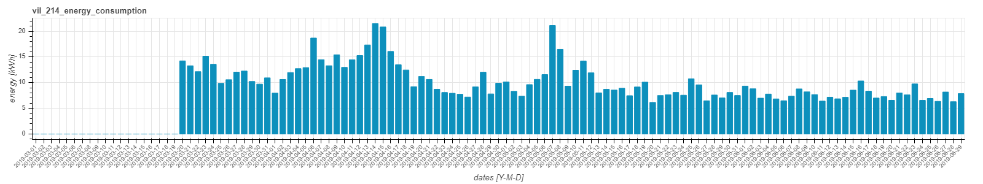
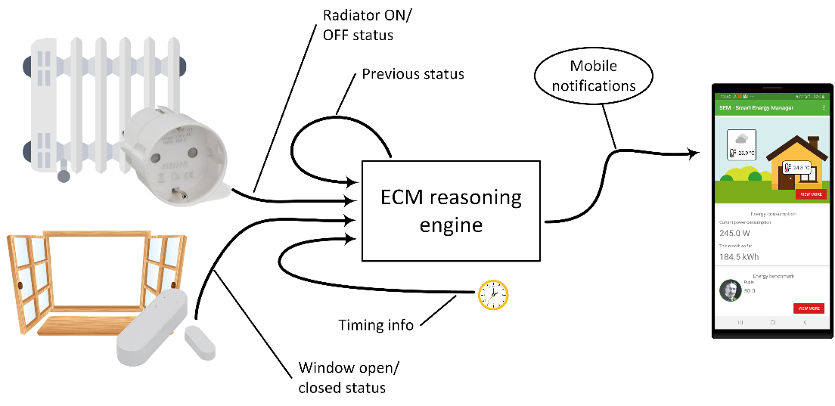
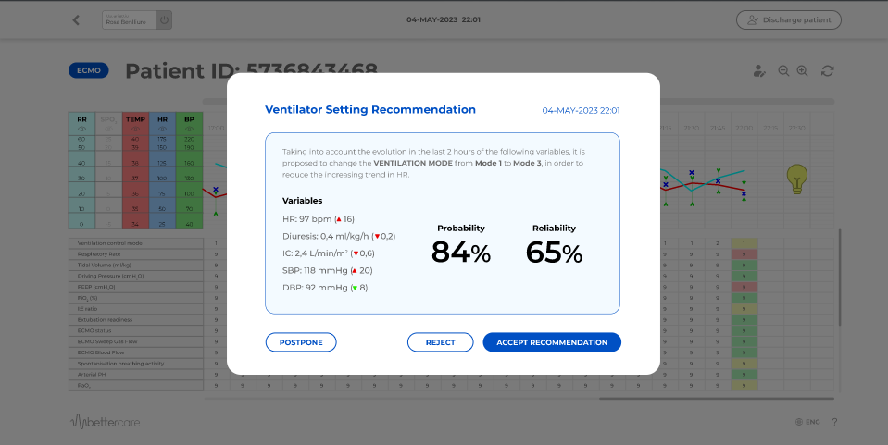

Other Applications
  Forecasters of different purposes - PV production, wind turbine production, national electrical load, residential/commercial facilities electrical load
  Consumer energy efficiency benchmarking service
  Decision support system for mechanical ventilation in intensive care units
  Results recognized by EU Innovation Radar
  Innovative solutions, https://project-sinergy.org/Innovative-solutions
  Publications:
    D. Pujić and N. Tomašević, "Hybrid ensemble neural network approach for photovoltaic production forecast," 2021 29th Telecommunications Forum (TELFOR), Belgrade, Serbia, 2021, pp. 1-4, doi: 10.1109/TELFOR52709.2021.9653369.
    Esnaola-Gonzalez I, Jelić M, Pujić D, Diez FJ, Tomašević N. An AI-Powered System for Residential Demand Response. Electronics. 2021; 10(6):693. https://doi.org/10.3390/electronics10060693
    F. Safaei et al., ‘X-Vent: ICU Ventilation with Explainable Model-Based Reinforcement Learning’, in ECAI 2024, IOS Press, 2024, pp. 4719–4726. doi: 10.3233/FAIA241069.

Slide 26
THANK YOU FOR YOUR ATTENTION!
Katarina Stanković, MSc EE & CS
Research and Development Associate
katarina.stankovic@pupin.rs

