Slide 1

EuroCC4SEE WORKSHOP IN BELGRADE
20-22 May 2025
NCC Montenegro
Success stories

Slide 2


NCC Montenegro @ a glance
NCC governance
NCC infrastructure
UDG is a host University and Leading partner and UoM is an Associated partner in EuroCC2/EuroCC4SEE
National reference point for HPC/HPDA/AI-related activities/ infrastructure/services
23 team members focused on HPC/HPDA/AI awareness, capacity building, research excellence, technical expertise and user support.
Local resources at UDG and UoM (CPU + GPU)
Yotta Advanced Computing
EuroHPC supercomputing resources
Member of GRNET consortium - new EuroCC HPC supercomputer DEDALUS (from 2026)
NCC MNE
NCC MNE
https://eurocc.udg.edu.me

Slide 3
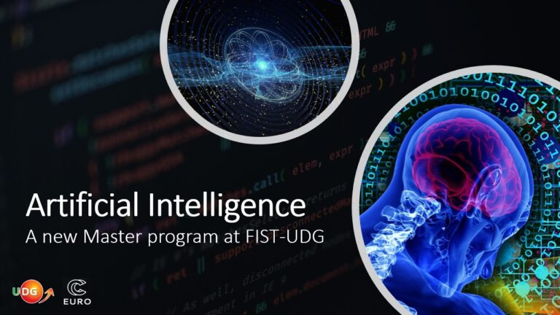
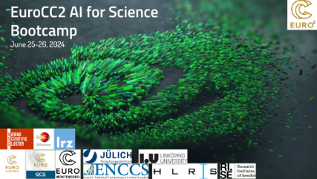

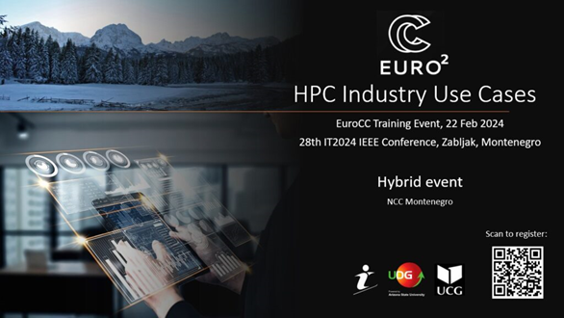
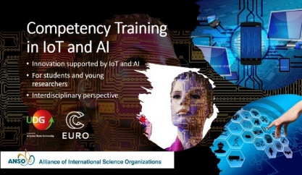


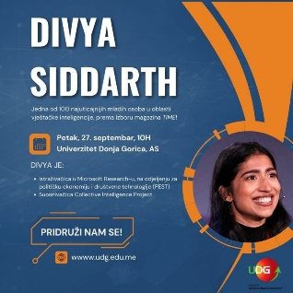
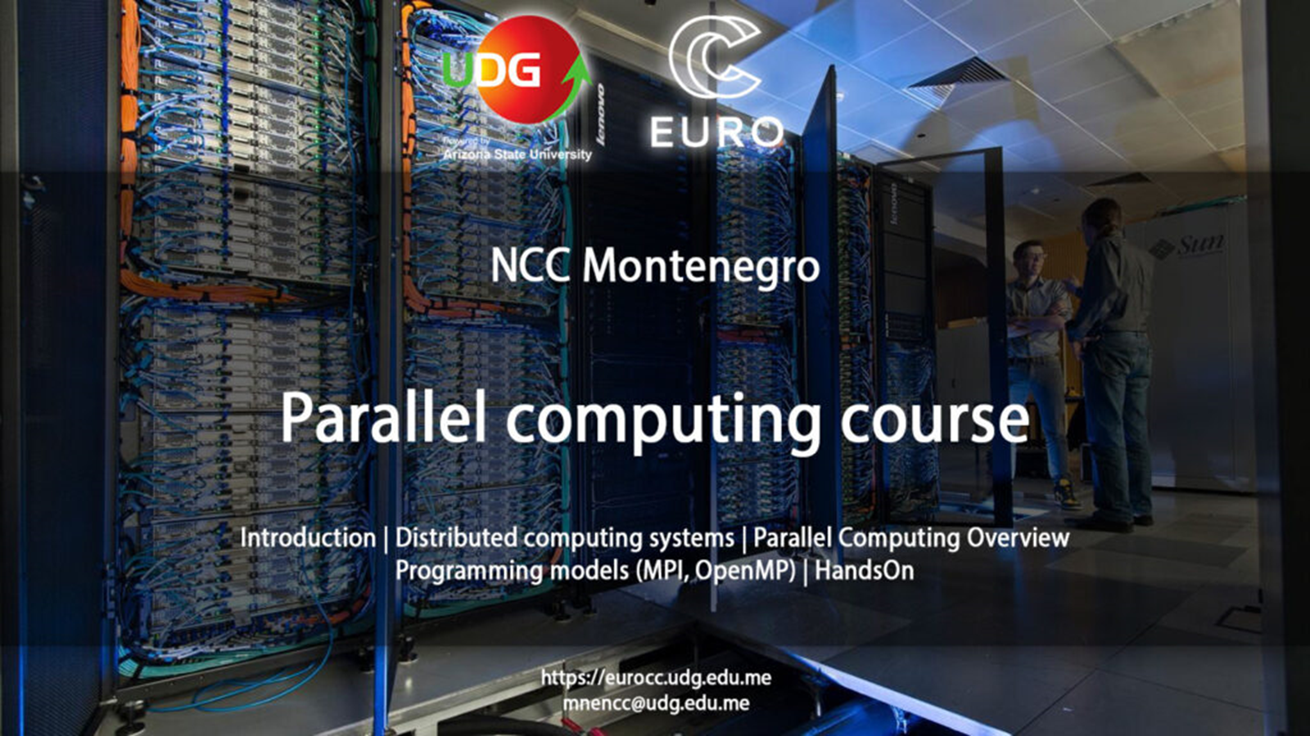


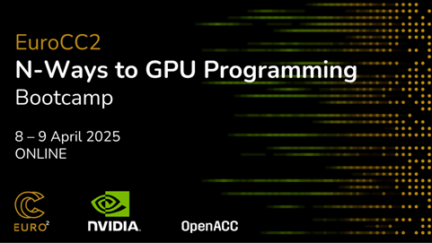
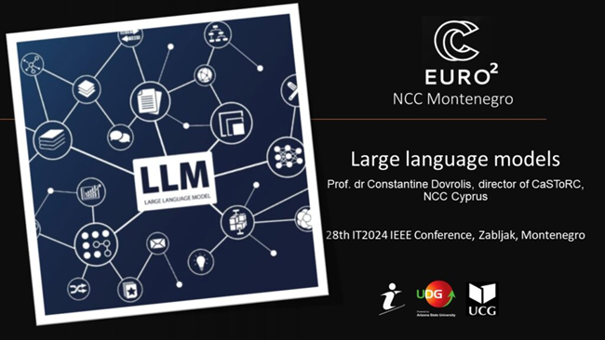
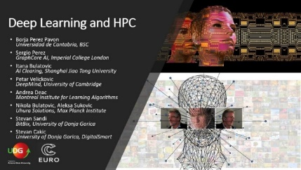
HPC/HPDA/AI skills development @NCC MNE
Academic/study programs
Professional training courses
Invited Lectures
HPC/AI @ IT IEEE conference
The first nationally accredited AI Master program at UDG
Many courses related to AI/ML, parallel programming, parallel and distributed systems at UoM
Professional courses for industry, academia and public sector
Technology-centric (HPC, Python, PP, DL, Edge IoT, NLP…) training portfolio
Industry-oriented (S3: energy, health, agriculture) workshops & courses
Collaboration
FIST
UDG
ETF
UCG
PMF
UCG
FON UB
ANSO
IFM
CANU
CIGRE
NCCMNE
NCC DE
NCC
ESP
NCC
AT
NCC
SWE
NCC CY
NCC
RO
NCC
SLO
NCC
TR
NCC
NMK
NCC
SRB
NCC
BiH
https://eurocc.udg.edu.me

Slide 4
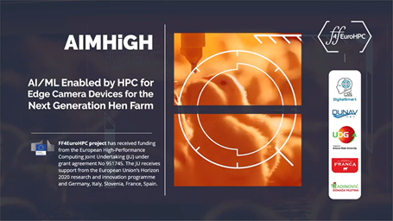
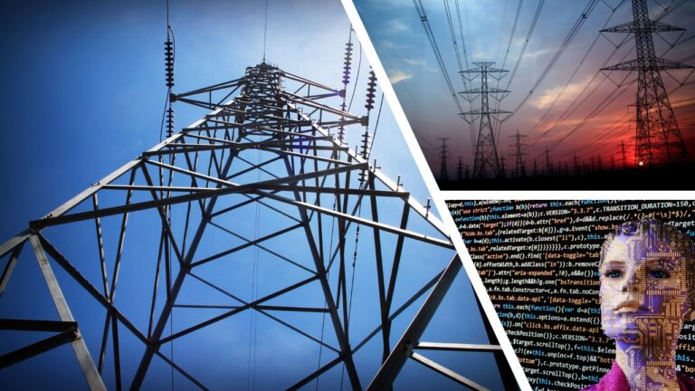
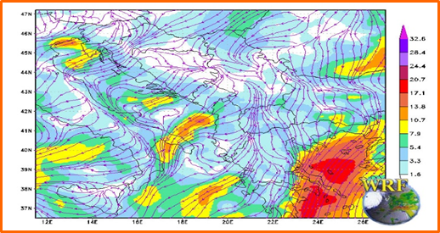
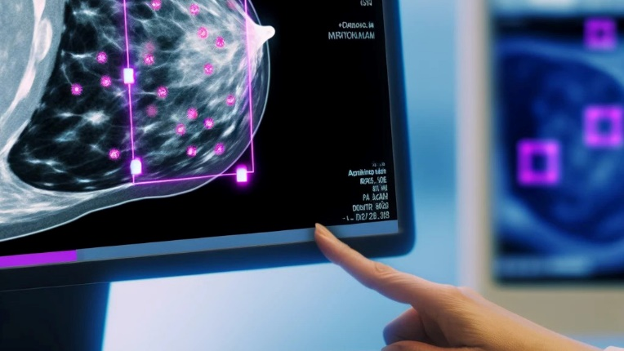


Success Stories in Montenegro
AI/ML COMPUTER VISION FOR POULTRY FARMS
FORECASTING DAY-AHEAD ELECTRICITY METRICS WITH HPC/ML
PRECISE WEATHER PREDICTION
Medical imaging:
Breast Cancer Detection
https://eurocc.udg.edu.me/success-stories/
https://eurocc.udg.edu.me/success-stories/

Slide 5


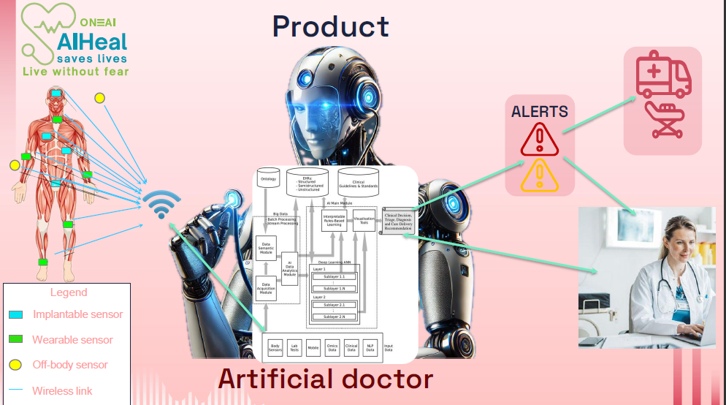
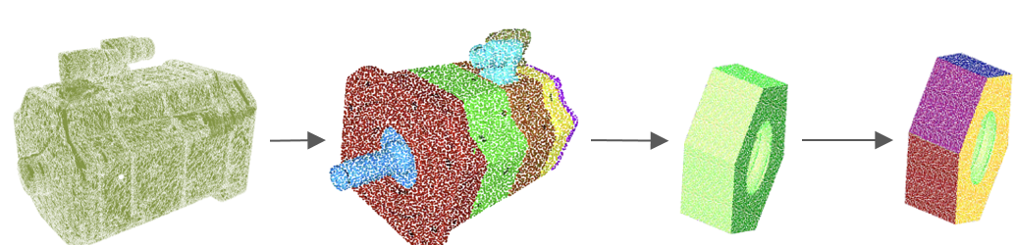
Success Stories in Montenegro
Generative AI Intelligent Process Automation Platform
PAID-T: Price Action Intelligent
Detection Trading
AI Segmentation and 3D Scan Inspection
AI HEAL
https://eurocc.udg.edu.me/success-stories/
https://eurocc.udg.edu.me/success-stories/

Slide 6
AI/ML COMPUTER VISION FOR POULTRY FARMS
FF4EUROHPC Project, featured in FF4EuroHPC success stories booklet
Realized by: DigitalSmart and DunavNet IT companies, UDG and supported by Franca and Radinovic meat industry companies
Monitoring chickens on large poultry farms is labor-intensive and costly, requiring constant attention to environmental conditions and animal well-being.
AI and ML algorithms were used to create prediction models such as counting chickens, detecting dead chickens, and estimating their weight and size, which could indicate the appearance of certain diseases.
HPC is used to efficiently apply deep learning to train and later calibrate these prediction models (over 10-fold improvement in time savings, accuracy of over 90% for chicken detection and segmentation).
This process led to the creation of a new type of precision agriculture sensor that combines cameras, edge computing, and an IoT platform in order to support the next generation of poultry farms.
https://eurocc.udg.edu.me
Notes:
Yotta (Rijeka) HPC was leased through FF4EuroHPC call.
HPC provided a crucial, over 10-fold improvement in time savings for the development of custom prediction models. accuracy of over 90% for chicken detection and segmentation.
Results enable the chicken farms to reduce both manual labour costs and chicken mortality rate by 10%, saving hundreds of thousands of Euros annually

Slide 7
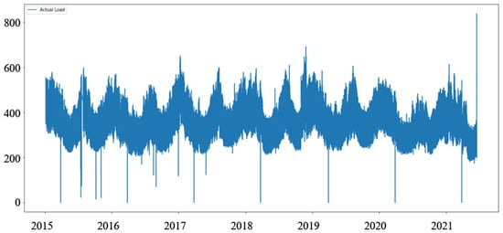
FORECASTING DAY-AHEAD ELECTRICITY METRICS
WITH ARTIFICIAL NEURAL NETWORKS
The day-ahead energy market lets participants commit to buy or sell wholesale electricity one day before the operating day, to help avoid price inconsistency.
The experiment examines the efficiency of time-series prediction models, based on artificial neural network (ANN) architectures, when given the dataset of hourly values.
The datasets used include the Hungarian Power Exchange market day-ahead price dataset and the Montenegrin dataset for load prediction.
https://eurocc.udg.edu.me
Notes:
Milutin Pavicevic sa energetike. Prvo koristio Google Colab, pa onda Yotta

Slide 8
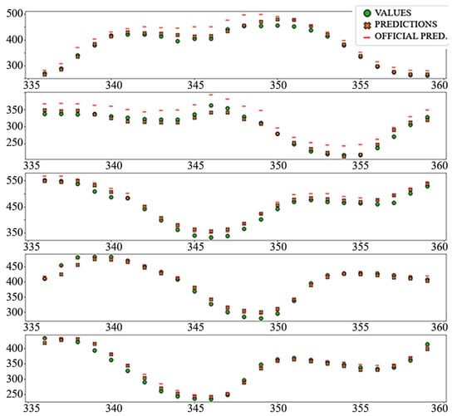
FORECASTING DAY-AHEAD ELECTRICITY METRICS
WITH ARTIFICIAL NEURAL NETWORKS
The performance of temporal convolutional neural (TCN) model are tested, as a relatively new approach to time-series prediction.
When predicting electricity load, models are compared to the official prediction supplied by the European Network of Transmission System Operators for Electricity (ENTSO-E) transparency platform.
BENEFITS:
Accurate electricity price forecasting could help the energy market participants to reduce price risks and maximize profits.
HPC provides time saving, 10x or more, allowing for faster calculation of prediction models and calibration on daily basis.
Load prediction: “TCN_Dense” mode
https://eurocc.udg.edu.me
Notes:
In addition to traditional neural networks and recurrent neural networks with long short-term memory (LSTM) cells
Neural network models shown significant improvement in accuracy compared to naive models, linear regression, and in the case of the consumption dataset, official prediction.

Slide 9
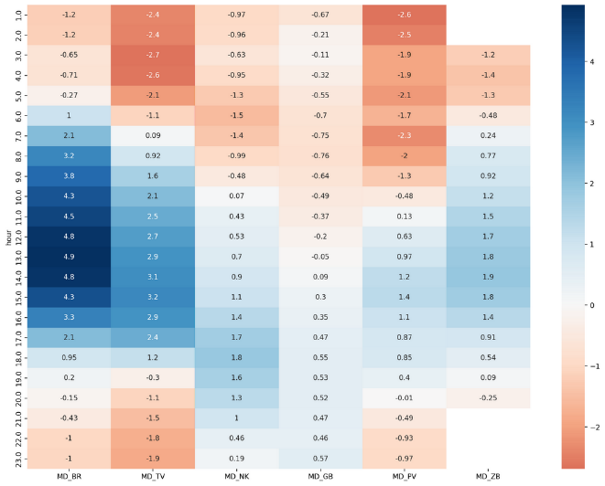
PRECISE WEATHER FORECASTING
Institute for Hydrometeorology and Seismology (IHMS) and NCC Montenegro
Verification of the Temperature, Wind and Precipitation for the High-Resolution Weather Research and Forecasting Nonhydrostatic Mesoscale Model (WRF-NMM) over the complex terrain of Montenegro, with the resolution of 0.5km
The necessity of setting up high-resolution model is essential to timely forecast meteorological phenomena.
Dataset: 5 years (2017 to 2021), 6 stations (BR, TV, NK, GB, PV, ŽB)
BENEFITS:
Speed-up of numerical weather prediction with increased computational capacity.
Enabling and enhancing more accurate weather modelling.
Potential business impact could be explored and verified due to more precise weather forecasting on localized level and through multiple applications related to: smart agriculture, tourism activities, green energy, maritime etc.
Mean temperature difference heat map
https://eurocc.udg.edu.me
Notes:
Prvo korisitli virtualnu laboratoriju na Yotta HPC (Rijeka) resurs, a onda na Benchmark poziv dobili pristup Vega HPC-u (CPU resursi), za vremensku prognozu rezolucije 0,5km.
Verification was performed comparing WRF NMM predicted values and measured values for temperature, wind and precipitation for six Montenegrin weather stations in a five-year period using statistical parameters.

Slide 10

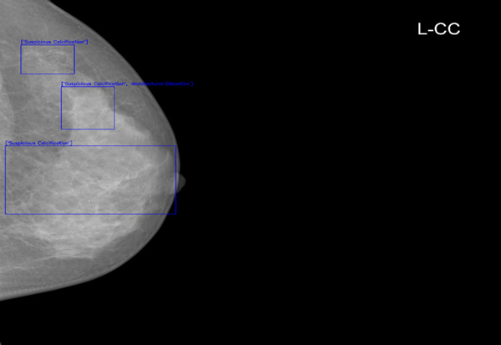
Medical imaging: Breast Cancer Detection
The analysis of mammographic images is crucial for early cancer detection but is hindered by the complexity of tissue patterns, radiologist fatigue, and subjective interpretation.
This project integrates advanced image processing, like Contrast Limited Adaptive Histogram Equalization (CLAHE), to enhance visualization and ML object detection models for precise abnormality identification.
Supported by EuroCC and driven by the UoM, the initiative improved analysis efficiency by 25% and reduced manual examination time by 35%.
BENEFITS:
Accelerated Diagnostics: Faster detection of abnormalities and reduced image analysis time improve early diagnosis and free radiologists for critical tasks.
Enhanced Precision: Improved identification of tumor types supports personalized treatment approaches.
Patient-Centric Benefits: Faster results reduce patient stress, promotes digitalization in health diagnostics.
https://eurocc.udg.edu.me
Notes:
MSc student sa ETF/a, kojem je mentor Igor Jovancevic sa PMF-a. Koristio Yotta HPC resurse

Slide 11

PAID-T - PRICE ACTION INTELLIGENT DETECTION TRADING
PAID MNE startup company provides PAID-T - a scalable software solution for investment funds, banks, proprietary trading companies and brokers, that can self-adapt to stock market conditions and offers strict control of risk exposure.
  The goal is to recognize stock market trends and determine the best time to invest.
Using stock market data (over 16 million one-minute data points from mid-2018 to 2024, macroeconomic elements with over 55 K records dating back to 2007, swaps and spreads—June 2018 to November 2024) and internally developed algorithms, PAID-T recognizes market patterns and identifies optimal investment opportunities.
The analyses cover all time frames, from short-term fluctuations to long-term trends, and they adapt quickly to market changes.
With the support of NCC Montenegro, PAID MNE gain access to LUMI-C resources on April 2024, through a Development Call.
Benefits: speed up testing, from 18 hours per simulation on average to less than one minute, depending on the number of parameters used.
PAID MNE have made another succefull application on Develompent Call, obtaining access to LUMI-C and LUMI-G partitions for the period of one year, starting form April 2025.
https://eurocc.udg.edu.me
Notes:
ROI - Return on Investment .
publicly accessible one-minute OHLC data across 15 trading pairs, sourced from EightCap Global Ltd [11]. This extensive data collection, featuring over 16 million data points from mid-2018 to 2024, serves as the backbone for our pattern detection algorithms, ensuring that simulations reflect diverse market conditions.
In addition to historical records, the PAID-T system incorporates a continuous real-time data stream that boasts over 280 million entries. This dynamic feed is crucial for real-time strategy adaptation and reflects the current trading milieu.
Our datasets also incorporate macroeconomic elements with over 55,000 records dating back to 2007, elucidating the interplay between market movements and economic fluctuations. Supplementary financial instrument data such as swaps and spreads—June 2018 to November 2024—provides nuanced insight into transaction costs and potential market conditions affecting trade execution

Slide 12

GENERATIVE AI INTELLIGENT PROCESS AUTOMATION PLATFORM
Uhura Solutions company is developing an AI platform for document-driven process automation in financial services.
Generative AI Intelligent Process Automation Platform is a project supported by Innovation Fund of Montenegro that aims at revolutionizing the financial industry through the integration of advanced AI-driven automation solutions that combine LLM, low-code development, and process automation workflows.
Uhura is developing a model capable of analysing financial documents and providing precise answers to user queries, highlighting relevant document sections used to form the response.
Uhura collaborates with customers, getting insights into their needs and requirements and data are obtained from partnerships with leading financial entities.
With the support of NCC team, Uhura gained access to 4500 GPU hours on the Leonardo supercomputer through Development call, in May 2024 .
https://eurocc.udg.edu.me
Notes:
Uhura Solutions je prva crnogorska startup kompanija koja je dobila investiciju od američkog fonda i akceleratora Techstars i jedne od najvećih britanskih banaka Barclays

Slide 13

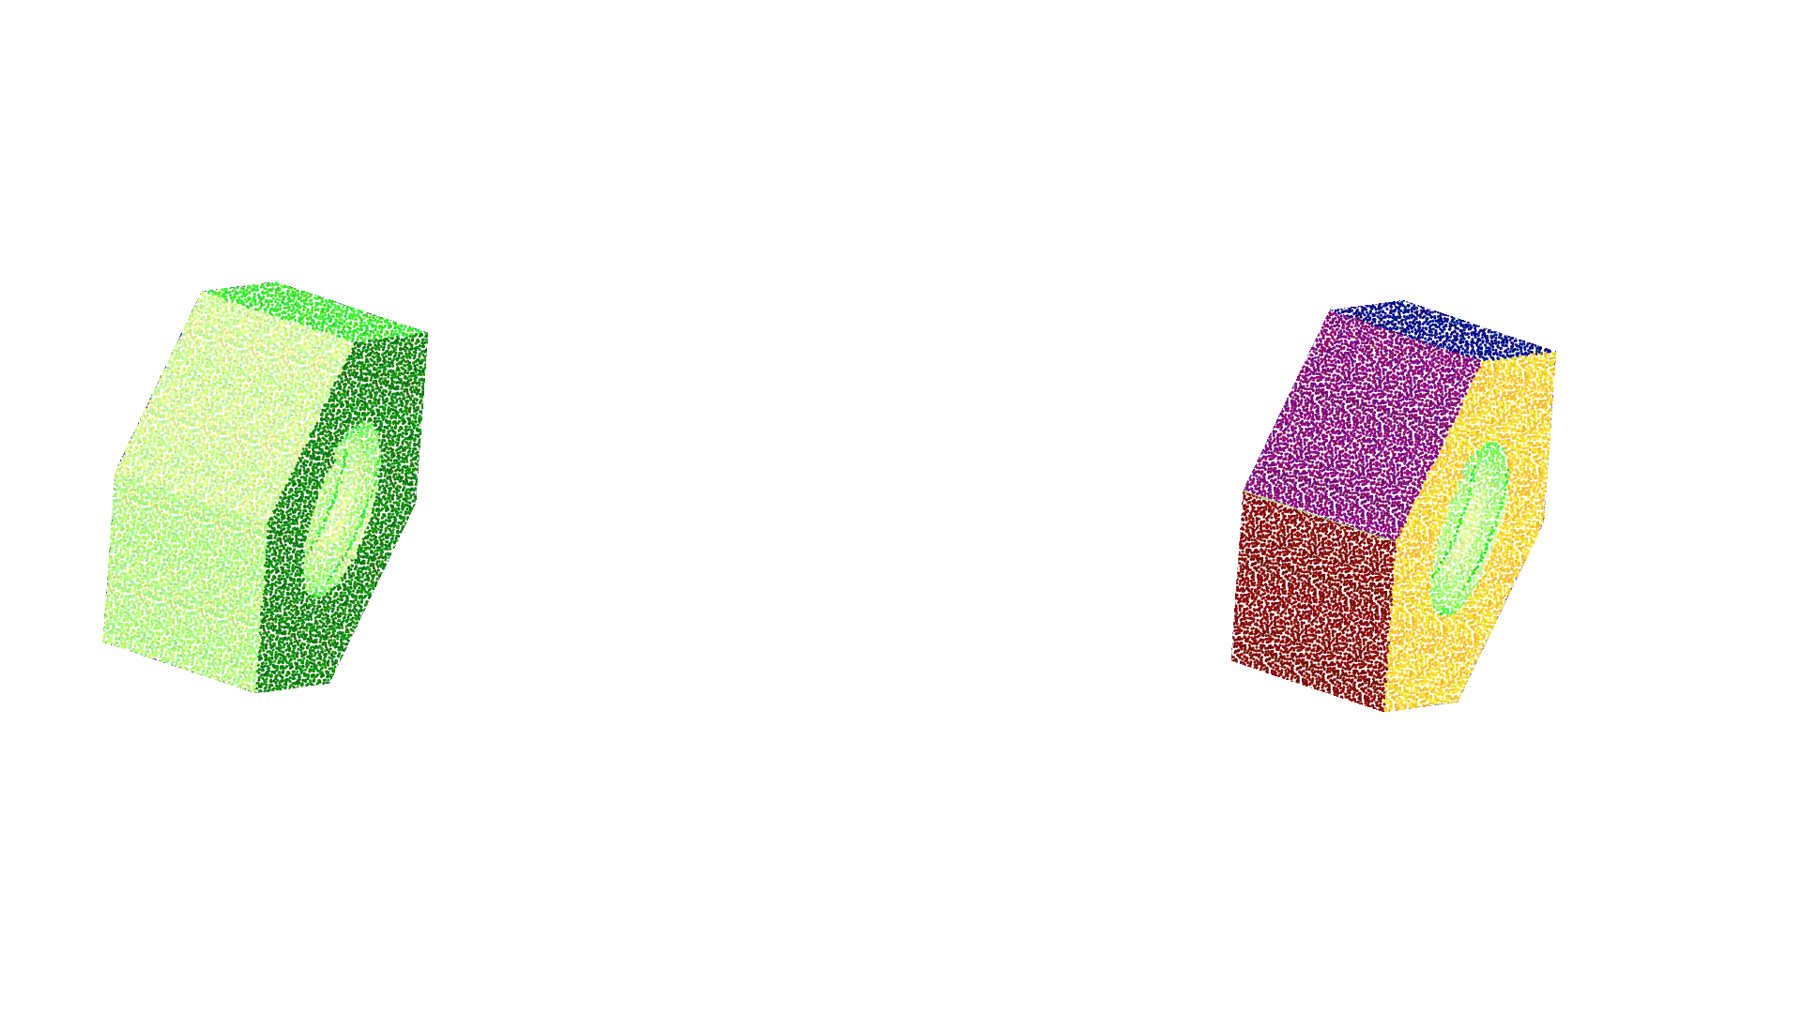
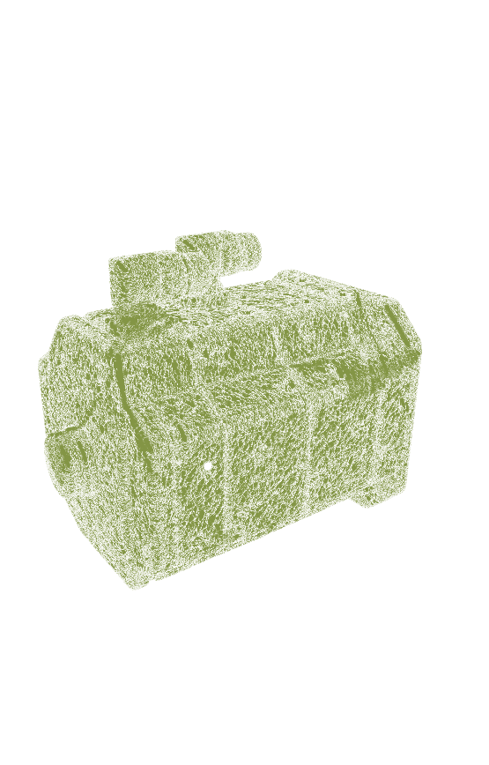
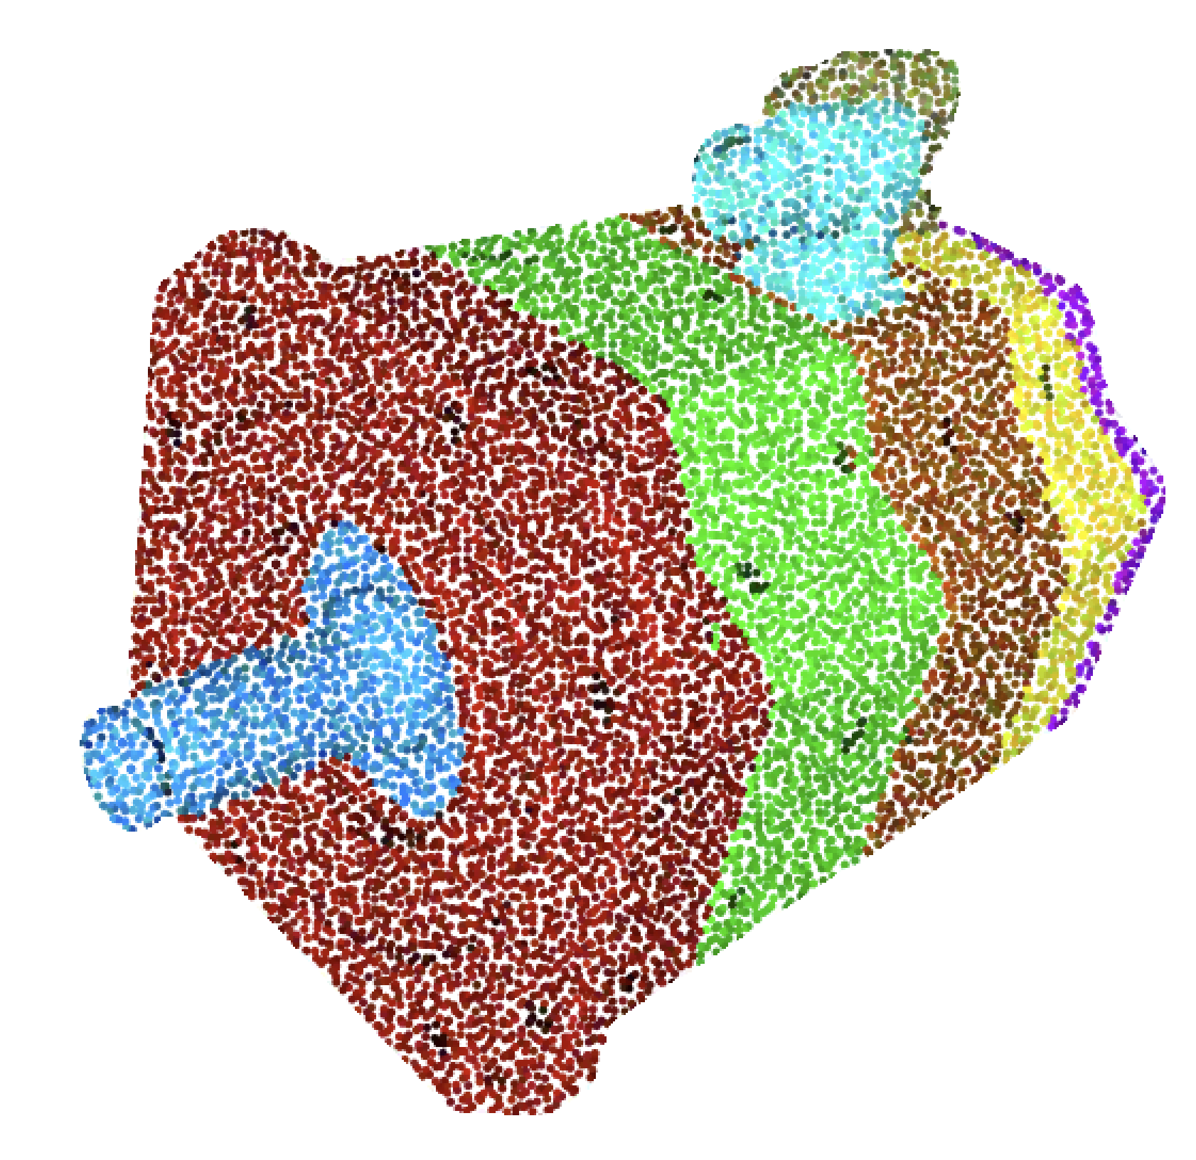

AI Segmentation and 3D Scan Inspection
Research group from the University of Montenegro – Faculty of Science and Mathematics is working on a system for automatic segmentation of 3D representations of mechanical assemblies obtained using 3D scanners.
Identification of mounted parts and their relative positions is an important step for reverse engineering, automation of disassembling process, quality control, AR/VR, creation of digital twins, operator training (for assembling and disassembling processes), etc.
The goal is:
  development of deep learning system to tackle segmentations of mechanical assemblies,
  adaptation of existing models for segmentation of 3D point clouds to make them more suitable for industrial use cases.
Segmentation system
Segmentation system
Scanned assembly /
3D point cloud
Segmented parts
Parts detection
Primitive surfaces detection
CAD model
https://eurocc.udg.edu.me
Notes:
In April 2025, research team from Faculty of Science and Mathematics, UoM, got an access to Leonardo HPC on a Benchmark call, thus obtaining 3500 GPU node hours on the Booster partition. NCC Montenegro provided support in this application

Slide 14

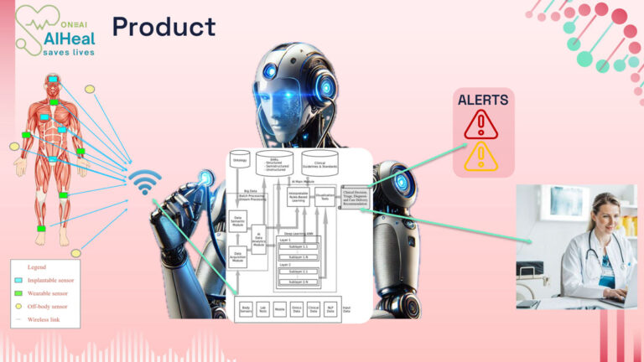
AI HEAL
Developed by ONE AI startup and supported by the Innovation Fund of Montenegro, AIHeal project integrates sensor technologies and smart mobile devices to monitor patient health in real-time.
The system enables precise diagnostics, reduces costs, and optimizes health conditions monitoring.
The goal is to develop a smart-phone application for monitoring different health parameters and obtaining AI advices based on the experiences of doctors across the world.
The project deals with great amount of data which are going to be used for the training of AI Heal model.
With the support of NCC Montenegro team, in May 2025 ONE AI gained access HPC resoures on LUMI supercomputer, for a one year, through the Development Call.
https://eurocc.udg.edu.me
Notes:
Aplikacija koja je rezultat projekta „Zdravstveni sistem zasnovan na vještačkoj inteligenciji“, finansiranog od strane Fonda za inovacije, omogućava preciznu dijagnostiku, smanjenje troškova i optimizaciju zdravstvene njege. Očekuje se da će AIHeal u narednim godinama značajno smanjiti pritisak na zdravstvene sisteme i pomoći u prevenciji zdravstvenih problema. Sistem je dizajniran za široku upotrebu, od porodične medicine do specijalizovanih bolničkih odjeljenja. Prema projekcijama, AIHeal će do 2030. godine koristiti više od 500.000 pacijenata.

Slide 15

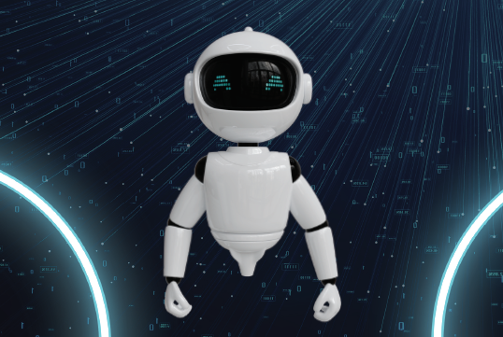
Success Stories
  Montenegro project is among the Winners of Fortissimo Plus (FFplus) first Open Call for Business Experiments
  “Transforming Business Culture and Hiring Through High-Performance Computing GenAI-HPC4WB,” a notable initiative from Montenegro by a startup company called Recrewty.
    This project aims to revolutionize recruitment processes in the Balkan region by integrating generative AI, ML and HPC.
    By analysing psychometric data, CVs, and interviews using AI models tailored to regional languages—the project seeks to enhance hiring accuracy and efficiency.
FiveG is developing Wasco AI - an advanced custom-built AI assistant designed for
enterprise applications in order to enhance and simplify everyday business operations.
  Support for young researchers
    Several BSc and MSc thesis (https://eurocc.udg.edu.me/publications-thesis/)
    Research papers (https://eurocc.udg.edu.me/publications-papers/)
https://eurocc.udg.edu.me
Notes:
Call aimed at encouraging small and medium-sized enterprises (SMEs) to adopt High-Performance Computing (HPC) technologies. 126 proposals from 220 organizations across 30 European countries. After a rigorous evaluation process, 19 sub-projects were selected for funding, involving 43 organizations, including 34 SMEs,

Slide 16

Thank you!
NCC Montenegro
National Competence Centre for High-Performance Computing
Web: https://eurocc.udg.edu.me/
Enis Kočan
enisk@ucg.ac.me
University of Montenegro
NCC Montenegro is supported by EuroCC2 and EuroCC4SEE projects. EuroCC2 and EuroCC4SEE have received funding from the European High-Performance Computing Joint Undertaking (JU) under grant agreement No 101101903 and No 101191697. The JU receives support from the European Union’s Digital Europe Programme and Germany, Bulgaria, Austria, Croatia, Cyprus, Czech Republic, Denmark, Estonia, Finland, Greece, Hungary, Ireland, Italy, Lithuania, Latvia, Poland, Portugal, Romania, Slovenia, Spain, Sweden, France, Netherlands, Belgium, Luxembourg, Slovakia, Norway, Türkiye, Republic of North Macedonia, Iceland, Montenegro, Serbia, Bosnia and Herzegovina.

