Slide 1



EuroCC4SEE Workshop in Belgrade, 20-22 May 2025
USING HPC FOR MECHANISTIC DESCRIPTION
OF CHEMICAL REACTIONS
Milena Petković

Slide 2
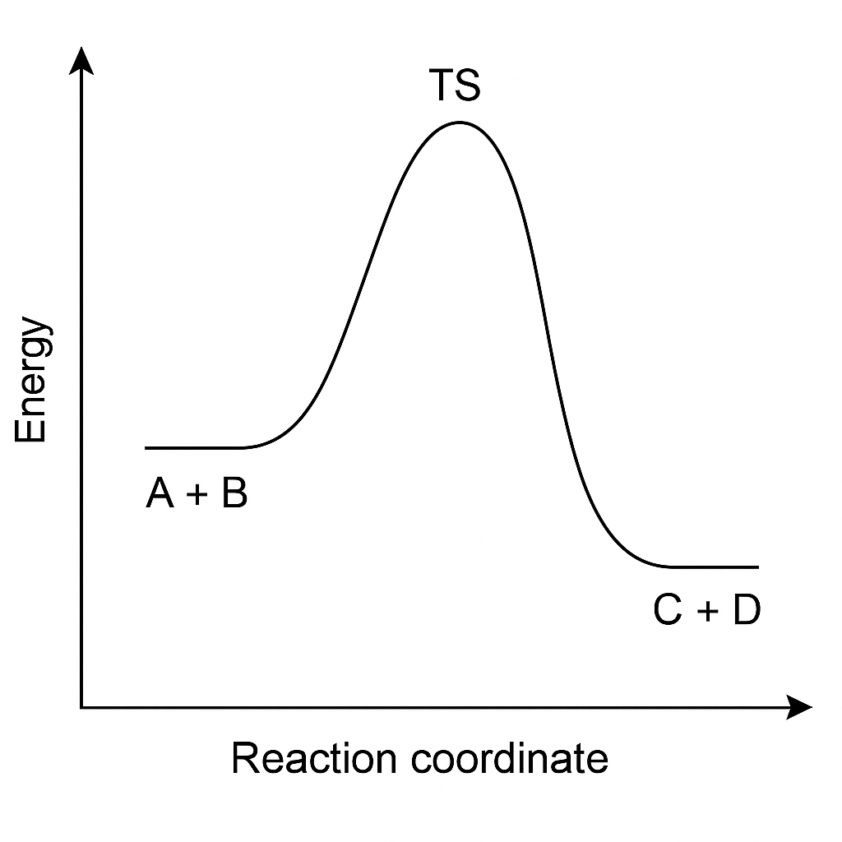
Chemical changes: importance of their detailed analysis
A + B → C + D
vs.
design of catalysts
drug design
manipulation of chemical reactions
…

Slide 3
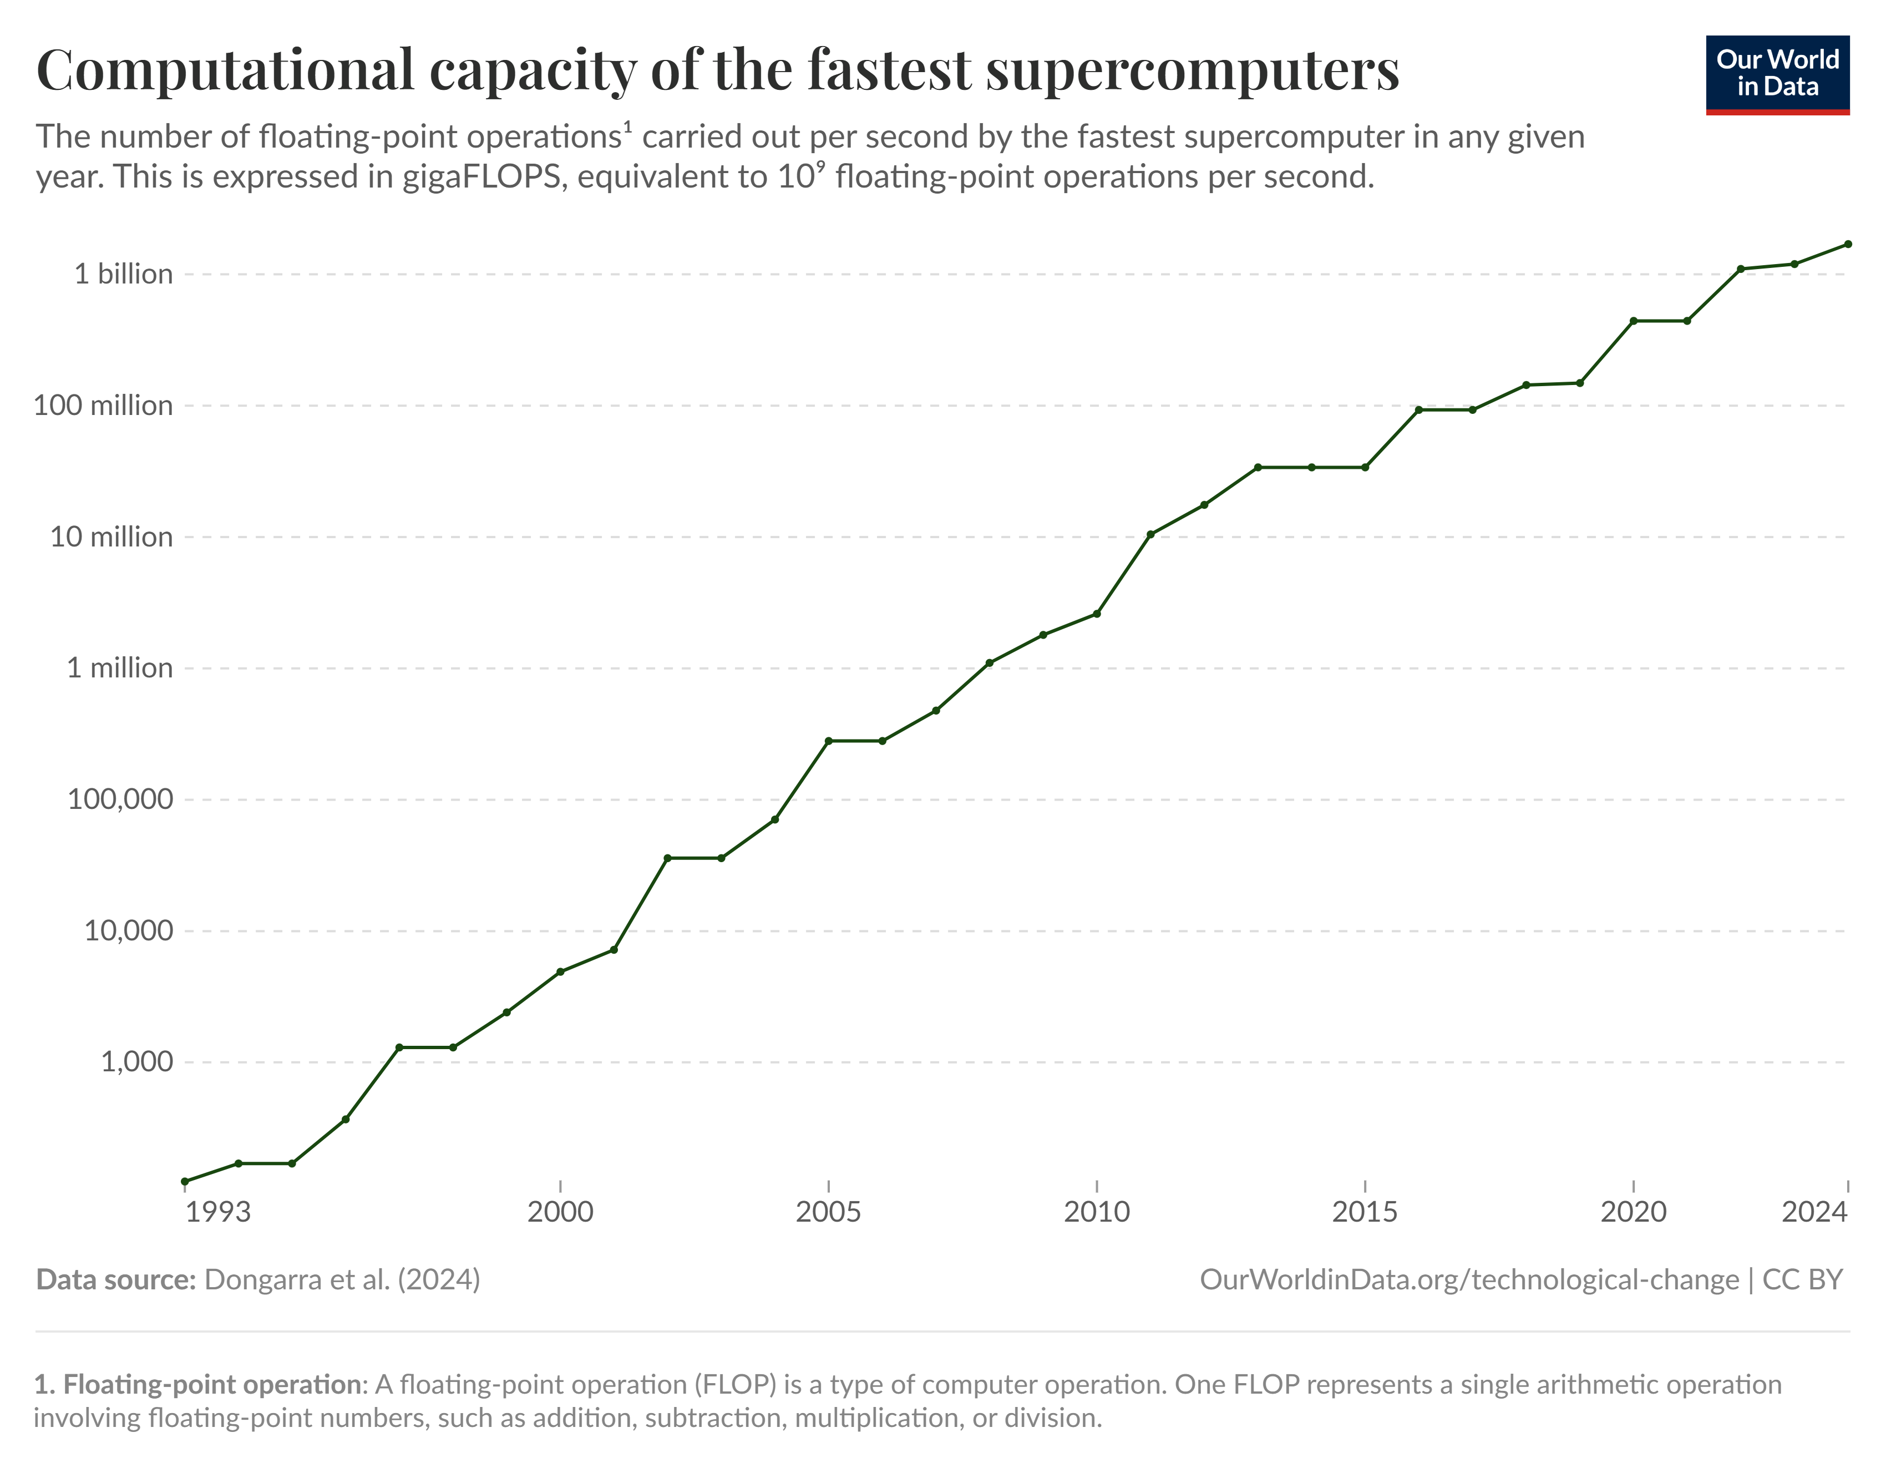
What a difference 30 years make

Slide 4
HPC in computational chemistry
Supercomputers and parallel processing required for:
high-level simulations
treating large and complex systems
performing long simulations
sampling configurations

Slide 5
Types of simulations
quantum mechanics (ab initio, DFT, semi-empirical)
molecular mechanics
hybrid methods (QM/MM, AIMD)
Monte Carlo simulations

Slide 6
Quantum computing software
ADF
CP2K
GAMESS
Gaussian
Molcas
Molpro
NWChem
ORCA
Q-Chem
Quantum ESPRESSO
TURBOMOLE
VASP
WIEN2k
…

Slide 7
Challenges
Designing a reliable model & choosing a suitable level of theory.
high accuracy requirements
complex reaction pathways
multidimensional potential energy surfaces
long simulation times
large systems
Compromise between accuracy and computational cost.

Slide 8
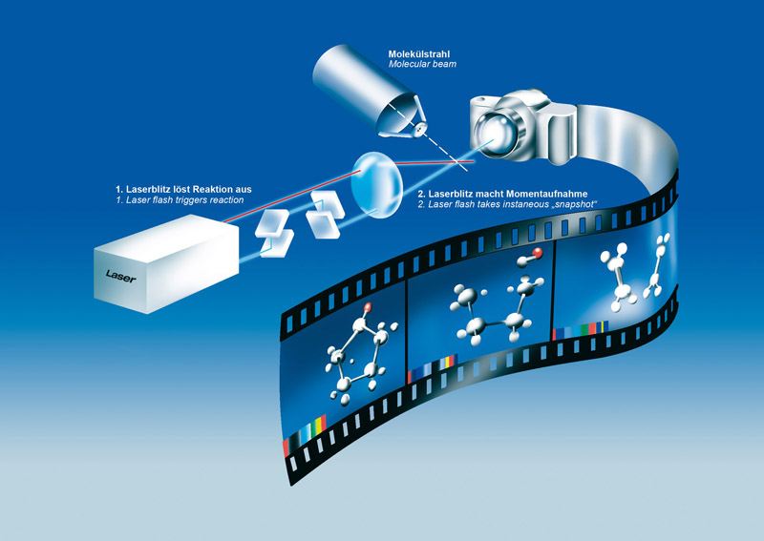
Goal
This figure was created by experimentalists. Supercomputers enable theoreticians to design high-dimensional models that enable such a detailed descriptions of molecular transformations in the course of a chemical reaction.
https://www.eiroforum.org/media/photo-galleries/european-xfel/attachment/femtochemie-femtochemistry/

Slide 9
Examples
designing catalysts
synthetic routes that include unstable species
reactions in the interstellar space
light-driven reactions
…

Slide 10
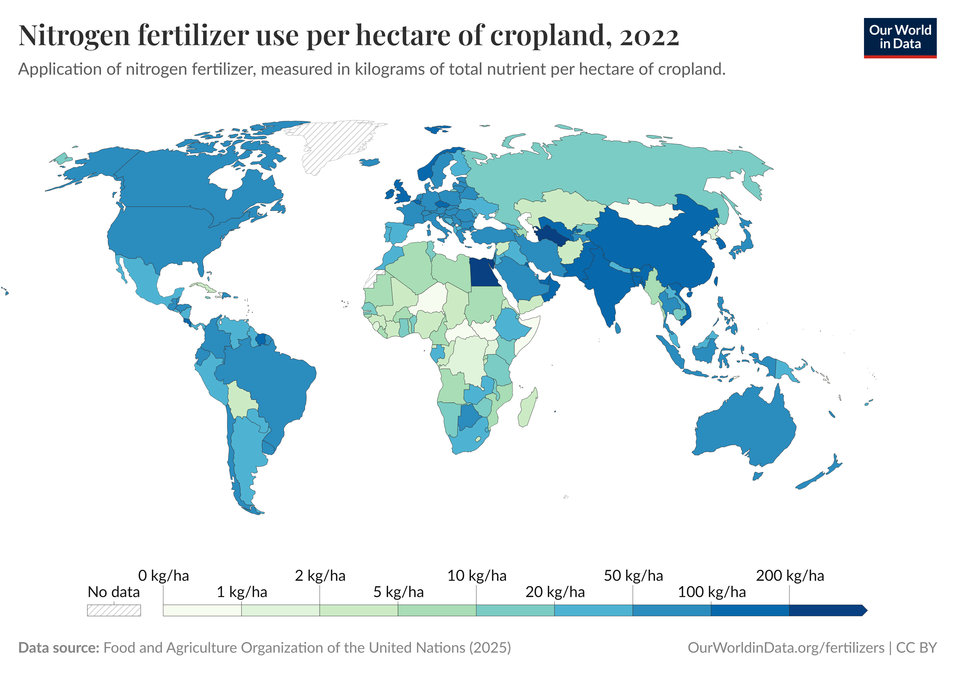
Case study: designing catalysts (1)

Slide 11
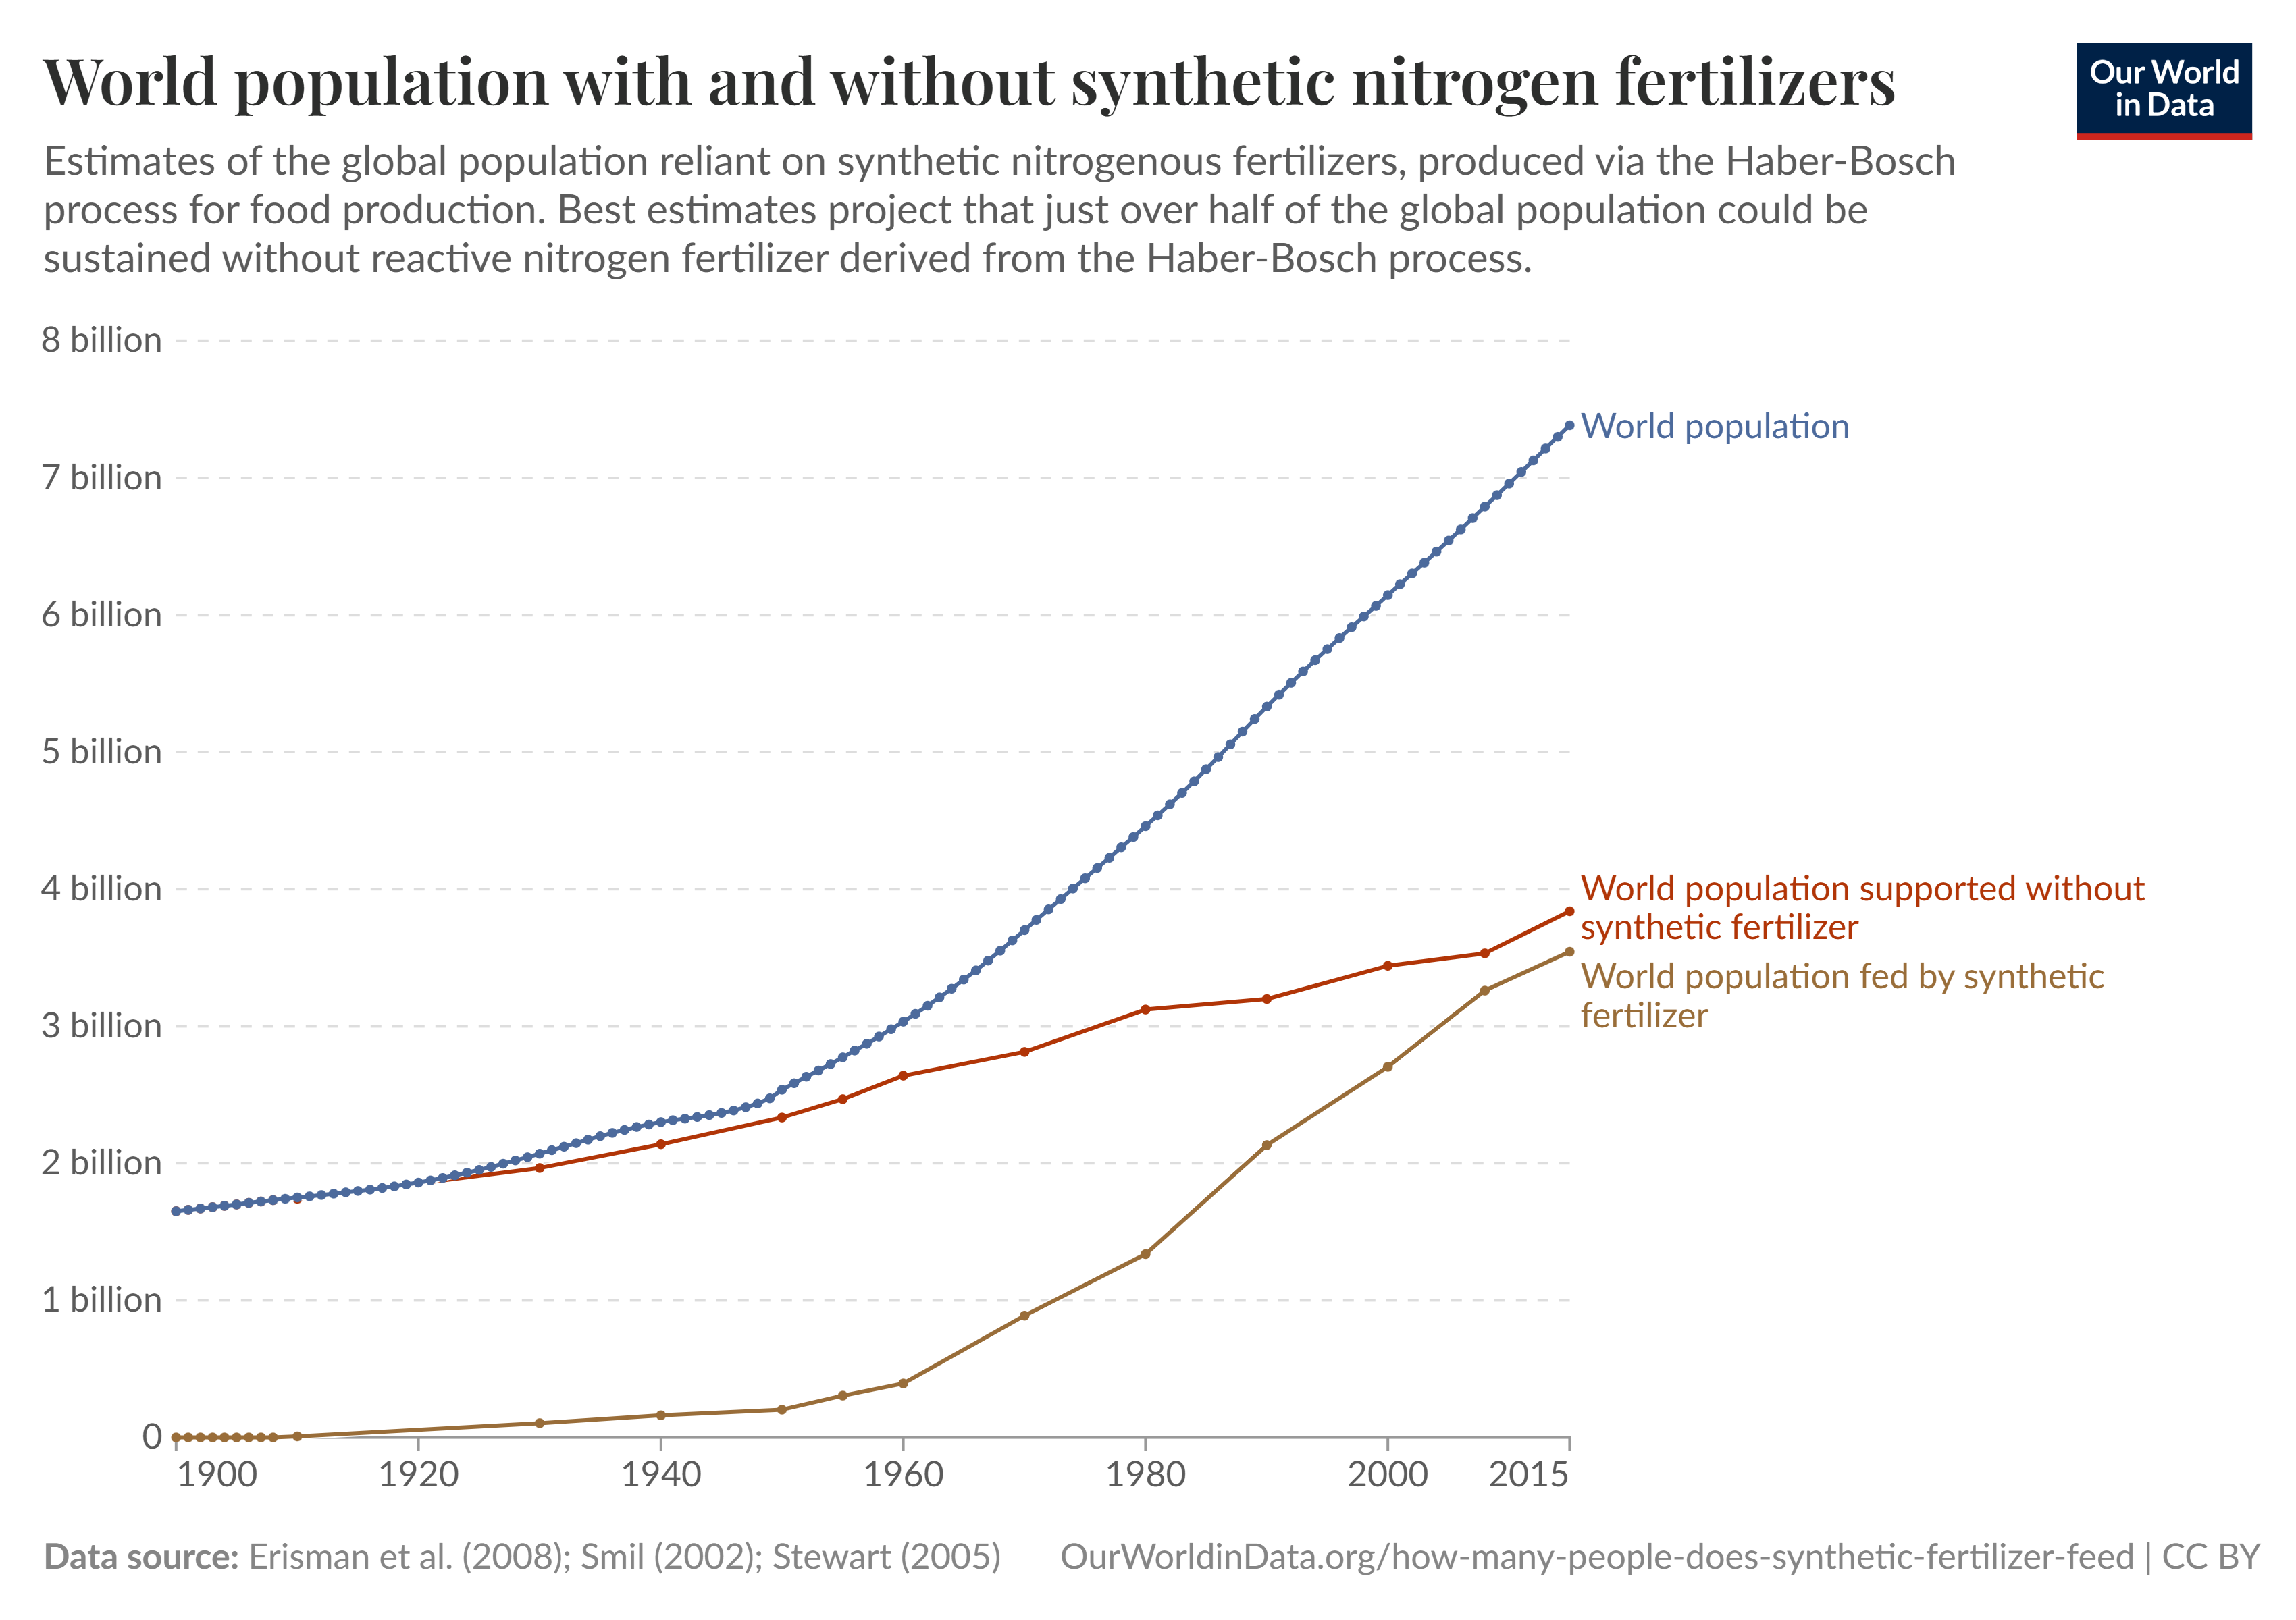
Case study: designing catalysts (2)

Slide 12
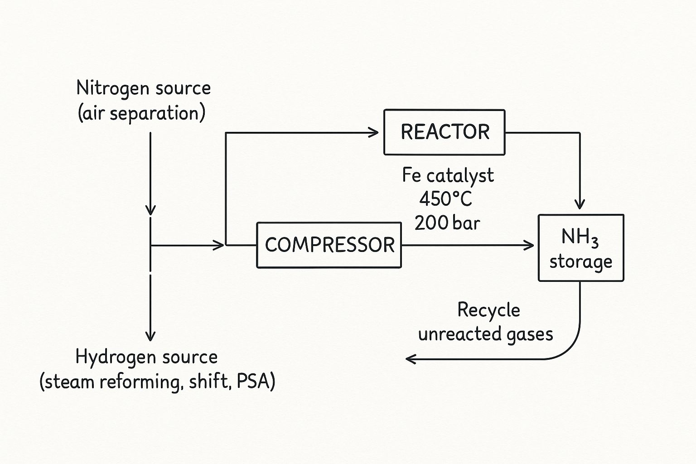
Case study: designing catalysts (3)
H₂ + 3N₂ → 2NH₃
Fe catalyst → Haber-Bosch process

Slide 13
Case study: synthetic routes that include unstable species
Z. Liu, A. I. McKay, L. Zhao, C. M. Forsyth, V. Jevtović, M. Petković, G. Frenking, D. Vidović, J. Am. Chem. Soc. 144 (2022) 7357

Slide 14
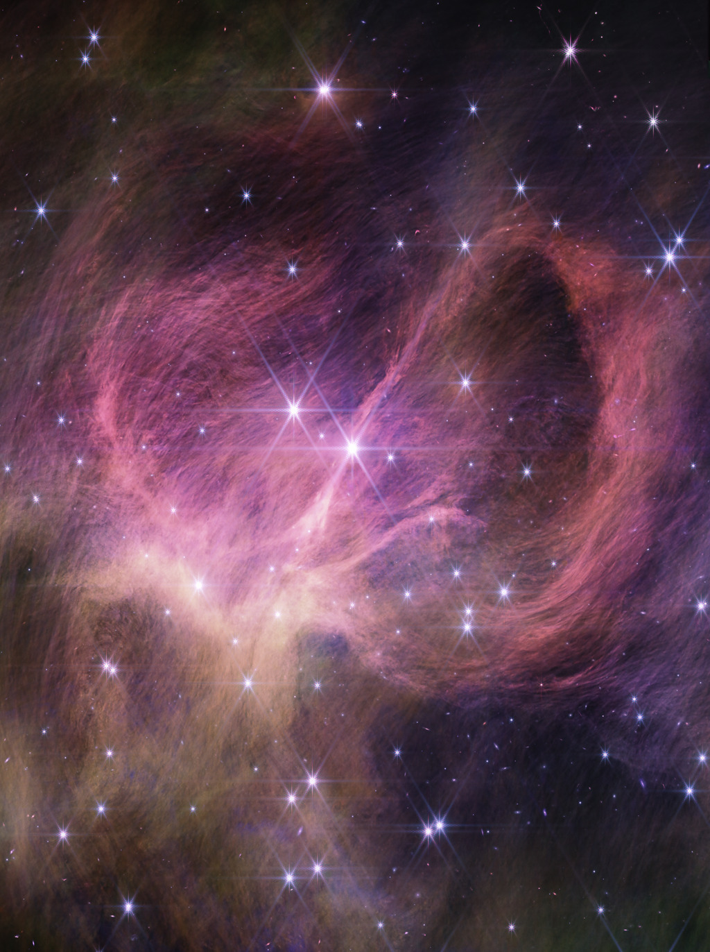
Case study: reactions in the interstellar space
free-floating brown dwarf
interpretation of astronomical
observations
chemical origin of stars
formation of complex molecules
https://svs.gsfc.nasa.gov/31291/

Slide 15
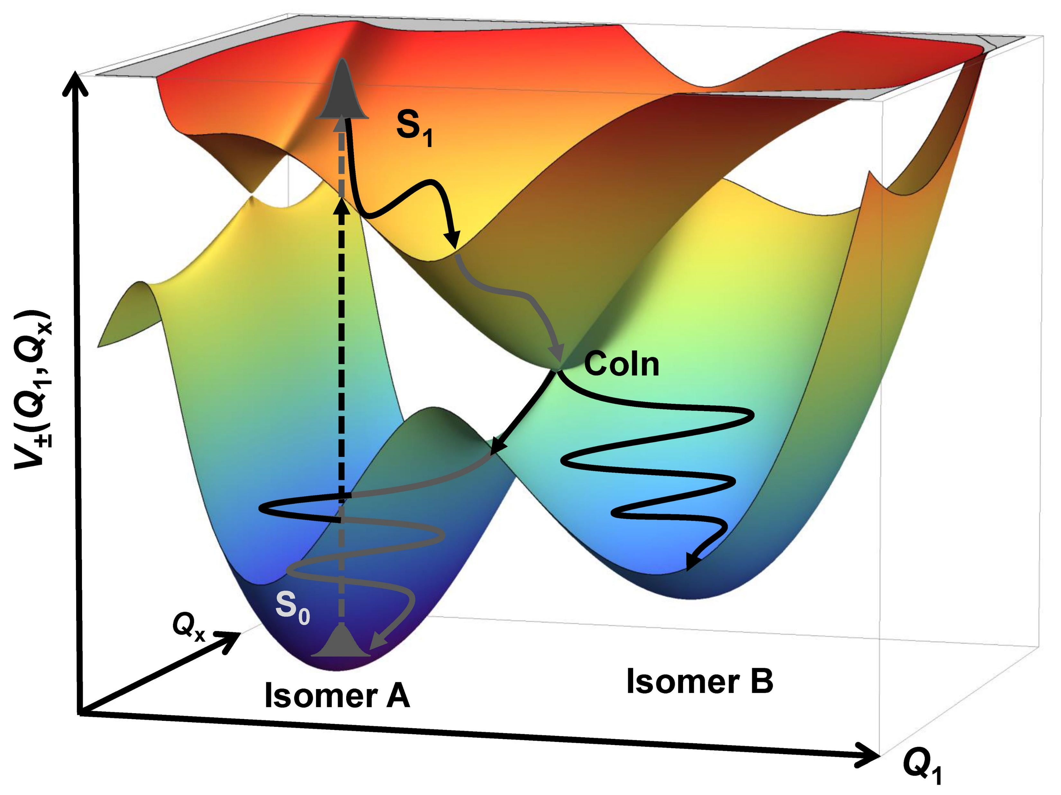
Case study: light-driven reactions
designing high-dimensional models
https://www.temps.phc.uni-kiel.de/en/research/laboratories-and-instrumentation/femtosecond-spectroscopy

Slide 16
Conclusions
The progress of modern computational chemistry is tightly linked to advances in high-performance computing:
high-level electronic structure calculations
large systems
long timescales

Slide 17
Thanks to
Institute of Physics, Belgrade
I would like to dedicate this talk to all the students and teachers who stood against corruption and the collapse of the educational system in Serbia during the 2024/2025 academic year.

