Slide 1
European Open Science Cloud:
Enabling Open and Collaborative Research
Prof. Boro Jakimovski, prof. Anastas Mishev
Ss. Cyril and Methodius University of Skopje, North Macedonia
Workshop: In memory of Antun Balaž — Insights into Complex Systems
Institute of Physics Belgrade | June 12, 2026
✦ In memory of Dr. Antun Balaž (1973–2025)

Slide 2
Introduction — The Open Science Vision
INTRODUCTION
🔓 Open Science
🌐 European Policy
🤝 The SEE Challenge
Free flow of knowledge, data and publications across borders and disciplines — from individual labs to pan-European infrastructure.
EC Horizon 2020 & Horizon Europe mandates FAIR data and open access. EOSC is the flagship instrument for this transformation.
Bridging the digital divide: connecting South-East Europe to the mainstream European research data infrastructure.
EOSC: Enabling Open and Collaborative Research | In memory of Antun Balaž | June 2026

Slide 3
The Regional Landscape — Where We Started
INTRODUCTION
Challenges before 2015
The Project Journey
Fragmented national e-infrastructures with no regional integration
Limited HPC access for SEE researchers
No common VRE or shared data services
Brain drain — top talent lacking local infrastructure
Weak alignment with Western European research practices
Growing gap vs. EU mainstream in open science readiness
2015–18
VI-SEEM
2019–22
NI4OS-Europe
2021–23
EOSC Future
2022–25
Skills4EOSC
2023–26
EOSC Beyond
EOSC: Enabling Open and Collaborative Research | In memory of Antun Balaž | June 2026

Slide 4

VI-SEEM
VRE for Regional Interdisciplinary Communities in SEE & Eastern Mediterranean
16
3
H2020
2015–18
Partners
Focus
Communities
GA 675121
Duration
What it did
Key Outcomes & IPB Role
Unified regional e-infrastructures (HPC, Grid, Cloud) into a single Virtual Research Environment
Served Life Sciences, Climatology & Digital Cultural Heritage communities
16 partners across SEE & Eastern Mediterranean
Open calls for compute & data resources for regional researchers
First integrated cross-border VRE for the SEEM region
Reduced digital divide & improved research competitiveness
IPB was a core consortium partner — contributing HPC resources, application support & scientific user engagement
Antun Balaž: key contributor to compute infrastructure & community outreach
🔗 vi-seem.eu | cordis.europa.eu/project/id/675121
EOSC: Enabling Open and Collaborative Research | In memory of Antun Balaž | June 2026

Slide 5

NI4OS-Europe
National Initiatives for Open Science in Europe
15
44
H2020
2019–22
Countries
Partners
GA 857645
Duration
What it did
Key Outcomes & IPB Role
On-boarded national open science providers into EOSC service portfolio
Set up National Open Science Cloud Initiatives (NOSCIs) in 15 countries
Spread FAIR principles & trained researchers and data stewards regionally
Coordinated with OpenAIRE NOADs, RDA national nodes and NGIs
Successfully built a federated ecosystem praised in EC final review
North Macedonia and IPB among active regional contributors
IPB contributed services and national expertise to open science uptake
Antun Balaž: one of the key scientific drivers for the adoption of the services on-boarded by the proejct
🔗 ni4os.eu | cordis.europa.eu/project/id/857645
EOSC: Enabling Open and Collaborative Research | In memory of Antun Balaž | June 2026

Slide 6

EOSC Future
Integrating, Consolidating and Connecting e-Infrastructures for Open Science
EOSC-Core
EOSC-Xch
H2020
2021–23
Service Layer
Exchange Layer
GA 101017536
Duration
What it did
Key Outcomes & IPB Role
Operationalized the EOSC platform: EOSC-Core, EOSC-Exchange & Interoperability Framework
Brought together all major stakeholders under one project umbrella
Developed scientific use cases with thematic research communities
Launched EOSC Digital Innovation Hub and EOSC Observatory
EOSC transitioned from vision to operational federated data space
Regional communities gained access to EOSC-Core services
IPB contributed expertise in HPC use cases and community engagement
Antun Balaž: regional support in the SEE/WB region
🔗 eosc-future.eu | cordis.europa.eu/project/id/101017536
EOSC: Enabling Open and Collaborative Research | In memory of Antun Balaž | June 2026

Slide 7

Skills4EOSC
Skills for the European Open Science Commons — Training Ecosystem for FAIR Science
18
44
HE
2022–25
Countries
Partners
GA 101058527
Duration
What it does
Key Outcomes & IPB Role
Addresses the human dimension of open science — skills & training
Network of Competence Centres (CCs) across 18 European countries
FAIR-by-Design methodology for reusable training materials
Harmonised curricula and professional recognition framework for data stewards
Pan-European training ecosystem and quality assurance framework established
Recognition system for open science skills across Europe
IPB participated in training activities and Competence Centre network
Antun Balaž: Training and adoption of OS principles at the national level
🔗 skills4eosc.eu | cordis.europa.eu/project/id/101058527
EOSC: Enabling Open and Collaborative Research | In memory of Antun Balaž | June 2026

Slide 8

EOSC Beyond
Extending EOSC — Cross-Domain Interoperability & New Communities
Cross-Domain
New
HE
2023–26
Interoperability
Communities
Horizon Europe
Duration
What it does
Key Directions & IPB Role
Pushes EOSC boundaries with cross-domain interoperability frameworks
Integrates new scientific communities beyond initial EOSC scope
Advances AAI (Authentication & Authorization Infrastructure) for federated access
Bridges EOSC with global data spaces and non-European partners
Expanding EOSC reach into underserved disciplines and regions
Building on NI4OS and EOSC Future foundations for SEE continuity
IPB maintains active role in regional coordination and service provision
Antun Balaž: unfortunately, we lost Antun before he could share with us his wisdom and insights.
🔗 eosc-beyond.eu | cordis.europa.eu/project/id/101131875
EOSC: Enabling Open and Collaborative Research | In memory of Antun Balaž | June 2026

Slide 9
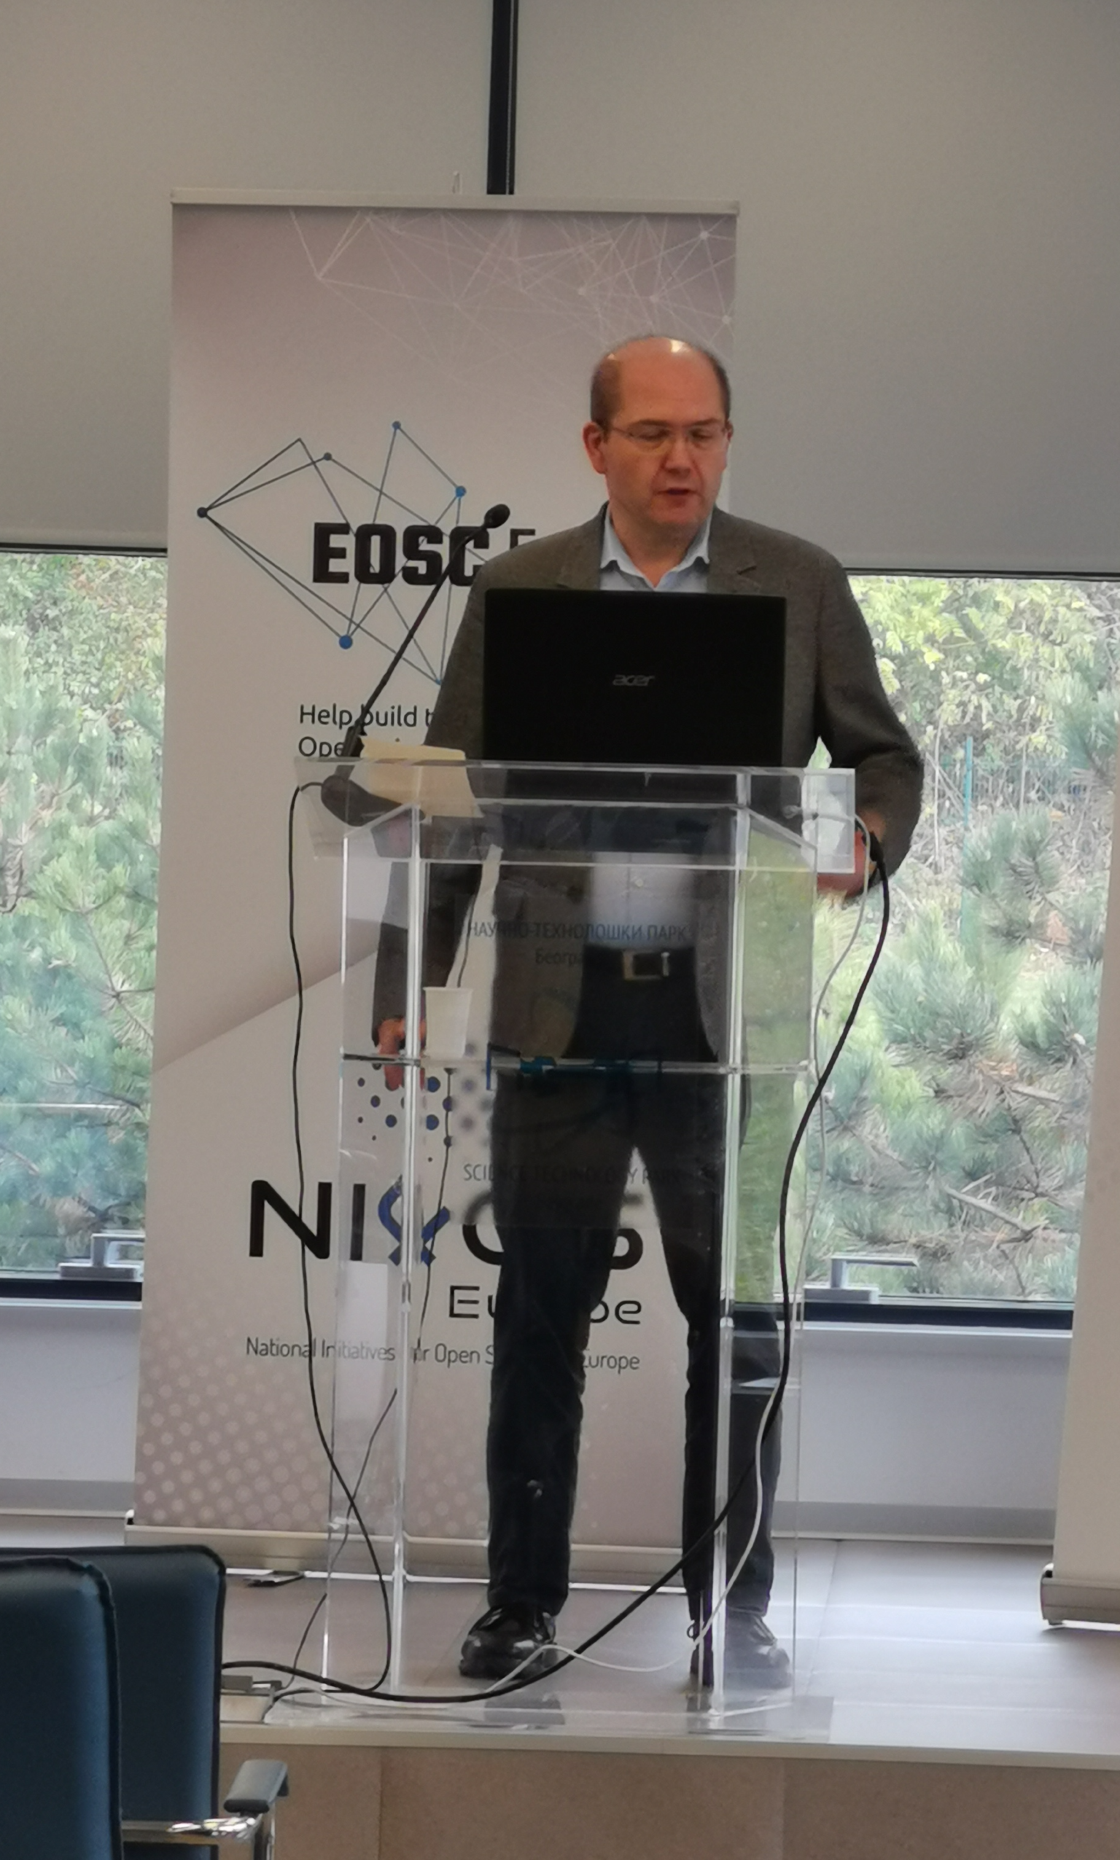
Dr. Antun Balaž — The Scientist Behind the Infrastructure
📷
Photo of
Antun Balaž
(to be added)
Dr. Antun Balaž (1973 – 2025)
Institute of Physics Belgrade, Serbia
Antun Balaž was a Principal Research Fellow and Deputy Director at the Institute of Physics Belgrade, where he founded and led the Scientific Computing Laboratory — bridging world-class physics research with the development of regional and European open science infrastructure.
He was a friend and colleague, always willing to help and guide. He will be missed…
EOSC: Enabling Open and Collaborative Research | In memory of Antun Balaž | June 2026

Slide 10
Antun's Contributions — Projects & Community
Scientific background
Entry into e-infrastructure
Leadership and institutional roles
Researcher in ultracold quantum gases and Bose-Einstein condensation, with expertise in collective and nonlinear excitations of BEC systems, developing novel numerical methods and parallel algorithms — a natural foundation for leadership in high-performance and distributed computing
A key contributor to the SEE-GRID programme, which established a strong regional human network in distributed scientific computing and built a powerful Grid infrastructure across South-Eastern Europe, spanning multiple phases over six years
Corresponding member of SANU, Deputy Director of the Institute of Physics Belgrade, President of the National Science Council for Physics, and a member of the Management Board of the European Open Science Cloud (EOSC) since 2021 — spanning national, regional, and pan-European governance
Vision for regional collaboration
Championed equitable access to research infrastructure for Southeast European scientists, translating that vision into concrete action through projects including VI-SEEM, NI4OS-Europe, EOSC Future, EOSC Beyond, and Skills4EOSC
EOSC: Enabling Open and Collaborative Research | In memory of Antun Balaž | June 2026

Slide 11
Antun's Legacy
🏗️
🤝
🌍
What he built
The people he mentored
The culture he shaped
Foundational e-infrastructure contributions that remain operational and continue to serve the regional research community.
A generation of researchers and engineers who carry forward his commitment to open, accessible science.
A collaborative spirit across borders — the belief that science grows stronger when infrastructure is shared and knowledge is open.
✦ [Optional: personal reflection from the speaker]
EOSC: Enabling Open and Collaborative Research | In memory of Antun Balaž | June 2026

Slide 12
The EOSC Today — State of Play 2025/2026
EOSC TODAY
2M+
200+
40+
EOSC
Fed.
Researchers
with EOSC access
Services in
the EOSC catalogue
Countries
participating
Federation model
launched 2024
EOSC Federation launched (2024): EOSC EU Node serves as blueprint for national nodes across Europe
Federated AAI (Authentication & Authorization Infrastructure) operational — single sign-on for research across borders
FAIR data principles widely adopted — growing repository ecosystem with interoperable metadata
SEE region has moved from observer to active contributor — NRENs and research institutes as service providers
Post-2027 sustainability being planned — EOSC Gravity project shaping future governance model
EOSC: Enabling Open and Collaborative Research | In memory of Antun Balaž | June 2026

Slide 13
Challenges & Open Questions
CHALLENGES
💰 Sustainability
📚 Skills Gap
Long-term funding beyond project cycles remains the critical open question. National governments and institutions must step up.
Training researchers and data stewards is a continuous effort. Skills4EOSC addressed this, but national structures are still maturing.
🏛️ Institutional Commitment
🌍 Western Balkans Integration
Open science requires policy changes at university and national level — not just infrastructure but culture shifts.
Countries outside EU (incl. North Macedonia) face governance and funding gaps — EOSC must remain inclusive.
EOSC: Enabling Open and Collaborative Research | In memory of Antun Balaž | June 2026

Slide 14
Conclusion — The Journey Continues
VI-SEEM
→
NI4OS
→
EOSC Future
→
Skills4EOSC
+
EOSC Beyond
From fragmented regional e-infrastructure to a federated European Open Science Cloud — a decade of continuous, collective effort
The SEE region has moved from beneficiary to active contributor, with IPB and its researchers at the heart of this transformation
Open science is not just about technology — it is about trust, collaboration, and the people who build it together
Antun Balaž embodied this spirit. His work across these projects is woven into the infrastructure that European researchers use today
EOSC: Enabling Open and Collaborative Research | In memory of Antun Balaž | June 2026

Slide 15
Thank You | Acknowledgements & References
Thank you for the invitation and for keeping Antun's memory alive through science.
Prof. Boro Jakimovski
Prof. Anastas Mishev
Saints Cyril and Methodius University
Skopje, North Macedonia
Funded by EC Horizon 2020 & Horizon Europe
With gratitude to all EOSC project collaborators
and to the community Antun helped build
References
[1] VI-SEEM: VRE for Regional Interdisciplinary Communities in SEE & EM — H2020 GA 675121 — cordis.europa.eu/project/id/675121
[2] NI4OS-Europe: National Initiatives for Open Science in Europe — H2020 GA 857645 — cordis.europa.eu/project/id/857645
[3] EOSC Future: Integration of e-Infrastructures for Open Science — H2020 GA 101017536 — cordis.europa.eu/project/id/101017536
[4] Skills4EOSC: Training Ecosystem for Open and FAIR Science — HE GA 101058527 — cordis.europa.eu/project/id/101058527

