Slide 1
High-performance applications on heterogenous systems - benchmarking and optimisation
Prof. Emanouil Atanassov
Bulgarian Academy of Sciences,
Institute of Information and Communication Technologies, Sofia, Bulgaria
In memory of Antun Balaž - insights into complex systems
11 - 12 Jun 2026, Belgrade, Institute of Physics Belgrade
Notes:
Hello, my name is Aleksandar Kirilov, i`m a researcher at IICT and would like to present my report on designing a SYSTEM FOR BIOINFORMATIC PROCESSING OF METAGENOMIC DATA.

Slide 2
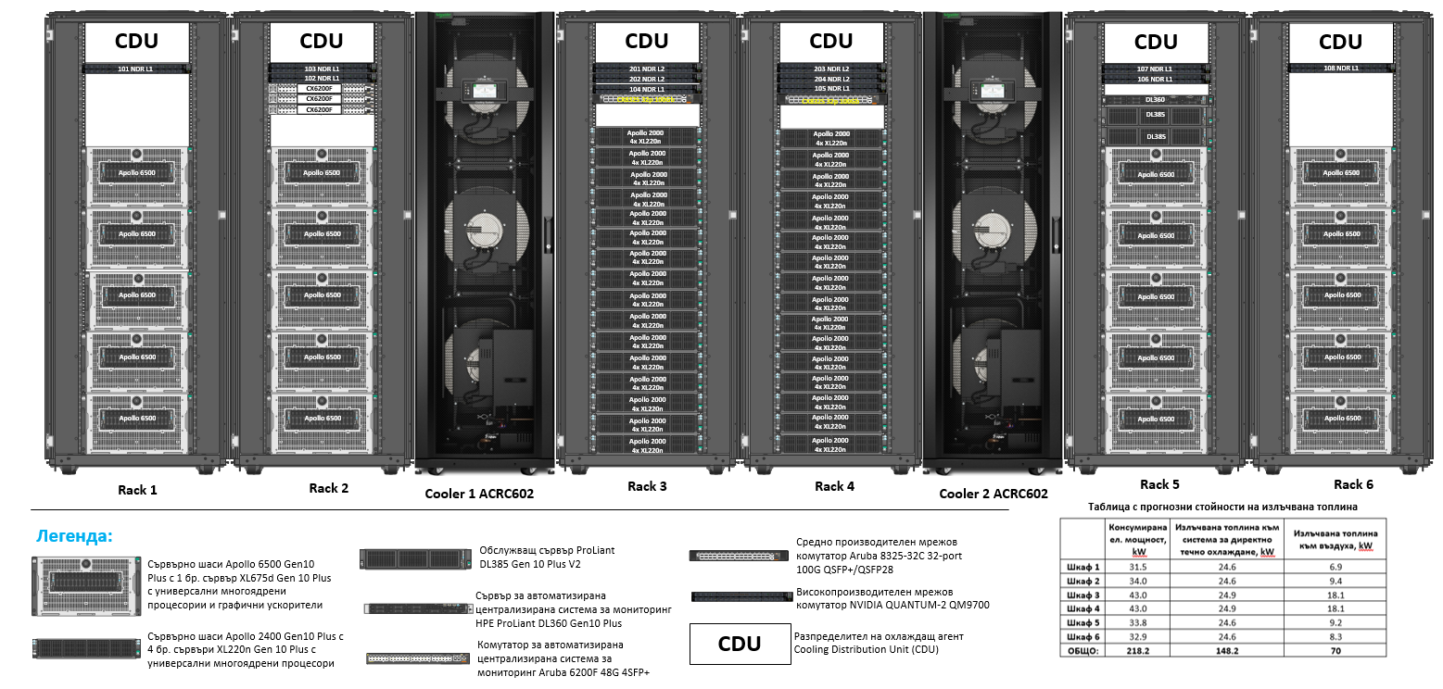
HEterogeneous MUltipurpose Supercomputer - General view

Slide 3
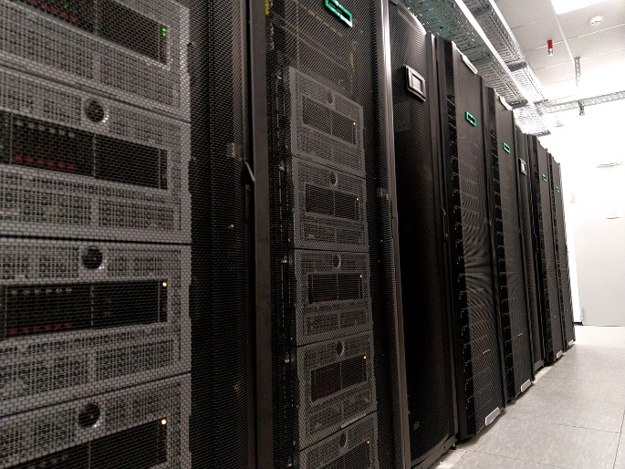
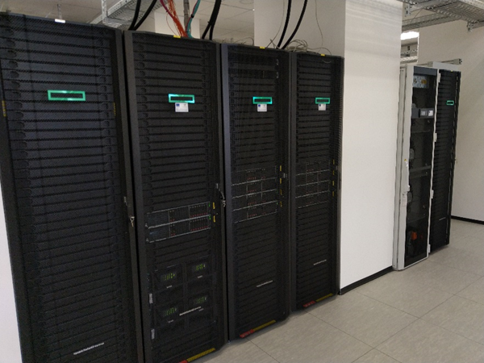
HEMUS positioning within the datacenter
The supercomputer HEMUS has the natural focus within the datacenter.
Infiniband connection with the storage system with capacity of more than 6 Petabytes
Building monitoring system (BMS)
UPS + diesel generator for power
Infiniband connection with Avitohol

Slide 4
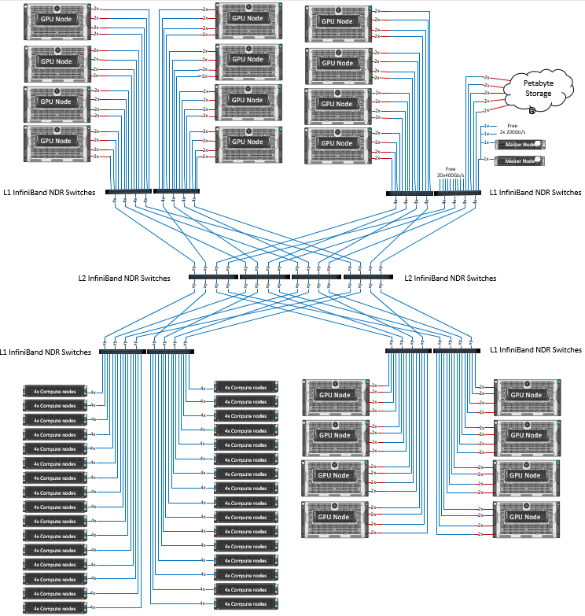
Non-blocking Infiniband interconnection

Slide 5
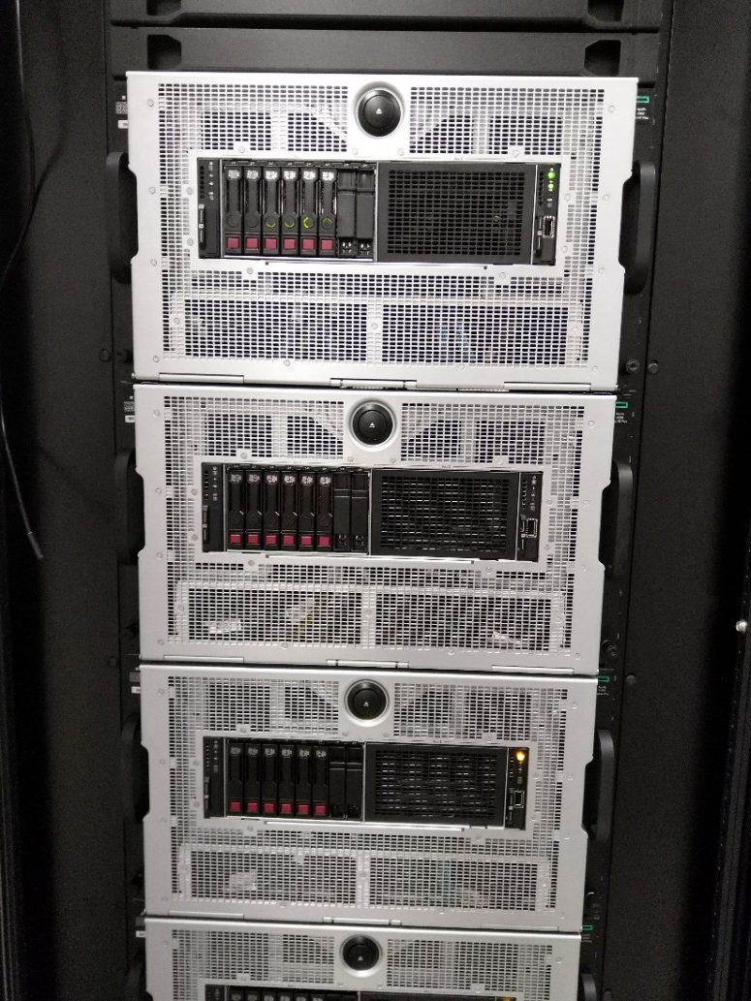
GPU- enabled subsystem
Servers | 20 x HPE ProLiant XL675d Gen10 Plus
CPUs | 2 x AMD EPYC 7742 (2.25GHz/64-core/225W) 64 cores/128 HT (128 cores / 256 HT per node)
GPU | 8 x NVIDIA A100 TENSOR CORE 40GB SXM Peak 64-bit floating point performance - 19,5 Tflops Memory bandwidth - 1,555GB/s Interconnectivity within node NVLink: 600GB/s (8 x 20 =160 in total, 160x40 GB = 6,25 TB RAM)
RAM | 16x32 GB = 512 GB DDR4-3200 MHz per node
Total CPUs | 2 560 cores / 5 120 HT
Total RAM | 10 TB
Interconnect | Non-blocking HDR Infiniband
Bandwidth | 200 Gbps
Storage | 2 x 480GB SATA SSD - 960 GB 4 x 3.84TB NVMe Gen3 SFF SC U.3 SSD = 15.36 TB Total: 16.30 TB per node 20 x 16.30 TB = 320 TB total

Slide 6
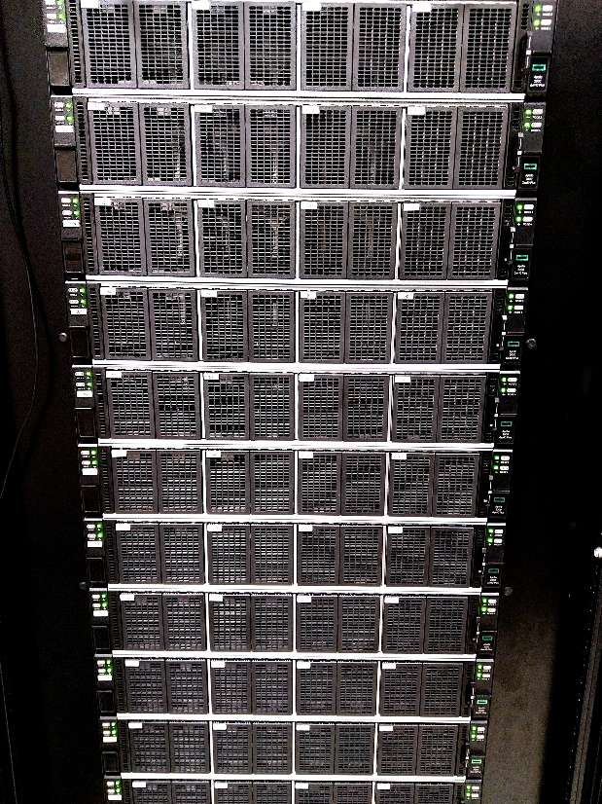
CPU - only subsystem
Servers | 128 x HPE ProLiant XL220n Gen10 Plus
CPUs | 2xIntel Xeon-Platinum 8352Y 2.2GHz 32-cores/64 HT (64 cores / 128HT per node)
RAM | 16x16GB = 256 GB DDR4-3200 MHz per node
Total CPUs | 8 192 cores/16 384 HT
Total RAM | 32 TB
Interconnect | Non-blocking NDR Infiniband
Bandwidth | 200 Gbps
Storage | 2 x 480GB NVMe Gen3 SSD = 960 GB per node Total: 120 TB

Slide 7

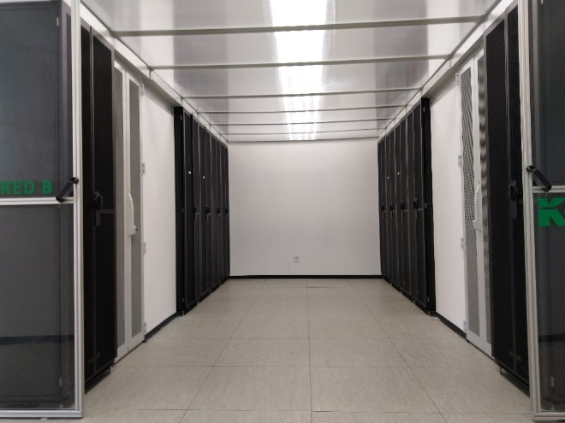
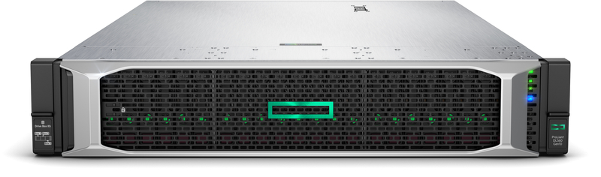
System for data storage and processing
Access to more than 5 PB of HDD/SSD storage
Servers with large amounts of RAM for in-memory data processing
  4 х Intel Xeon Gold 6238L 2,1GHz, 22 cores;
  3 ТB RAM per server
  2 x 480 GB SSDs
Melanox InfiniBand HDR 40-port QSFP56 managed, 200 Gbps per port

Slide 8
Linpack test results and discussion
360th place in Top500 list November 2024
2.53 PFlop/s Linpack performance
3.21 Pflop/s theoretical peak performance (of the gpu subsystem only, otherwise 0.5 more from the cpu subsystem)
The configuration of the grid in the HPL.dat file was important, 160 cards map to 8x20.
Usually cpu-based systems benefit from `more square’ grids.
GPU cards draw maximum power - 400W each card – 64 kW just for the cards.

Slide 9

HPCG test results and discussion
Much less parameters could be changed in the input.
Less systems provided such tests (the efficiency with respect to the theoretical peak performance is smaller)
109th place with 36.42 Teraflops

Slide 10
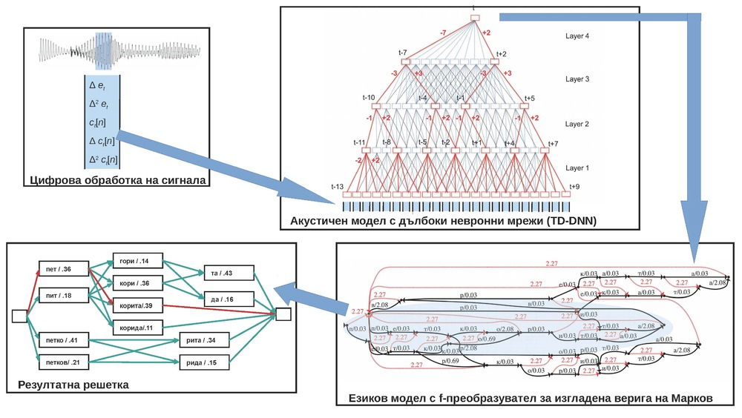
Mixed precision test
The test is at https://hpl-mxp.org/
Much fewer systems provided test results.
The test measures acceleration of the computations done in mixed precision (with refinement) vs double precision Linpack.
We again used NVIDIA binary named HPL-AI, because of the connection with AI workloads, where smaller precisions are used (even smaller than single precision).
19.76s 15.37 Pflops 9.12s 10.52 Pflops with refinement
Speedup vs double precision Linpack – 4 times.
NVIDIA A100 potential in lower precision computations:
  Half Precision (FP16) – 78 TFLOPS
  Brain Floating Point (BF16) – 39 TFLOPS

Slide 11
Efficiency
HEMUS achieves >2.5 Pflop/s with less power than Avitohol
Efficiency of measured linpack performance vs theoretical peak performance
Name | HP Linpack | Theoretical | Efficiency
Avitohol | 0.26 | 0.41 | 63%
Discoverer | 4.52 | 5.94 | 76%
HEMUS | 2.53 | 3.21 | 79%

Slide 12
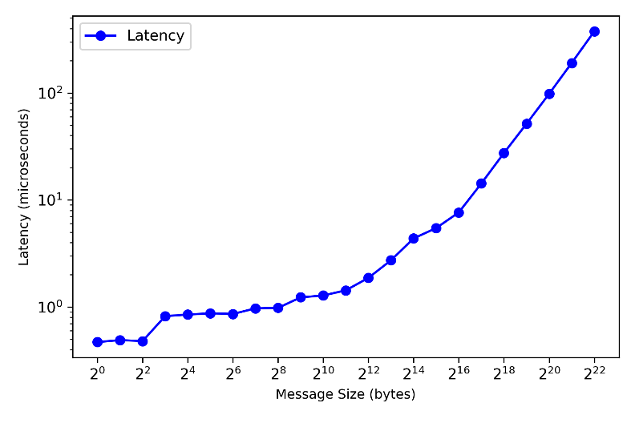
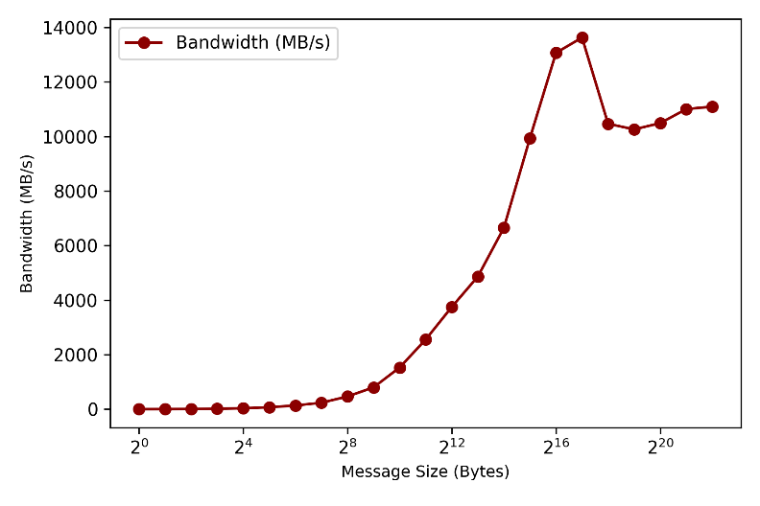
Latency and bandwidth testing
Fig. OSU MPI Latency Benchmark
Fig. OSU MPI Bandwidth Benchmark

Slide 13
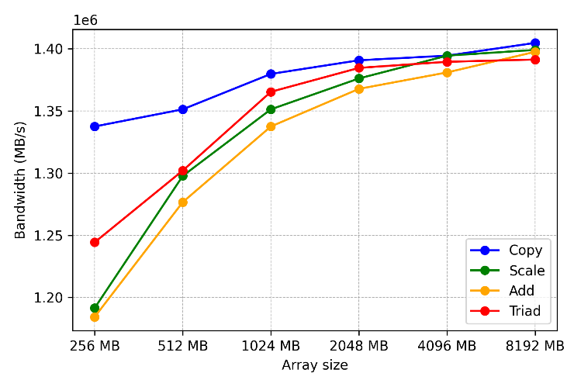
Test results on STREAM benchmark
Fig. 3. STREAM bandwidth results (in MB/s) for different FP32 operations on the NVIDIA A100

Slide 14
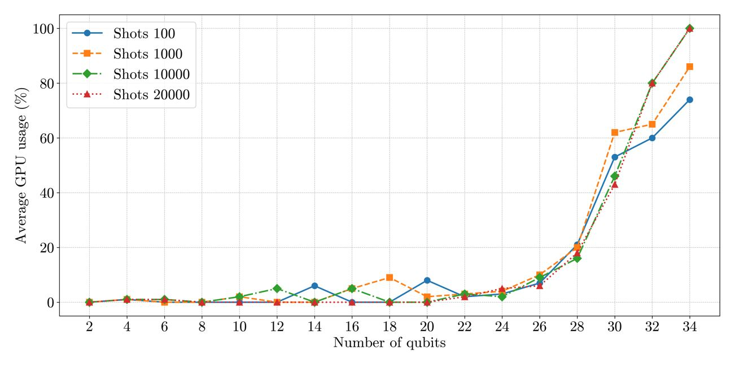
Quantum computing simulations using CPUs & GPUs
Average GPU usage (%)

Slide 15
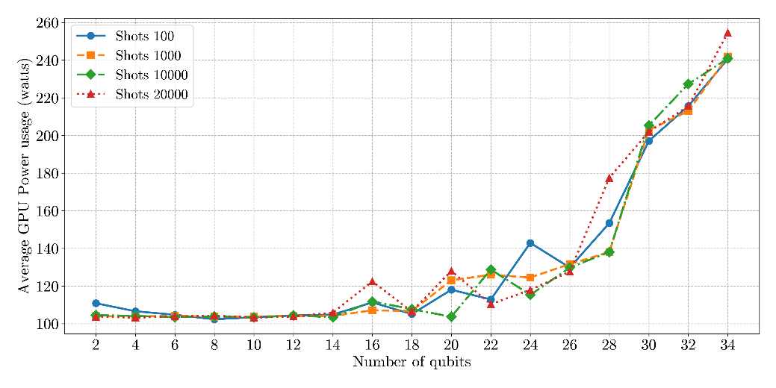
Power consumption
Fig. Average GPU usage (watts) for different number of qubits

Slide 16
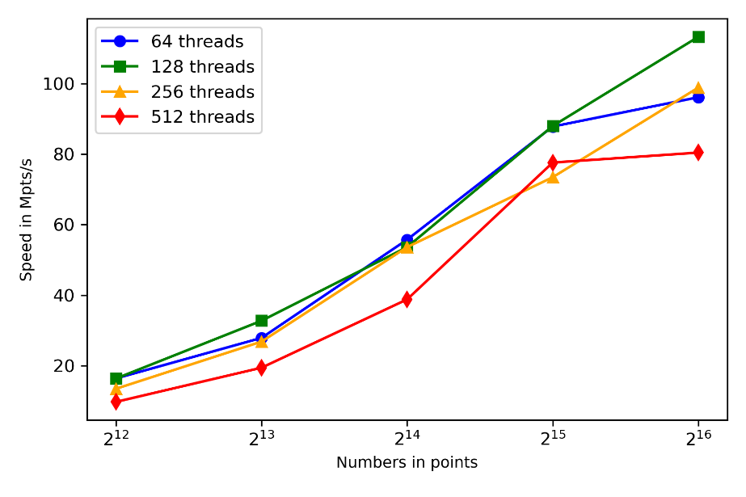
Speed of Quasi-Monte Carlo algorithms using GPUs when varying number of threads
Speeds of generation of the same algorithm, with varying number of points, dimension 4096 and different number of threads in the kernel launch

Slide 17
Speeds of MC and QMC generation
Generator/Number of points | 4096 | 8192 | 16384 | 32768 | 65536
Sobol, custom | 0.71 | 1.24 | 2.43 | 4.38 | 8.65
Sobol, custom with Owen scrambling | 0.11 | 0.21 | 0.42 | 0.68 | 0.98
Sobol, cuRAND | 1.24 | 1.24 | 1.24 | 1.24 | 1.24
Philox32 (custom RNG) | 16.35 | 32.74 | 53.63 | 87.99 | 113.27
cuRAND Philox | 27.78 | 55.56 | 79.87 | 113.07 | 147.69
Speeds of generation when using different algorithms (random, Sobol with and without scrambling, library or custom), with varying number of points and dimension 4096.

Slide 18
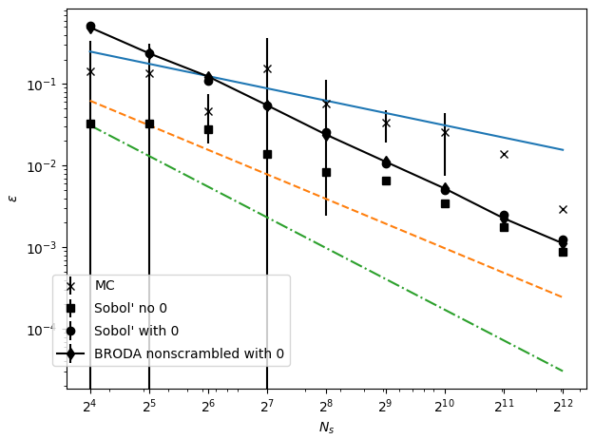
MC/QMC integration errors
Figure: Errors in numerical integration

Slide 19
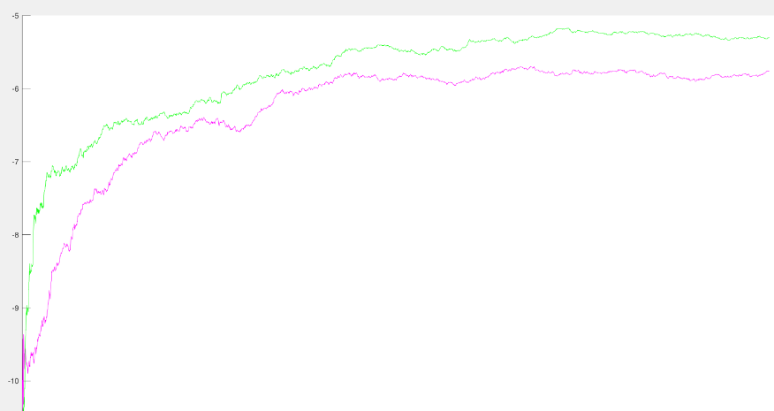
Advantage of specifically optimized direction numbers
Figure: Spurious correlations - Kuo (green) vs optimised (pink)

Slide 20
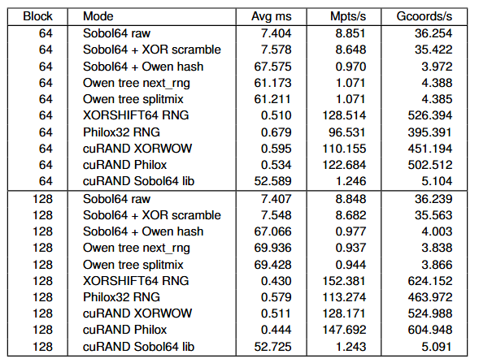
Generation speeds on GPU
Table: Performance for 65536 points

Slide 21
Acknowledgements
This work has been accomplished with the partial support by the Grant №D01-98/26.06.2025 for providing access to e-infrastructure of the NCHDC – part of the Bulgarian National Roadmap on RIs.

