Slide 1
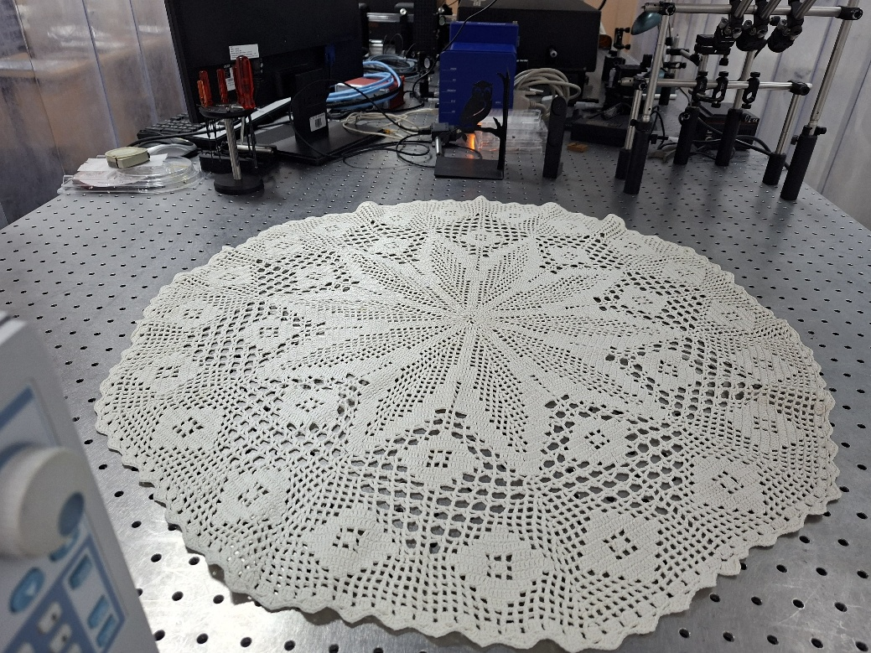
Nature-inspired periodicity on optical table
Jovana Petrović
Vinča Institute of Nuclear Sciences, Belgrade, Serbia

Slide 2
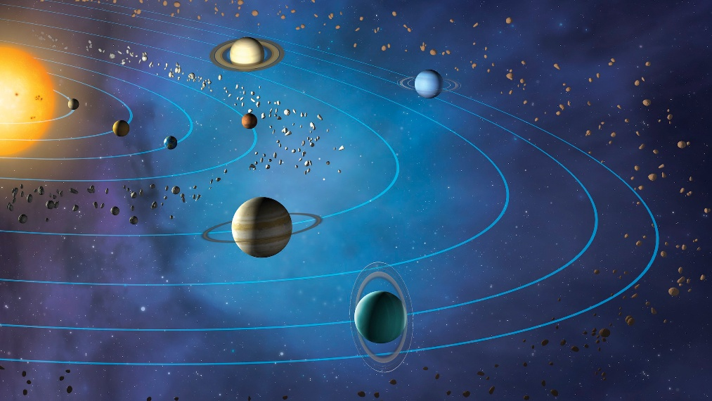
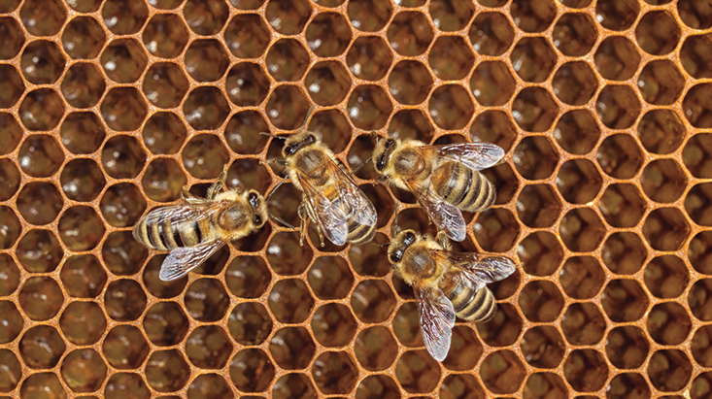
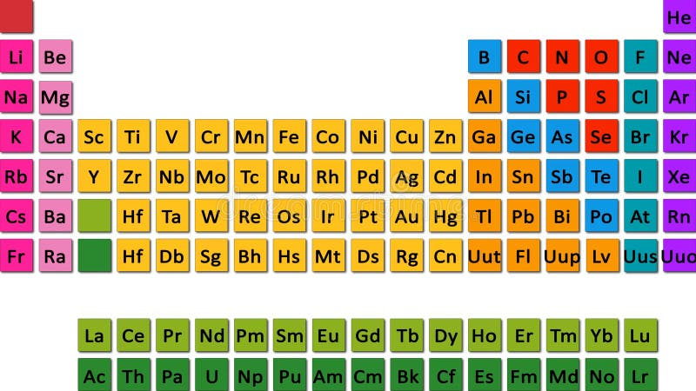
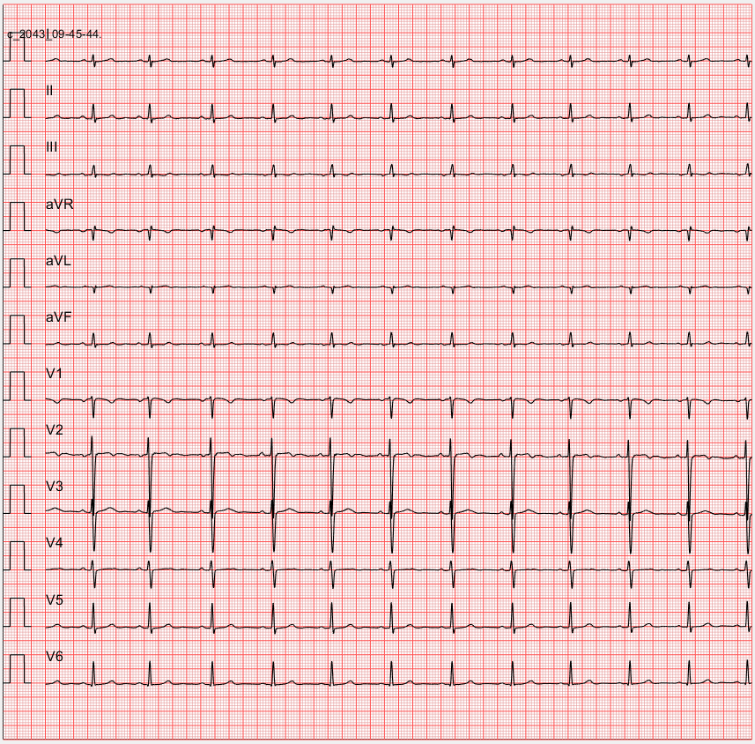
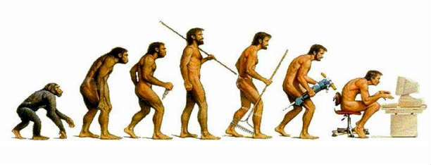
Periodicity in nature

Slide 3

Periodicity in nature

Slide 4
Periodicity in nature

Slide 5
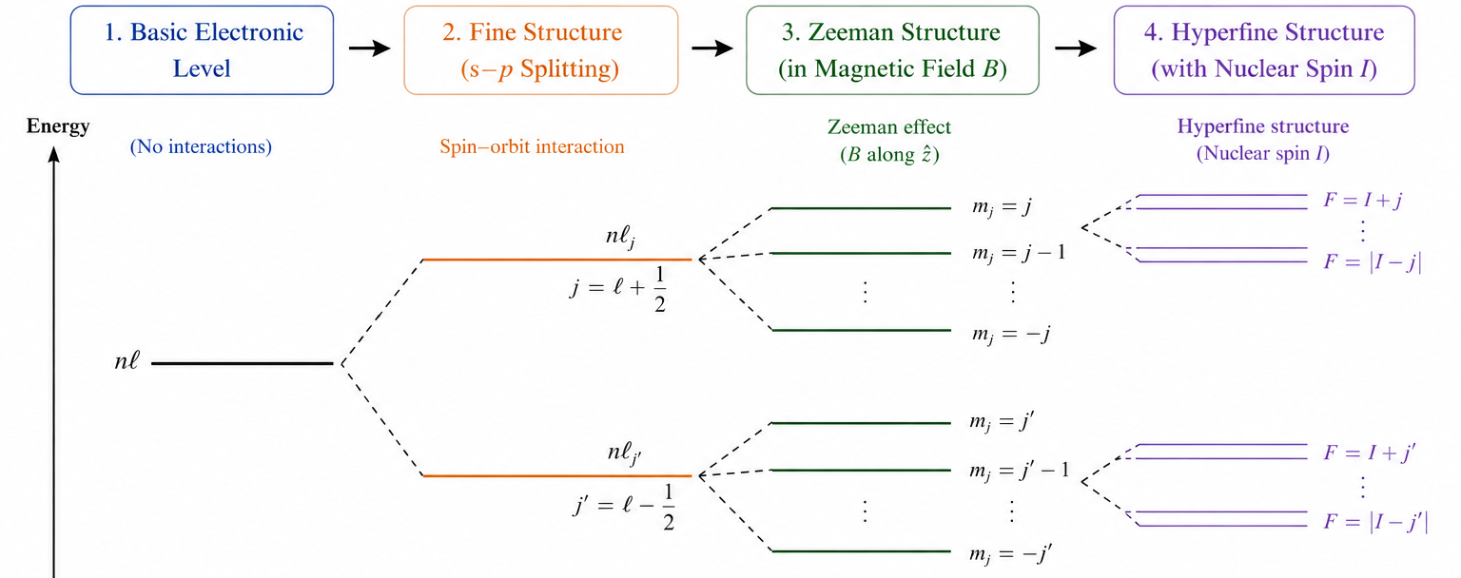
Atomic transitions

Slide 6
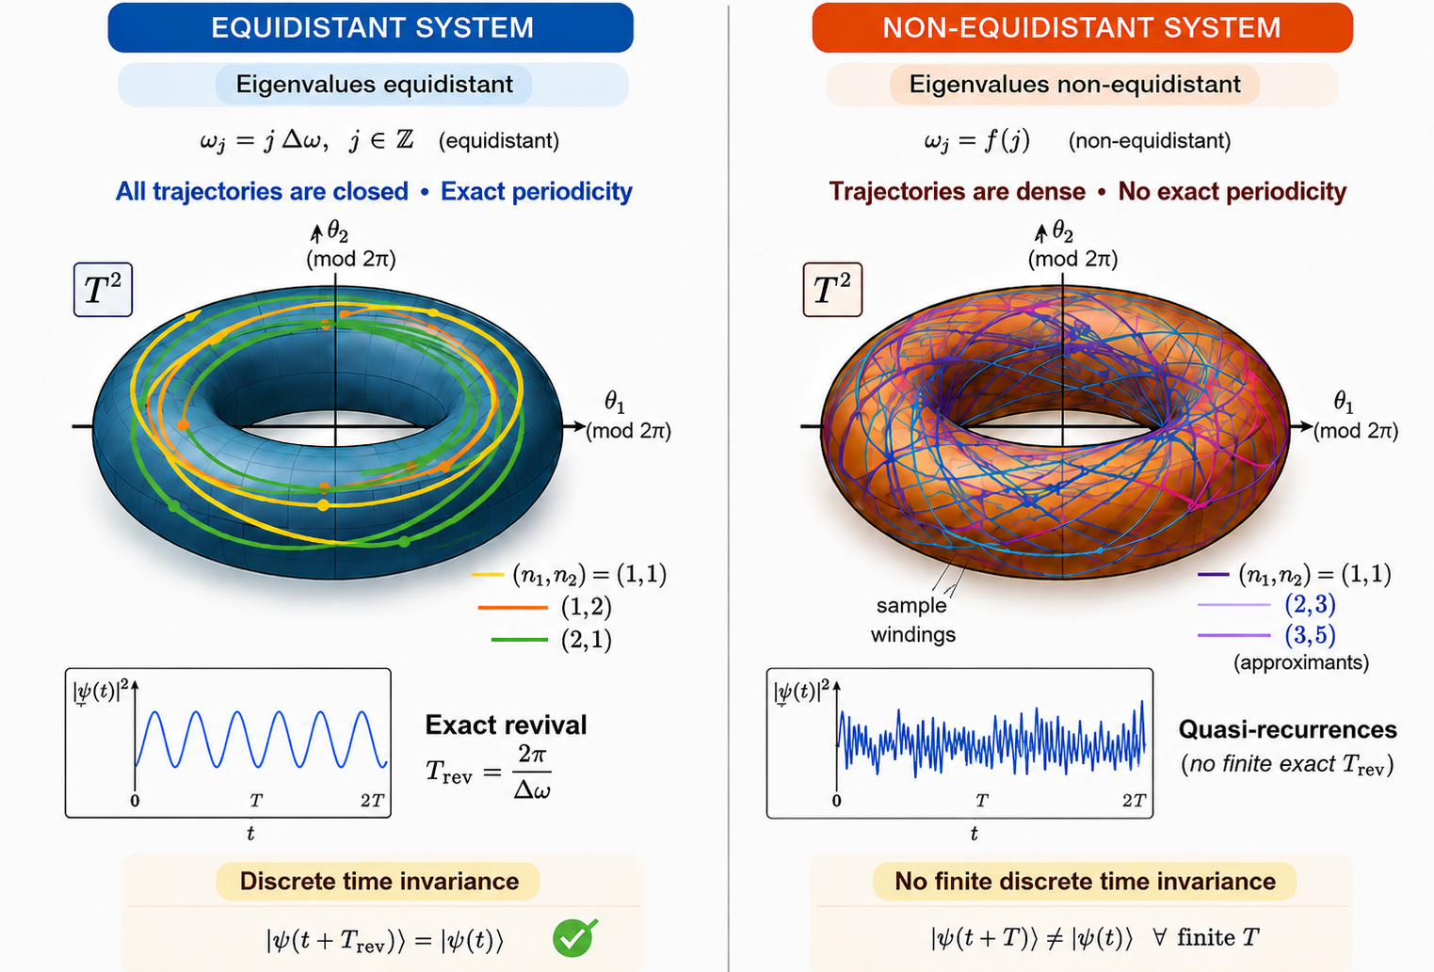
Wannier-Stark ladder

Slide 7
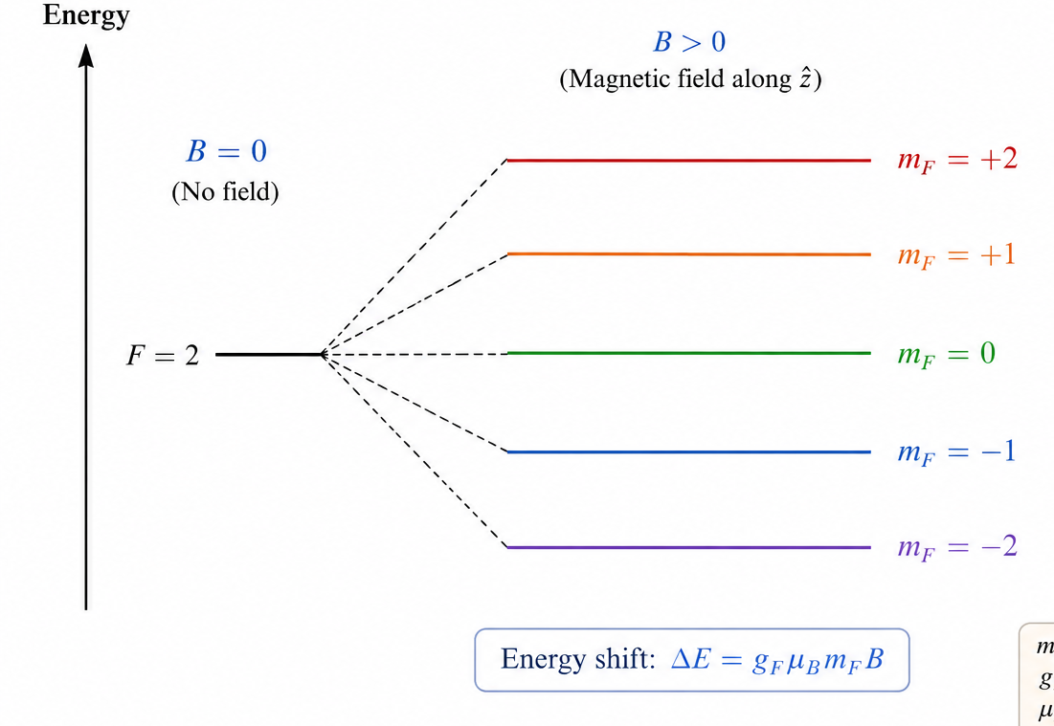
Coupling of Zeeman states in a BEC

Slide 8
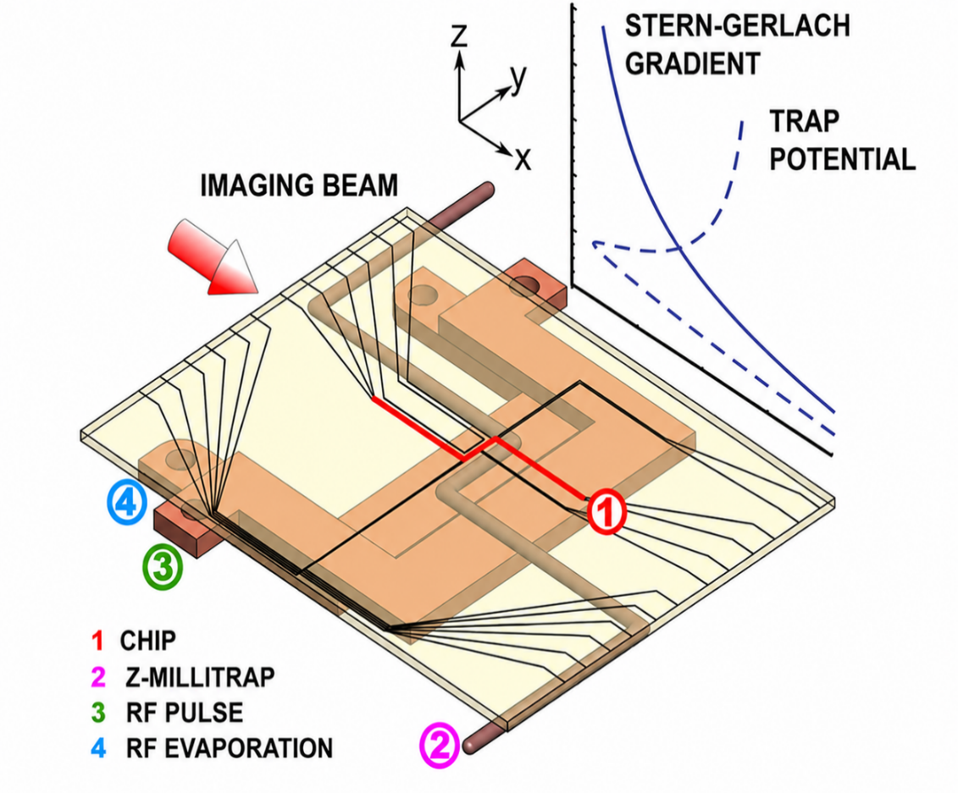
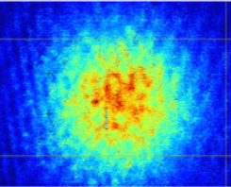

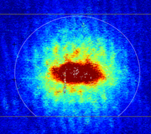
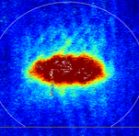
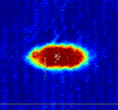

Coupling of Zeeman states in a BEC
m_{F} = 2
N = 30000
T = 0.5 μK

Slide 9
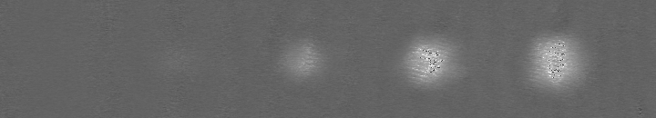
Coupling of Zeeman states in a BEC
m_{F} = -2
m_{F} = -1
m_{F} = 0
m_{F} = 1
RF Generator
m_{F} = 2

Slide 10
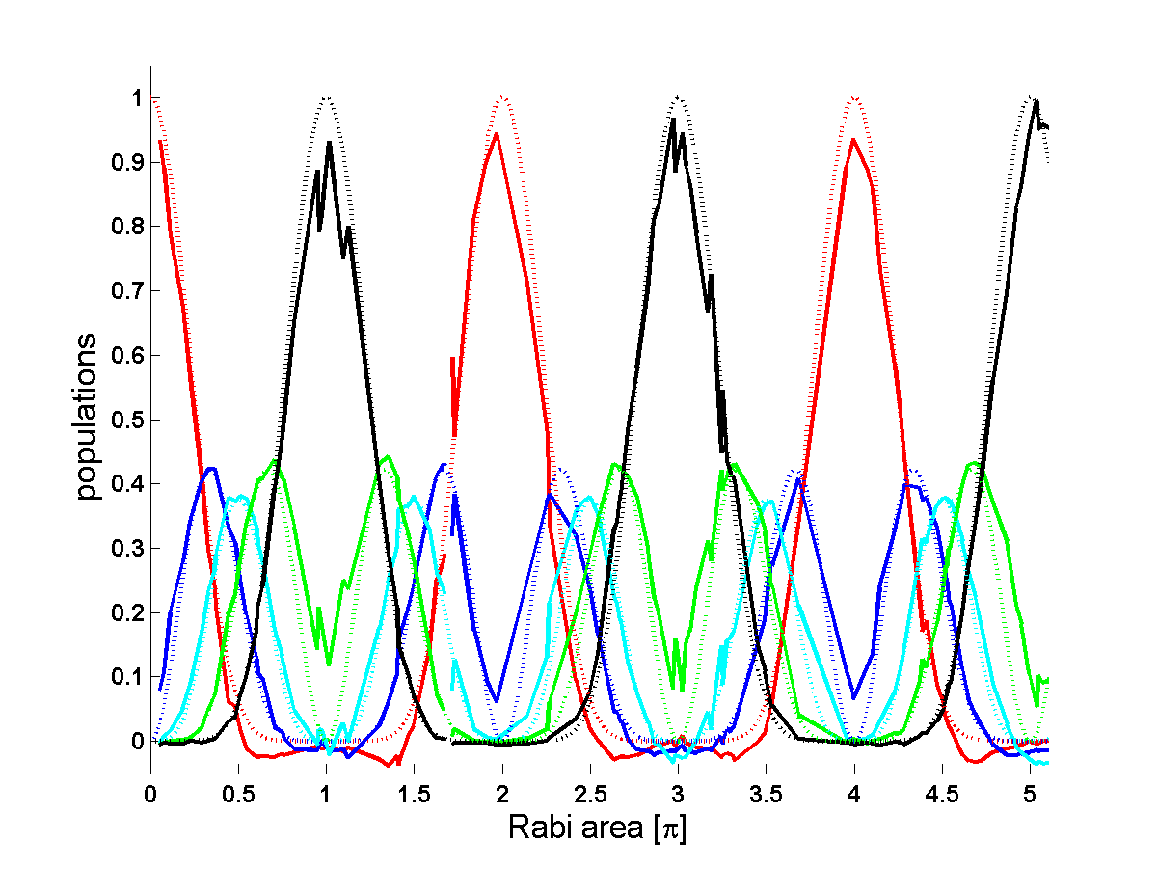
Coupling of Zeeman states in a BEC
m_{F} = -2
m_{F} = -1
m_{F} = 0
m_{F} = 1
m_{F} = 2

Slide 11
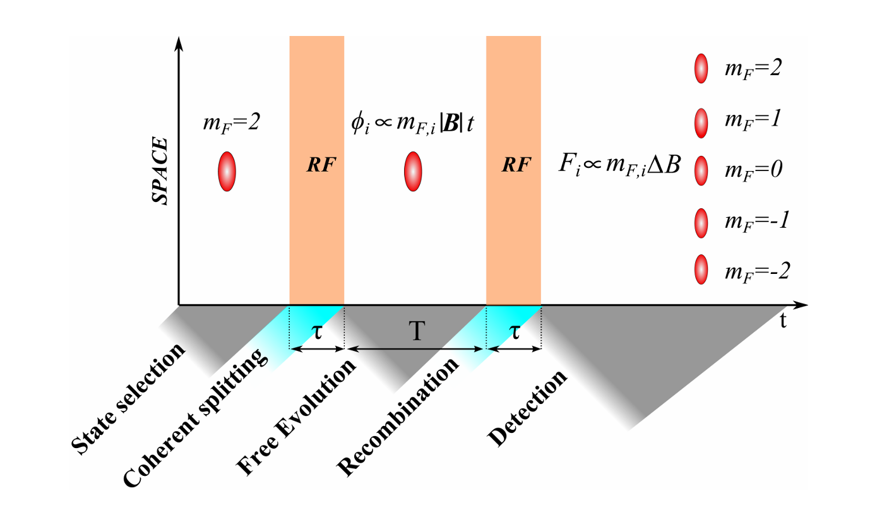
A multi-state interferometer
Petrovic et al. New J. Phys 15, 043002 (2013)

Slide 12
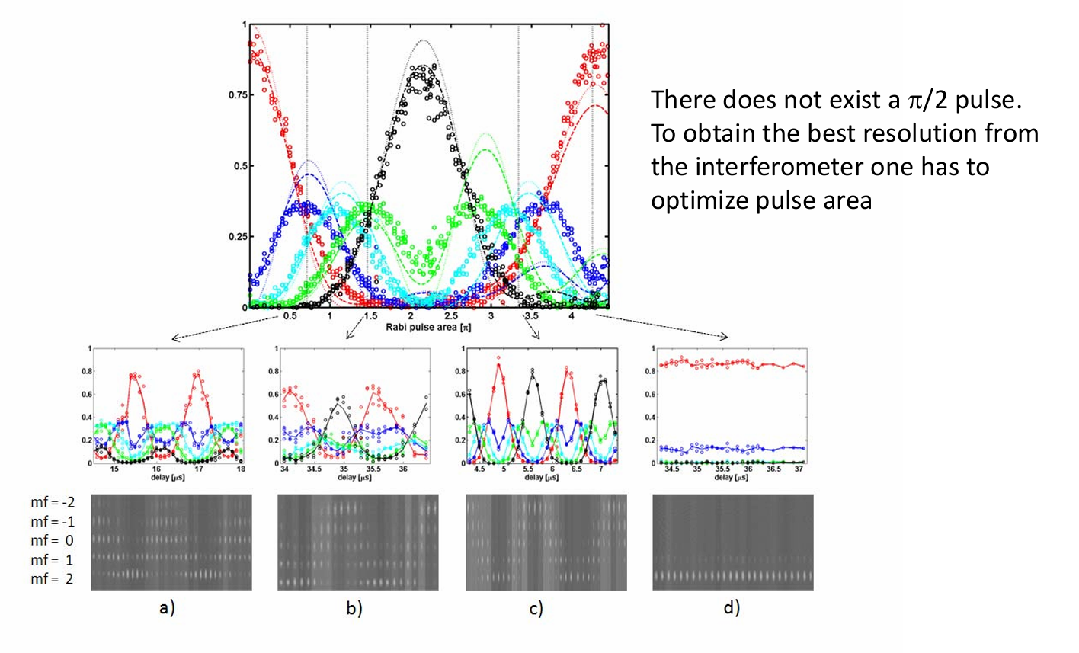
A multi-state interferometer
Petrovic et al. New J. Phys 15, 043002 (2013)

Slide 13
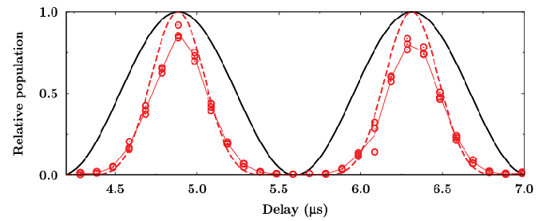
A multi-state interferometer
Petrovic et al. New J. Phys 15, 043002 (2013)

Slide 14
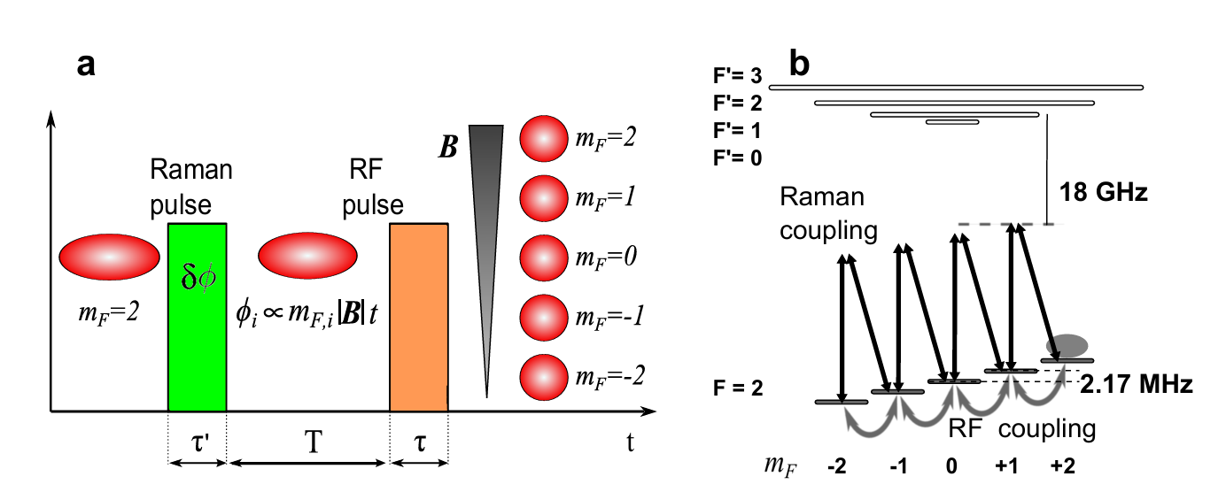
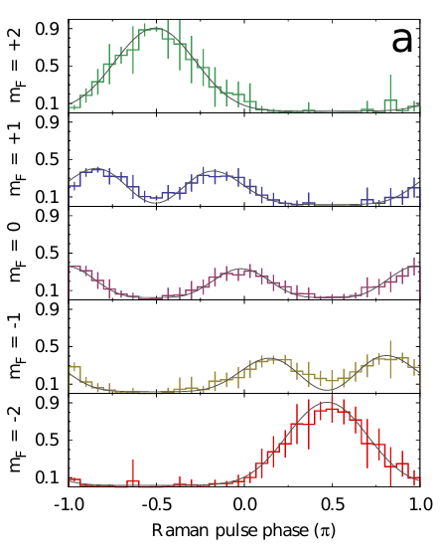
Quantum memory read-out
m_{F} = +2
m_{F} = +1
m_{F} = 0
m_{F} = -1
m_{F} = -2
Lombardi et al. Opt. Express 22, 19141 (2014)

Slide 15
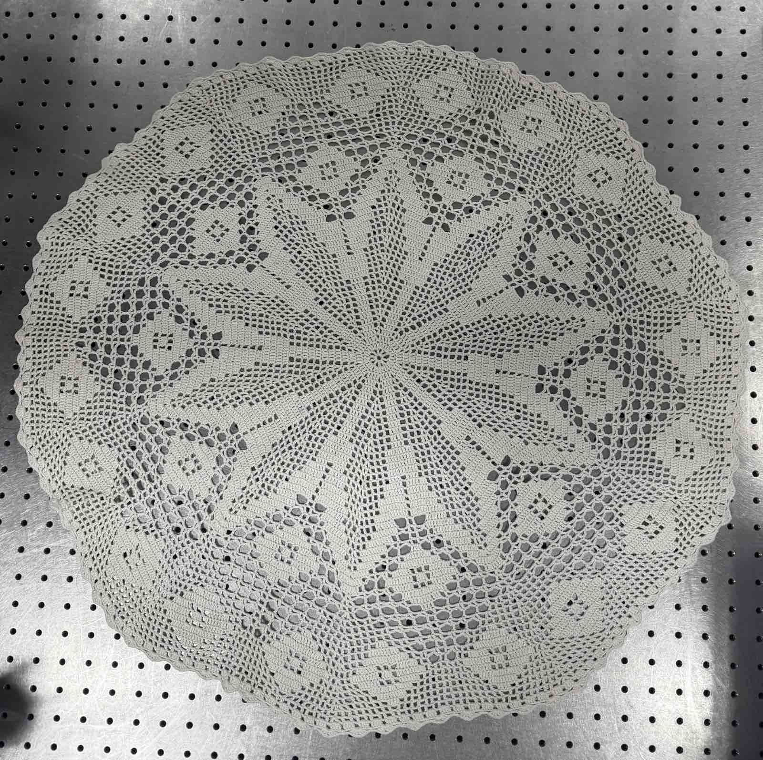
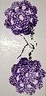
How do we construct periodic systems?
10
10
20
180

Slide 16
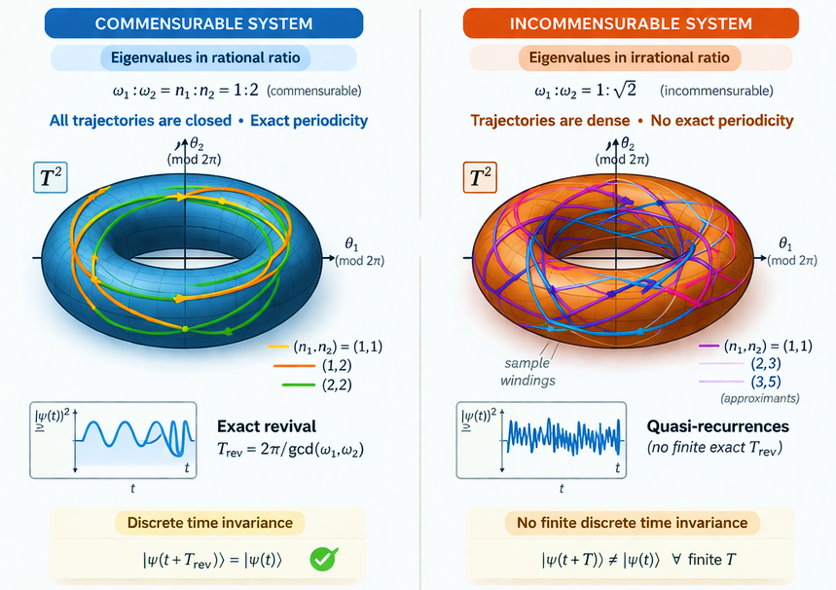
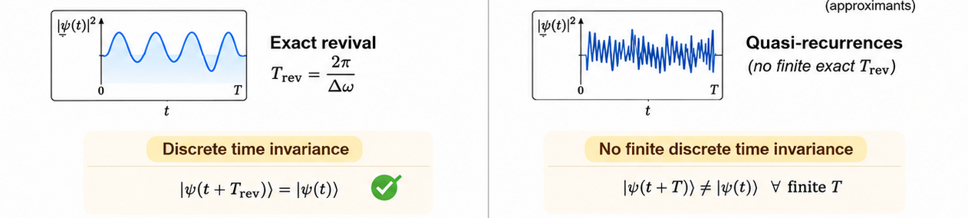
Commensurable eigenvalues effect periodicity

Slide 17
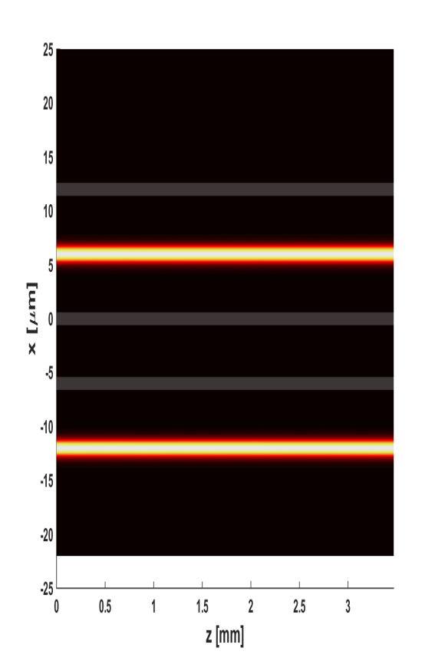
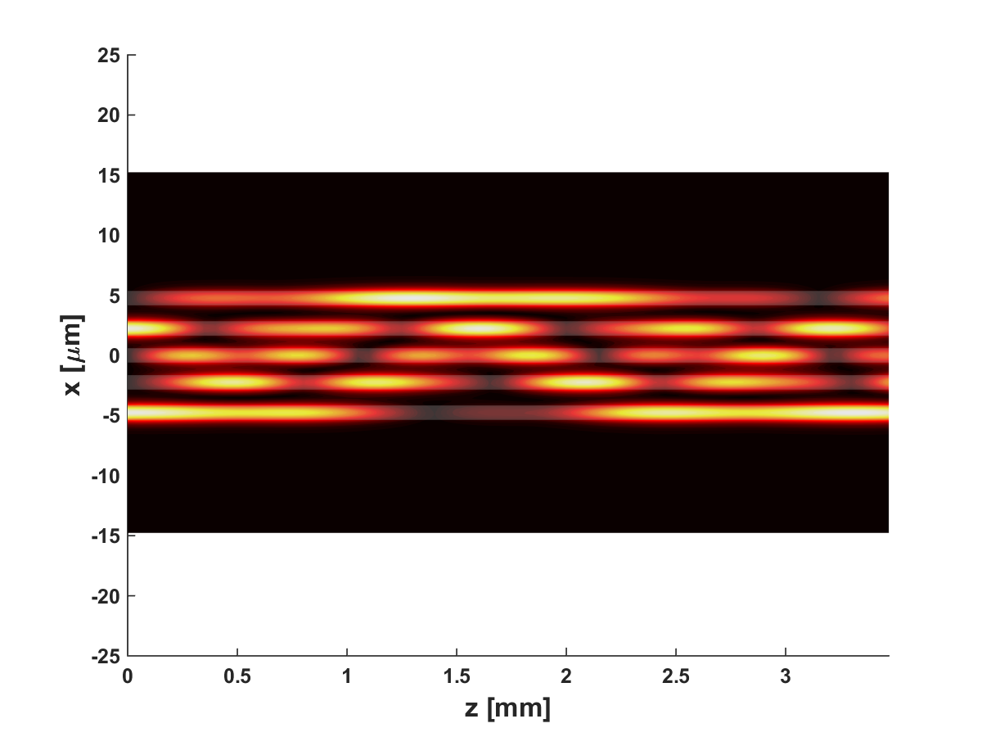
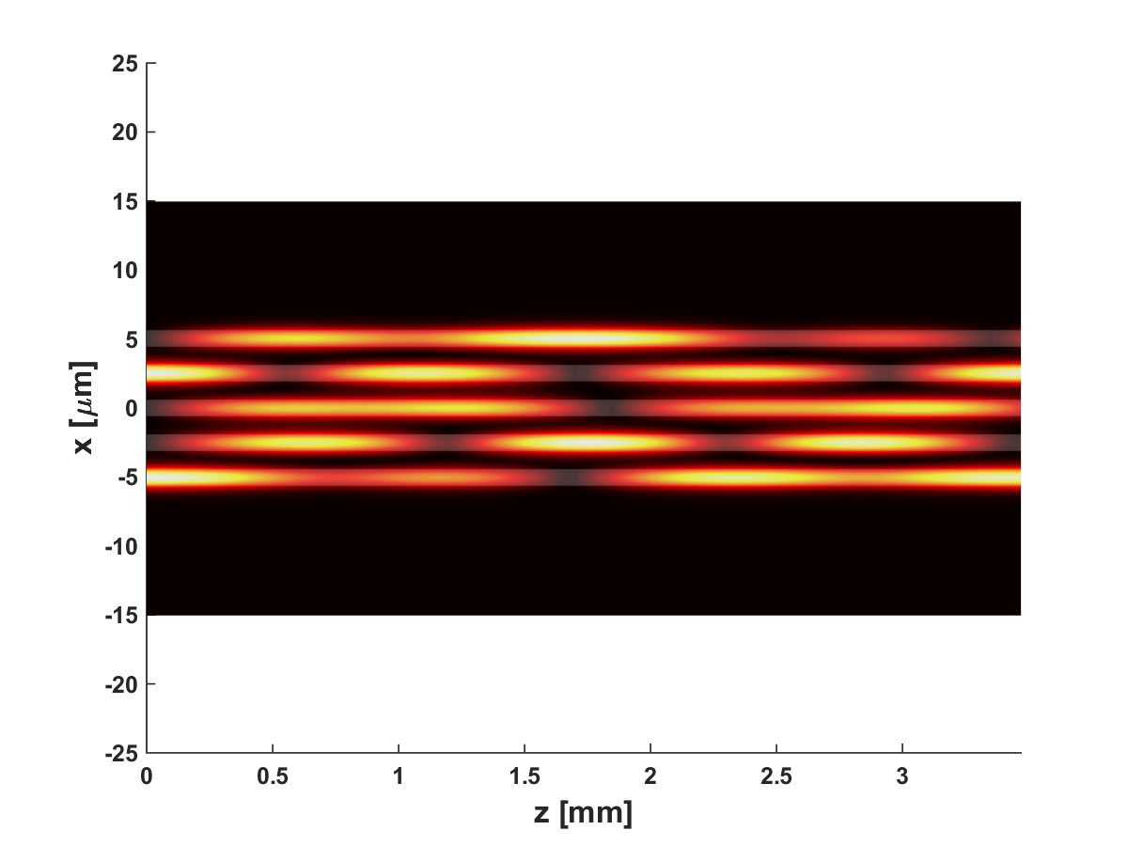

Benefits from periodicity
Input
Output = input
0
0
1
1
0
0
0
1
0
1
1
0
0
0
0
0
0
0
0
0
0
1
1
1
1
0
1
0
1
1

Slide 18
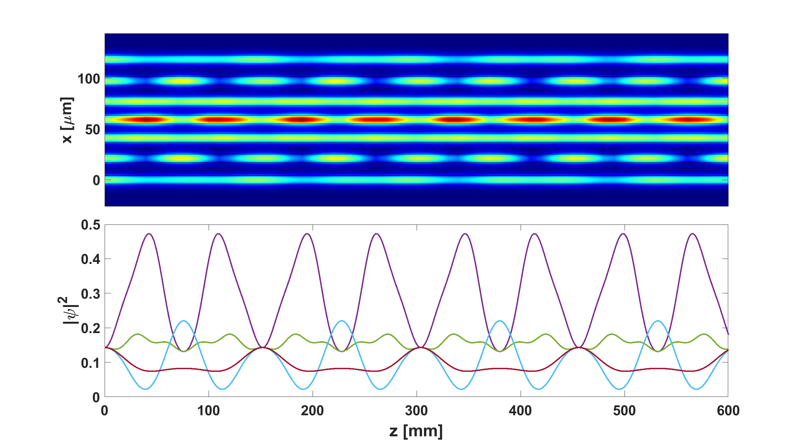
Optical interconnect
Petrovic et al. Opt. Laser Technol. 163, 109381 (2023)

Slide 19
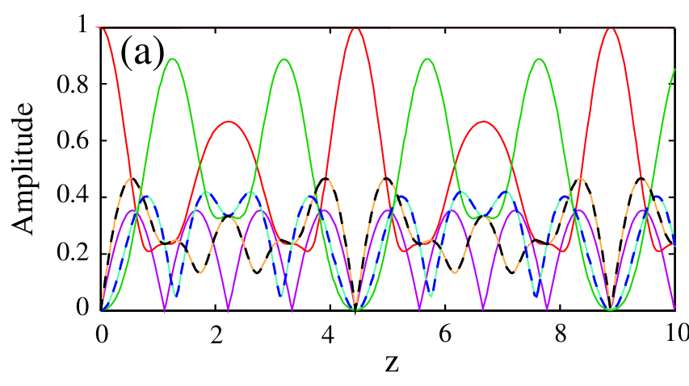
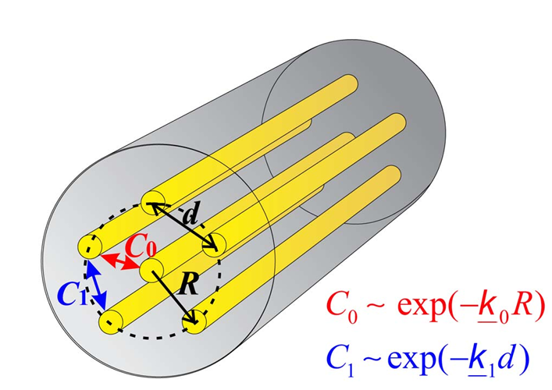
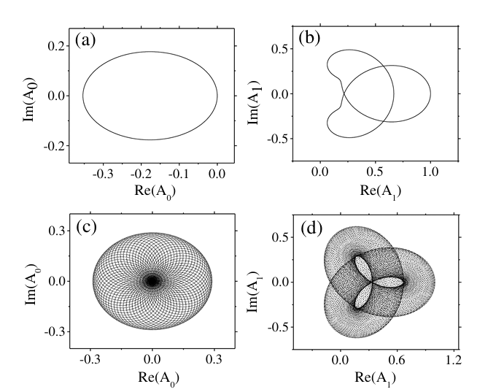
Long-haul optical fibre link
Radosavljevic et al., JOSA B 32, 2520 (2015)

Slide 20
How to construct a periodic system?
Commensurable eigenvalues
Inverse eigenvalue design
System Hamiltonian
λ5
λ4
λ3
λ2
{λj}
H = {{c_{j,j±1}δ_{j,j±1}}}
λ1
Petrovic & Veerman, Ann. Phys. 392, 128 (2018)
Collaboration with J.J.P. Veerman, State University Portland, US

Slide 21
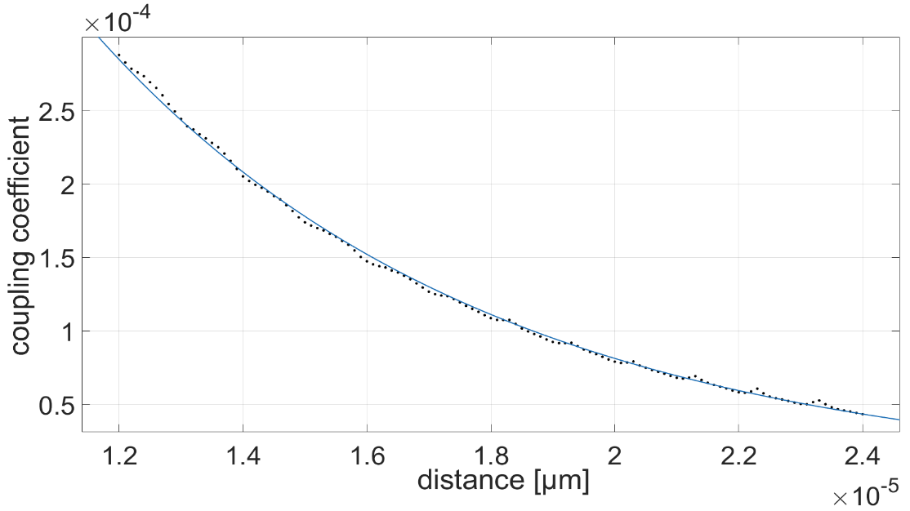
How to construct a photonic periodic system?
H = {{c_{j,j±1}δ_{j,j±1}}}
c
cj,j+1
d
dj,j+1
Petrovic & Veerman, Ann. Phys. 392, 128 (2018)

Slide 22
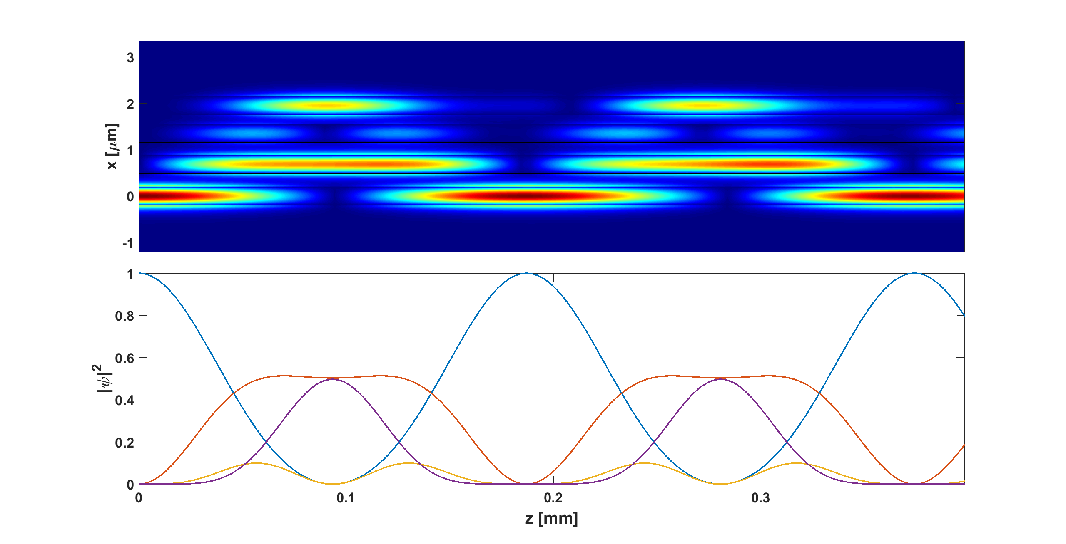
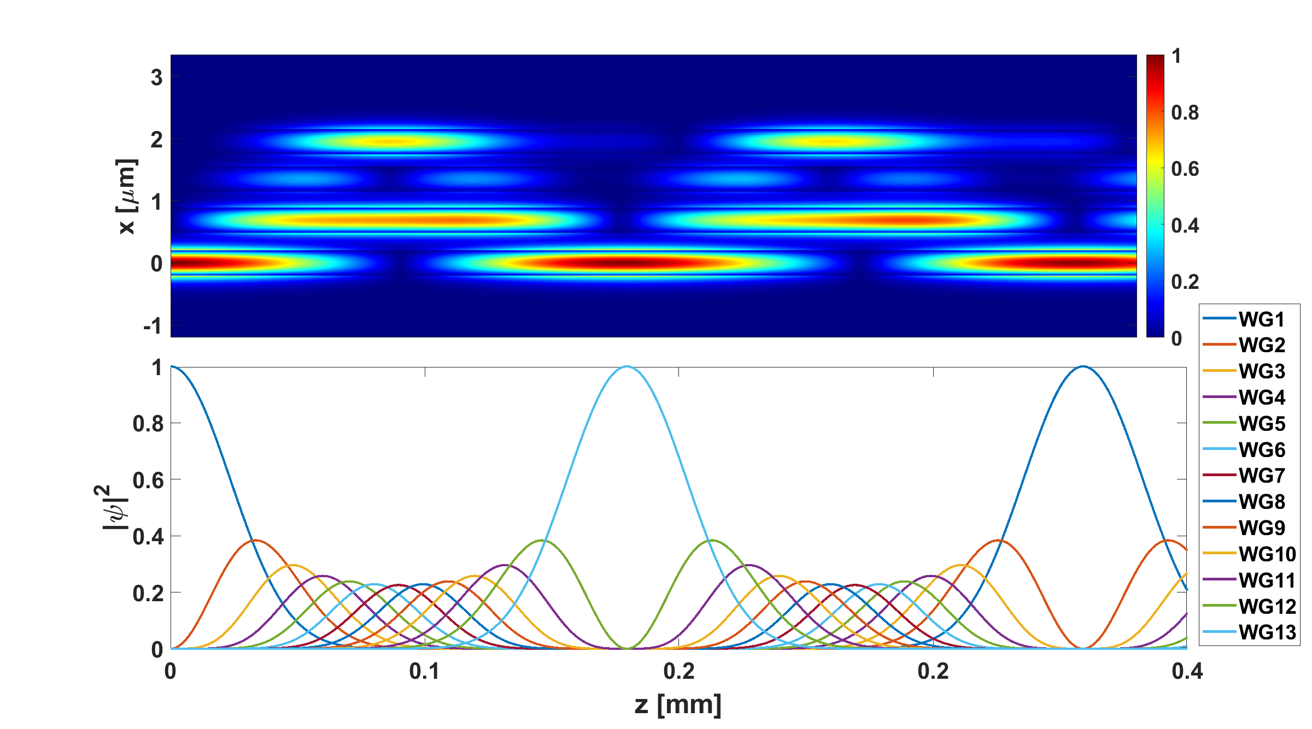
Spatial symmetry is not a requirement and spatial periodicity is forbidden
Petrovic et al. Opt. Laser Technol. 163, 109381 (2023)

Slide 23
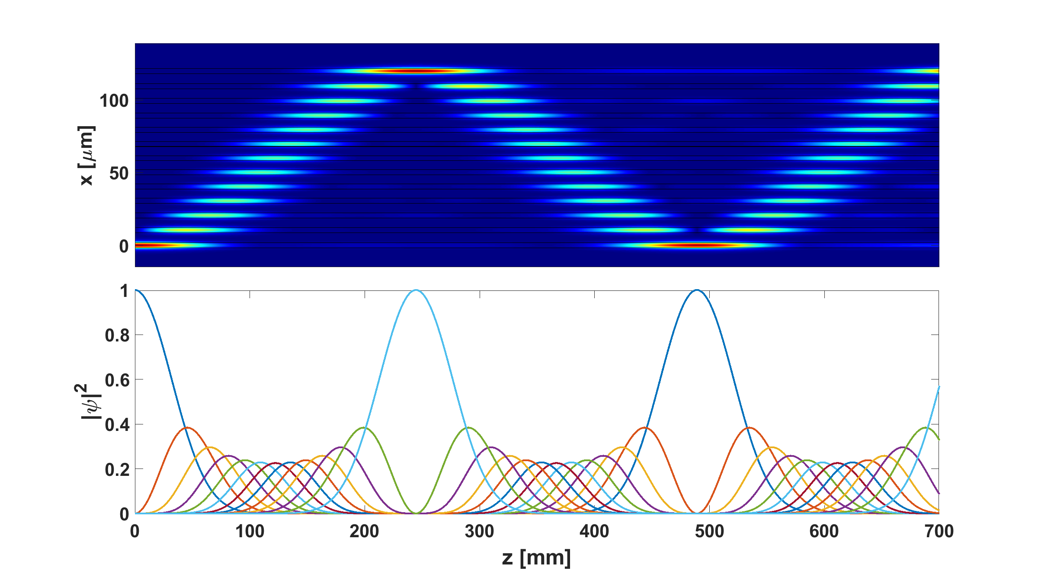
Perfect transfer
perfect transfer (commensurability + parity)
Wavelength dependence:
the longer the wavelength,
the shorter the period.
Petrovic & Veerman, Ann. Phys. 392, 128 (2018)

Slide 24
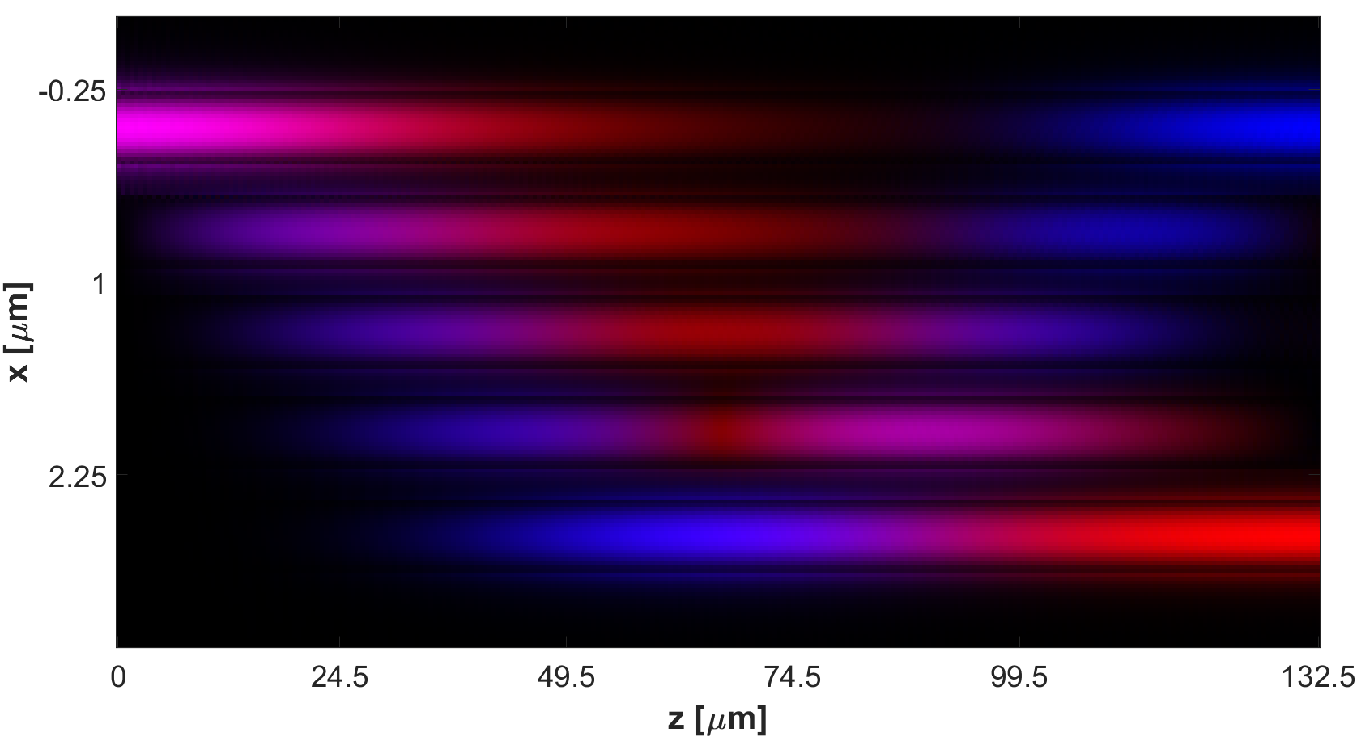
Perfect transfer
perfect transfer (commensurability + parity)
Wavelength dependence:
the longer the wavelength,
the shorter the period.
Petrovic & Veerman, Ann. Phys. 392, 128 (2018)

Slide 25
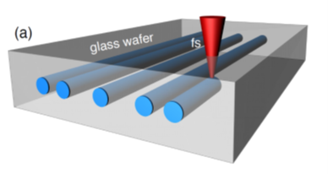

Demonstration by fs laser writing
Vildoso et al. Opt. Express 31, 12703 (2023)
Stojanovic et al. J. Opt. 163, 109381 (2025)
Collaboration with R. Vicencio, Universidad de Santiago, Chile

Slide 26
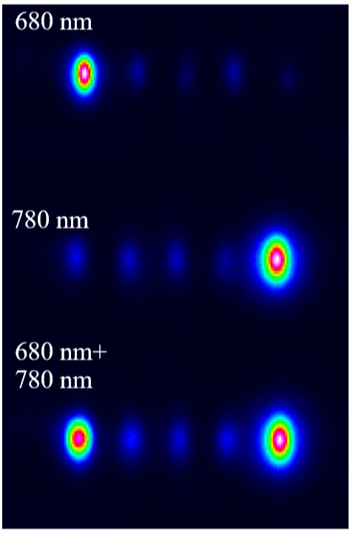
Demonstration by fs laser writing
interconnect
Vildoso et al. Opt. Express 31, 12703 (2023)
Stojanovic et al. J. Opt. 163, 109381 (2025)
Collaboration with R. Vicencio, Universidad de Santiago, Chile

Slide 27
Demonstration by fs laser writing
interconnect
perfect transfer
Vildoso et al. Opt. Express 31, 12703 (2023)
Stojanovic et al. J. Opt. 163, 109381 (2025)
Collaboration with R. Vicencio, Universidad de Santiago, Chile

Slide 28
Demonstration by fs laser writing
interconnect
perfect transfer
VIS/NIR splitter
Vildoso et al. Opt. Express 31, 12703 (2023)
Stojanovic et al. J. Opt. 163, 109381 (2025)
Collaboration with R. Vicencio, Universidad de Santiago, Chile

Slide 29
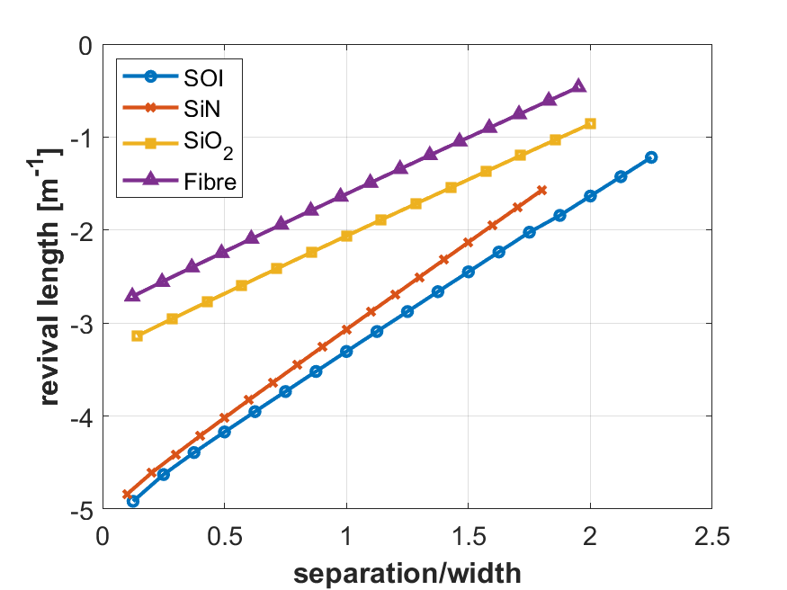
Footprint scaling in different materials
Petrovic et al. Opt. Laser Technol. 163, 109381 (2023)

Slide 30
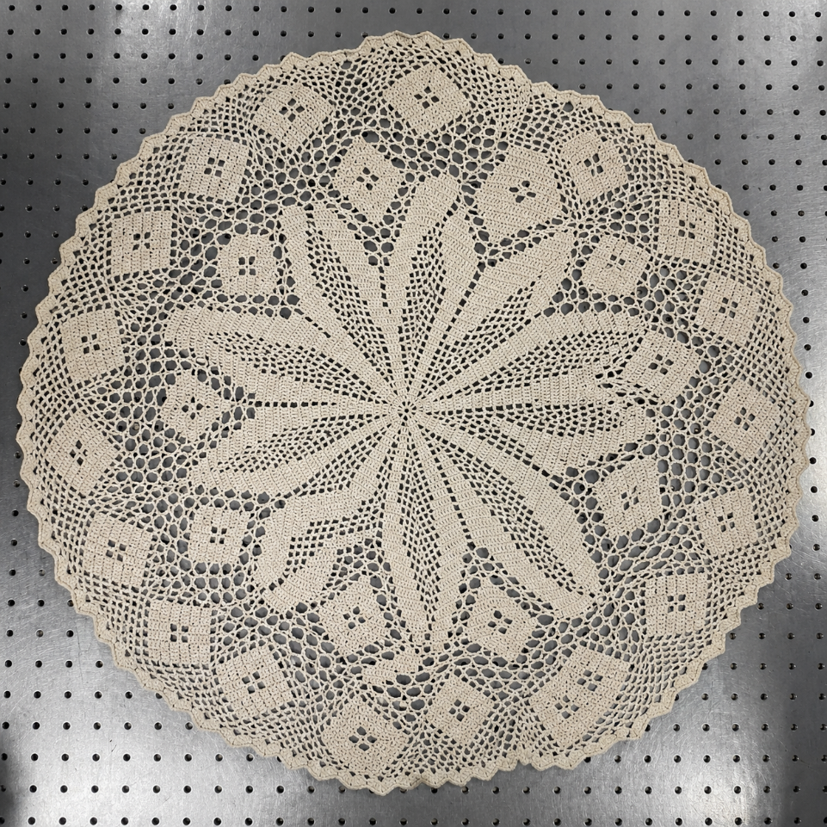
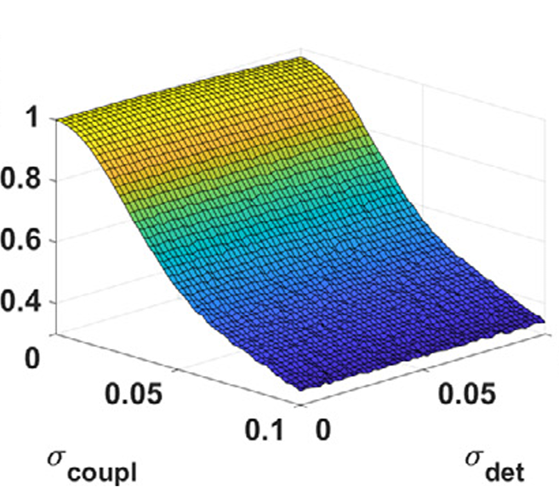
Fault tolerance
Petrovic et al. Opt. Laser Technol. 163, 109381 (2023)

Slide 31
How much periodicity is healthy?
Notes:
Antun from a conference in Luxemburg

Slide 32
How much periodicity is healthy?
Heart beat variability
Healthy 30–80 ms
Petrovic et al. Clinical Study SensSmart 576/15 (2023-2025)

Slide 33
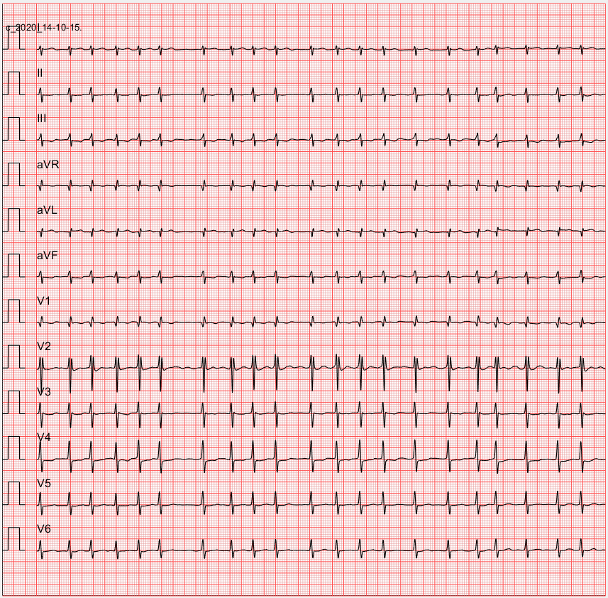
How much periodicity is healthy?
Heart beat variability
Healthy 30–80 ms
Atrial fibrilation >100 ms
Petrovic et al. Clinical Study SensSmart 576/15 (2023-2025)

Slide 34
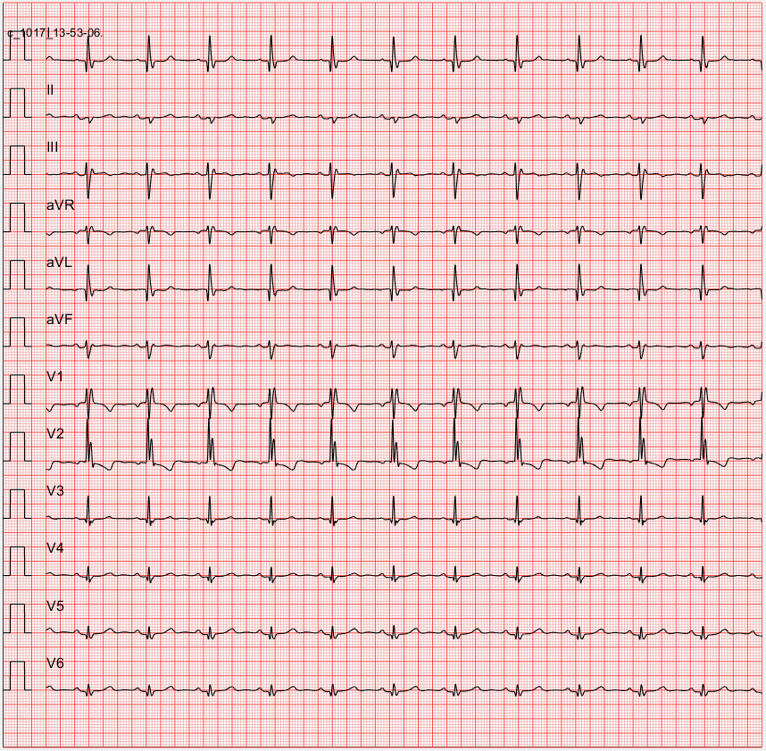
How much periodicity is healthy?
Heart beat variability
Healthy 30–80 ms
Atrial fibrilation >100 ms
Heart failure 10–40 ms
Petrovic et al. Clinical Study SensSmart 576/15 (2023-2025)

Slide 35

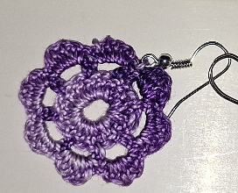
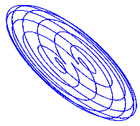
Continuity...
~m
~cm
~µm
quantum

Slide 36
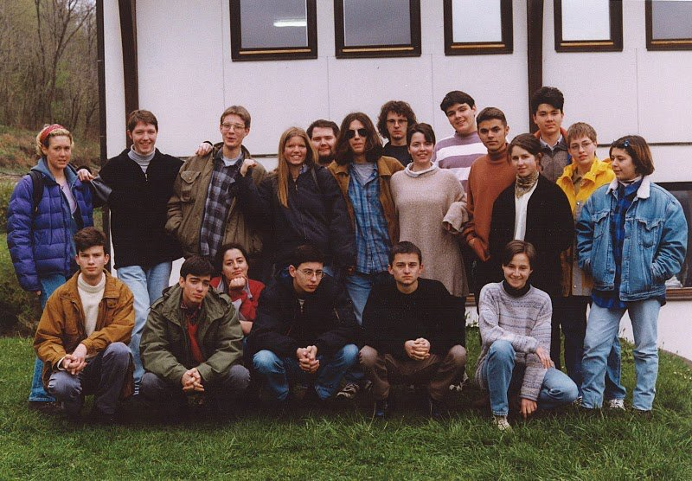
Continuity... Petnica 1997

Slide 37
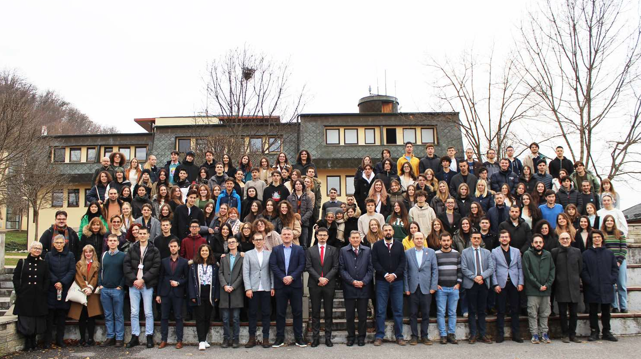



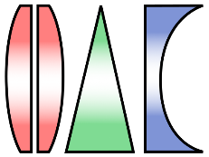



Continuity... Petnica 2025
Petnica 1997

Slide 39
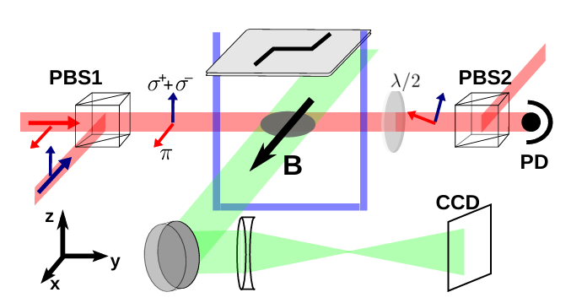
Raman pulse phase detection

