Slide 1
Complex Networks analysis of Belgian rail
Jelena Grujić
June 12th Belgrade
In memory of Antun Balaž - insights into complex systems

Slide 2
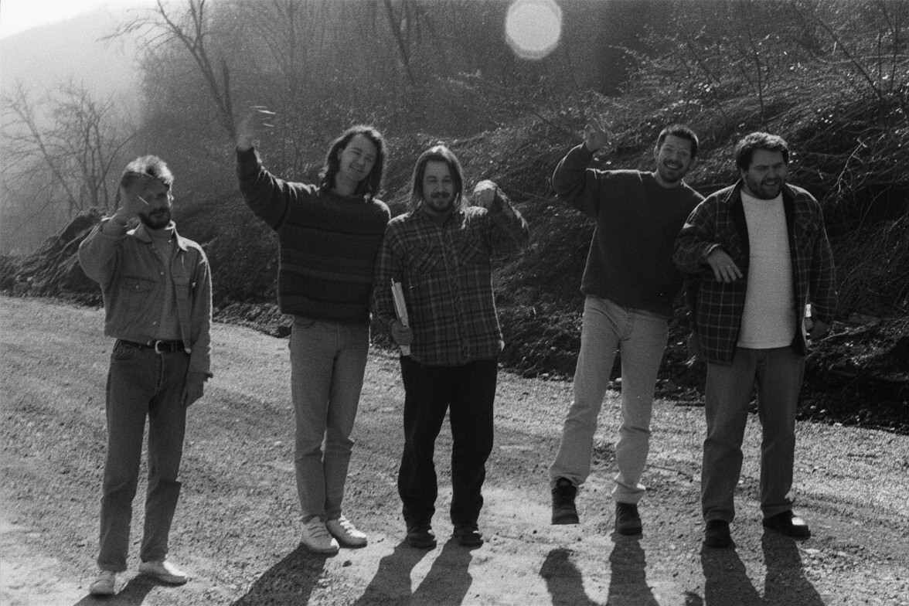

Once upon a time in Petnica Science Center…

Slide 3
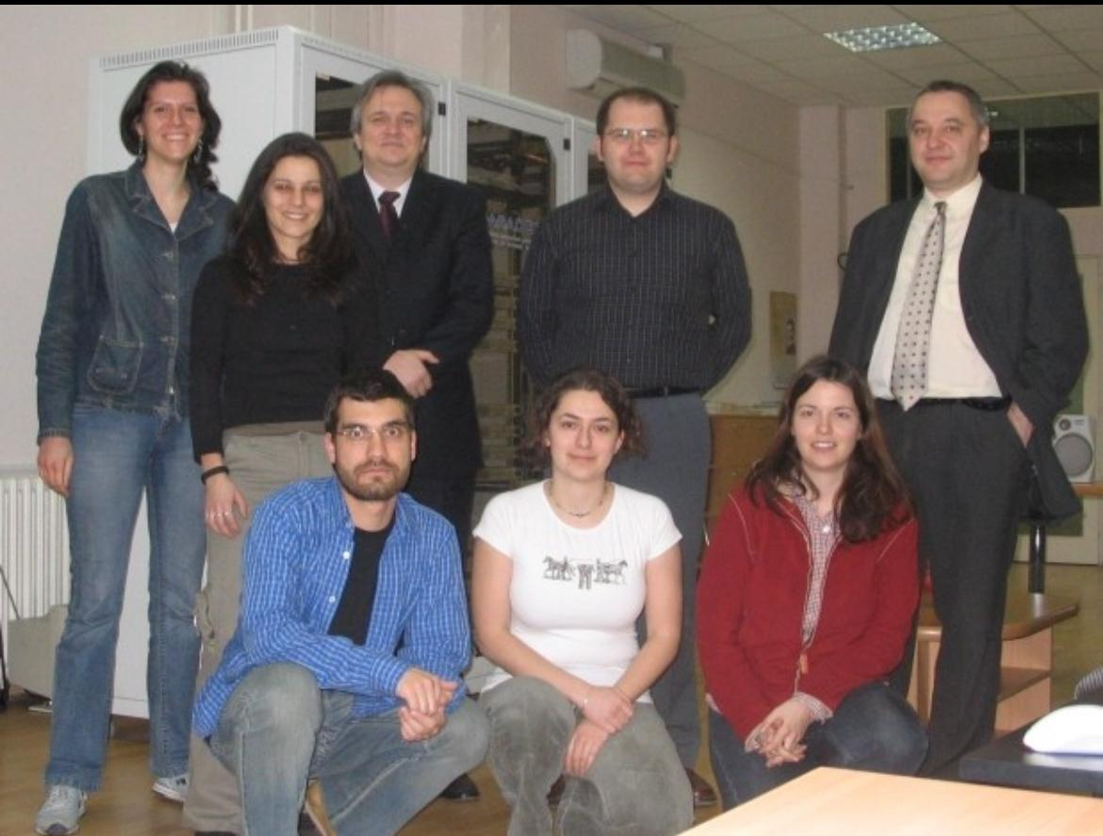

A little while later at Institute of Physics Belgrade…

Slide 4
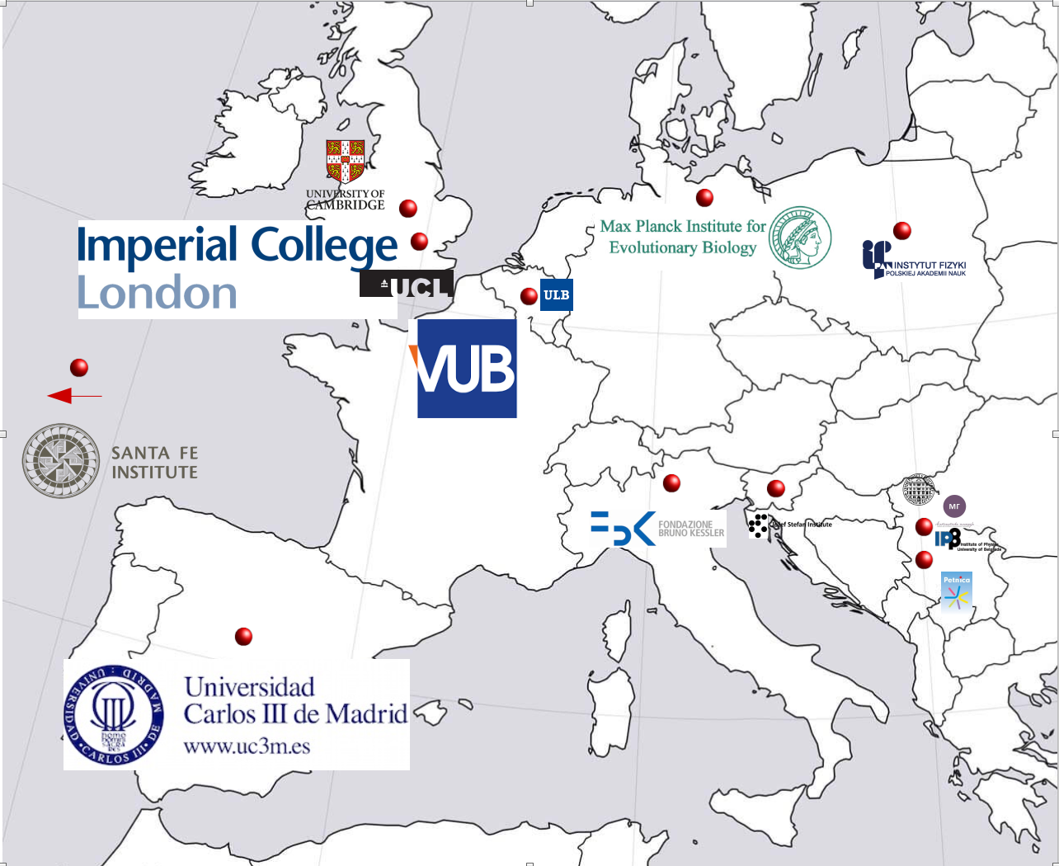
My story
Physicist
Science Communication
Complex Systems
Complex Networks
Game Theory
Behavioral Experiments
Machine Learning
AI
Data Science
Data Engineering
Notes:
I am old, so when I started doing this, late 90s, early 2000s, there was no Data Science. Data was something which just started to be available in large quantities, so my journey was very different then yours will be if you start it now.

Slide 5
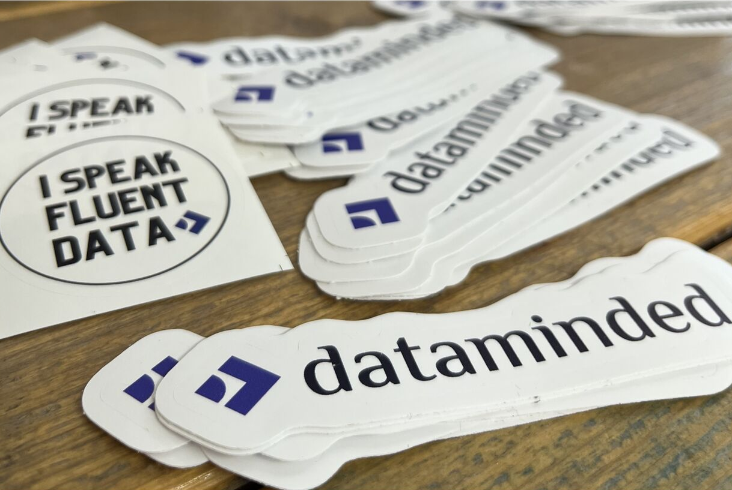
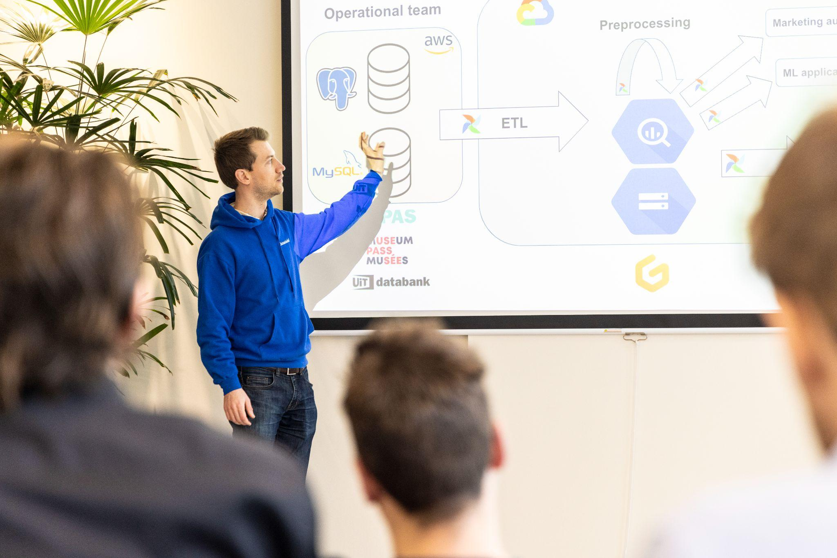
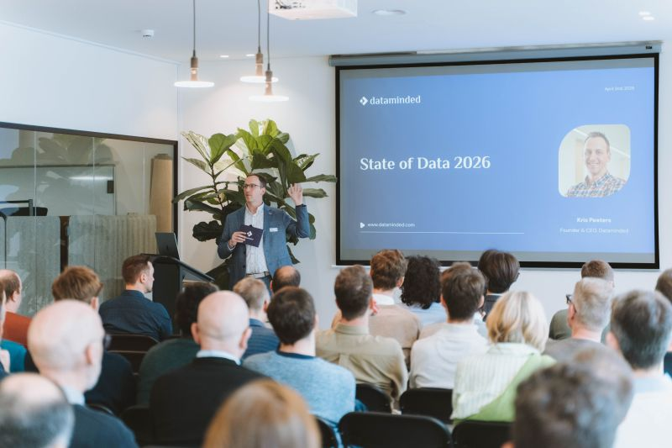

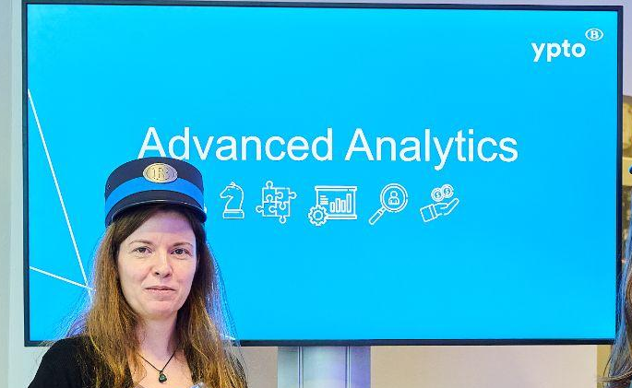
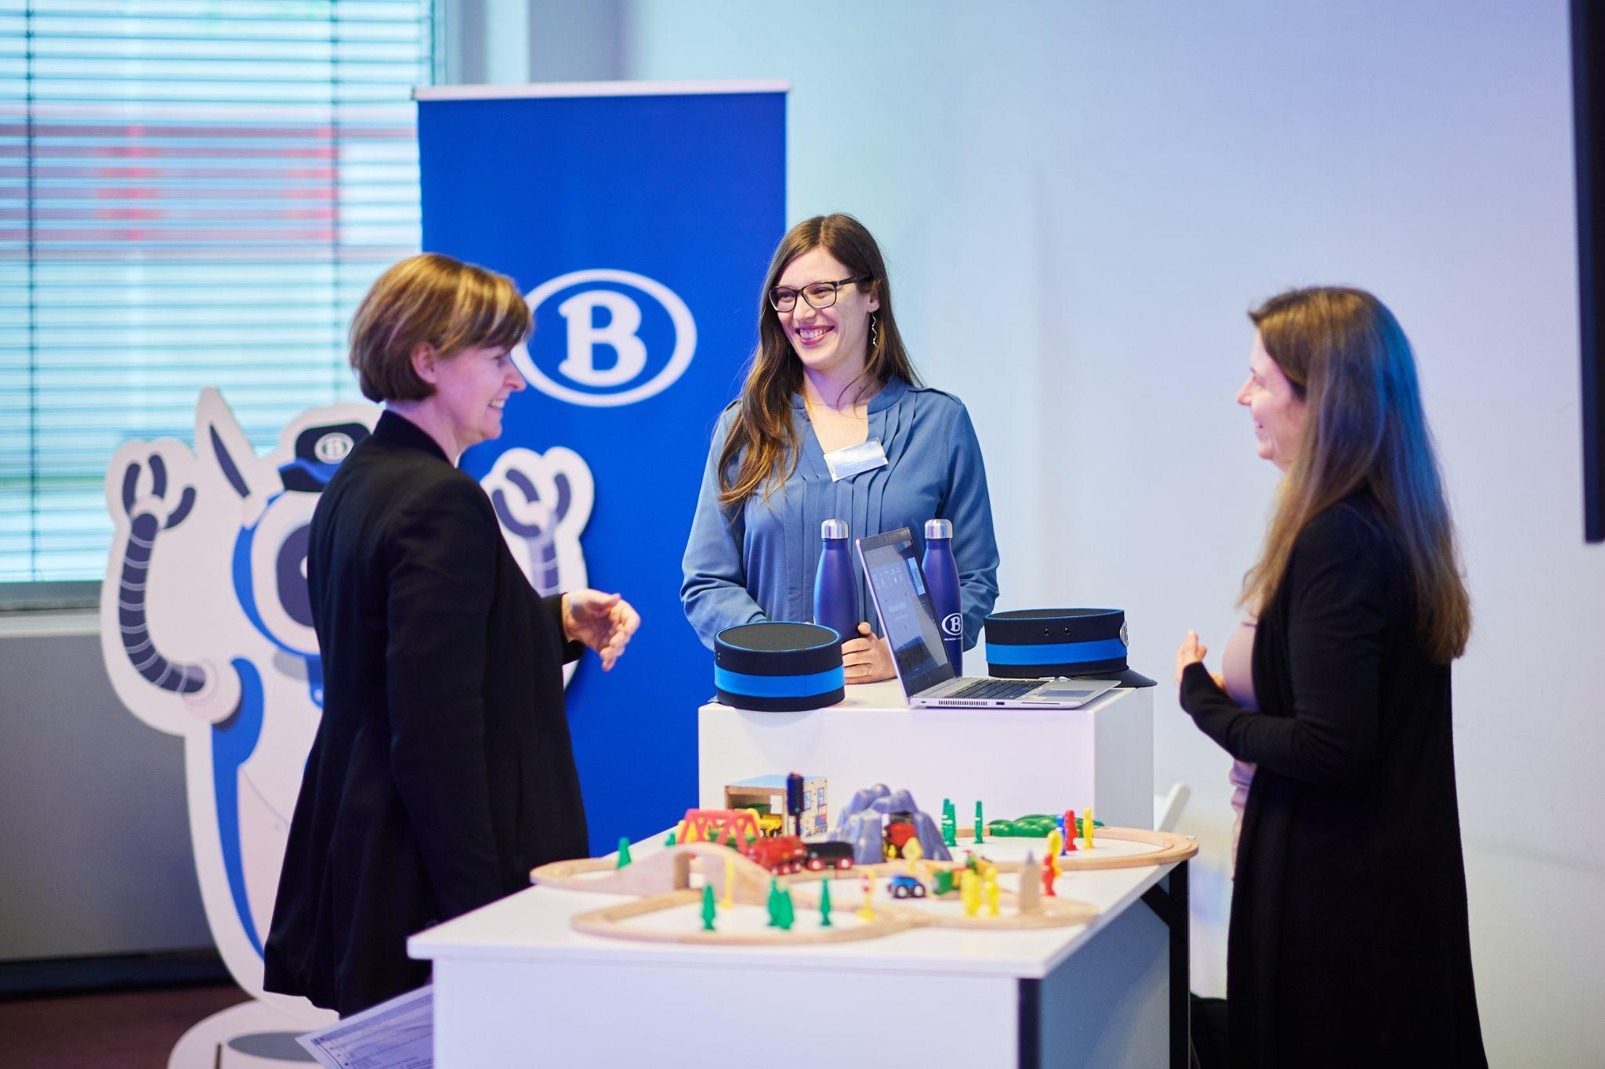
Nowadays in Belgium…

Slide 6
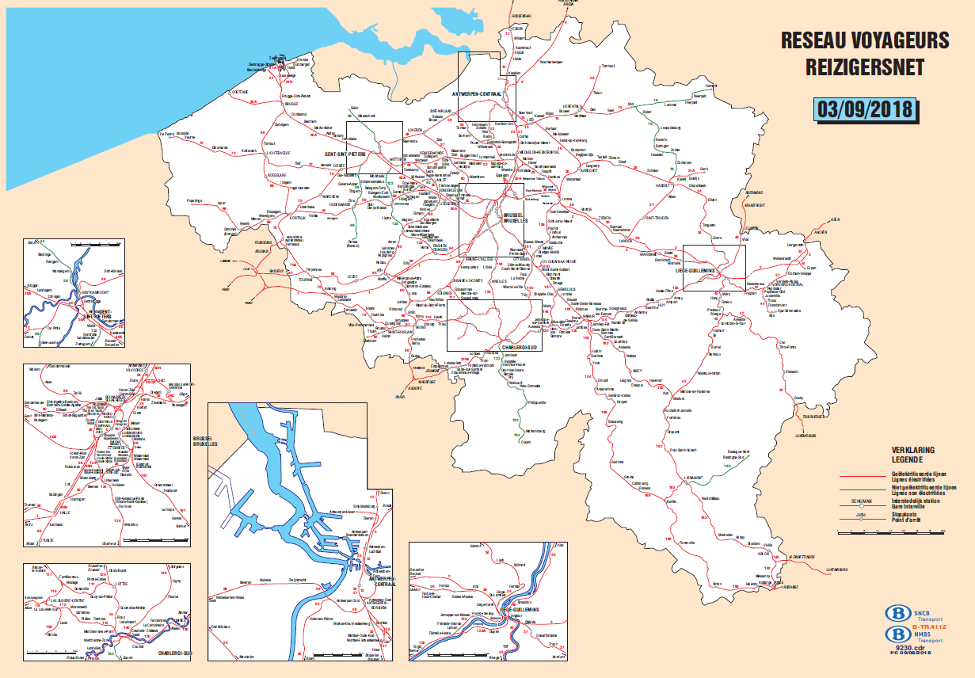
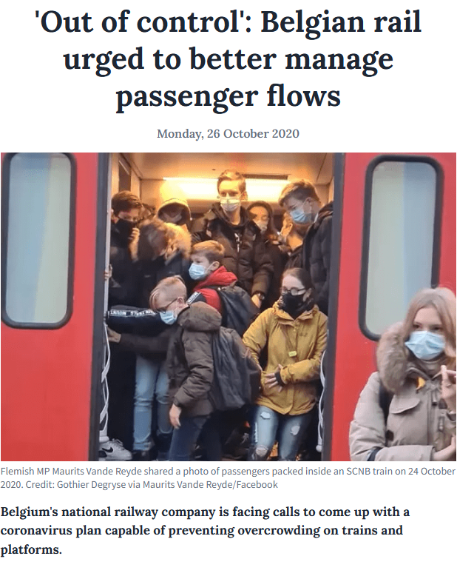
Trains in Belgium

Slide 7
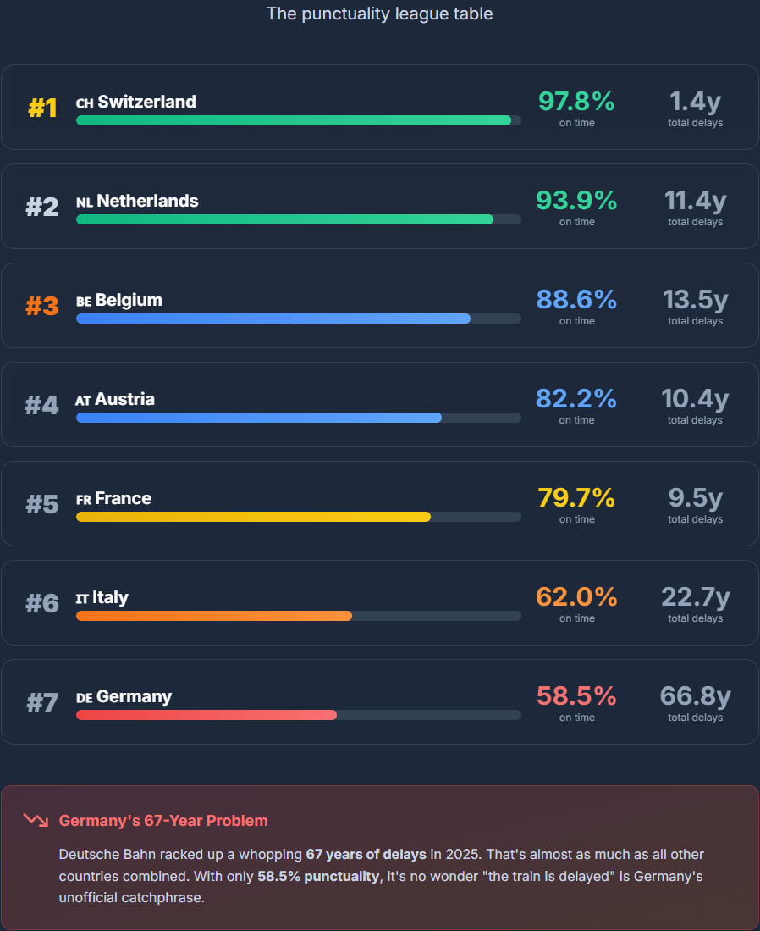
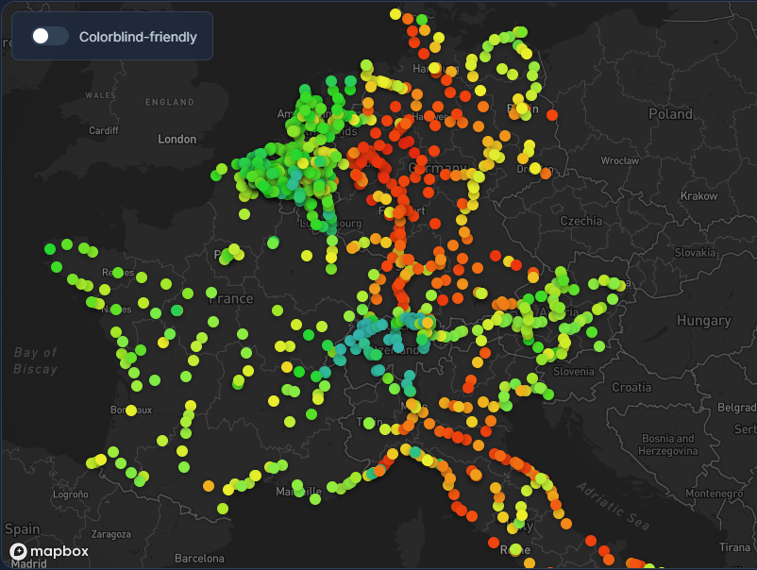

Slide 8
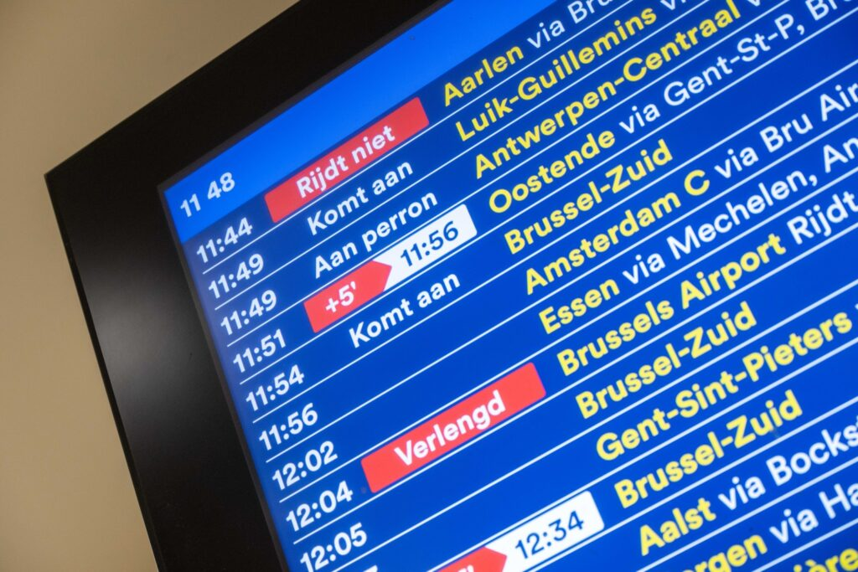
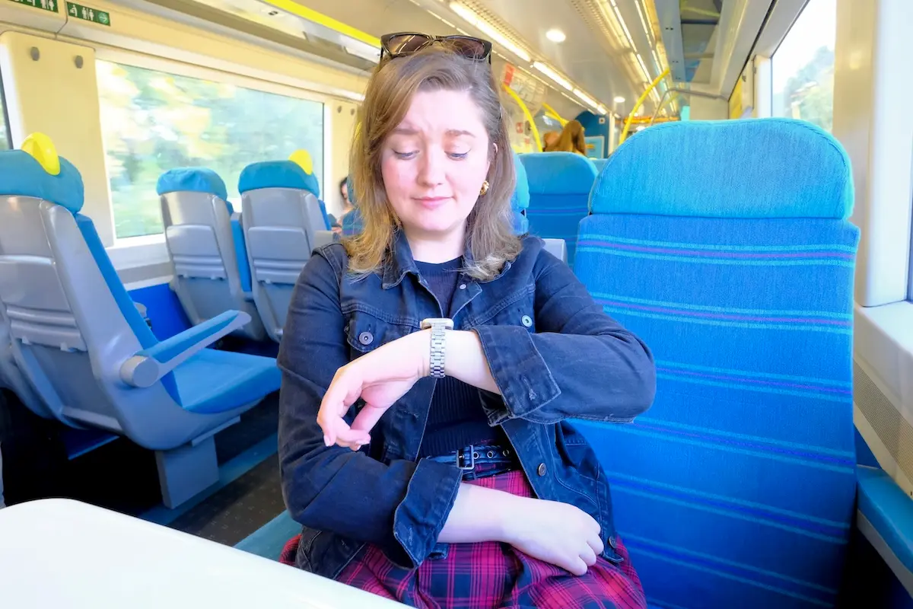
What is the most important reason for train delays?

Slide 9
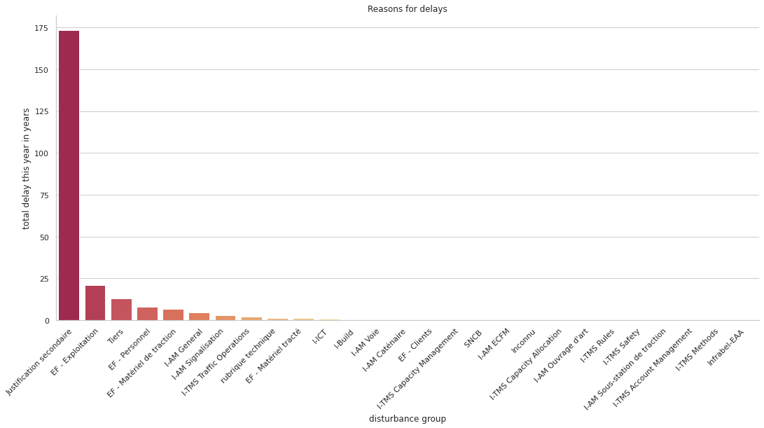
Biggest reason of delays are other trains!

Slide 10
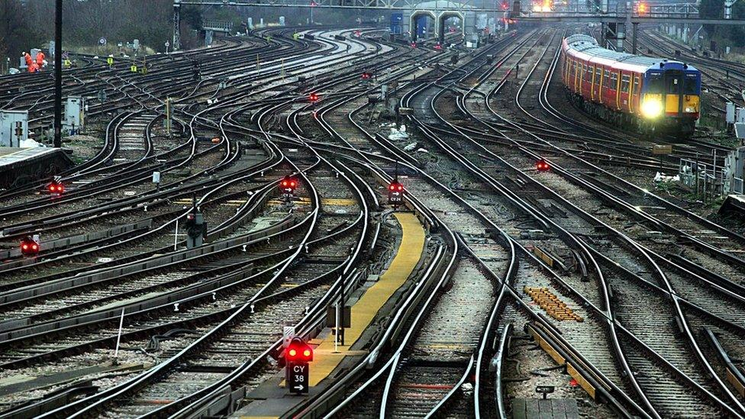


Trains network is complex system!
Small initial delay can cause large delay in the system

Slide 11
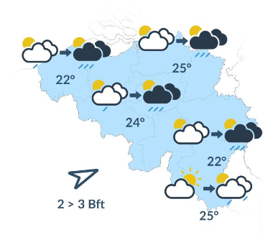

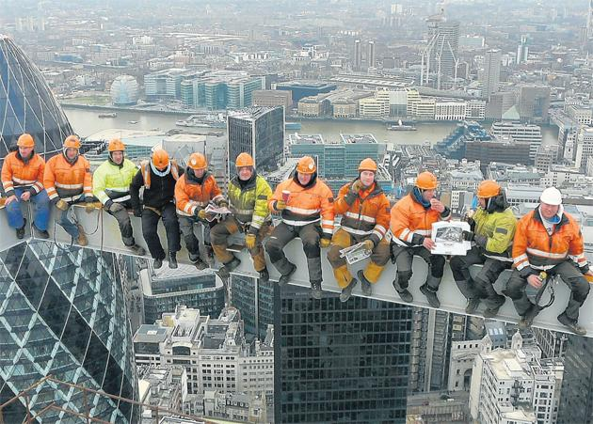

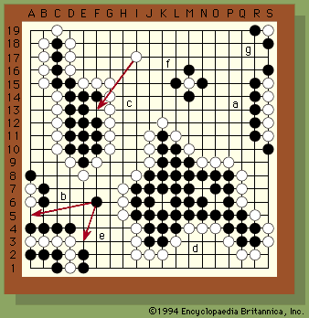


Complex vs Complicated
Unpredictable behaviour
Many parts

Slide 12
Complex vs Complicated
Not sum of its part
Sum of many parts

Slide 13
Complex OR Complicated?

Slide 14
Complex AND Complicated
We cannot resolve complex problems the same way we solve complicated problems!

Slide 15
Complex ≠ Complicated
tools ≠ tools

Slide 16
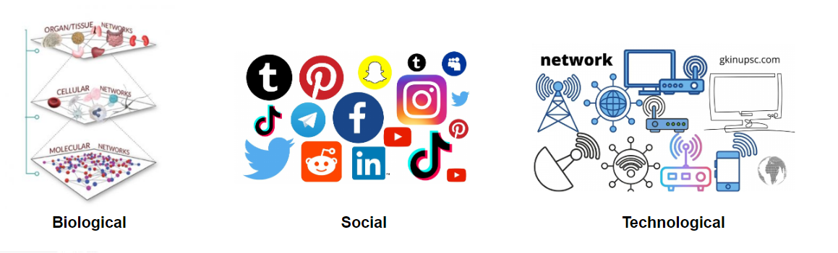
Complex Networks - Definition
Framework which allows us to get insight about relationships between entities in complex systems
Nodes and Links
  People and relationships
  Computers and links
  Chemicals and reactions

Slide 17
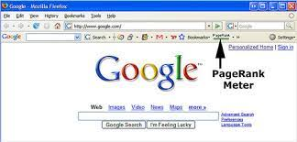
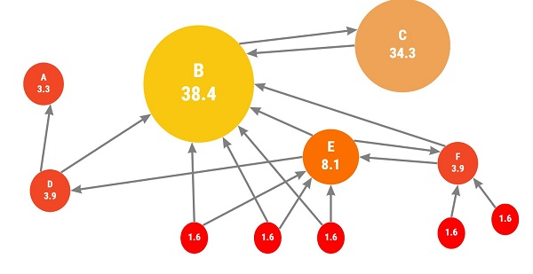
Google’s PageRank
Importance of the website depends on the importance of the web sites which link to it

Slide 18





PageRank vs Strength

Slide 19
POC: Three networks
Train network
Train number network (aggregated)
Ptcar (Point caractéristique) network (aggregated)

Slide 20

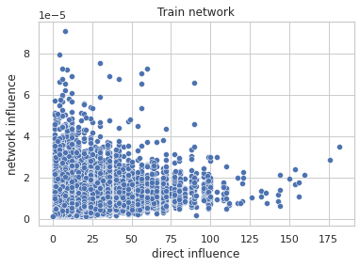
Train network
Nodes: Trains
Links: target train made source train late
  source: justification table
Direct impact is poor predictor of total influence!
PageRank
fraction of trains delayed in the whole network
impacted
train
originator
train
strength
number of trains which were delayed directly

Slide 21
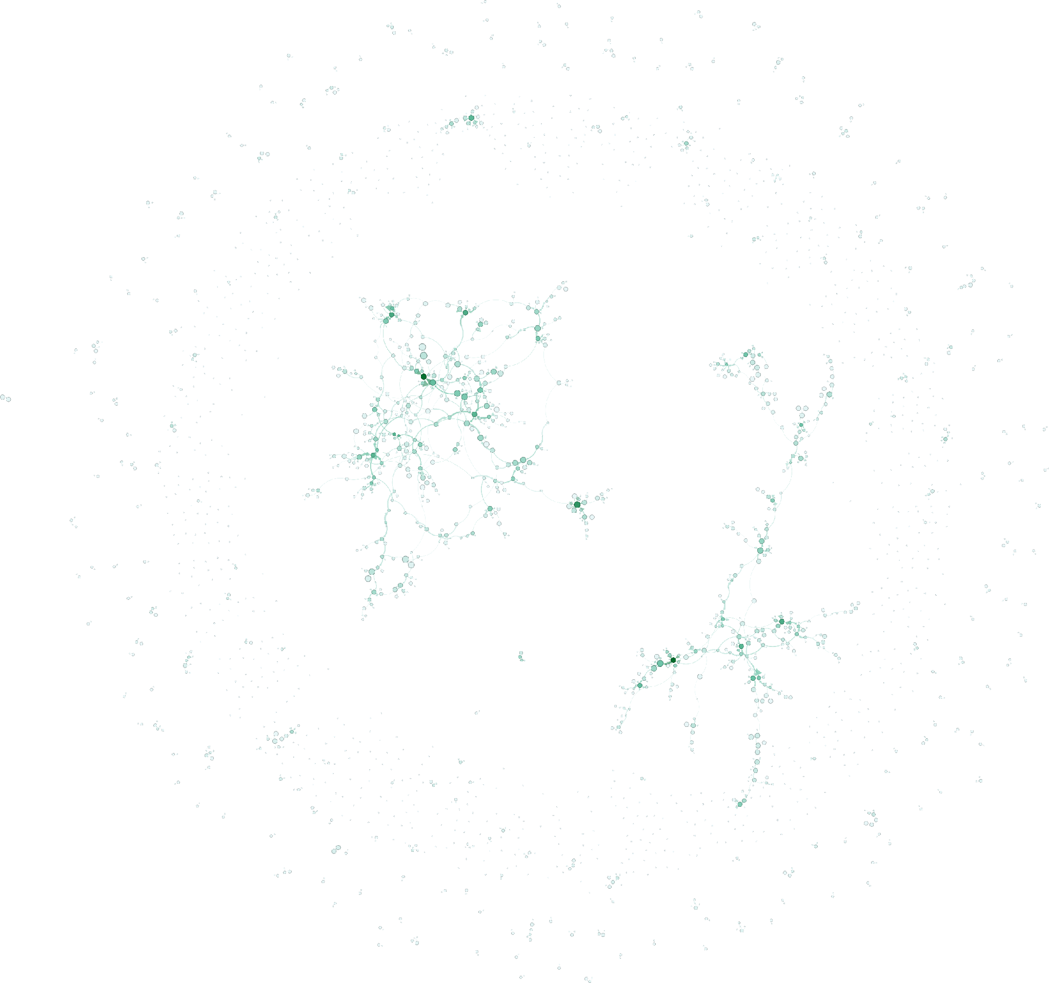
NETWOK
Train network
January 2nd 2023

Slide 22
NETWOK
Some events we can impact!

Slide 23
NETWOK
Sometimes
we can inform!

Slide 24
Train number network (aggregated)
Nodes: Train numbers
Links: target train made source train late
  Source: justification table
Weight: how many times?
impacted
train number
originator
train number

Slide 25
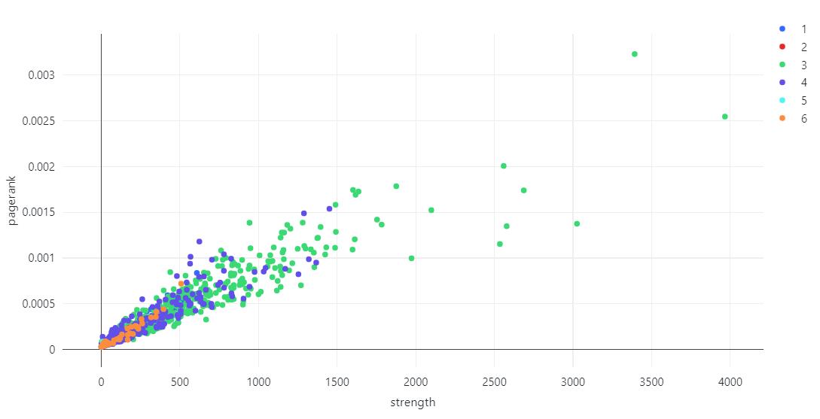
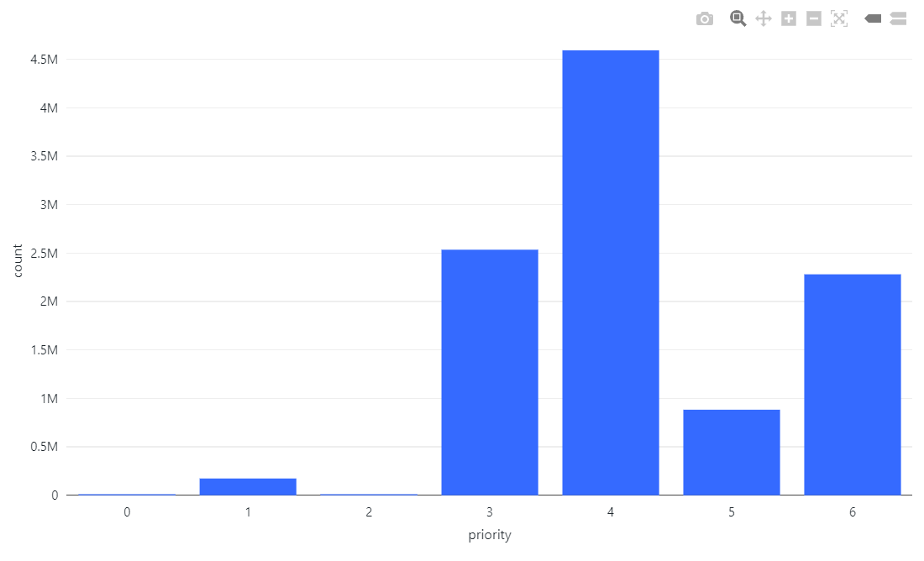
Train number network
Correlation due to aggregation

Slide 26
Train number network
Help us point out the outliers on which we can work to improve punctuality

Slide 27
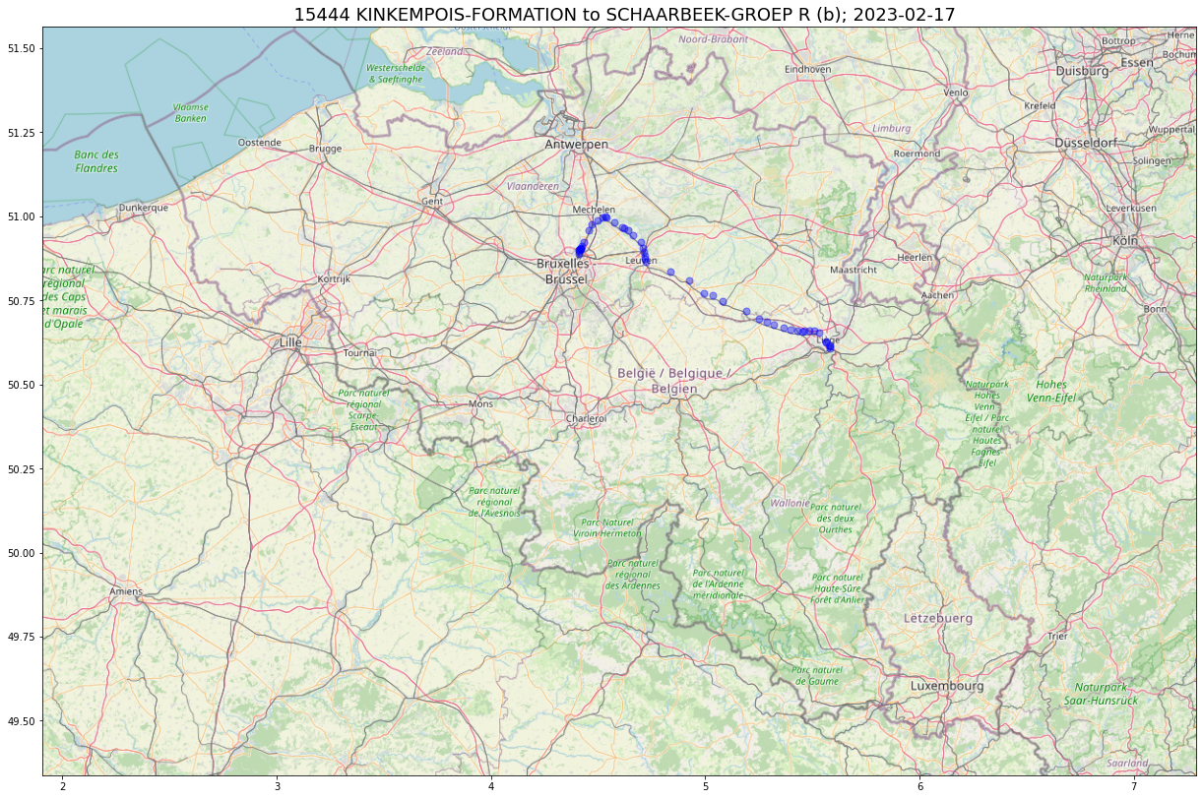
12:43:00
Priority 6
PAV indépendants (empty train)
900 days since 2017
2023-05-02 – 90 trains directly
99 ptcars
LIEGE-GUILLEMINS – 1063 times
KINKEMPOIS-BLOCK 2
LANDEN
WAREMME
LEUVEN
VILVOORDE

Slide 28
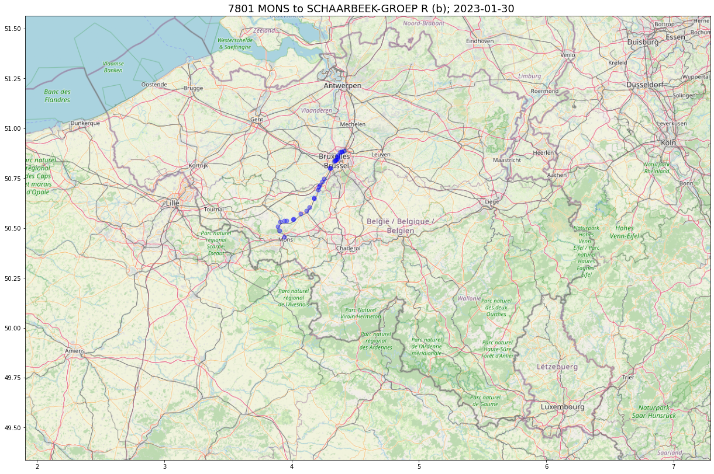
Train no: 7801
MONS - SCHAARBEEK-GROEP R
06:32:00
Priority 4
P-train

Slide 29
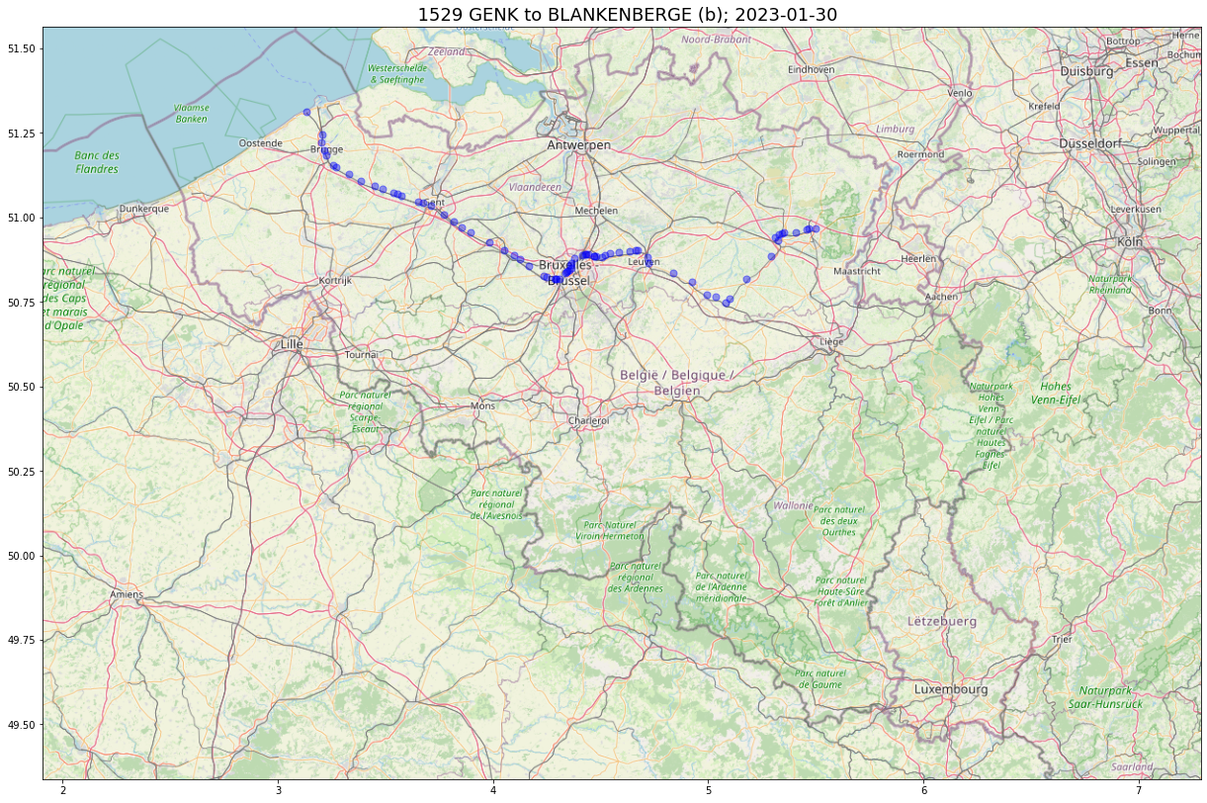
Train no: 1529
GENK - BLANKENBERGE
06:30:00
Priority 3
IC-L-S

Slide 30

Train no: 1706
QUIEVRAIN -> LIEGE-GUILLEMINS
Time: 06:13:00
Priority 3
IC-L-S
Strength 3392
PageRank 0.0032280098004719496
Highest PageRank

Slide 31

Train no: 1738
LIEGE-GUILLEMINS -> QUIEVRAIN
Time: 15:55:00
Cat 3
IC-L-S
PageRank 0.0025447061681081
Strength 3966
Highest strength

Slide 32
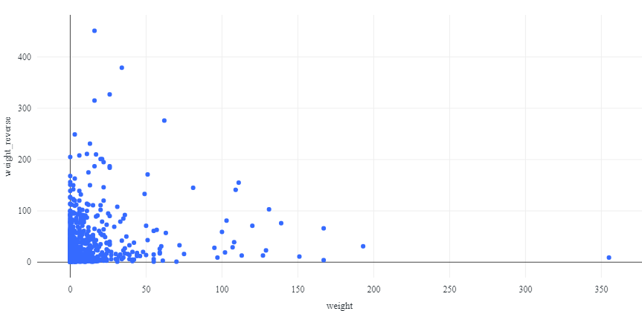
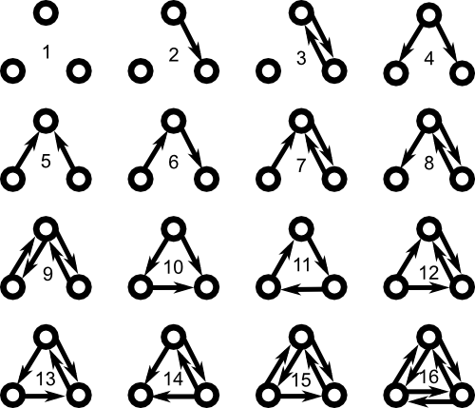
Trains often impacting each other
1
2
8803-3688
9216-2031
2836-586
1738-8582
weight reversed
number of times train 2 delayed train 1
weight
number of times train 1 delayed train 2

Slide 33
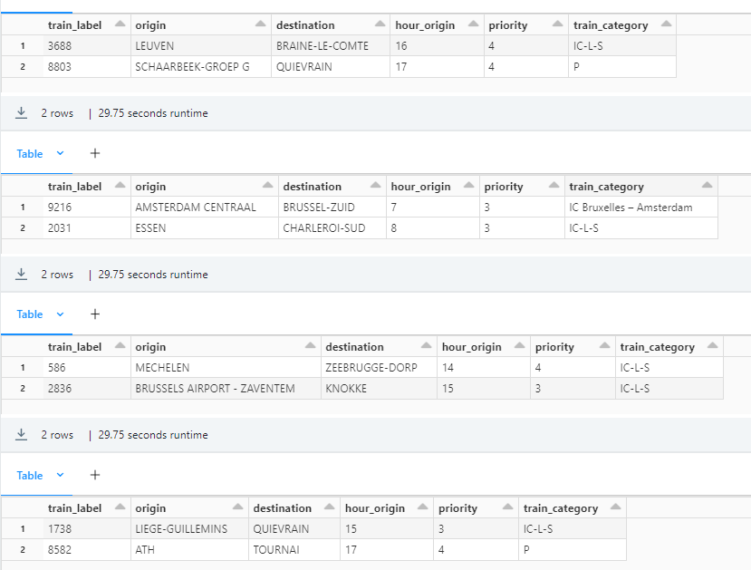
Trains delaying each other
8803-3688
9216-2031
2836-586
1738-8582

Slide 34
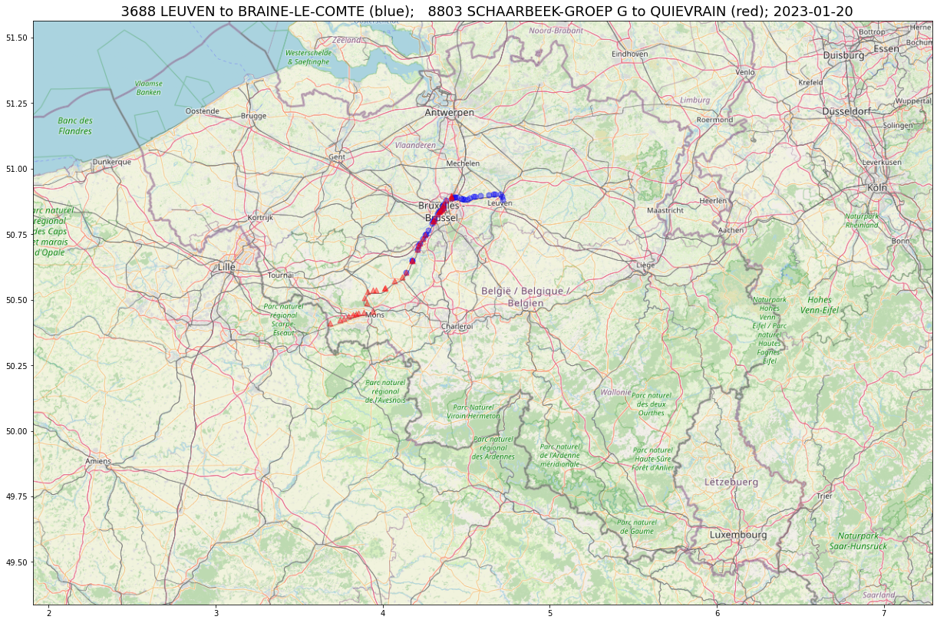
8803
was one of the worst p-trains

Slide 35
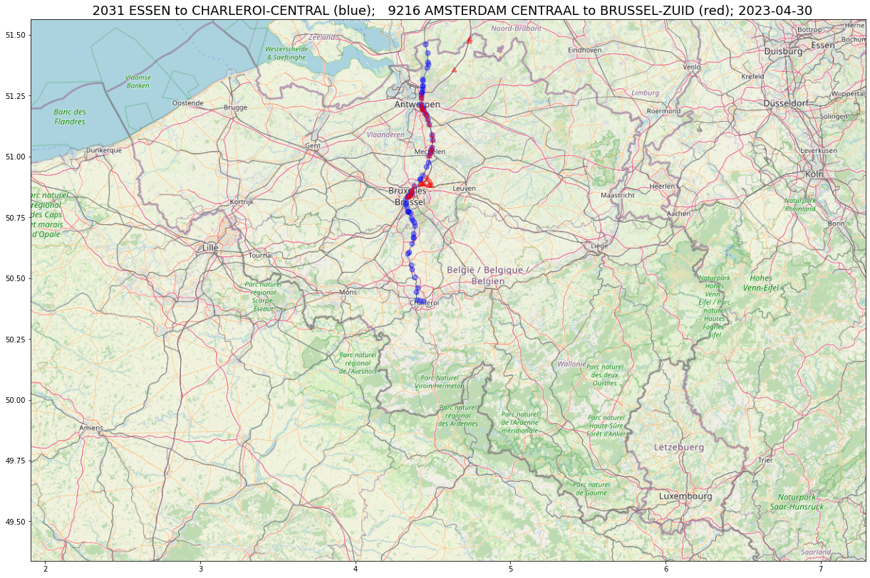

Slide 36
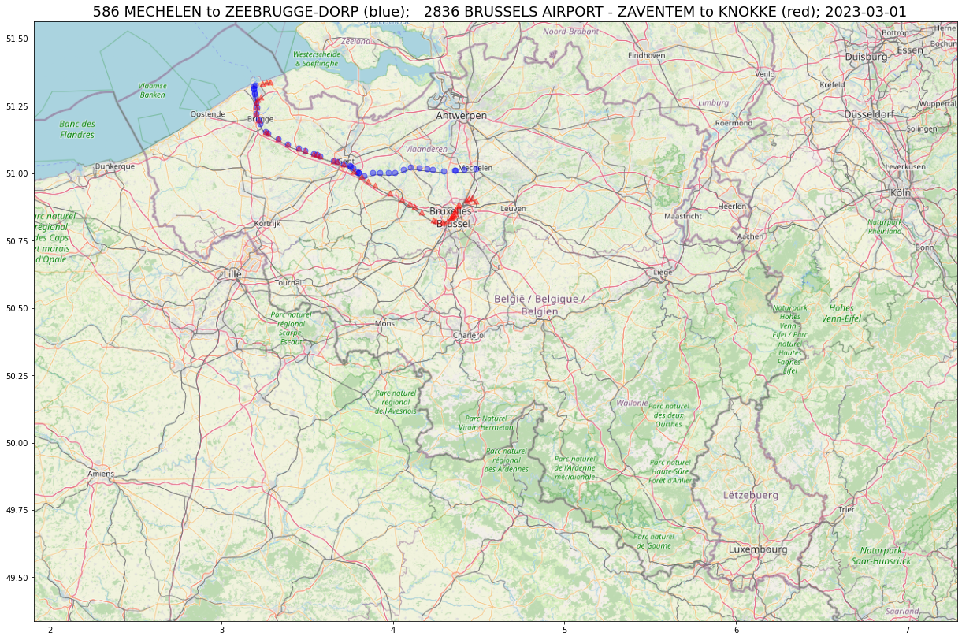

Slide 37
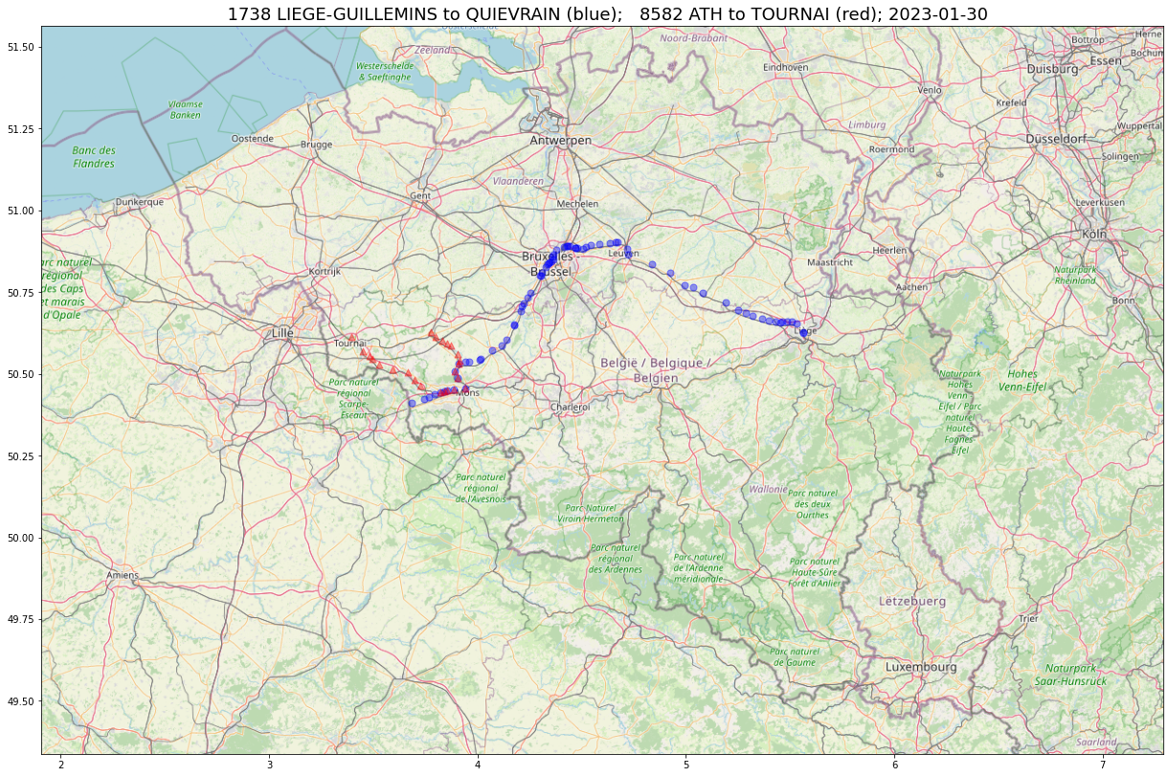

Slide 38


Network 3 - ptcars
Weight: how many times?
impacted
ptcar
originator
ptcar
where impacted train was delayed
where originator train was delayed

Slide 39
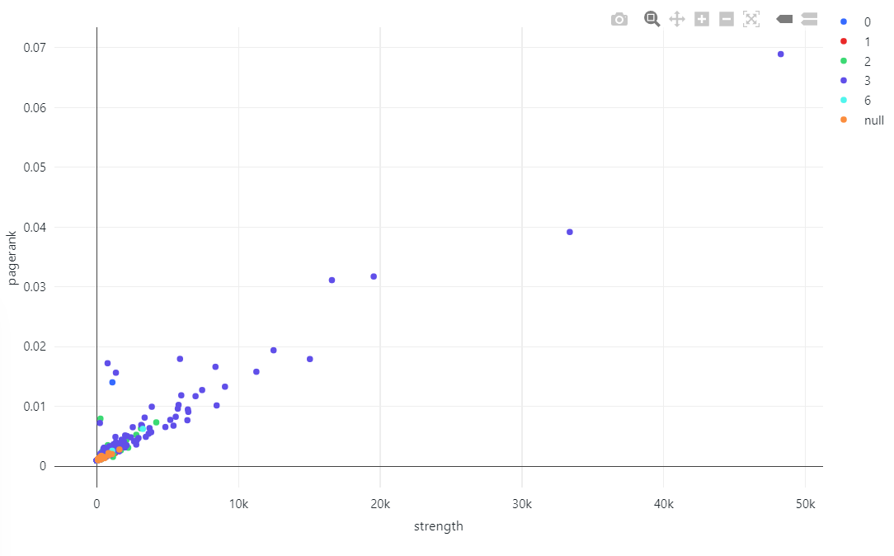
Ptcar network
PageRank vs Strength
Brussels Midi
Brussels Central
SCHELLEBELLE
ROCHEFORT-JEMELLE

Slide 40
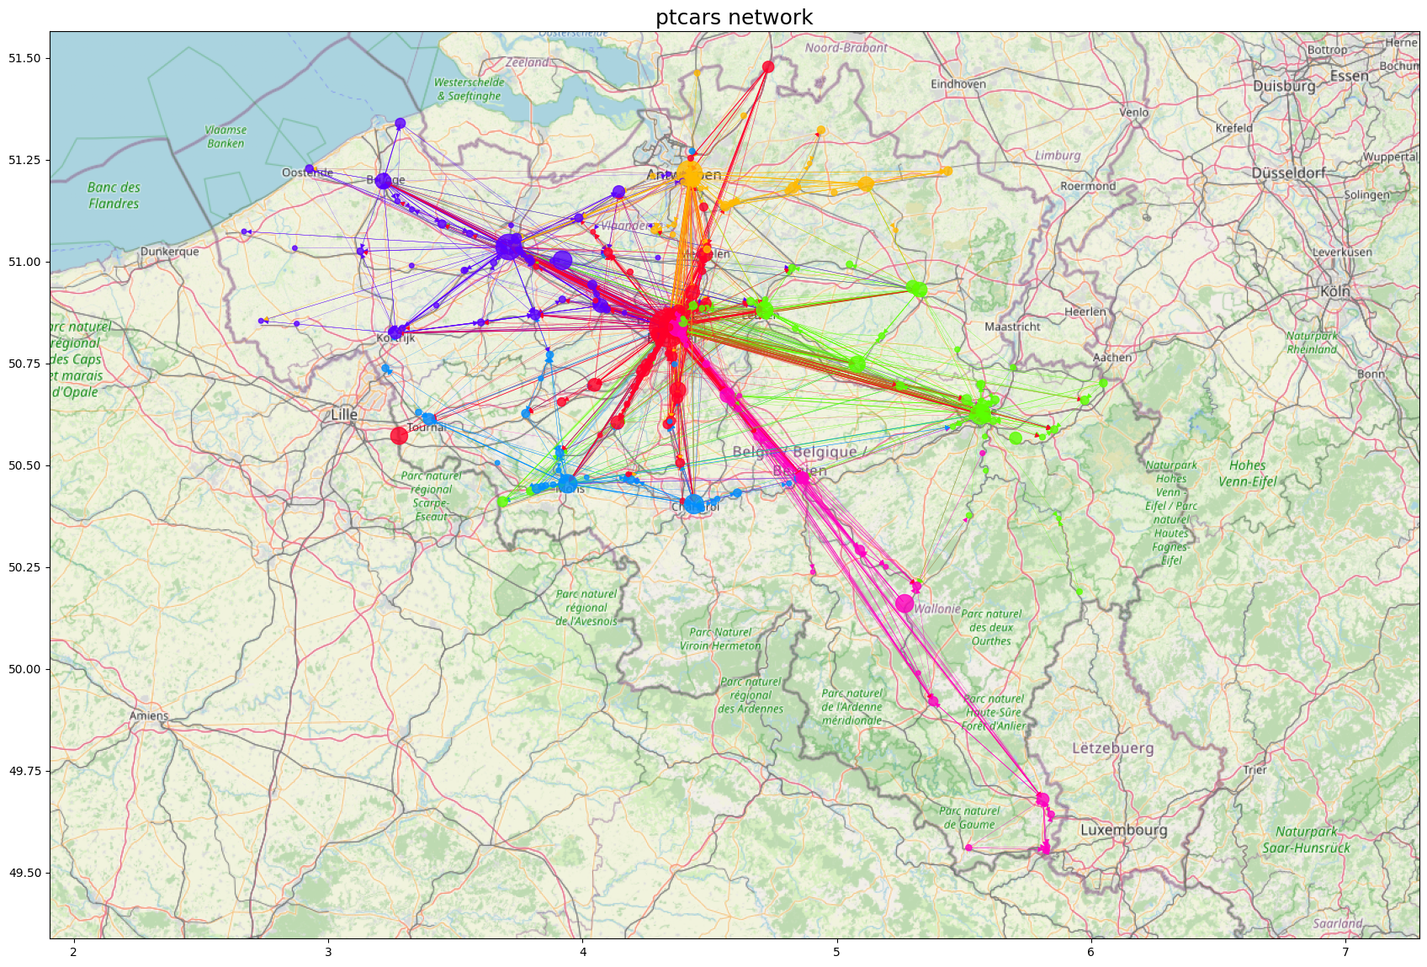

Slide 41
SCHELLEBELLE
ROCHEFORT-JEMELLE

Slide 42
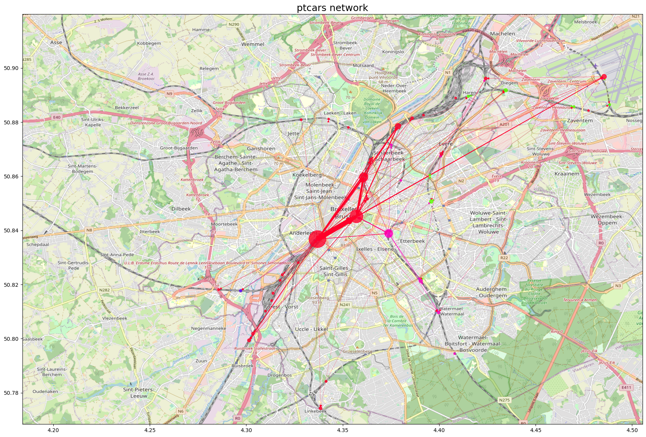

Slide 43
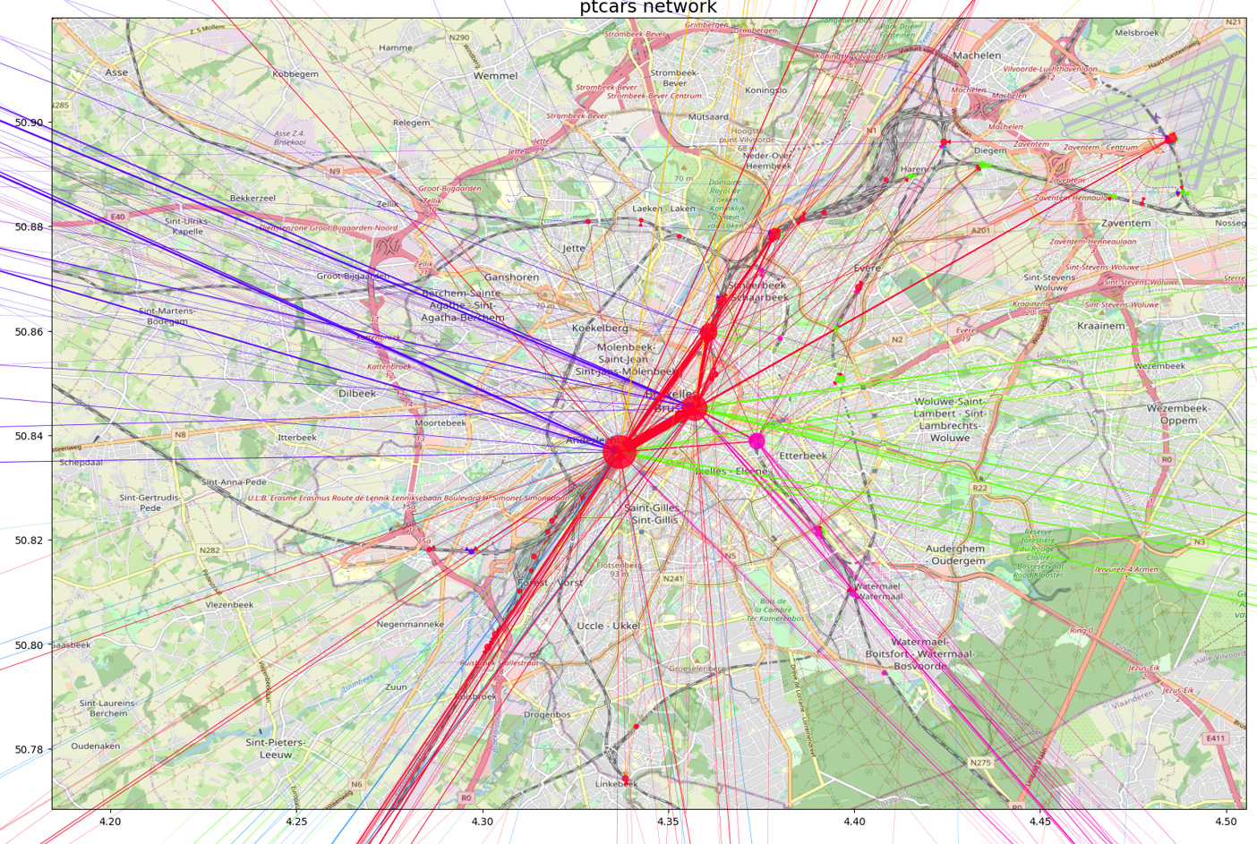

Slide 44
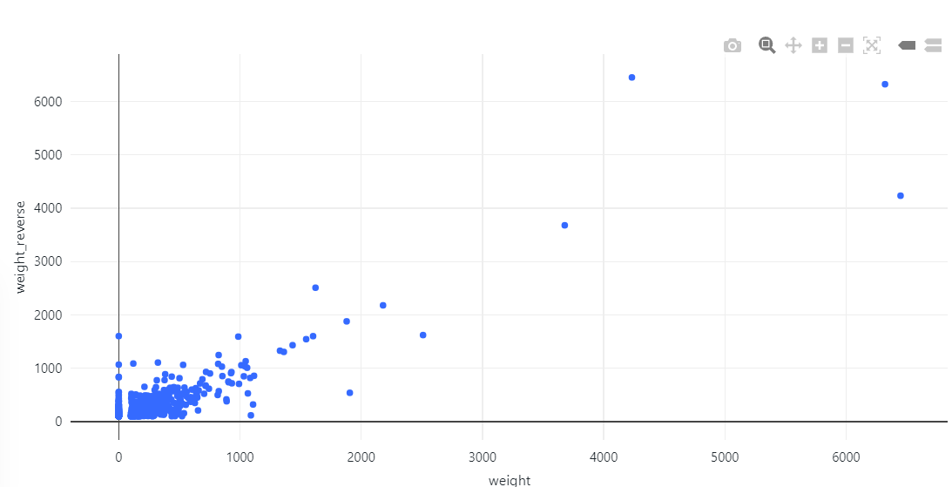
Ptcars – reciprocity
Brussels Midi > Brussels Central
bigger influence
Brussels – Luxembourg > Ottignies
bigger influence

Slide 45
Conclusions
Trains network is a Complex System and needs to be analyzed as such!
Direct influence is a poor indicator of global influence
New tool to spot problematic trains
Mutually destructive trains
Problematic ptcars
Partition the system
SCHELLEBELLE
ROCHEFORT-JEMELLE

Slide 46
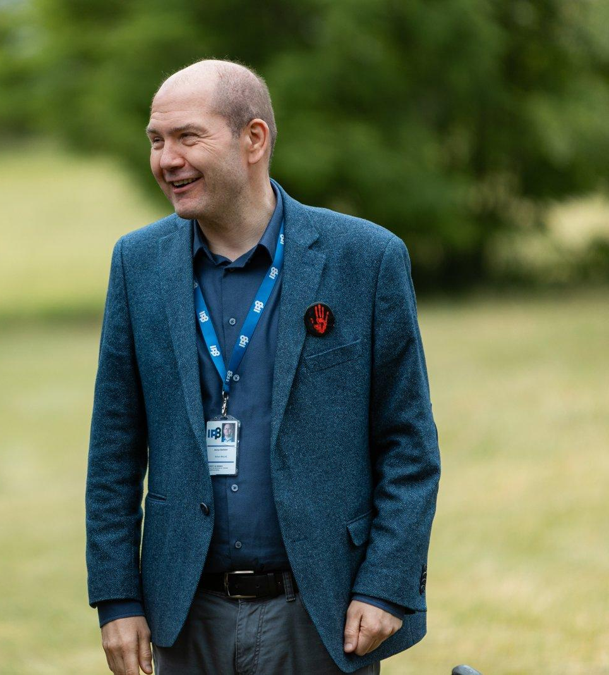
Thank you!

Slide 47
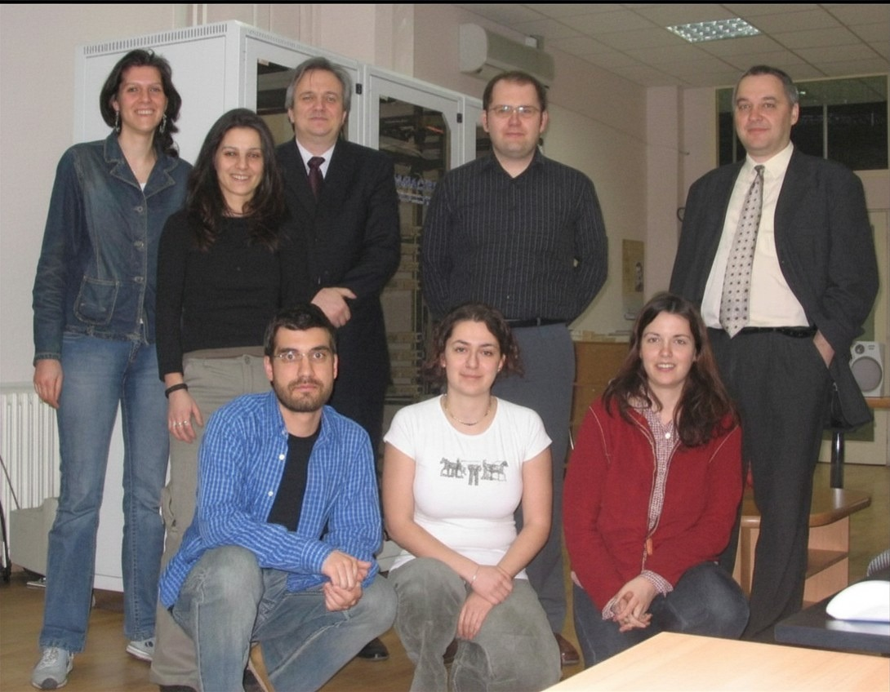
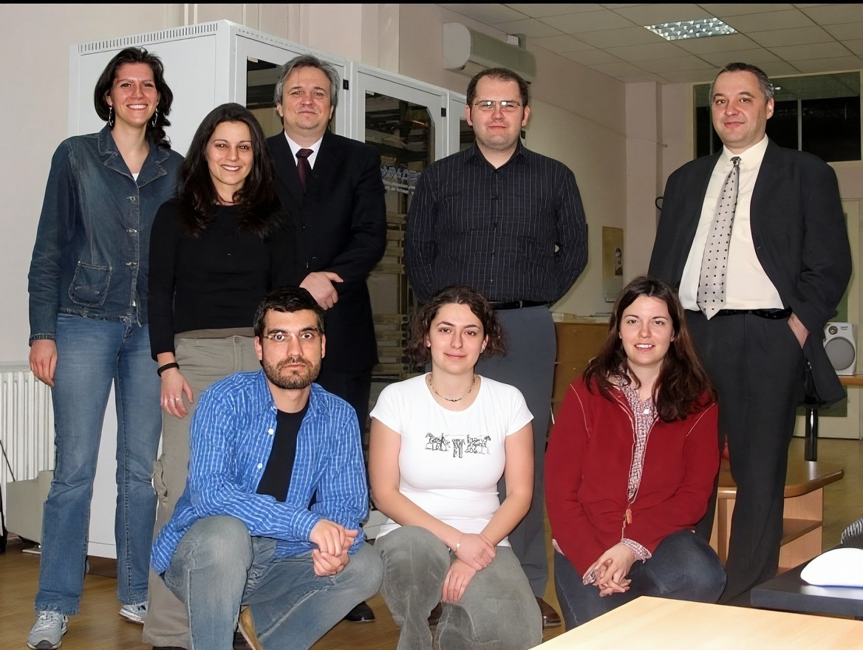
A little while later at Institute of Physics Belgrade…

